Slide 1

Cathode readout test result
C. Lu
Princeton University
(7/24/2012)

Slide 2
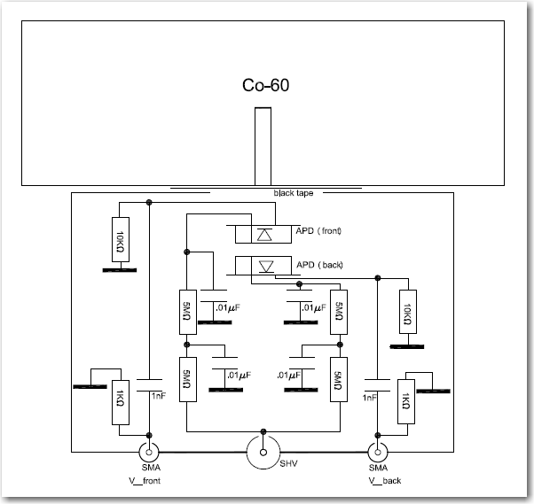
Cathode readout
Front APD connected to scope ch#1 thru Mini-Circuits ZVA213 amplifier
Back APD connected to scope ch#3 thru Miteq AM-4A amplifier & attenuator (2X)

Slide 3
64 mm² APD test results
Two Gaussians overlapped, possible explanation is: broader one is produced by β ray in both APDs, narrow sharp peak is the result of cross talk signals.

Slide 4
(1) Samples of Cross talk events
Vertical lines indicate where the zero crossing points are.

Slide 5
Cross talk events (cont’d)

Slide 6
(2) Samples of β Ray produced events

Slide 7
Samples of β Ray produced events (cont’d)

Slide 8
4mm² APD test results
Same setup (but w/o attenuator for channel #3) for 4mm² APD test
β Ray produced events:
Cross talk events:

Slide 9
Samples of cross talk events

Slide 10
Samples of cross talk events (cont’d)

Slide 11
β Ray events

Slide 12
β Ray events (cont’d)

Slide 13
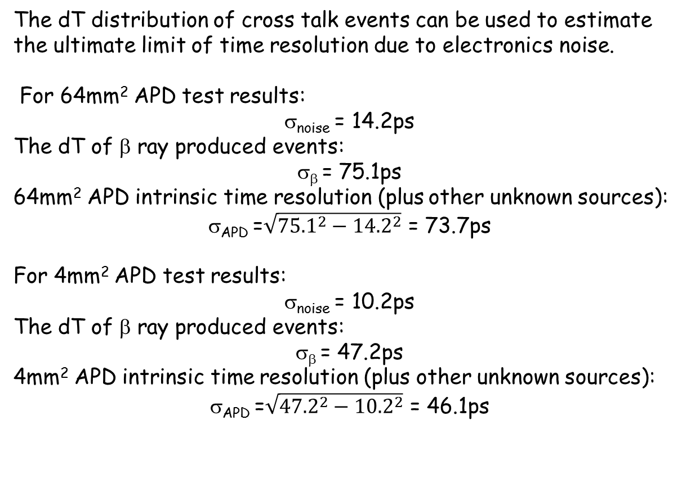
Discussion
The dT distribution of cross talk events can be used to estimate the ultimate limit of time resolution due to electronics noise.
For 64mm² APD test results:
σ_{noise} = 14.2ps
The dT of β ray produced events:
σ_{β} = 75.1ps
64mm² APD intrinsic time resolution (plus other unknown sources):
σ_{APD} =$\sqrt{{75.1}^{2}−{14.2}^{2}}$ = 73.7ps
For 4mm² APD test results:
σ_{noise} = 10.2ps
The dT of β ray produced events:
σ_{β} = 47.2ps
4mm² APD intrinsic time resolution (plus other unknown sources):
σ_{APD} =$\sqrt{{47.2}^{2}−{10.2}^{2}}$ = 46.1ps

Slide 14
Discussion
If we want to use APD as fast timing device for MIP it is the most critical R&D item: where is this large time jitter coming from?
Zero crossing algorithm is not the best strategy to derive the dT?
APD internal signal propagation time jitter (due to different distance from hit location to the readout pin)?
Drift time jitter of primary ionization electrons to the APD avalanche region?
**************************************************************
(1) Look at the waveform samples provided above, we did see the time difference between two waveforms is having big jitter, which is not likely to be able to shrink by changing the algorithm.

Slide 15
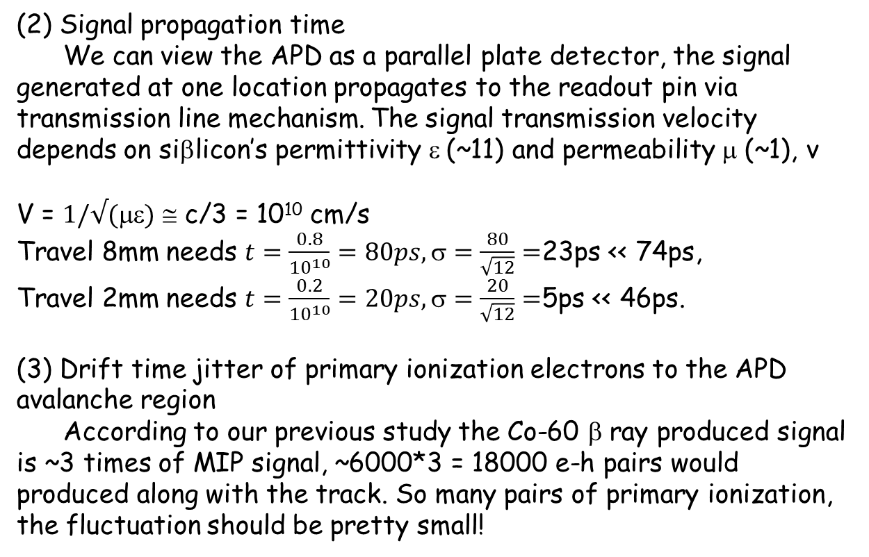
Discussion (cont’d)
(2) Signal propagation time
We can view the APD as a parallel plate detector, the signal generated at one location propagates to the readout pin via transmission line mechanism. The signal transmission velocity depends on siβlicon’s permittivity ε (~11) and permeability μ (~1), v
V = $1/√()$ ≅ c/3 = 10¹⁰ cm/s
Travel 8mm needs $t=\frac{0.8}{{10}^{10}}=80ps, =\frac{80}{\sqrt{12}}=$23ps << 74ps,
Travel 2mm needs $t=\frac{0.2}{{10}^{10}}=20ps, =\frac{20}{\sqrt{12}}=$5ps << 46ps.
(3) Drift time jitter of primary ionization electrons to the APD avalanche region
According to our previous study the Co-60 β ray produced signal is ~3 times of MIP signal, ~6000*3 = 18000 e-h pairs would produced along with the track. So many pairs of primary ionization, the fluctuation should be pretty small!

Slide 16
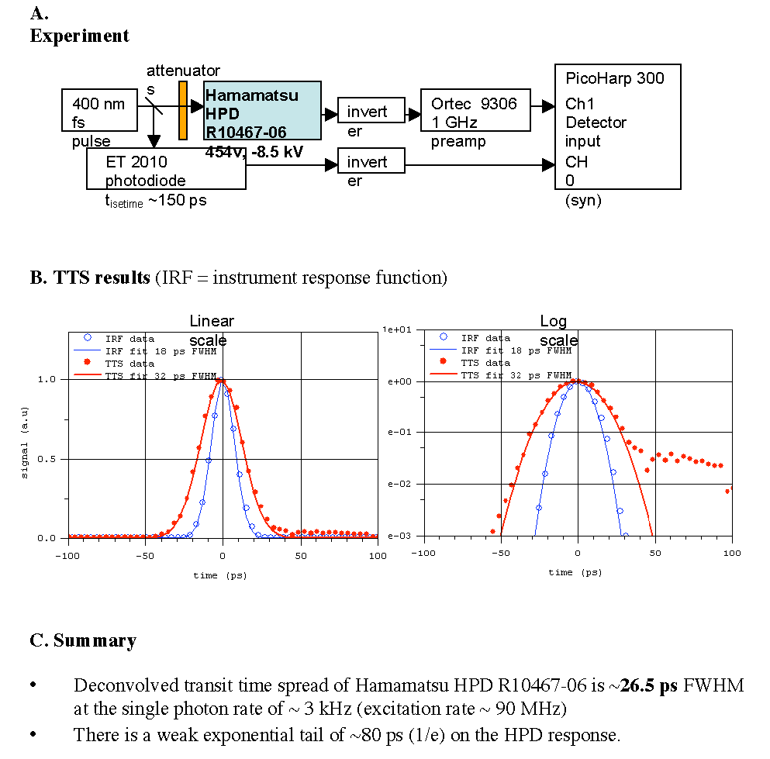
Discussion
Study by T. Tsang (2009) of a Hamamatsu HPD with a 400-nm femtosecond laser pulse gave σ ~ 11 ps.
Perhaps the resolution of an APD should be similar.
We may need to switch from beta-source tests to laser tests and/or beam tests with position measurements to clarify the situation.

