Slide 1

APD Beam Test @ PSI
A quick peek of 6/2/2013 Data Set
Changguo Lu
Princeton University
June 4, 2013

Slide 2
PSI Beam Test 6/1-2/2013 Data Set
Total 55 data files in this data set, from 6/1/2013 to 6/2/2013, 23.6 GB.
In this report only one data file is included, just to see what the data looks like:
Histograms of signal amplitude;
Waveforms from three channels, two 64mm^2 APDs (ch#1 and #2), one 4mm^2 APD (ch#3);
S/N, baseline shift, etc.

Slide 3
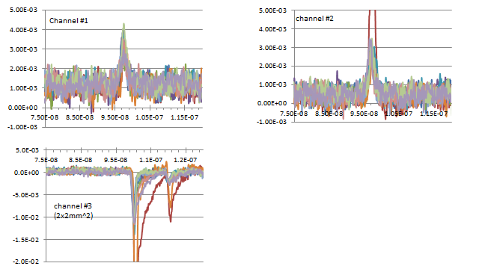
Waveforms
The total events is 2500 in this data file, we select for those events: channel #1 and #2 amplitude > 2.0mV, 432 events are left.
In each plot 10 waveforms are overlapped.

Slide 4
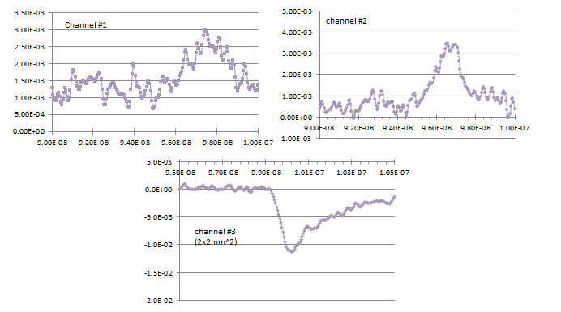
Waveforms (cont’d)
Typical waveforms with zoomed time scale:

Slide 5
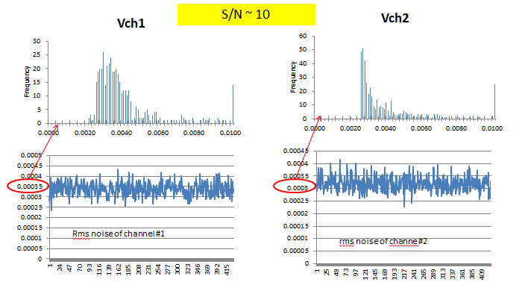
Amplitude histograms
Channel #3 is used as trigger, Vth = -1.5mV:

Slide 6
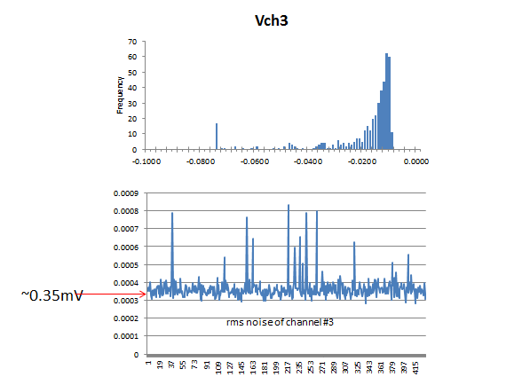
2x2 mm^2 APD signal & noise

Slide 7
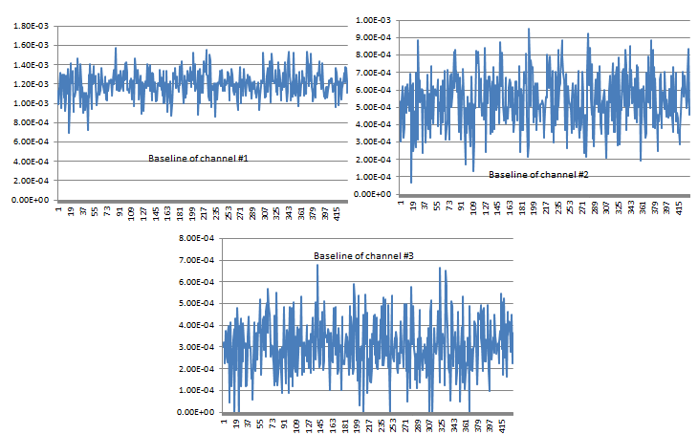
Baselines

Slide 8
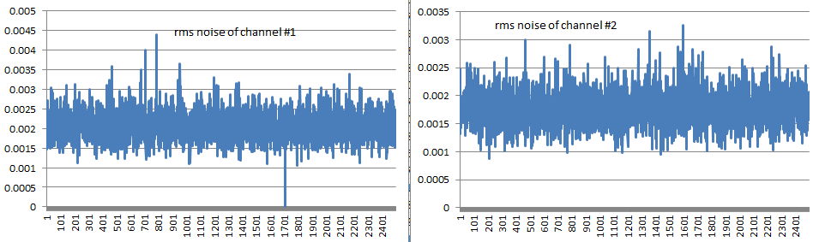
rms noise of cascade amplifiers
Data file 06-02-026 was taken with cascade amplifiers for channel #1 and #2. Inspect their rms noise:
~ 2mV
~ 1.75mV
They are much larger than 0.35mV of single amplifier rms noise.

Slide 9
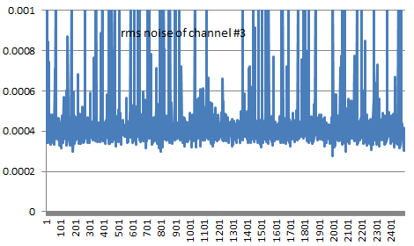
rms noise of channel #3
Channel #3 is still with single amplifier, its rms noise looks similar as before:
~ 0.4mV

Slide 10
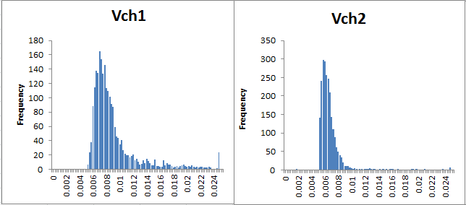
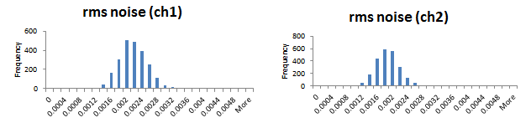
Amplitude/rms noise histograms of channel #1 & #2
Compare to single amplifier, cascade amplifiers show much higher noise:
2.1mV
2mV

Slide 11
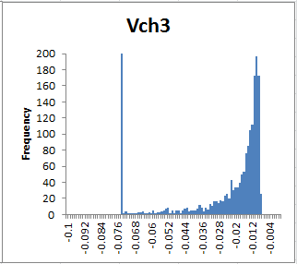
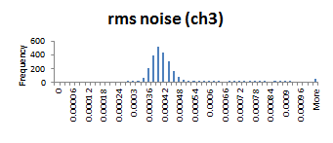
Amplitude histograms of channel #3
Cascade amplifiers to raise the signal amplitude, at the same time the rms noise also “amplified”. It won’t help to improve S/N ratio!

