Slide 1

Signals Observed from
RMD Position-Sensitive APD
Changguo Lu
Princeton U
Feb 20, 2013

Slide 2
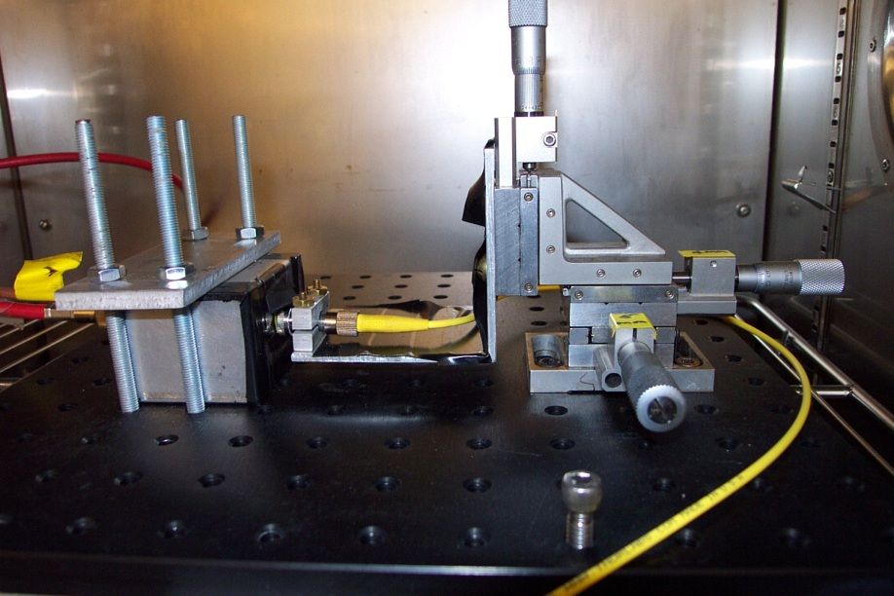
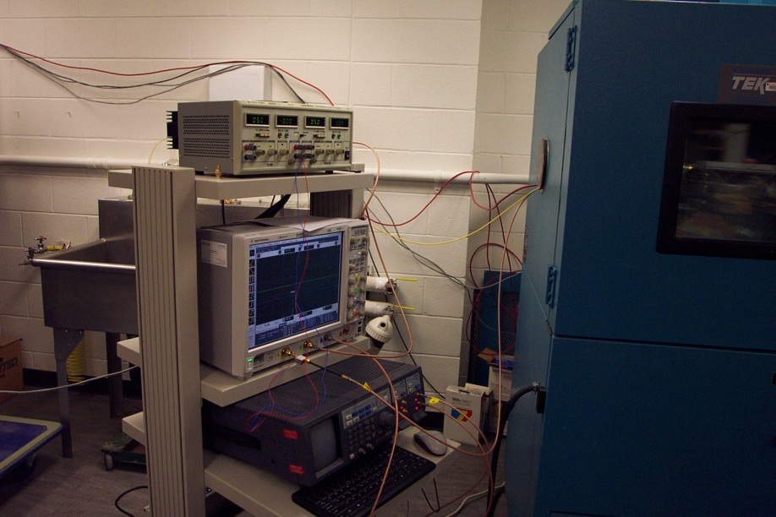
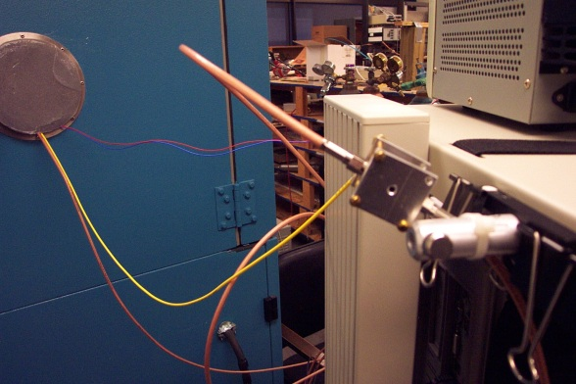
Test setup
In this test, the temperature was not controlled, the device was at room temperature, ~23°C. The APD and Fe55/Sr90/VCSEL(980 nm) laser diode are placed inside of the EC.
Internal view of the EC.
EC chamber
PSAPD test box (in the picture the box is for 4 mm² APD)
Optical fiber
Place Collimation lens (Thorlabs CFC-11X-B), Fe-55 or Sr-90 on this plate for test.
VCSEL laser diode box

Slide 3
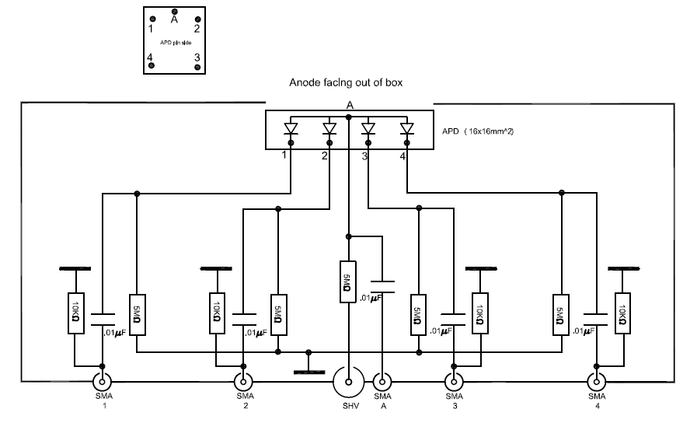
Circuit diagram of the test box

Slide 4
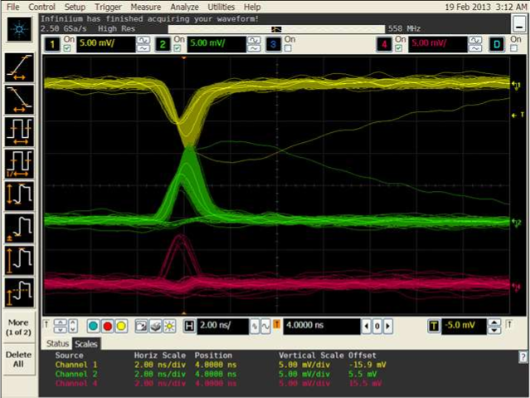
Screen Capture of PSAPD waveforms from Fe-55
Anode signal
Cathode pin #1
Cathode pin #2
2ns/div

Slide 5
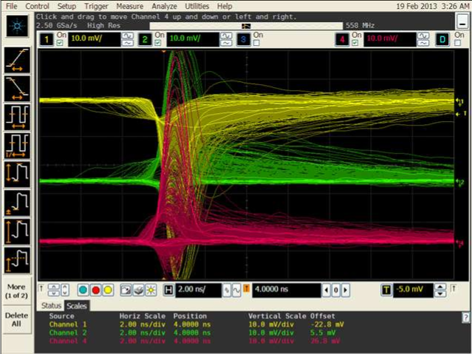
Screen Capture of PSAPD waveforms from Sr-90
Anode signal
Cathode pin #1
Cathode pin #2
2ns/div

Slide 6
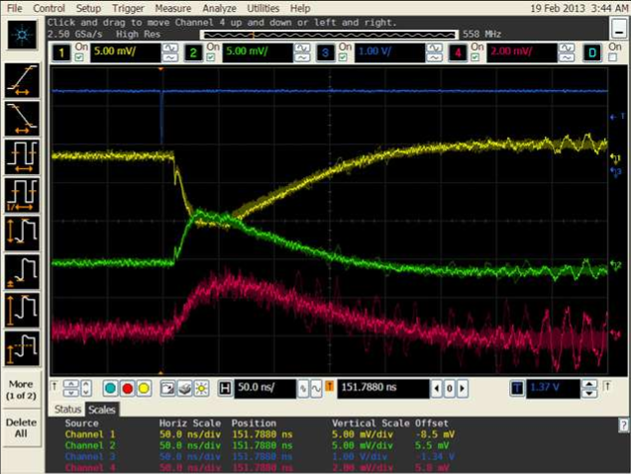
Screen Capture of PSAPD waveforms from VCSEL-980
Laser beam (equivalent MIPs ~70)trigger signal
Anode signal
Cathode pin #1
Cathode pin #2
Small fast signal,
could it be induced signal direct from the avalanche?
50ns/div
Signals from anode and cathode Pin #1 and #2 are very slow, similar to Thomas observed with 400-nm laser beam on 4 mm² APD. They might have similar mechanisms: due to electron drift in the silicon.

Slide 7
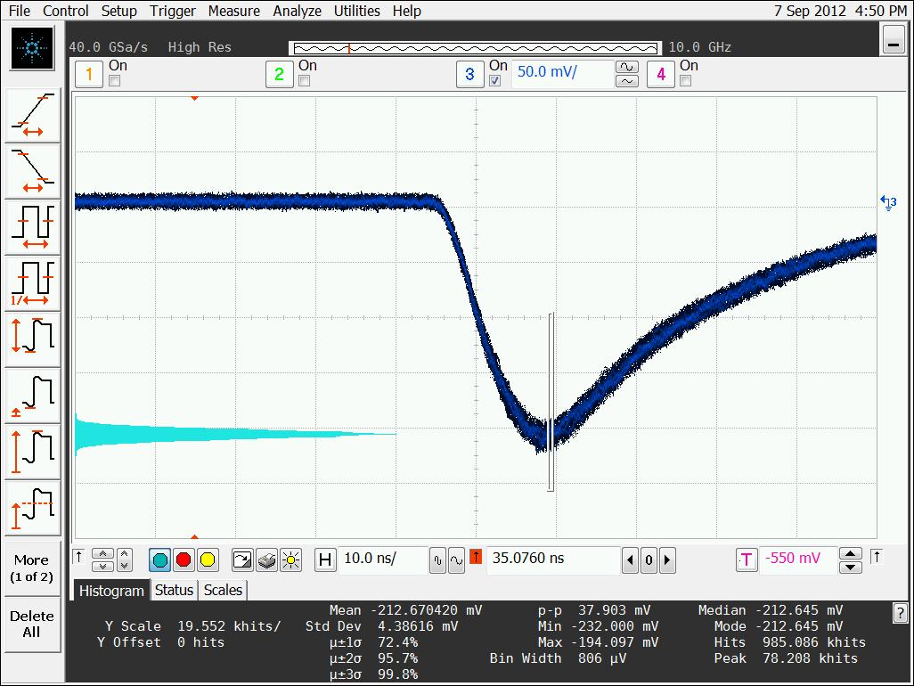
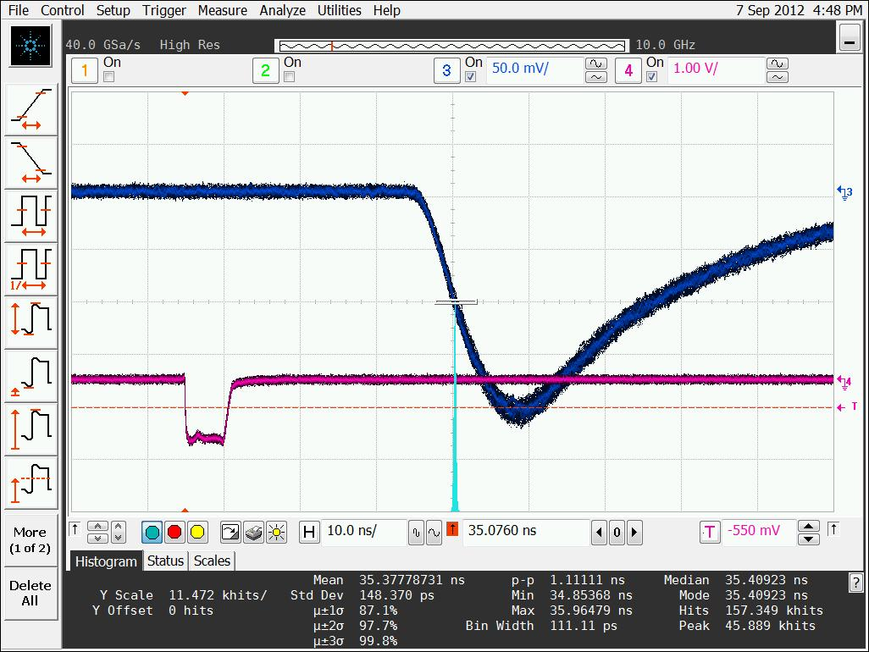
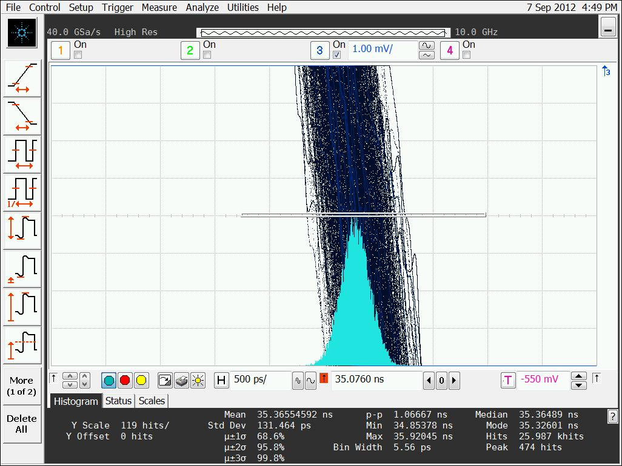
Sept 7, 2012 400 nm response using PicoQuant 70 ps variable reprate laser
Laser: 400 nm, 1.5 nW, 3x10⁵ photons/pulse
Signal: RMD APD + Ortec 9306 preamp
HV bias on APD -1.75 kV
(From Thomas report)
pulse amplitude
10 kHz, 1.5 nW, ~70 ps, ~3x10⁵ photons/pulse
APD signal pulse
t_{rise}=8.8 ns
Δt ~ 30 ns
10ns/div
timing jitter
~125 ps
APD now responses @ 400 nm. But it’s signal pulse is much slower than at NIR !! Charge shielding effect ?
Lu: Since 400 nm photons are absorbed in surface layer, the photo-electrons drift from where created to the P-N junction need longer time.

Slide 8
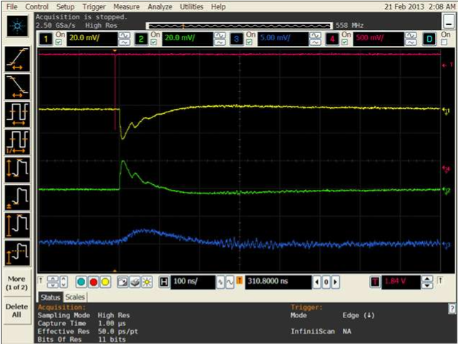

Screen Capture of PSAPD waveforms from VCSEL-980 (Laser beam closer to pin #1)
Laser beam trigger signal
Anode signal
Cathode pin #1
Cathode pin #2
Beam spot

Slide 9
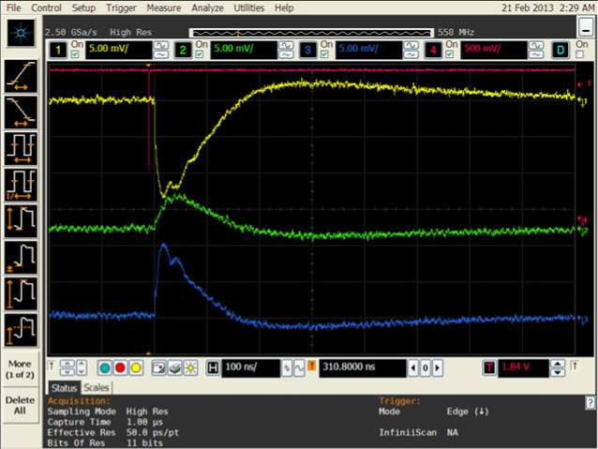
Screen Capture of PSAPD waveforms from VCSEL-980 (Laser beam around the center)
Laser beam trigger signal
Anode signal
Cathode pin #1
Cathode pin #2
Beam spot

Slide 10
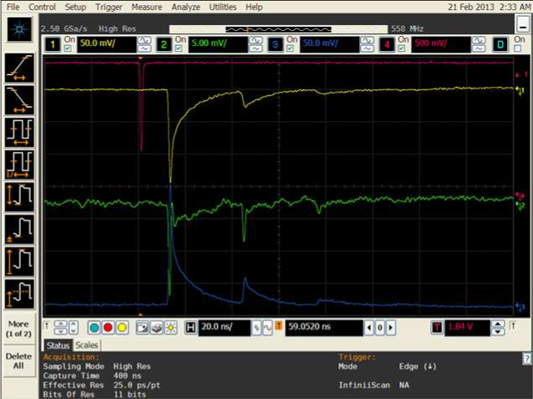
Screen Capture of PSAPD waveforms from VCSEL-980 (Laser beam closer to pin #2)
Laser beam trigger signal
Anode signal
Cathode pin #1
Cathode pin #2
Beam spot
Notice: the leading edge of the pulse is much sharper than previous two cases.

