Slide 1

Noise comparison for beam test box and Princeton test box
C. Lu
Princeton University
(1/15/2013)

Slide 2
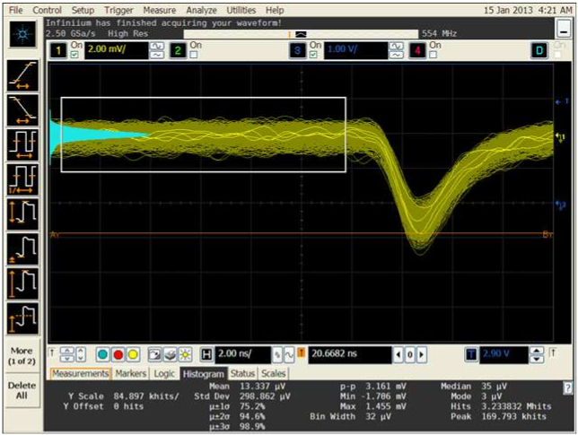
Beam test box
Use Agilent scope to investigate the noise level: get the standard deviation of the noise for the baseline:
Beam test box, 64mm^2 APD with mesh readout, ZX60 amplifier, scope bandwidth 554MHz, -1800V.
Standard deviation of the baseline: 0.298mV

Slide 3
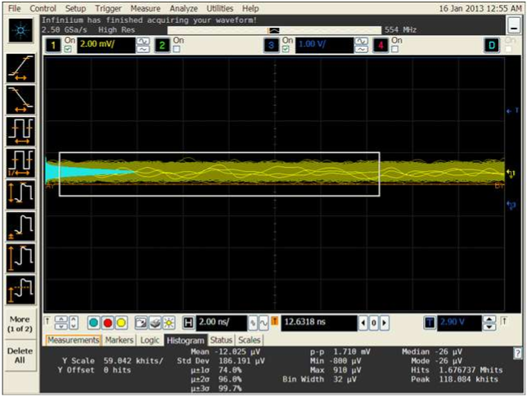
Princeton test box
Princeton test box, 64mm^2 APD with pad readout, ZX60 amplifier, scope bandwidth 554MHz, -1750V.
Standard deviation of the baseline: 0.186mV, much smaller than 0.298mV.

Slide 4
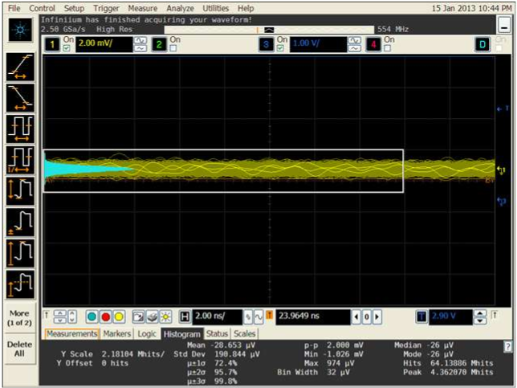
Princeton test box
Princeton test box, 64mm^2 APD, direct readout from electrode, ZX60 amplifier, scope bandwidth 554MHz, -1750V.
Standard deviation of the baseline: 0.19mV, much smaller than 0.298mV.

Slide 5
The noise floor measured from beam test box is much worse than Princeton test box: 0.298mV vs 0.19mV, all other conditions are same: 64mm^2 APD, ZX60 amplifier, similar HV (out test shows the noise does not depend on the HV), 20°C. This would degrade the beam test time resolution.

