Slide 1

Mesh APD gain study with Fe-55
C. Lu
Princeton University
(6/2/2015)

Slide 2
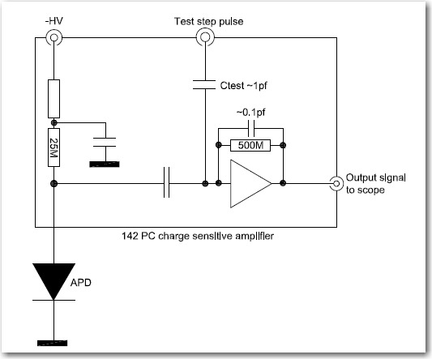
Test APD gain with ORTEC 142PC charge sensitive amplifier
The following three slides are from my 2012 report. In that study I used ORTEC 142PC charge sensitive amplifier to measure a 4 mm² APD gain.

Slide 3
Charge spectrum of Fe-55 source

Slide 4
APD gain vs. bias HV
Get the peak value from the charge spectrum, convert it to total number of electrons, and assume the primary e-hole pairs created by a 5.9 keV photoelectron is ~5900/3.6 = 1640, we can calibrate the APD gain:

Slide 5
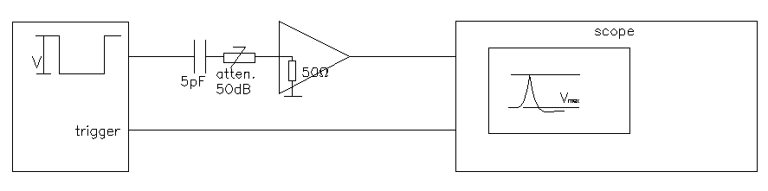
64mm² mesh APD gain study with Wenteq amplifier
Use a 5 pF capacitor in front of Wenteq 5008 amplifier to calibrate the system: (we have tested the input impedance of Wenteq 5008, ~55 W, see next two slides)
V (V) | V_{max} (mV)
-2.0 | 752
-1.5 | 575
-1.0 | 385
-0.5 | 193

Slide 6
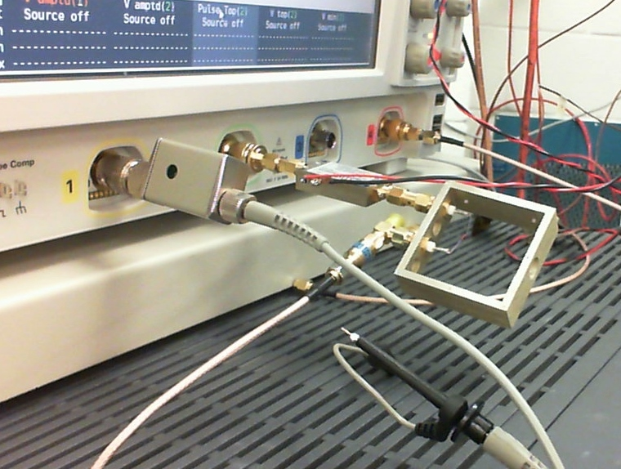
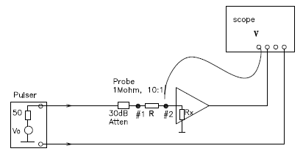
(“Amplifier Input Impedance Test” 10/14/2014, slide #2)
Setup for testing input impedance of amplifier
Based on Mitch’s suggestion we tested the input impedance of WENTEQ 5008 amplifier.
Amplifier
R
Attenuator (30 dB)
Cable from HP pulser
Scope probe(1 MW,10:1)
Use scope average mode to eliminate the noise, the measured waveforms at #1 and #2 are in next slide.

Slide 7
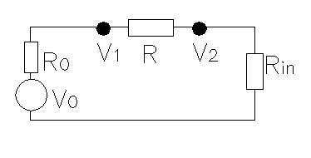
(“Amplifier Input Impedance Test” 10/14/2014, slide #3)
Input impedance
Scope is in high resolution mode: 12 bits.
HP Pulse generator
The tested input impedance of Wenteq 5008 is 54.8 W.
The amplifier’s output V_{amp} = 292.34 mV,
Wenteq 5008 amplifier Gain = V_{amp}/V₂ = 292.34/1.18 = 247.8 = 47.9 dB. Manufacturer specs: Gain ~ 47 – 53, our measured value is in this range.

Slide 8
Calibration of Wenteq amplifier
The total charge of the input signal to the Wenteq amplifier can be calculated as following:
Q = C * V * Atten. , C = 5 pF, Atten. = 50 dB = 1/320
Thus we can convert the input V into Q:
V (V) | Q (e’s) | APD Gain | V_{max} (mV)
-2.0 | 19.52x10⁵ | 1200 | 752
-1.5 | 14.64x10⁵ | 900 | 575
-1.0 | 9.76x10⁵ | 600 | 385
-0.5 | 4.88x10⁵ | 300 | 193
If Q is produced by Fe-55 5.9 keV X-ray, the corresponding APD gain can be derived by Q(e’s)/1640, 1640 is the primary # of e/h pairs, we put it into 3rd column.
The APD gain vs. V_{max} (mV) is: APD Gain = 1.59 * V_{max} (mV) – 5.877

Slide 9
64 mm² mesh APD gain
Fe-55 spectrum measured by Wenteq amplifier:
HV (V) | V_{max} (mV) | APD Gain
-1720 | 60 | 89.54
-1750 | 95 | 145.19
-1780 | 130 | 200.85
-1800 | 170 | 264.46
-1820 | 240 | 375.77

Slide 10
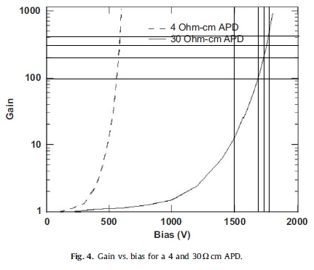
RMD reported 64 mm² APD gain
A study of low resistivity, deep diffused, silicon avalanche photodiodes coupled to a scintillator, M. McClish , R. Farrell, J. Glodo, K.S. Shah
NIMA 610 (2009) 207 http://physics.princeton.edu/~mcdonald/examples/detectors/mcclish_nim_a610_207_09.pdf
The basic approach for measuring gain involves irradiating the APD with pulsed light (from an LED) and recording the pulse amplitude at unity gain. Next, as the bias is increased, the pulse amplitude is recorded and normalized to determine the relative gain for each bias value.
400
300
200

