Slide 1

Amplifier Input Impedance Test
C. Lu
Princeton University
(10/14/2014)

Slide 2
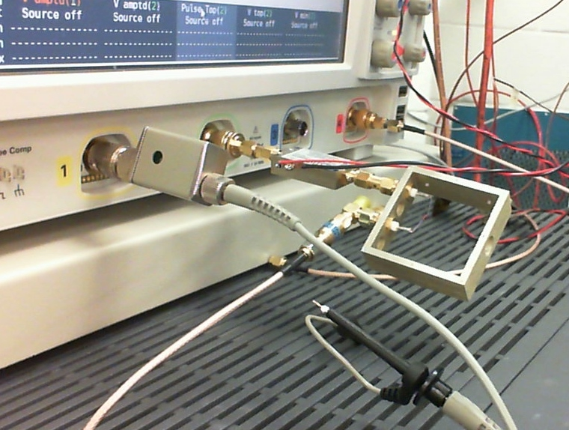
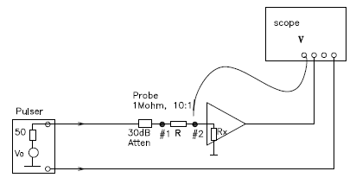
Setup for testing input impedance of amplifier
Based on Mitch’s suggestion we tested the input impedance of WENTEQ 5008 amplifier.
Amplifier
R
Attenuator(30dB)
Cable from HP pulser
Scope probe(1MW,10:1)
Use scope average mode to eliminate the noise, the measured waveforms at #1 and #2 are in next slide.

Slide 3
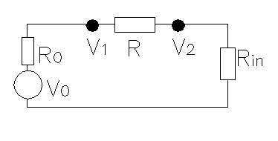
Input impedance
Scope is in high resolution mode: 12bits.
HP Pulse generator
The tested input impedance of Wenteq 5008 is 54.8W.
The amplifier’s output Vamp = 292.34mV,
Wenteq 5008 amplifier Gain = Vamp/V2 = 292.34/1.18 = 247.8 = 47.9dB. Manufacturer specs: Gain ~ 47 – 53, our measured value is in this range.

Slide 4
Input impedance (cont’d)
We notice that the test signal polarity used is opposite to the real APD signal, which should be positive pulse. We reversed the test pulse polarity, redo the test: Rin = 53.5W, the result is same.
Scope is in normal resolution mode.

Slide 5
Input impedance of Mini-circuits ZX60(2ns pulse)
Test Mini-circuits ZX60 amplifier:
Pulse width = 2ns, Rin = 79.6W.
Scope is in normal resolution mode.

Slide 6
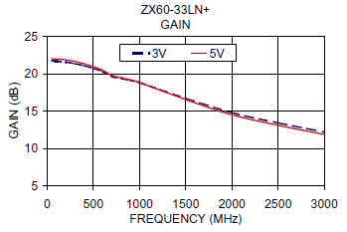
Input impedance of Mini-circuits ZX60(1ms pulse)
Test Mini-circuits ZX60 amplifier:
Pulse width = 1ms.
ZX60 gain curve is not flat from DC to 3GHz, so its output pulse for 1us pulse is not so simple.

Slide 7
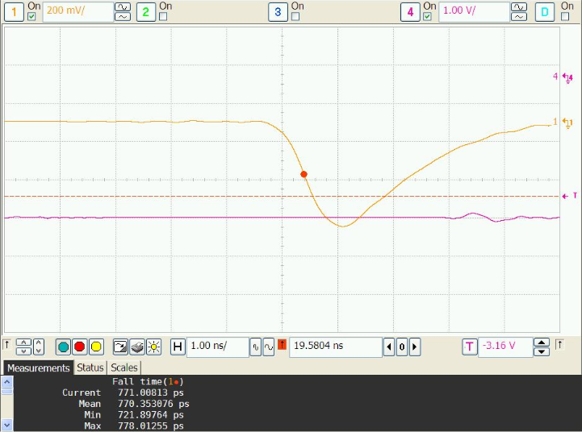
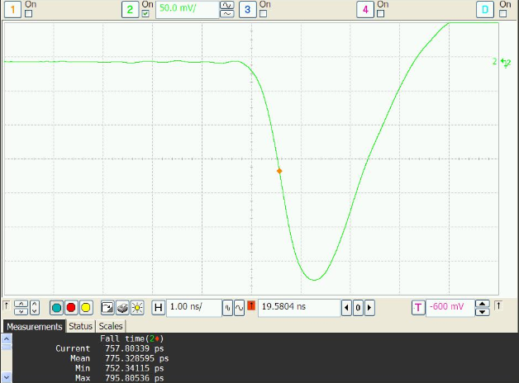
Remaining mystery of fast leading edge of APD signal
If the input impedance of these tested amplifiers is around 50 ~ 70W, it remains as a mystery: why the leading edge of the APD signal is so fast: ~800ps?!
For an exponential curve y = 1 - e^{-t/RC}, it takes 2.2RC from 10% to 90%,
2.2RC = 0.8ns, R = 50W, C = 7.3pF?! It means the APD output capacitance is only ~ 7.3pF?!
Wenteq 5010
Wenteq 5008
Leading edge 770ps
Leading edge 775ps

Slide 8
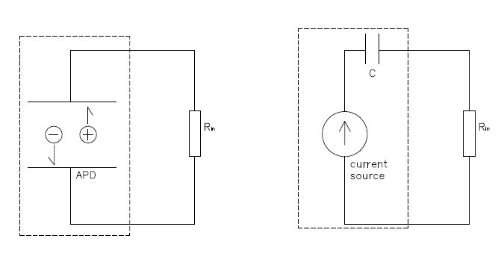
Mystery solved
Let us re-exam the signal formation mechanism in APD. The signal obtained on the electrode actually is due to the induced current created signal on the load (amplifier’s input impedance), there is nothing to do with the capacitance of the APD. The capacitance of the APD is in series (not in parallel) with the input impedance of the amplifier, as shown in the plot below:
Therefore the leading edge of the APD signal characterizes the APD induced current.

Slide 9
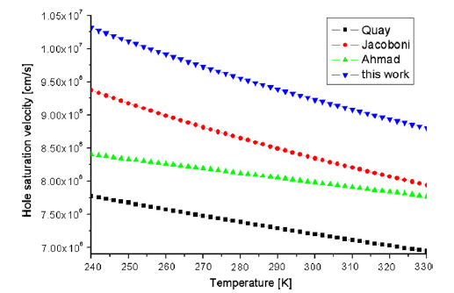
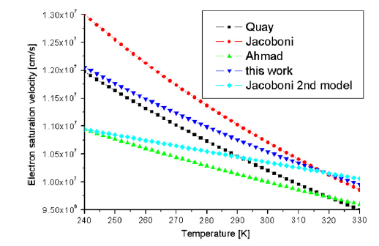
Characteristic of the induced current in APD
Electron and hole saturated drift velocity in silicon: (J. Becker etc. Solid-State Electronics, 56(2011)104)
Assume RMD APD P-N junction high E-field region (avalanche and signal formation region) is ~ 60um, according to above plot, the e/h saturated velocity ~ 10⁷cm/sec, the time for traveling thru the junction is ~ 60um/10⁷cm/sec ~ 0.6ns, which is similar to the leading edge of APD signal.

Slide 10
Implication of this conclusion
To match 0.6 ~ 0.8ns leading edge of the APD signal, as already mentioned in my previous report, the amplifier’s bandwidth needs to be
Bandwidth ~ 0.35/0.7ns = 500MHz.
Higher bandwidth brings no advantage, only increases high frequency noise. The scope high resolution mode gives us better time resolution in data analysis with constant fraction algorithm.
The standard 50W input impedance can avoid the reflection with 50W cable. The commercial amplifiers we have tested have their input impedance around 50W.

