Slide 1

APD gain calibration with Fe-55 source
C. Lu
Princeton University
(4/11/2012)

Slide 2
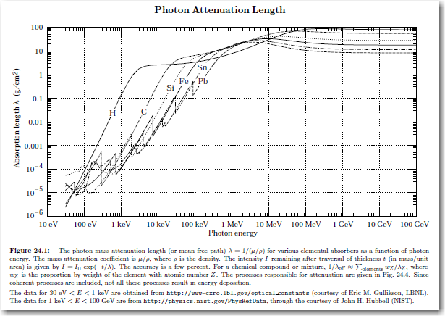
APD gain calibration with Fe-55 source
Fe-55 is a 5.9 keV X-ray source. The photon absorption length in several materials:
5.9 keV X-ray absorption length in silicon is ~ 0.006 g/cm².
Silicon density = 2.33 g/cm³.
λ = 0.006*2.33
= 0.014 cm
= 140 μm.

Slide 3
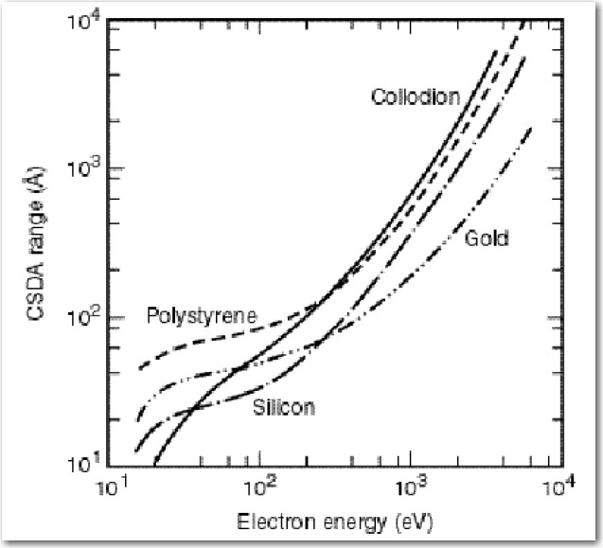
Electron CSDA range in silicon
Electron CSDA range, the continuous slowing down approximation range, is shown below. A 5.9 keV photoelectron can travel in silicon only ~ 1 μm:

Slide 4
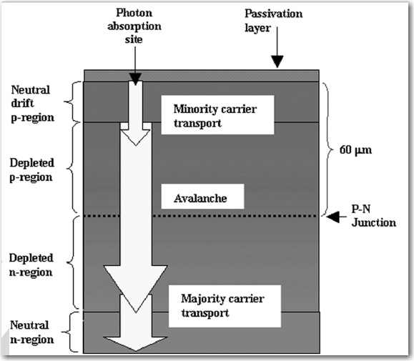
Crossectional view of a deep diffused APD.
Reexamination of deep defused silicon avalanche photodiode gain and quantum efficiency
Mickel McClish, et al.
IEEE Transaction on nuclear science, Vol. 53, No. 5, Oct. 2006

Slide 5
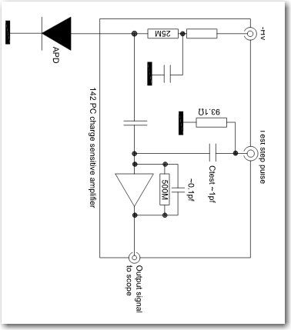
Test APD gain with ORTEC 142PC charge sensitive amplifier

Slide 6
Charge spectrum of Fe-55 source
Double peak in Fe-55 full energy charge spectrum

Slide 7
Double peak in charge spectrum
We saw the double peak structure for the Fe-55 5.9 keV peak. One of the explanation for this peculiar behavior might have same origin as the double peak time structure as Dick Farrell pointed out in his email: The APD p-type layer of 60 micron thickness consists of a 20 micron 'drift' region (low electric field) plus a 40 micron depletion region (high electric field). Some of the X-rays are captured in the “drift” region, where additional low gain might contribute in addition to the main “avalanche” gain, that forms the higher full energy peak.
If X-ray captured in this region, the total APD gain might be larger .
If X-ray captured in this region, the total APD gain is the gain in the avalanche region.

Slide 8
Calibrate charge sensitive amplifier with capacitor
The internal charge calibration capacitor in 142PC is C ~ 1 pf, inject a known amplitude step pulse V through this capacitor, we’ll know the total charge Q = C*V:

Slide 9
APD gain vs. bias HV
Get the peak value from the charge spectrum, convert it to total number of electrons, and assume the primary e-hole pairs created by a 5.9 keV photoelectron is ~ 5900/3.6 = 1640, we can calibrate the APD gain:

Slide 10
Fast amplifier with Fe-55 source
Use fast amplifiers (ZVA-213) we also saw the Fe-55 X-ray full peak, although they are not as good as the peak obtained with the charge sensitive amplifier. (Be aware the signal from fast amplifier is negative pulse, larger signal is towards left)
Fe-55 5.9 keV full energy peaks

