Slide 1

APD gain study with Fe-55, Co-60 and Cosmic rays
C. Lu
Princeton University
(4/25/2012)

Slide 2
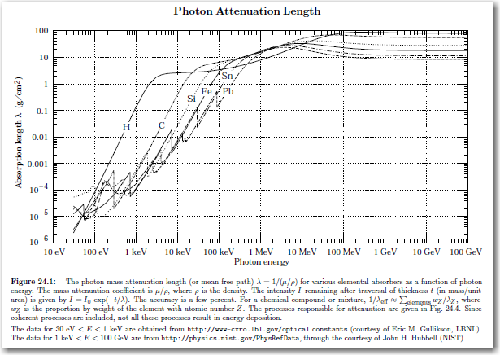
APD gain calibration with Fe-55 source
Fe-55 is a 5.9 KeV X-ray source. The photon absorption length in several materials:
5.9 KeV X-ray absorption length in silicon is ~ 0.01g/cm².
Silicon density 2.33 g/cm³.
0.006*2.33=0.014cm=140μm.

Slide 3
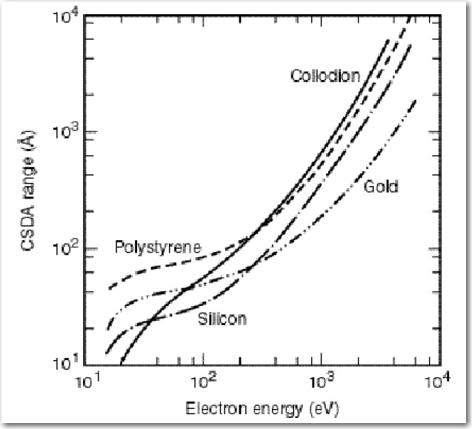
Electron CSDA range in silicon
Electron CSDA range, the continuous slowing down approximation range, is shown below. 5.9 KeV photoelectron can travel in silicon only ~1μm:

Slide 4
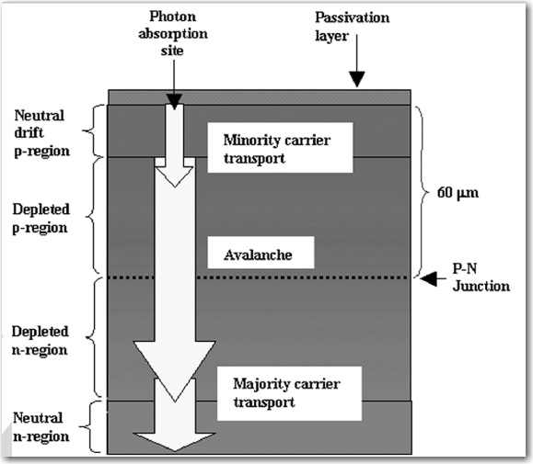
Crossectional view of a deep diffused APD.
Reexamination of deep defused silicon avalanche photodiode gain and quantum efficiency
Mickel McClish, et al.
IEEE Transaction on nuclear science, Vol. 53, No. 5, Oct. 2006

Slide 5
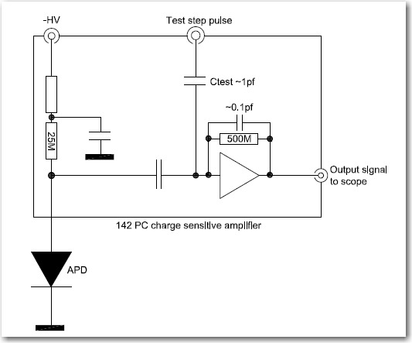
Test APD gain with ORTEC 142PC charge sensitive amplifier
4 mm² APD is used in following study:

Slide 6
Charge spectrum of Fe55 source
Double peak in Fe55 full energy charge spectrum

Slide 7
Double peak in charge spectrum
We saw the double peak structure for the Fe55 5.9KeV peak. One of the explanation for this peculiar behavior might have same origin as the double peak time structure as Dick Farrel pointed out in his email: The APD p-type layer of 60 micron thickness consists of a 20 micron 'drift' region (low electric field) plus a 40 micron depletion region (high electric field). Some of the X-rays are captured in the “drift” region, where additional low gain might contribute in addition to the main “avalanche” gain, that forms the higher full energy peak.
If X-ray captured in this region, the total APD gain might be larger .
If X-ray captured in this region, the total APD gain is the gain in the avalanche region.

Slide 8
Calibrate charge sensitive amplifier with capacitor
The internal charge calibration capacitor in 142PC is C~1pf, inject a known amplitude step pulse V through this capacitor, we’ll know the total charge Q = C*V:

Slide 9
APD gain vs. bias HV
Get the peak value from the charge spectrum, convert it to total number of electrons, and assume the primary e-hole pairs created by a 5.9 KeV photoelectron is ~5900/3.6 = 1640, we can calibrate the APD gain:

Slide 10
Fast amplifier with Fe-55 source
Use fast amplifiers (ZVA-213) we also saw the Fe55 X-ray full peak, although they are not as good as the peak obtained with the charge sensitive amplifier. (Be aware the signal from fast amplifier is negative pulse, larger signal is towards left)
Fe55 5.9 KeV full energy peaks

Slide 11
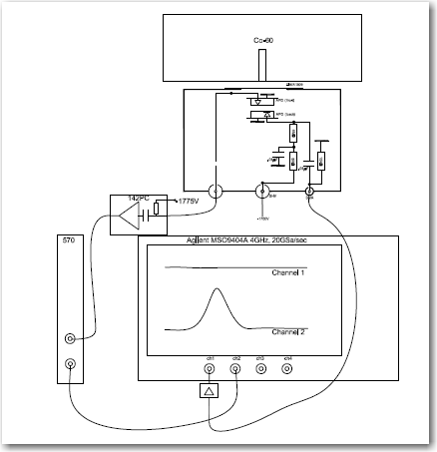
APD gain study with Co-60 source
So far we have used Co-60 to measured time resolution of the APDs. We would like to know the energy loss of Co-60 β ray in the APD, and predict its response to the m.i.p. Two 64mm² APDs are used in following study.

Slide 12
APD gain study with Co-60 source
Triggered on the back APD with fast amplifier ZVA-213, record the charge signal from the front APD with 142PC amplifier. Since the Co-60 charge signal is much larger than Fe-55 signal, we have to modify 142PC sensitivity, reduce it by a fact of ~20.
The modified 142PC calibration curve:
Fe-55 spectrum measured by same electronics system

Slide 13
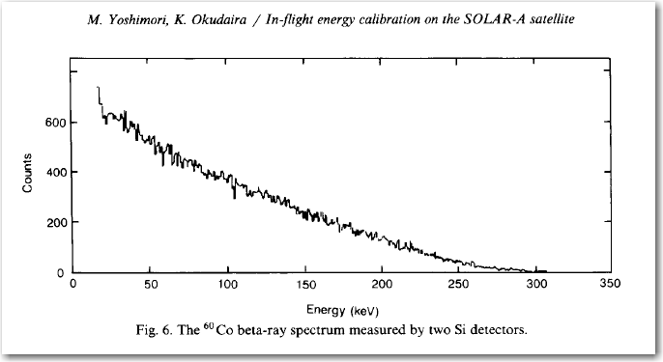
Co-60 spectrum
Measured charge spectrum for Co-60 source: HV @ -1775V. Since the Fe-55 peak is at 0.0325V, our rough conversion fact is 5.9KeV/0.0325V.
The brown colored curve represents self triggering events.
If we expect 6000 e/h pairs for m.i.p. signal, the corresponding energy loss would be ~22 KeV.
Co-60 β spectrum measured by silicon detector, 4mm in diameter, 100μm thickness (Hamamatsu Photonics 1722-2) NIM A272 (1988)880-884

Slide 14
Cosmic ray charge spectrum
Measured charge spectrum for cosmic ray, HV @ -1775V.
The brown colored curve represents self triggering events.
If we expect 6000 e/h pairs for m.i.p. signal, the corresponding energy loss would be ~22 KeV.
The calculated average energy loss for the cosmic ray spectrum is ~28 KeV, which is not too far away from ~22 KeV. The average energy loss for the tested Co-60 spectrum is ~95 KeV, which is 3.4 times higher than cosmic ray spectrum.

