Slide 1
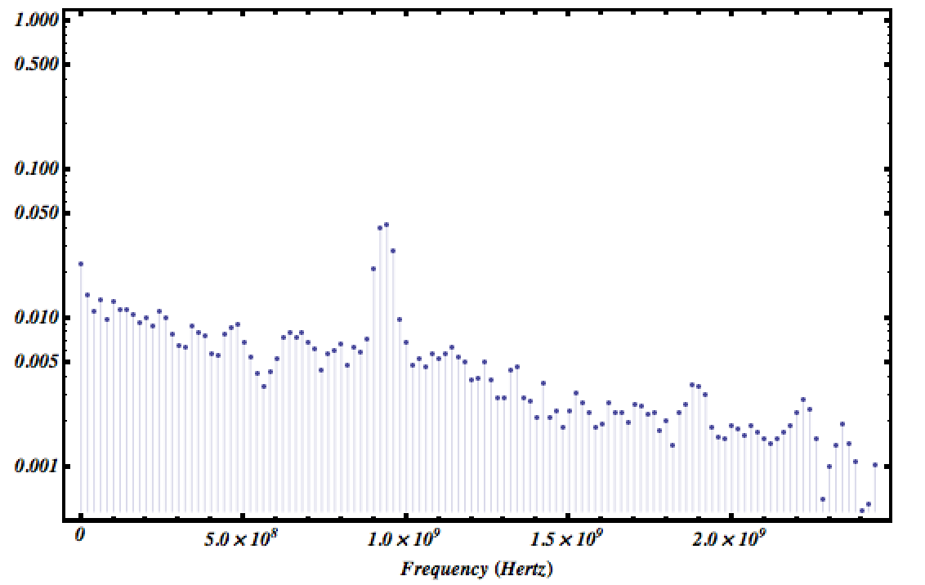
Artifact on FFT spectrum due
to scope vertical scale digitization error
Sebastian reported that the PSI beam test data shows strange behavior on FFT spectrum of its noise analysis.
The frequency peak is around 900MHz.

Slide 2
To understand where this strange peak comes from, I tried to reproduce this effect on my bench top setup.
I used LeCroy pulse generator to produce triggers for the Agilent scope. When the scope is recording the waveforms, it also does FFT analysis at same time. We set the full scale of the FFT spectrum as 2GHz. The amplifier used in this test is ZKL-1R5 +. For your convenience I attach the amplifiers comparison table below.
Amplifier | Bandwidth(MHz) | Gain |  |  |  | Noise figure
Wenteq ABL0100-01-5010 | 10 - 1000 | 50dB |  |  |  | 1.0dB
ZFL-2500+ | 500 - 2500 | 28dB |  |  |  | 6 ~ 8.6dB
ZKL-1R5+ | 10 - 1500 | 40 |  |  |  | 3.0dB
ZX60-33LN-S+ | 50 - 3000 | 100 | 1000 | 2000 | 3000 | 1.1dB
 |  | 21.9 | 18.8 | 14.5 | 11.9
ZVA-213 | 800 - 21000 | 26 |  |  |  | 2.5~4.7dB

Slide 3
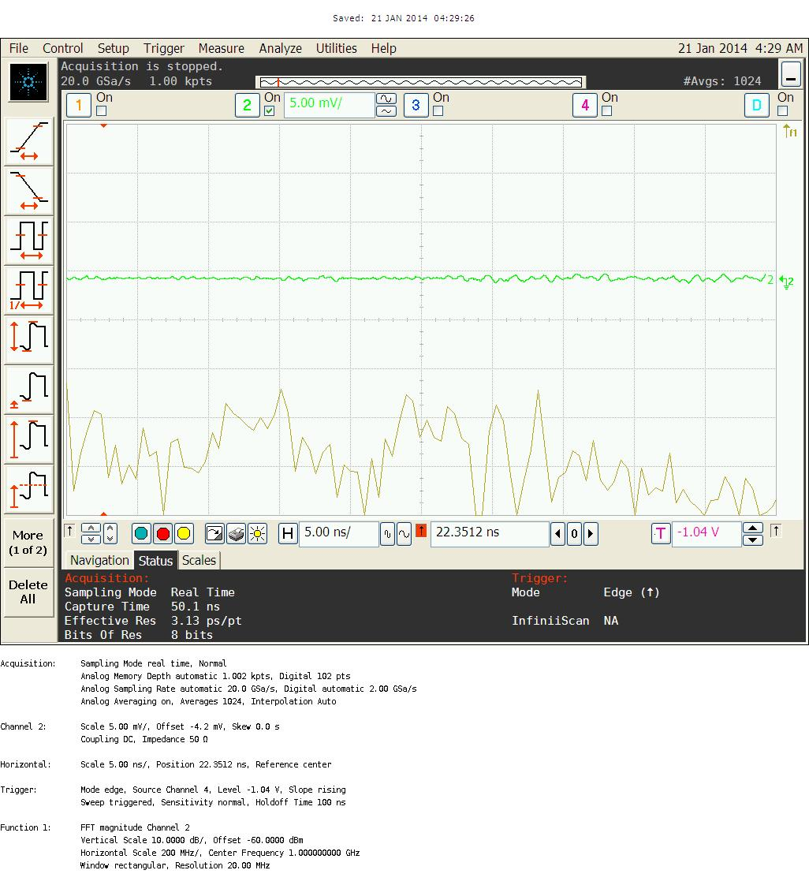
I noticed that the shape of recorded noise FFT spectra depends the vertical scale of scope. I listed two extreme cases: 5mV/div and 500mV/div here.
5mV/div
The FFT spectrum does not have any peak structure in it.

Slide 4

When the vertical scale changed to 500mV/div, around 900MHz a big peak appears, which is similar to what Sebastian found in PSI beam test data.
Seems to me this peak might be due to the artifact of digital scope digitization error.
500mV/div
The FFT spectrum does show a peak around 900MHz.

