Slide 1
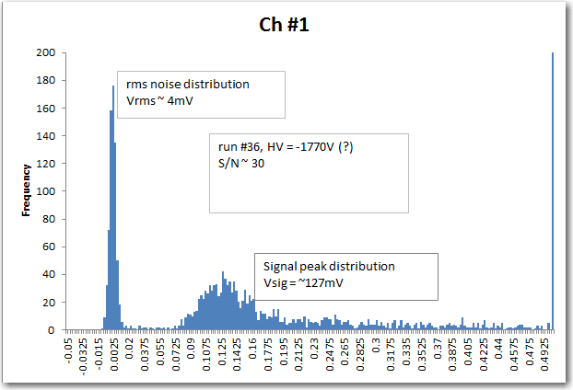
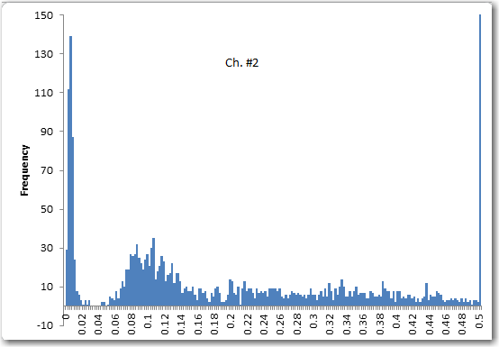
DESY Beam Test Analysis
C. Lu, Mar. 11, 2014
APD signal peak distribution
Run # 36

Slide 2
DESY beam test
APD signal peak distribution: Min-ion peak has disappeared
Run # 41

Slide 3
DESY beam test
From run #36 to run #42 the time span is ~ 5 hours. Last good run is #40.
Run # 42

Slide 4
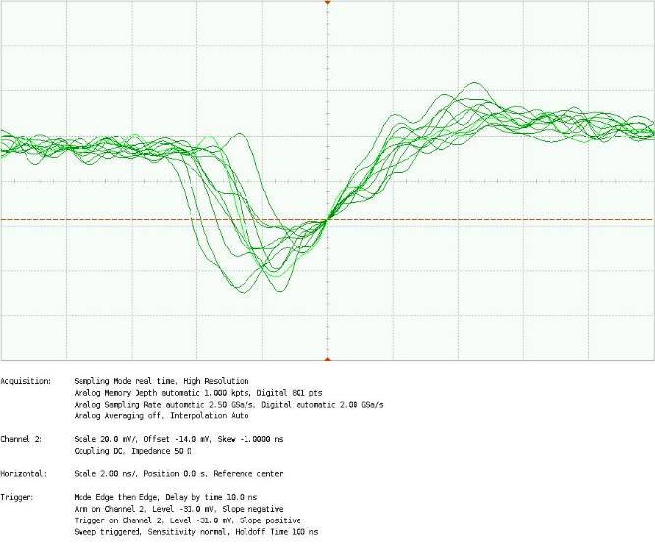
Wenteq amplifier (test at Princeton)
Fe-55 signal, 64mm^2 APD, HV = -1750V
20mV/div
2ns/div
Peak ~ 60mV

Slide 5
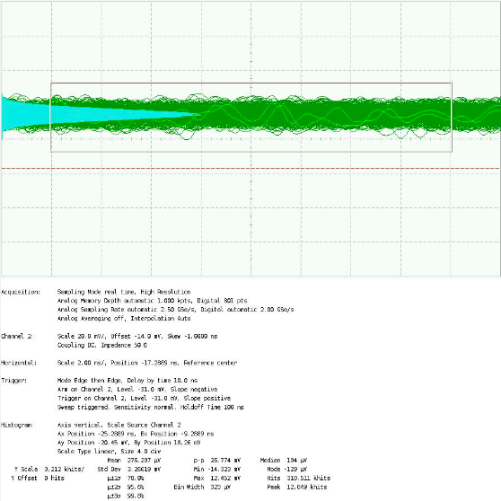
rms noise with Wenteq amplifier (test at Princeton)
20mV/div
2ns/div
rms noise ~ 3.3mV, S/N ~ 60/3.3 = 18

