Slide 1

Cross talk signal?
C. Lu
Princeton University
(5/24/2012)

Slide 2
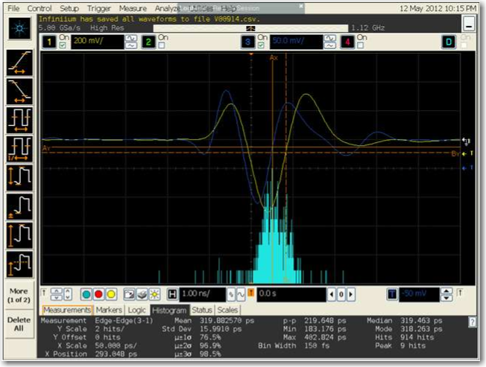
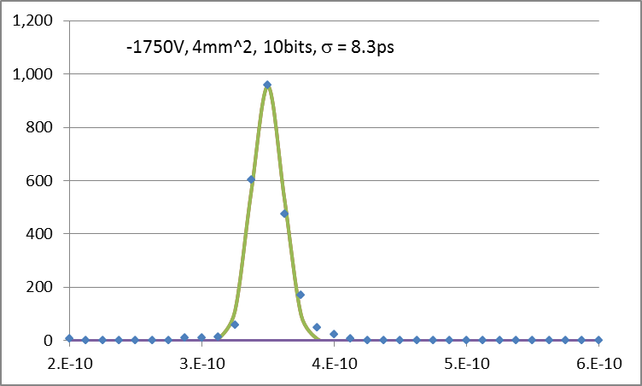
Is the back APD’s signal real or cross talk?

Slide 3
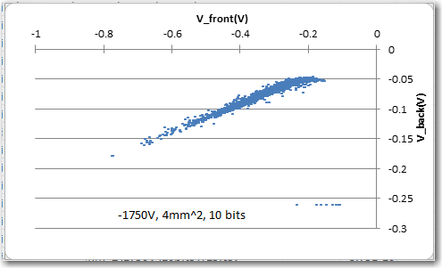
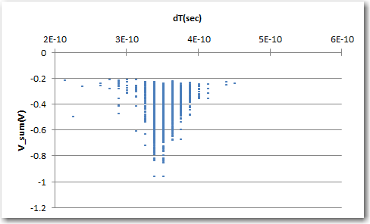
Suspicious scatter plot
Scatter plot of two APD’s signal amplitudes is suspicious. The points are lined up around a straight line almost perfect, that indicates the front and back signals are coming from a common source, not from two independent sources.
Scatter plot of dT vs. sum of two APDs signals.

Slide 4
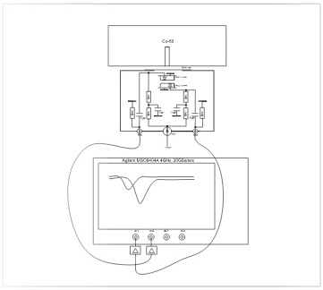
Time resolution test setup
APD test box, mount two APDs face to face, Co-60 source is placed on top of the box.
APD signal through ZVA-213 Mini-Circuits wideband amplifier connected to Agilent scope.
When β particle penetrates the front APD, and an avalanche is developed in this APD, its induced signal can be picked up by its anode as well as by the back APD’s anode. Two anodes is only ~1mm apart. If we set the trigger threshold of back APD channel lower enough (-50mV), two channels are reading out the signal from same source!

Slide 5
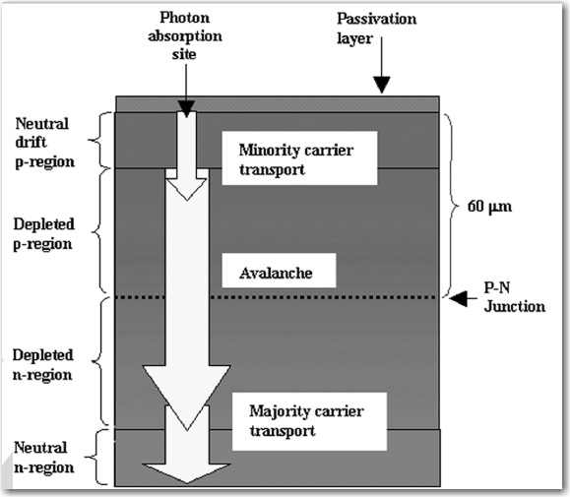
Mechanism of the cross talk
Cathode electrode grounded.
Front APD
Front APD anode electrode, send out induced signal from the movement of avalanche electrons.
Back APD
Picking up induced signal from front APD’s electron’s movement.
Two APDs are grounded together.

Slide 6
A possible explanation of the cross talk

Slide 7


Sample events for two different cases
Channel#2 signal looks like cross talk signal
Channel#2 signal looks like real signal from back APD

Slide 8
Discussion

Slide 9
Discussion (cont’d)

