Slide 1

Tests of the signal size of a 64 mm² mesh APD with cosmic rays and an Fe-55 source
C. Lu
Princeton University
(3/30/2016)

Slide 2
Test setup
The purpose of this test is to calibrate the 64 mm² mesh APD MIP-signal size.
Previously, we assumed the thickness of RMD mesh APD is ~ 40-60 μm; then a MIP would cause energy loss in this layer of silicon leading to 4440-6660 e-h pairs (see next slide).

Slide 3
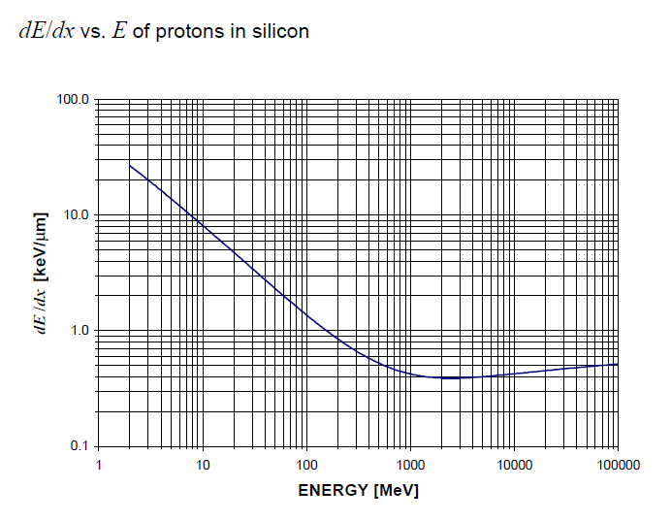
.
Energy loss in silicon for protons
0.4KeV/μm
~111 e-h pairs/ μm

Slide 4
Cosmic-ray events
I used a Wenteq 5008 amplifier right after the APD test box, with SMA cables connecting the output signals to the Agilent MSO9404 scope.
I set the trigger threshold at 20mV for the cathode positive signal, and recorded the mesh and cathode waveforms.
The scope settings were: scale @ 100 mV/div, BW limit @ 500 MHz.
The Landau fit of this spectrum see slide #7.

Slide 5
APD measured spectrum of Fe-55 x-rays
Under the same conditions, I also measured the Fe-55 5.9-keV x-ray spectrum:

Slide 6
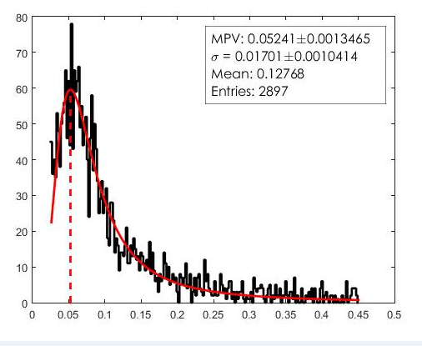
APD measured spectrum of cosmic rays
Under the same conditions, I also measured the cosmic ray spectrum: at -1750 V, I collected, filtered and analyzed a total of ~2900 good events. In the histogram below of signal peak amplitude with its Landau fit, the most probable V = 52.4 mV, the mean V = 127 mV:
The Fe-55 full-energy peak is ~ 38 mV, which corresponds to 1640 e-h pairs, thus we derived: 127/38*1640 = 5481 e-h pairs for the mean energy loss of MIP.
This is close to what I estimated above:
4440- 6660 e-h pairs; 52.4/38*1640 = 2261 e-h pairs for the MIP peak.

Slide 7
Cosmic-ray events

