Slide 1
Comparison between several amplifiers to the (laser diode/64mm^2 mesh APD) signal
The Laser Diode used in this test is WSLP-980-010m-4-PD fiber coupled laser diode, 980nm, 10mW laser diode, 6um thick, 80cm long fiber.
The trigger pulse is coming from LeCroy pulse generator 9210/9212. Parameters used are:
Vhigh = 0;
Vlow = -3.0V;
Width= 0.9ns;
Dealy = 0;
Lead = 0.25ns;
Trail = 0.25ns;
2 Pulse = Off;
Freq = 1MHz;
Invert = ON;

Slide 2
The operating HV for 64 mm^2 mesh APD = -1750V.
Five different amplifiers are used:
Amplifier | Bandwidth(MHz) | Gain |  |  |  | Noise figure
Wenteq ABL0100-01-5010 | 10 - 1000 | 50dB |  |  |  | 1.0dB
ZFL-2500+ | 500 - 2500 | 28dB |  |  |  | 6 ~ 8.6dB
ZKL-1R5+ | 10 - 1500 | 40 |  |  |  | 3.0dB
ZX60-33LN-S+ | 50 - 3000 | 100 | 1000 | 2000 | 3000 | 1.1dB
 |  | 21.9 | 18.8 | 14.5 | 11.9
ZVA-213 | 800 - 21000 | 26 |  |  |  | 2.5~4.7dB

Slide 3
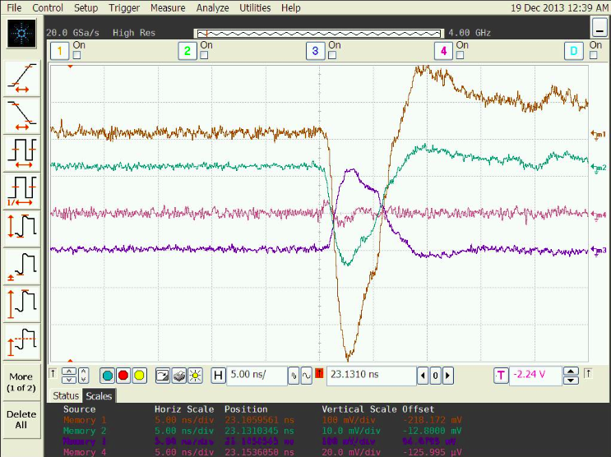
Comparison of amplifier’s output signals
Plot waveforms with same scale:
m1: Wenteq
m2: ZX60-33LN-S+
m4: ZVA-213
m3: ZKL-1R5+
Vertical scale: m1 100mV/div; m2 10mV/div; m3 100mV/div; m4 20mV/div

Slide 4
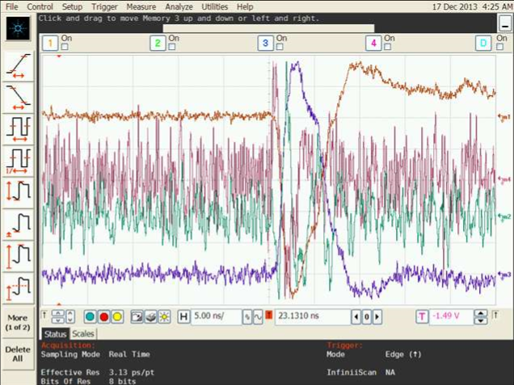
Comparison of amplifier’s output signals
Plot waveforms with different scale:
m1: Wenteq
m4: ZVA-213
m2: ZFL-2500+
m3: ZKL-1R5+

Slide 5
Comparison of amplifier’s output signals
Signal to Noise ratio:
(Adjust vertical resolution thus the scope bandwidth is 554MHz)
Amplifier | |V|_{max}(mV) | Rms(mV) | Signal/Noise ratio
Wenteq | 798.0 | 3.54 | 196.9
ZFL-2500+ | 10.8 | 0.453 | 23.9
ZKL-1R5+ | 250.0 | 1.58 | 148.0
ZVA-213 | 5.29 | 0.307 | 15.5
ZX60-33LN-S+ | 30.8 | 0.18 | 155.3
According to the test results the winner should be quite obvious, Wenteq. It has largest signal size and best S/N ratio. If we can afford to buy some Miteq 1660 amplifier, which has higher gain than Wenteq, it might be even better.

