Slide 1
Gain & Noise Comparison for Mini-Circuits, Wenteq and U. Penn Amplifier
Changguo Lu, Kirk McDonald
8/20/2013

Slide 2
How to make the comparison?
A 64 mm² mesh APD is used for this comparison.
HV is set at -1750V.
Use Fe-55 5.9-keV X-rays to generate the signal in the APD, then record baseline rms noise and Fe-55 full energy peak.

Slide 3
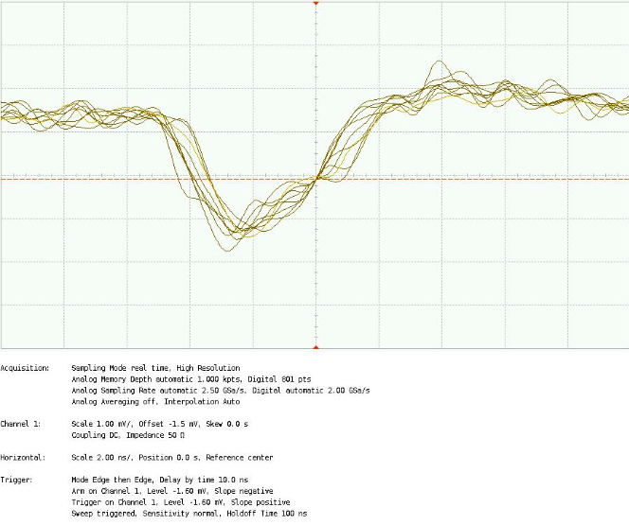
Mini-Circuits ZX60 amplifier
1mV/div
2ns/div
Peak ~ 2.5mV

Slide 4
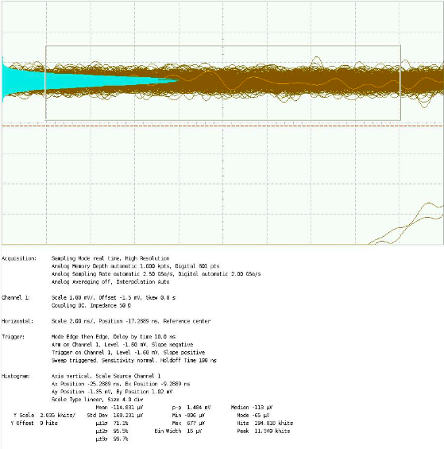
rms noise with ZX60 amplifier
rms noise ~ 0.168mV, S/N ~ 15

Slide 5
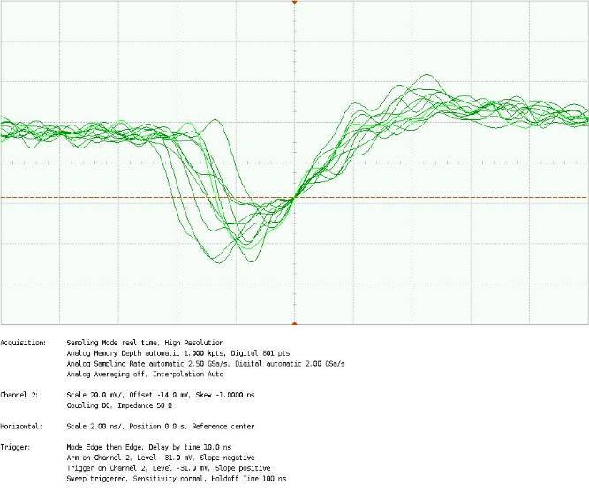
Wenteq amplifier
20mV/div
2ns/div
Peak ~ 60mV

Slide 6
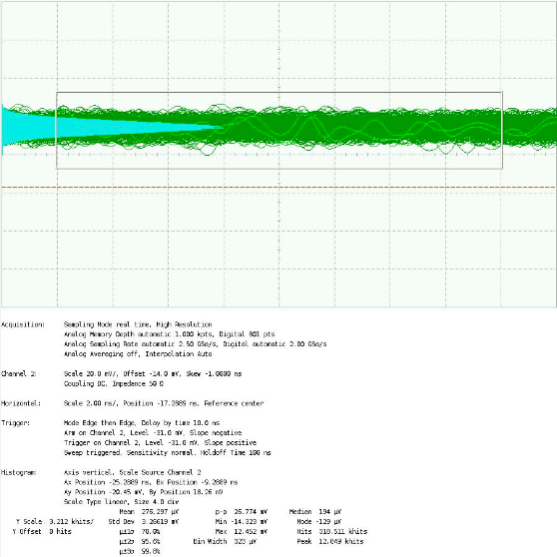
rms noise with Wenteq amplifier
20mV/div
2ns/div
rms noise ~ 3.3mV, S/N ~ 60/3.3 = 18

Slide 7
Fe-55 spectrum with U. Penn’s amplifier

Slide 8
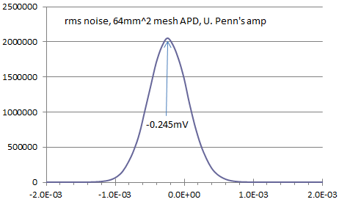
rms noise with U. Penn’s amplifier
With U. Penn’s amplifier its S/N ratio ~ 3.3/0.245 = 13.5
The gain of this amplifier is similar to Mini-circuits ZX-60, S/N is also similar.
The rise time of U. Penn’s amplifier is ~twice as slow as the other two amplifiers, ~3ns.

