Slide 1
Signal from anode, cathode and mesh of RMD 8x8 mm² mesh APD
Changguo Lu
2/5/2015

Slide 2
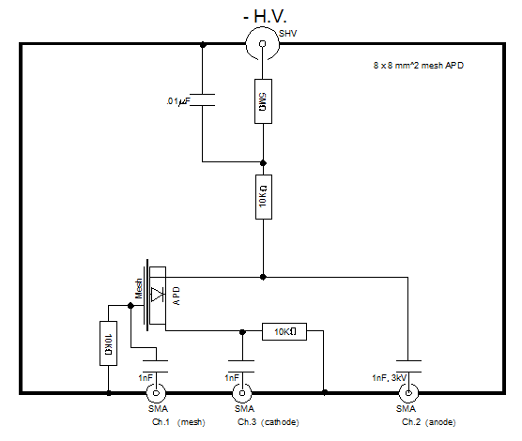
To understand the signal formation of APD we have to gather more information, which includes the difference of the signal size and shape on various electrodes.
For a 64 mm² mesh APD we can get three signals from Anode, Cathode and Mesh, respectively. With the help of Agilent digital scope we also can get various combination of these signals in real time, such as cathode-mesh, anode-mesh, etc.
All 3 signals measured across a 10-kΩ safety resistor.
In this study, all 3 signals were read out at the same time.
But, in “usual” operation, the Anode signal line would be left open.

Slide 3
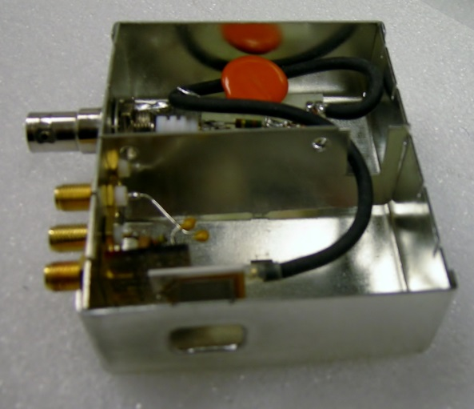
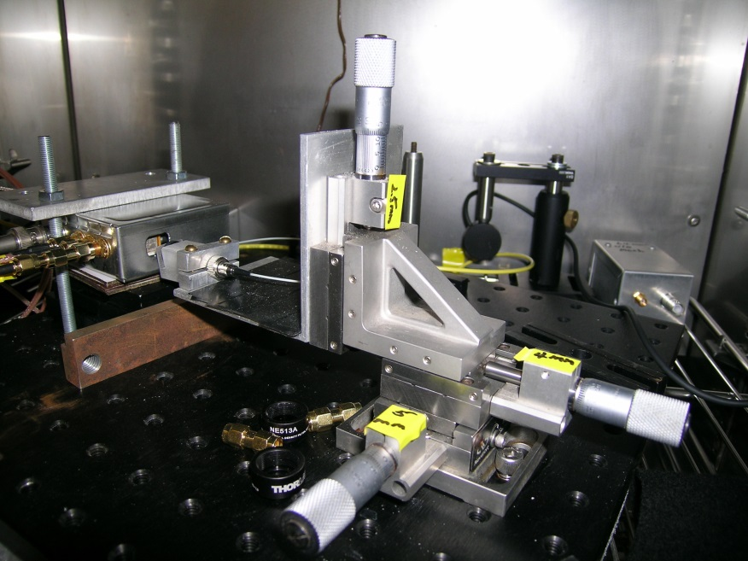
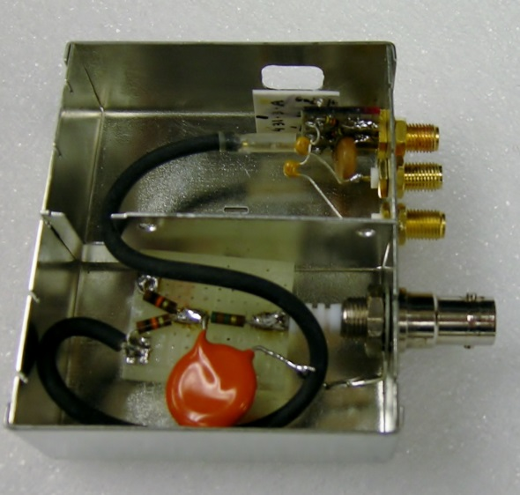
Test setup
Lens of laser diode
Front view of mesh APD
x
Back view of mesh APD
Test box
Box open window
Mesh APD
y
Coordinate system used in this test

Slide 4
Test setup
The Laser Diode used in this test is WSLP-980-010m-4-PD fiber coupled laser diode, 980-nm, 10-mW laser diode, 6um thick, 80-cm-long fiber.
The trigger pulse is coming from HP8131A pulse generator. Parameters used are:
Vhigh = 0;
Vlow = -3.6 V (varies later);
Width= 0.5 ns;
Freq = 10 kHz.
All three channels use Wenteq 5008 amplifier.
-1750 V is applied to the 64 mm² mesh APD.
The lens of the laser diode is mounted on an x-y stage, thus the laser beam can move along with x and y direction.
The tested mesh APD S/N: 431-3-A.

Slide 5
Scan results from various channels
We scan a 64 mm² mesh APD along with x and y directions for various channels: Cathode, Mesh, Anode, Cathode-Mesh and Anode-Mesh as shown below: Cathode-Mesh signal has wide flat distribution both on x and y directions:

Slide 6
Induced signal vs. beam position
This plot clearly shows induced current on cathode electrode is almost the mirror image of the induced current on anode + mesh electrodes. The induced signal from cathode is the largest one.
If we combine all three signals together and produce a signal = Cathode – (Mesh + Anode), we can double the signal size, also can reduce common mode noise, that can further improve the time resolution.
In the following tests we use Cathode-Mesh signal to measure the time resolution, it does show better results.
Next slide is Dick’s sketch of mesh APD, it can helps us to understand above statement.

Slide 7
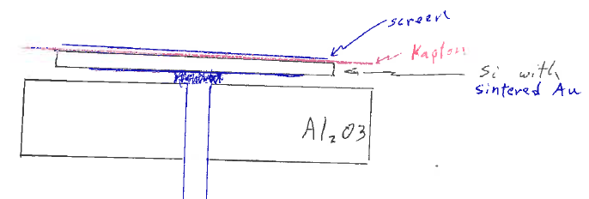
Dick’s sketch of mesh APD
Cathode electrode
According to Dick’s sketch if we believe the induced signal model we can see that the cathode electrode should be the best place to obtain the induced signal because the bottom electrode is Au-sintered and covers entire back side (8x8 mm²), there is no other electrode in between this electrode and the P-N junction.
The anode side mesh electrode, although covers the entire APD active area, but there is anode electrode in between the mesh and P-N junction, therefore the induced signal on mesh electrode is partly shielded by the anode. This picture is strongly endorsed by our test result on the previous slide.

Slide 8
How to calibrate laser diode measurement
Laser diode signal gives us a convenient means to test APD timing performance, however the reliable calibration of the absolute beam intensity is still an issue. Previously we had used known optical transmission, absorption coefficient of various materials in the mesh APD to calculate the MIP equivalent laser beam intensity, but the uncertainty of these coefficients bring in big error. Another calibration method we can use is Fe-55 source. The well defined full energy peak of 5.9-keV X-ray can easily compare to MIP with much less uncertainty.
Since the cathode signal varies with avalanche location, Fe-55 x-ray hits different points on the APD that will smear the full energy peak.
As we demonstrated before the Cathode-Mesh signal over the entire APD surface is much more uniform, we can expect better Fe-55 full energy peak with this signal.
On the left plot it does show this feature.

Slide 9
Time resolution
We know Fe-55 peak, we can thru adjusting HP pulser output signal amplitude to vary laser diode beam intensity, thus vary the APD output signal size and calculate its MIP equivalence.
HP Pulser Vlow(V) | Vmax (Cathode) | Vmax (Cat-Mesh) | # of equivalent MIPs* | σ_{t}(Cathode)(ps) ** | σ_{t}(Cathode-Mesh)(ps) **
-3.6 | 0.7 | 1.28 | 3.6 | 11.9 | 9.9
-3.57 | 0.324 | 0.625 | 1.7 | 16 | 12.6
-3.56 | 0.219 | 0.427 | 1.19 | 22.5 | 18.7
-3.55 | 0.168 | 0.313 | 0.87 | 32.5 | 25.1
*Assume the total # of electron-hole pairs created in APD is 5000.
** σ_{t} is measured direct by Agilent scope, it is the time jitter of trigger-Cathode and trigger-(Cathode-Mesh), see next slide for example of this setting.

Slide 10
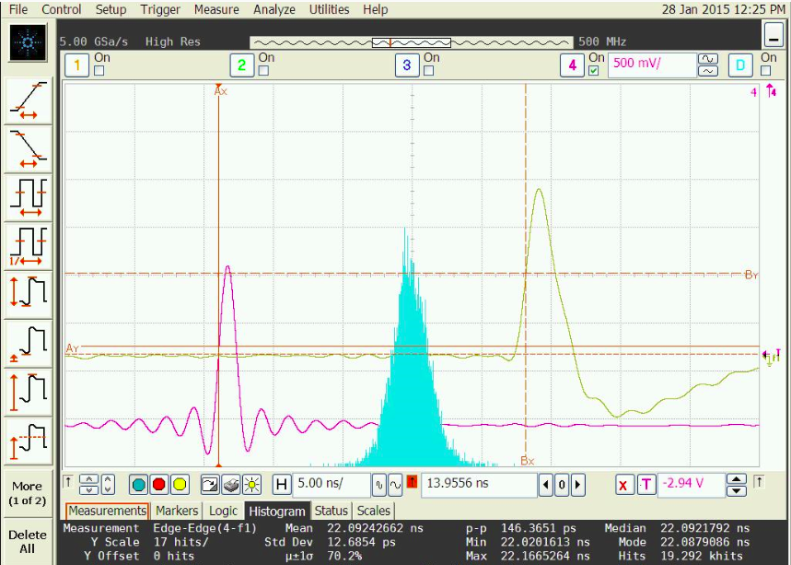
Screen capture of time resolution measurement
Cathode-Mesh signal
Reference point @50% of leading edge, t₂
Trigger signal
Reference point @50% of leading edge, t₁
Risetime ~ 1.3 ns
Distribution histogram of t₂-t₁
Std Dev ~ 12.6 ps

Slide 11
Comparison with Thomas’ results
Thomas scanned two types of 8x8 mm² APDs: normal APD w/o mesh and mesh APD.
Normal APD.
  The spatial response of this APD is quite uniform as shown in next two slides, but the time walk is seriously forbidden it from our application.
  The signal is readout from anode, there is an indium ring surrounding the entire anode and connected to anode readout pin.
  (2) Mesh APD.
  The spatial response of it shows the amplitude is decreasing with x and y, which is similar to what observed in this report.
  The time walk is much improved compare to normal APD.
  For your convenience I reproduced five slides from his 2012 reports below.

Slide 12
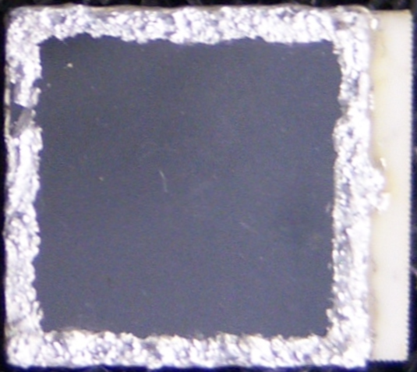
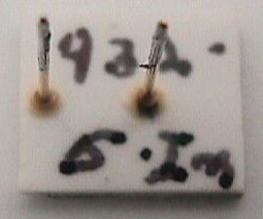
Oct. 22, 2012
RMD APD 8x8 mm² - indium
Spatial response map
APD bias at -1.75 kV, 980 nm Vcsel, spot size <100 µm
~3 ns pulse, 1 kHz, 2.6x10⁴ photons/pulse
(noise limited to photon statistics of ~160 photons/pulse)
← + y-position
← + x-position
Indium
- H.V.
marking
on the back
APD signal amplitude has good spatial uniformity
σ=2.2% in 7.5x7.5 mm² center region

Slide 13
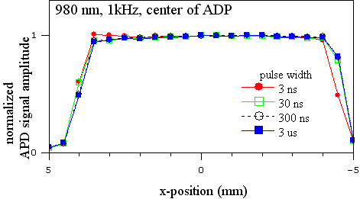
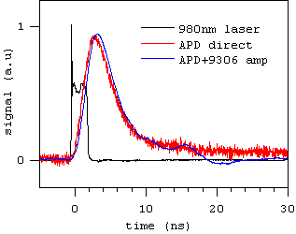
Oct. 22, 2012
RMD APD 8x8 mm² - indium
Pulse width dependence
← + y-position
APD signal pulse shape - 3 ns
← + x-position
Indium
- H.V.
APD signal pulse width is ~ 5ns, broader than previous APDs (1-3 ns)

Slide 14
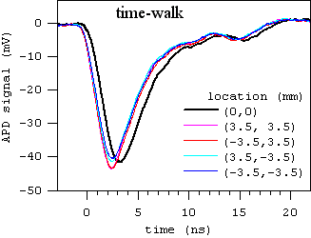
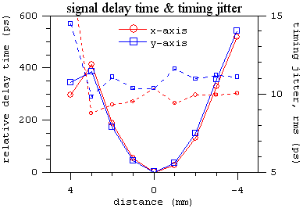
Oct. 22, 2012 RMD APD 8x8 mm² – indium Signal delay time on APD
(3.5,-3.5)
(-3.5,-3.5)
← + y-position
(0,0)
(3.5,3.5)
(-3.5,3.5)
← + x-position
Indium
- H.V.
APD time-walk translates to timing jitter in particle detection

Slide 15
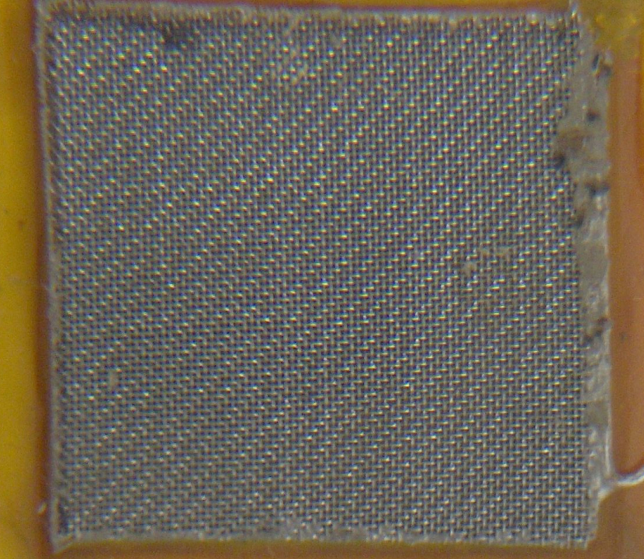
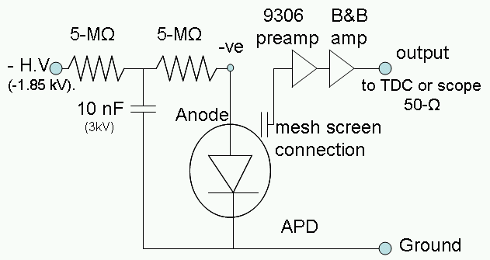
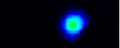
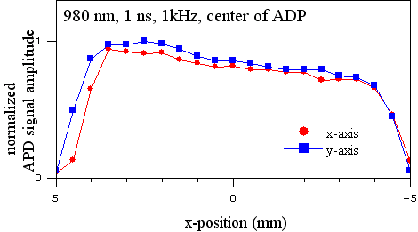
Nov.29, 2012 1-MIP time-walk & time jitter
← + y-position
(0,0)
← + x-position
1-MIP spatial response map
spot size
320 µm
FWHM
x & y line-out map

Slide 16
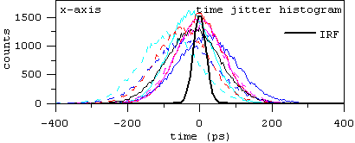
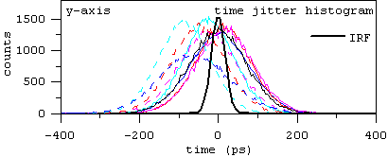
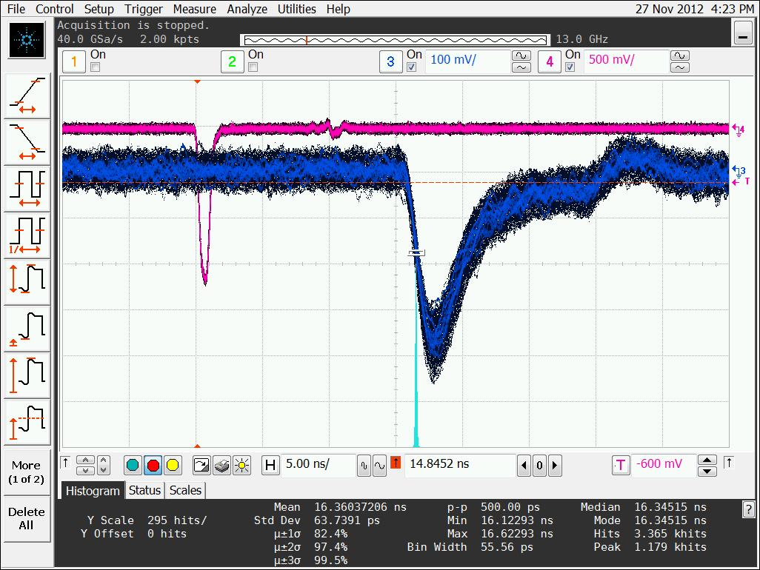
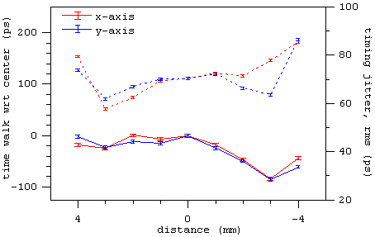
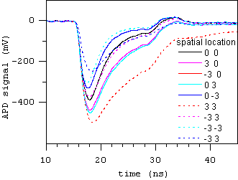
Nov.29, 2012 1-MIP time-walk & time jitter
Quantitative analysis
using HydraHarp400
← + y-position
(0,0)
← + x-position
at center (0, 0)
1-MIP <σ>~70 ps
trigger
APD
signal

Slide 17
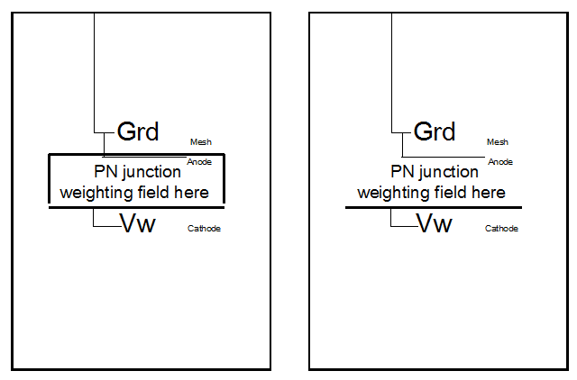
Do all three electrodes need to be hooked up?
According to induced signal mechanism when we calculate the weighting field we have to set the pick up electrode to certain potential V_{w ,} set the rest electrodes to ground, then calculate the weighting field with this configuration. If we leave some of the electrodes unconnected, the reference potential of this part of device is unknown in the calculation. However the device is enclosed in a metal box, which is grounded, therefore the weighting field would be quite different. We can anticipate that the field would decrease, so does the induced signal.
The following slide shows that w/ and w/o mesh electrode readout the cathode signals are fact of two different! It supports the above hypothesis. For the anode electrode w/ and w/o it makes little affect on the weighting field since mesh electrode covers larger area, so no significant influence on mesh and cathode signals.

Slide 18
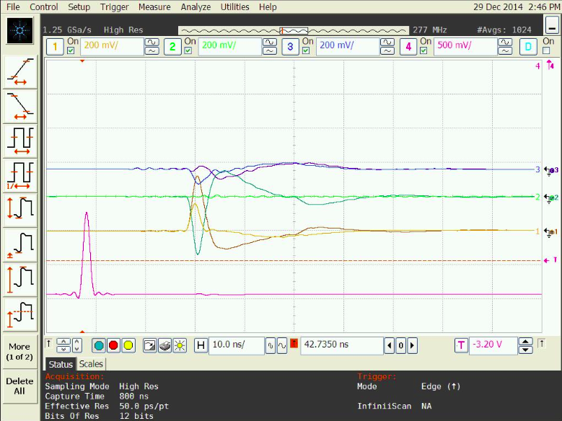
w/ and w/o mesh readout: cathode signal size are fact of 2 different
w/o mesh readout
Anode
Mesh
w/ mesh readout
Cathode

Slide 19
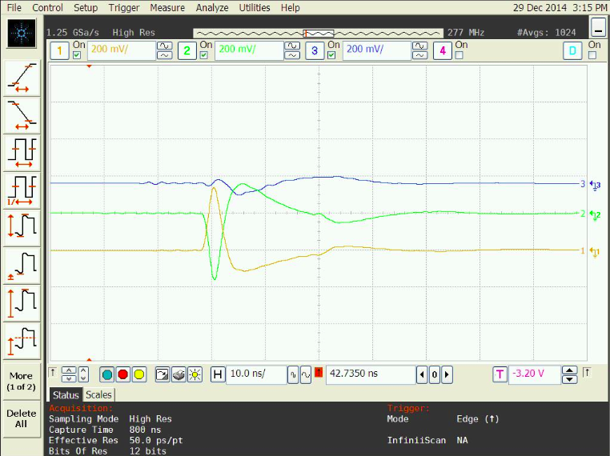
w/ mesh readout
Anode
Mesh
Cathode
For clarity here we only show the signal for with mesh readout scenario. The cathode signal is large.

Slide 20
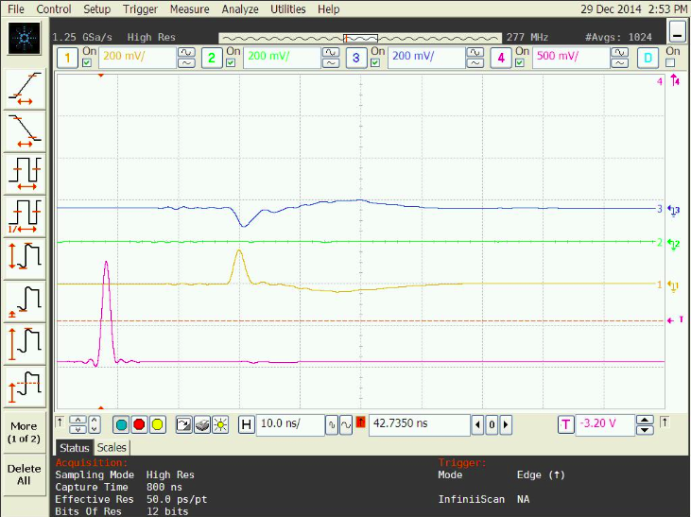
w/o mesh readout
Anode
Mesh
Cathode
Here we only show the signal for without mesh readout scenario. The cathode signal is much smaller.

Slide 21
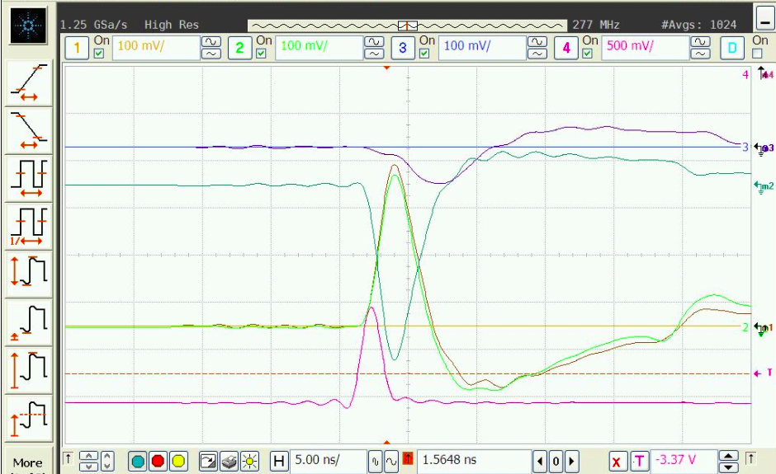
w/ and w/o anode readout
Anode
w/ anode readout
Mesh
Cathode
w/o anode readout
Pay only attention to the cathode signals (arrow marked ones), ignore all other waveforms on the screen.
W/ and w/o anode readout make small difference for two scenarios.

Slide 22
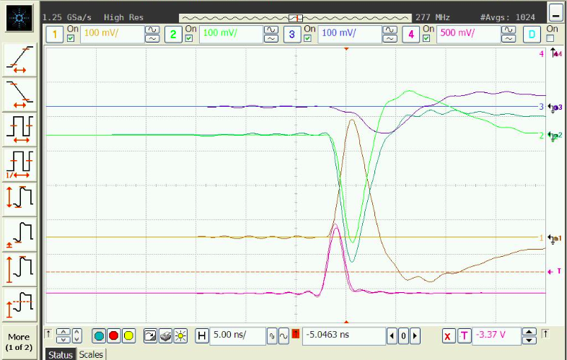
w/ and w/o anode readout
w/o anode readout
w/ anode readout
Pay only attention to the mesh signals (arrow marked ones), ignore all other waveforms on the screen.
W/ and w/o anode readout make small difference for two scenarios.

Slide 23
w/ and w/o anode readout
From above test results we can say that w/ or w/o anode readout makes little difference on the mesh and cathode signal. With the induced signal mechanism in mind this result is easy to understand. Since the anode electrode is direct under the mesh electrode and covers less area as mesh, with or without this electrode has little influence when we calculate the weighting field, therefore the induced signals on mesh and cathode keep almost the same.

