Slide 1

APD Beam Test @ CERN
Third Data Set Analysis Results
Changguo Lu
Princeton University
Feb 28, 2013

Slide 2
CERN Beam Test Data Set #3
The third CERN beam test dataset has 484 events, the configuration of the test setup is same as before:
Channel #1: scintillation counter,
Channel #2 and #3: 2 RMD 8x8 mm² mesh APDs,
Channel #4: 2x2 mm² APD.
Channel #2 used as trigger counter.
Among 484 events
268 events V(ch#2) > 14mV;
245 events V(ch#3) > 10mV;
29 events are having V(ch#2) > 14 mV AND V(ch#3) > 10mV. We call these 29 events as good events and analyzed dt distribution.

Slide 3
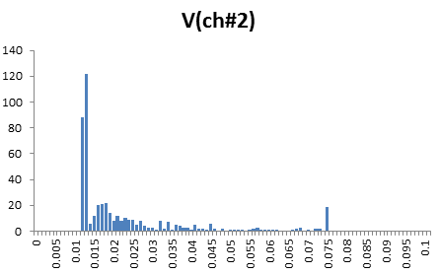
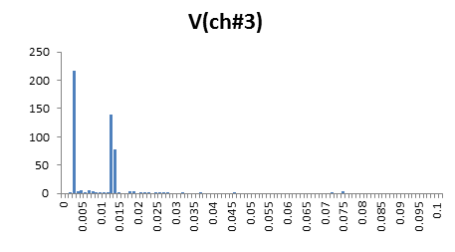
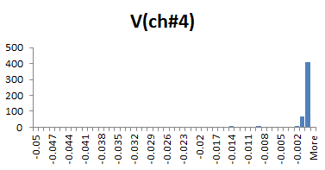
Amplitude Histograms
W/o any selection the histograms of channel #2, 3, 4 signal amplitude are showing below. Channel #1 has no any signal identified.
V > 14mV
V > 10mV
Channel #4 also shows no real signal, only noise.

Slide 4
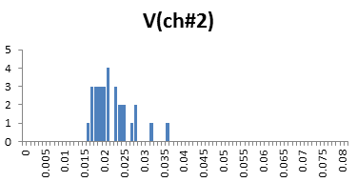
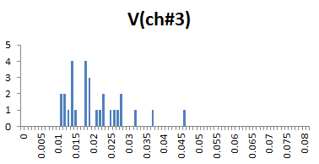
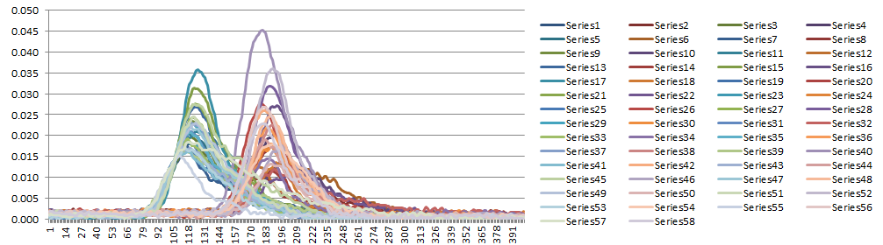
29 good events
Can we say MIP signal around here?
Channel #2 is used as trigger
Waveforms of 29 good events (ch#2 and ch#3)
50ps per data point

Slide 5
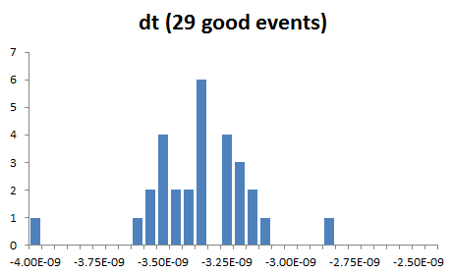
Dt distribution for 29 good events

