Slide 1

APD Beam Test @ CERN
Second Data Set Analysis Results
Changguo Lu
Princeton University
Feb 26, 2013

Slide 2
CERN Beam Test Data Set
Sebastian provided a set of 520 data events, which were preselected from the raw data files.
Channel #1: scintillation counter,
Channel #2 and #3: 2 RMD 8x8 mm² mesh APDs,
Channel #4: 2x2 mm² APD.
This data set is for VCSEL test of two APDs, so only channel #2 and #3 are having signal, ch#1 and #4 only recorded baseline noise.
All 520 events have big enough signal for channel #2 and #3;
their peak-amplitude histogram and time-difference histogram are reported in following slides.

Slide 3
Channel #2 & #3 Amplitude Histograms

Slide 4
δt distribution

Slide 5
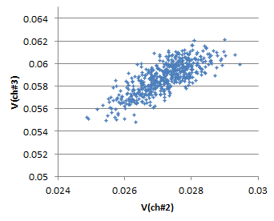
Waveforms
The signals are quite uniform as expected.
Scatter plot of V(ch#2) vs. V(ch#3) shows their linear correlation.

Slide 6
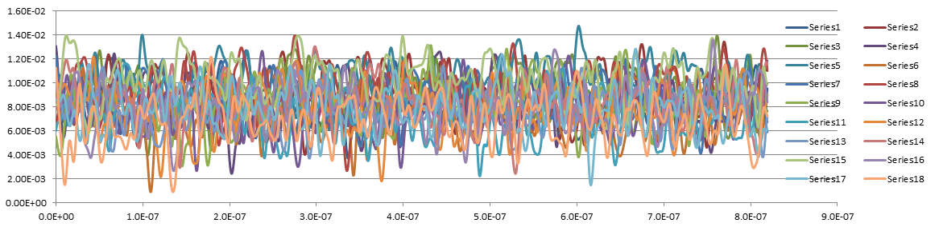
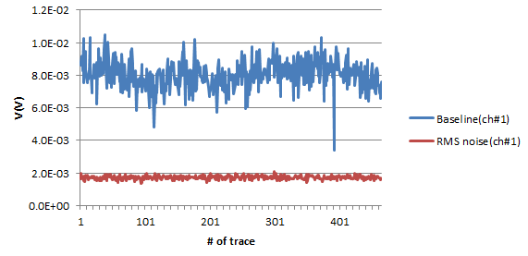
Samples of Channel #1 traces
No signal can be identified, noise only.
~450 traces are analyzed for the baseline shift and rms noise figure as shown on left.

Slide 7
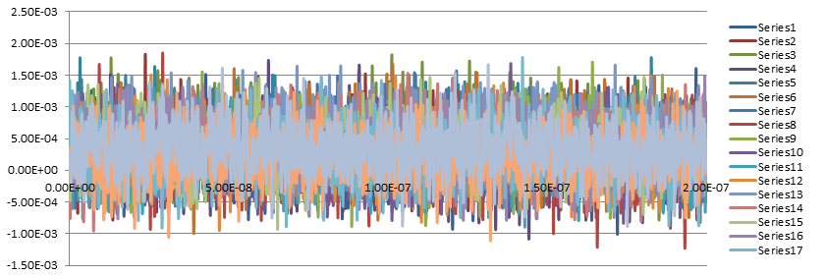
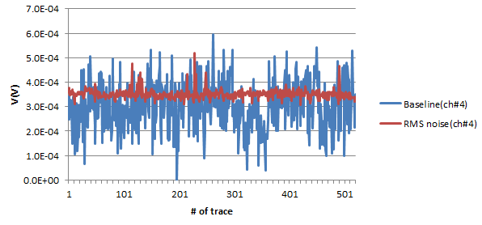
Samples of Channel #4 traces
No signal can be identified, noise only.
~500 traces are analyzed for the baseline shift and rms noise figure as shown on left.

