Slide 1

APD Beam Test
-- Preliminary Data Analysis Results
Changguo Lu
Princeton University
Feb 21, 2013

Slide 2
Beam test data set
Sebastian provided a set of 1000 raw data events, which were obtained in CERN H8 (Running parasitically behind NA 61 calorimeter).
channel #1: scintillation counter,
channel #2 and #3: 2 RMD 8x8 mm² mesh APDs,
channel #4: 2x2 mm² APD.
Among 1000events I found
  391 events: channel #1 |signal| > 10mV;
  1000 events: channel #2 signal > 5mV;
  197 events: channel #3 signal > 5mV, --- Analyze these events to get channel #2 and #3 amplitude histograms and time resolution histogram;
  38 events: channel #4 |signal| > 5mV;
7 events: all four channels have signal, which satisfy the above criteria, but only 5 of them are good events (see slide #4).

Slide 3
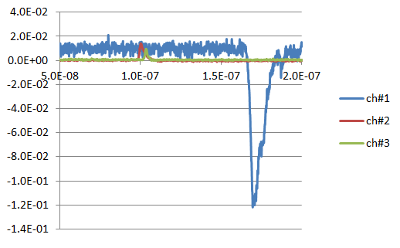
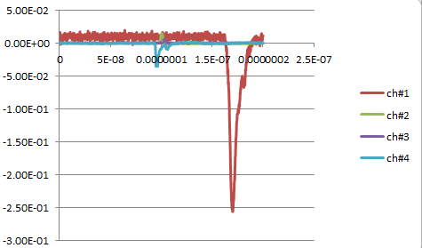
Samples of triple & quadruple coincidence events
|CH#1| > 10mV
CH#2 > 5mV
CH#3 > 5mV
|CH#1| > 10mV
CH#2 > 5mV
CH#3 > 5mV
|CH#4| > 5mV

Slide 4
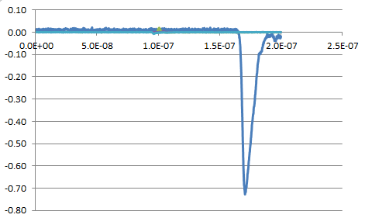
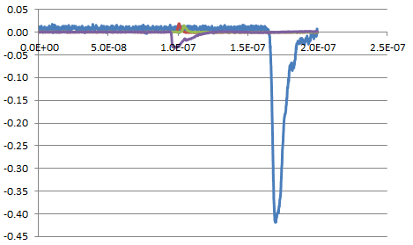
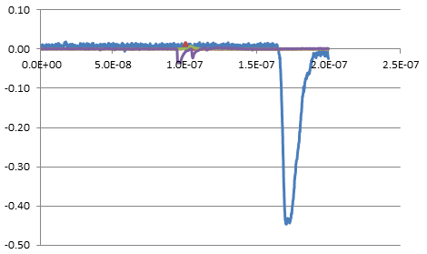

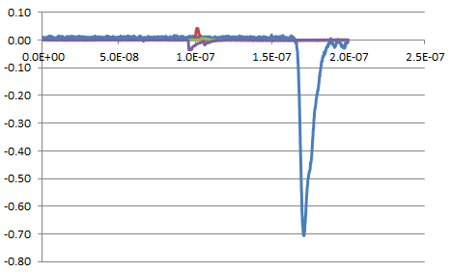
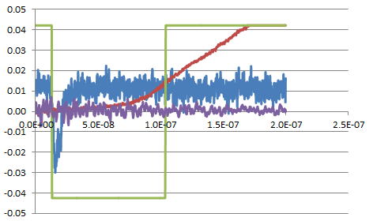
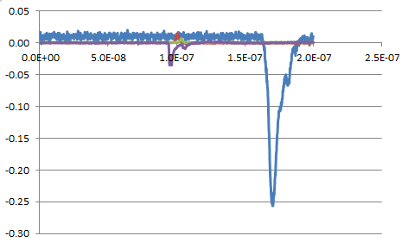
Five good quadruple coincidence events
#65
#166
#269
#297
#733
#882
Bad event

Slide 5
5 quadruple coincidence events (normalized)

Slide 6
Excel file for these 5 events
(You can right click on the plot, on drop down menu choose Edit Data to get the excel file for this plot)
Two waveforms in same event have same color

Slide 7
Time and amplitude distributions of these 5 events

Slide 8
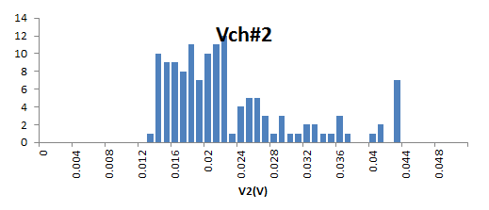
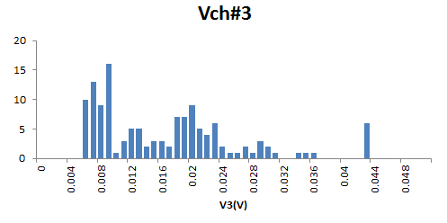
Pulse height histograms of double coincidence events
133 events included in the histograms

Slide 9
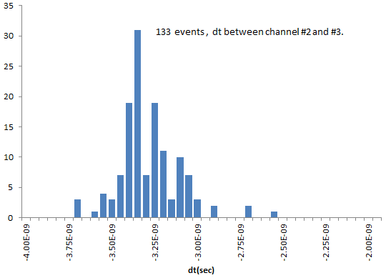
Time resolution histogram
31 events in this bin (see next slide for some of them)
Too little statistics to draw any conclusion at this moment. The signal is small and noisy, time interval is big (50 ps).

Slide 10
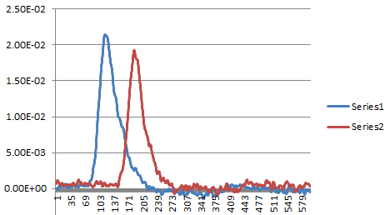
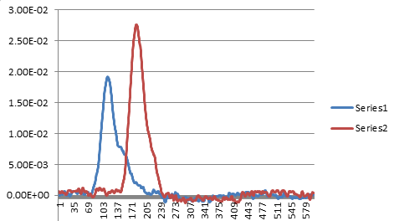
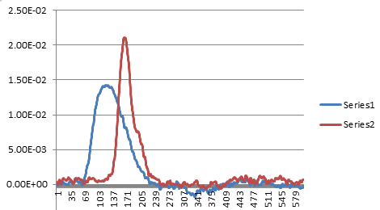
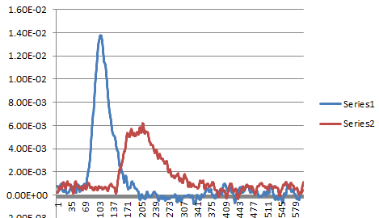
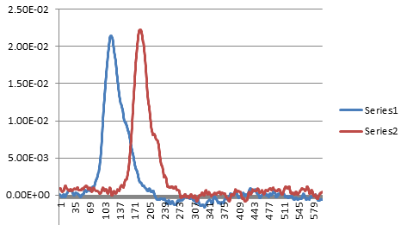
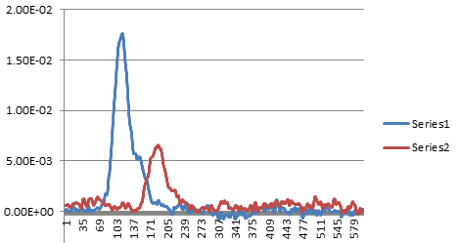
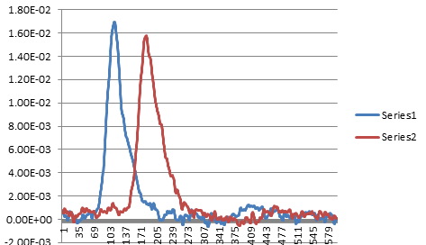
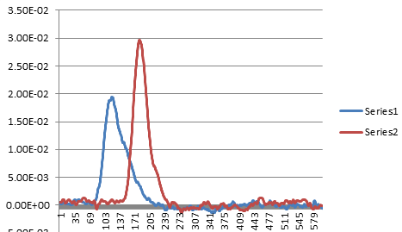
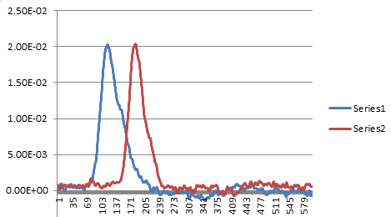
Waveforms for the events at dt bin -3.35E-9
Total 31 events in this bin, here are 9 sequential events w/o any other selection.

Slide 11
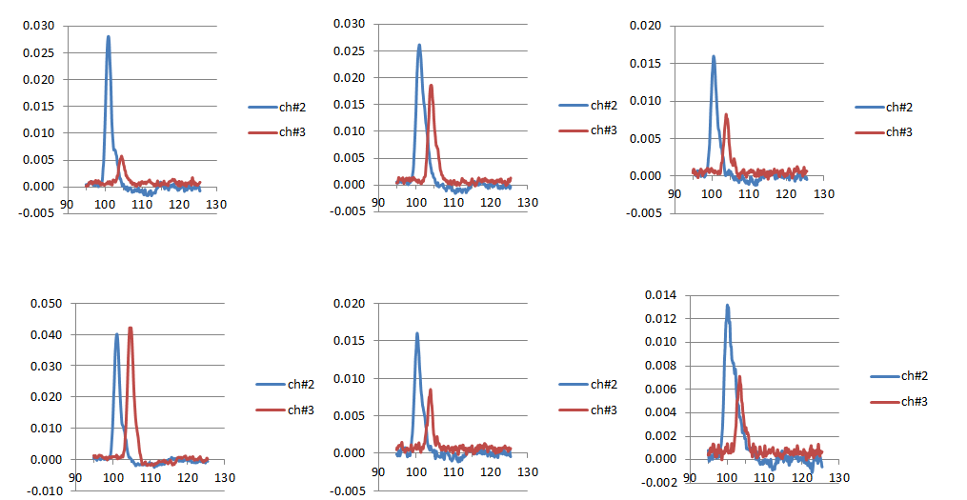
Some samples of analyzed good events
(included in above histograms)

Slide 12
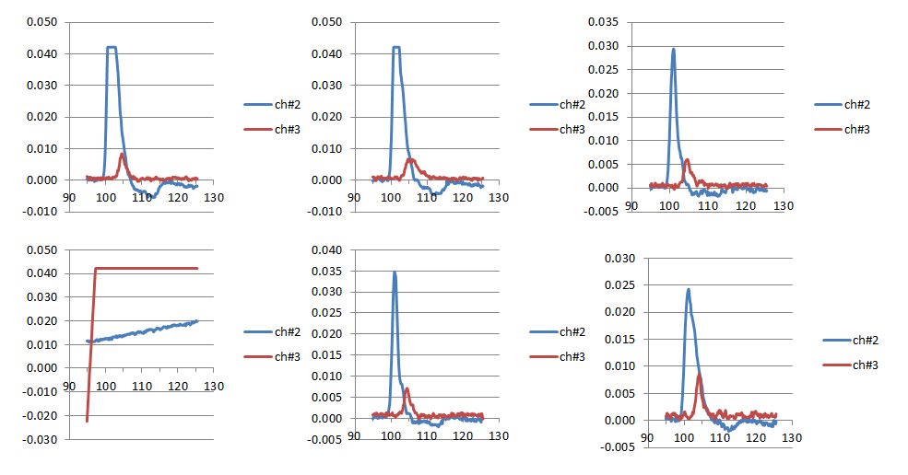
Some samples of analyzed bad events
(not included in above histograms)

Slide 13
All good double coincidence events
Each bin on X-axis represents 50 ps time interval, total 599 bins are shown on the plot. From the plot my impression is the time resolution is quite poor, it is unlikely through any software tricks we can get it down to ~10 ps resolution.

Slide 14
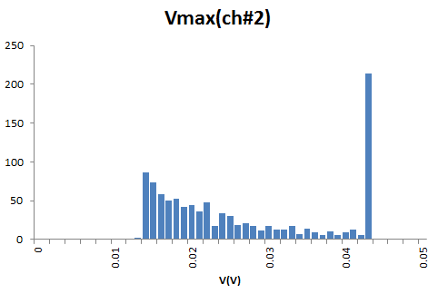
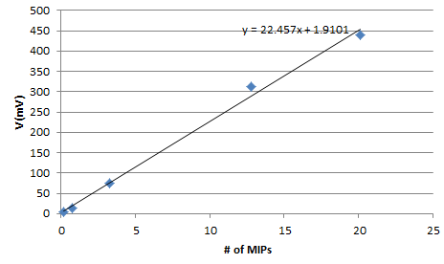
V spectrum of ch#2 1000 events
Since the trigger was set by ch#2, all 1000 events show V > 5 mV. The V spectrum of this channel should show the characteristic of the MIP particle.
Threshold here
Scope saturation here.
According to our calibration with laser beam 4 mm² APD/ZX60 amplifier, the # of MIP vs. V(mV) (@-1750 V) is
V(mV) = 22.5*(# of MIP) + 1.91
The error around 1 MIP region could be very big.
The beam test used a different amplifier.

Slide 15
A few comments on the future beam test
Use lower scope bandwidth to filter out the high frequency noise, from 500 MHz to 1 GHz is adequate;
Set the time interval to 12.5 ps or less, 50 ps is too coarse;
Use the amplifiers we well understood and calibrated;
The time resolution from the preliminary analysis is very poor, it might be due to the bad beam quality;
…

