Slide 1

VCSEL-980nm test for beam test box
C. Lu
Princeton U
Jan 2, 2013

Slide 2
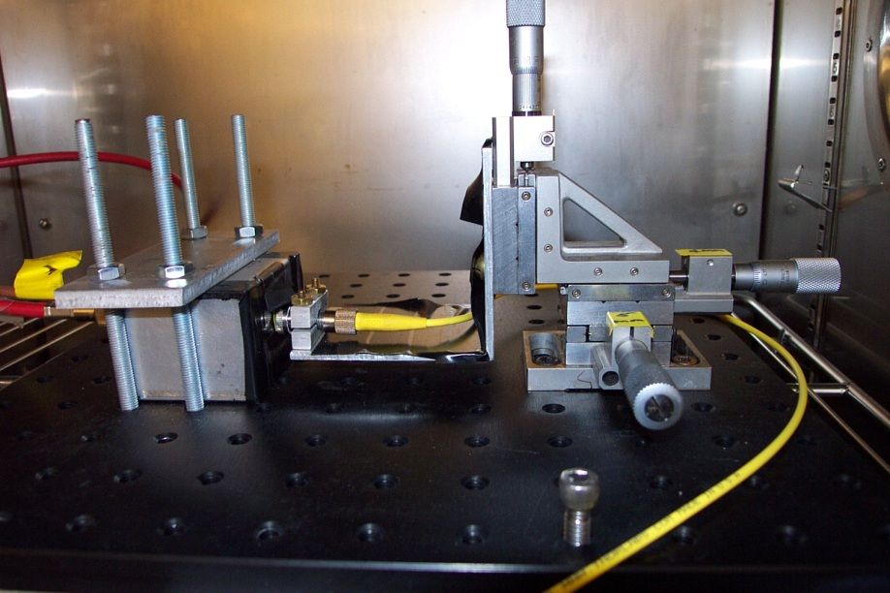
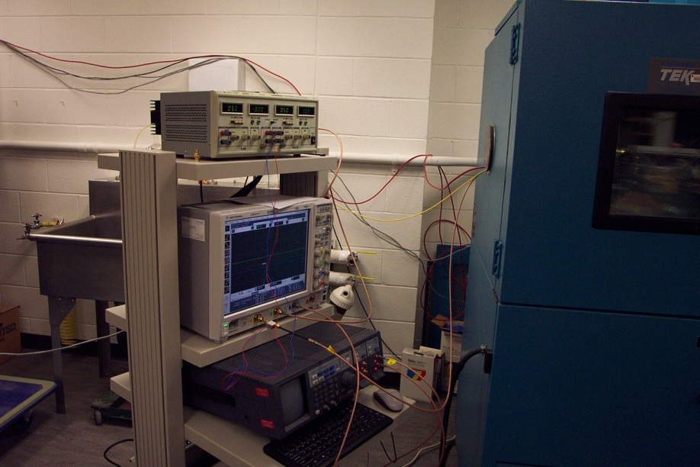
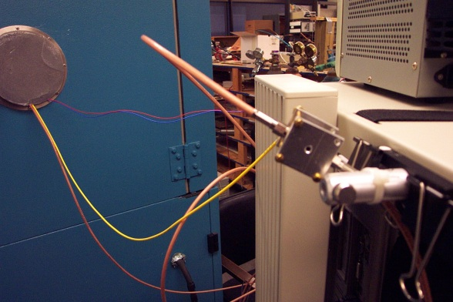
Test setup
An environmental chamber is employed to create a temperature controlled test environment. The temperature can be set from -30C to 30C.
APD and VCSEL(980nm) laser diode are placed inside of the E.C.
Internal view of the E.C.
E.C. chamber
Beam test box (64mm^2 APD)
Optical fiber
VCSEL laser diode box
Collimation lens (Thorlabs CFC-11X-B)

Slide 3
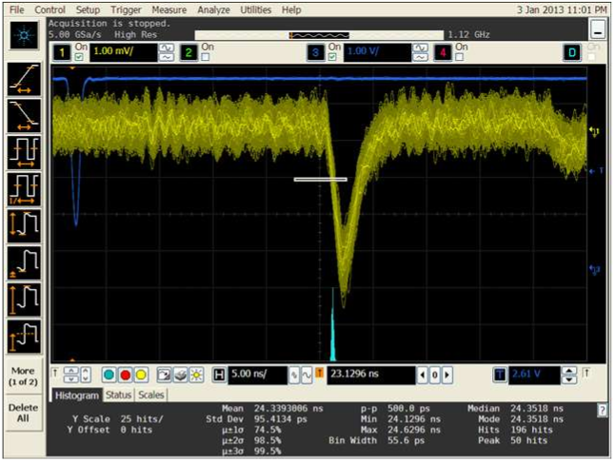
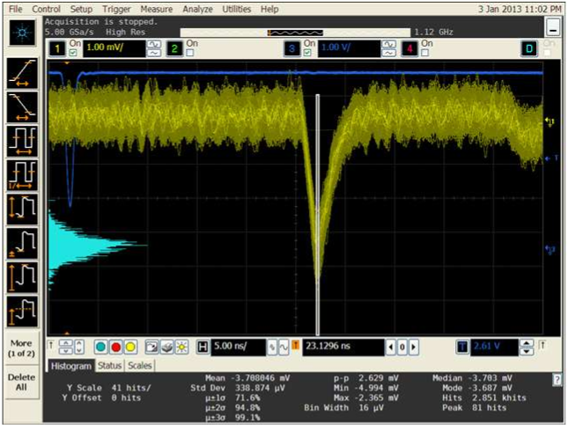
Various screen captures (t resolution & amplitude)
0°C, -1750V
1mV/div
5ns/div

Slide 4
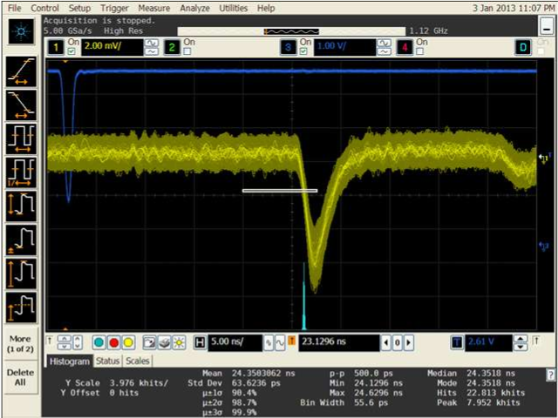
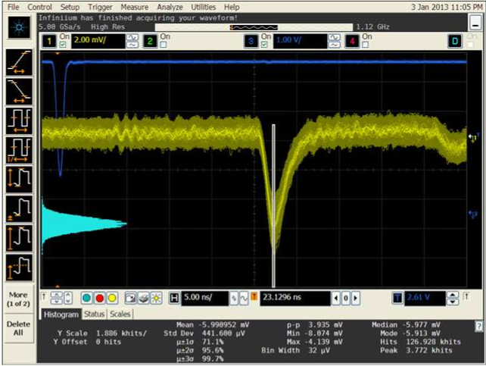
0C, -1775V
2mV/div
5ns/div

Slide 5
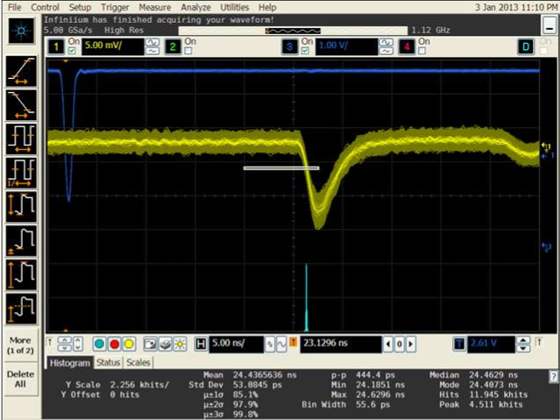
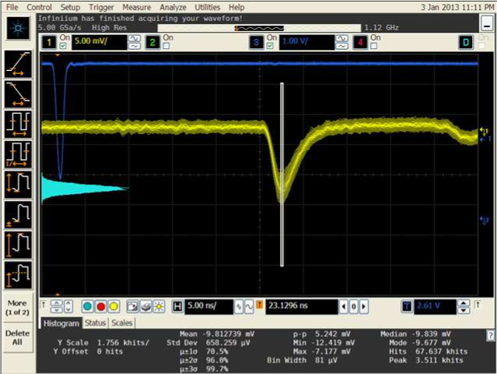
0C, -1800V
5mV/div
5ns/div

Slide 6
-20°C, -1750V
5mV/div
5ns/div

Slide 7
-20°C, -1775V
5mV/div
5ns/div

Slide 8
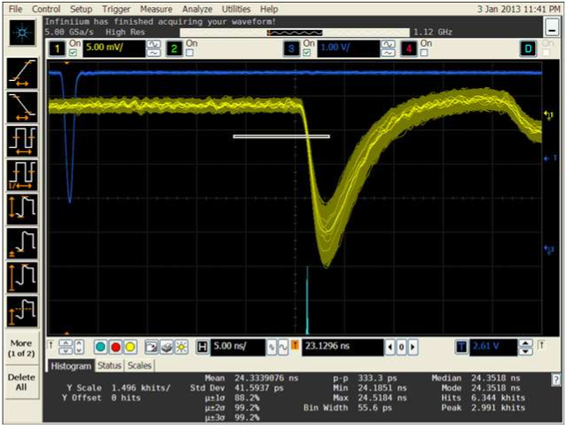
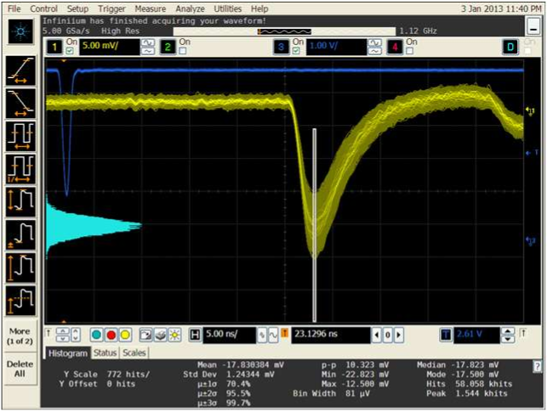
-20°C, -1800V
5mV/div
5ns/div

Slide 9
Summary of the test results
HV(V) | Averaged signal amplitude(mV) |  | Ratio (-20°C/0°C) | Time resolution (ps) |  | Ratio (-20°C/0°C)
 | 0°C | -20°C |  | 0°C | -20°C
-1750 | -3.7 | -7.3 | 1.97 | 95.4 | 56.3 | 0.59
-1775 | -6.0 | -12.8 | 2.1 | 63.6 | 45.0 | 0.7
-1800 | -9.8 | -17.8 | 1.8 | 53.0 | 41.6 | 0.78

Slide 10
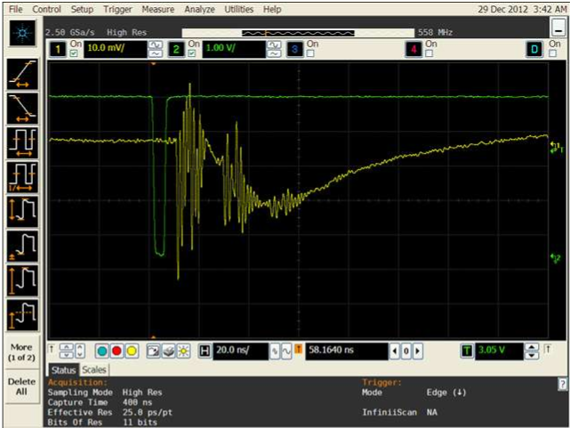
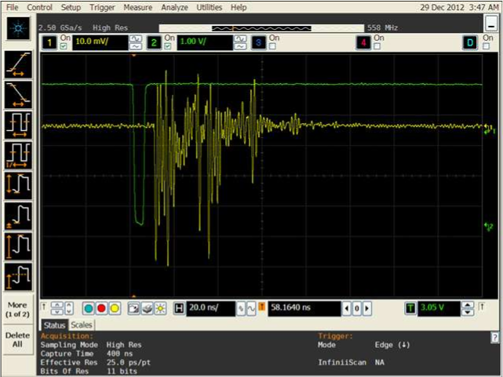
4mm^2 and 64mm^2 APD response to LED light pulse
4mm^2 APD w/o mesh/Kapton covered, the pick-up signal due to the LED driving pulse is overlapped on the APD signal.
64mm^2 APD w/ mesh/Kapton covered, with and w/o HV on APD makes no difference to the output signal, so all the structure we see here is due to the pick-up of the APD mesh from the LED driving pulse.

