Slide 1

Analysis of Sebastian’s generated MIP events
C. Lu
Princeton University
(4/20/2016)

Slide 2
.
1000 waveforms and pulse height distribution
Sebastian generated 1000 waveforms with 20 picosecond sampling, and each waveform having 150 samples.
Waveforms
Pulse height distribution
(narrow Landau)

Slide 3
.
Time resolution
Use constant-fraction method to analyze the data file: (Constant fraction 20%, delay time 1 ns)

Slide 4
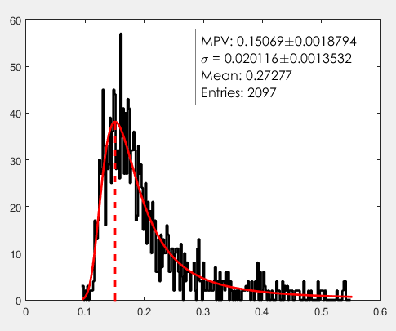
.
1000 waveforms and pulse height distribution
Sebastian generated another 1000 waveforms with much broader Landau distribution:
Pulse height distribution
(broad Landau)
Waveforms
Notice the variation of leading edge’s slope.

Slide 5
.
Time resolution
Use constant-fraction method to analyze the data file: (Constant fraction 0.1, 0.2 and 0.3, delay time 1 ns)
The constant-fraction method is based on the assumption that the leading edge of the pulse has similar slope, but we noticed that the leading edge of this data set (broad Landau) varies (see previous slide).
Hence, the time resolution is worse for the broad Landau simulation.
Can we find a new algorithm to analyze this data?

