Slide 1

ATF Beam test report (2)
C. Lu, K. McDonald
Princeton University
T. Tsang
Brookhaven National Lab
4/3/2013

Slide 2
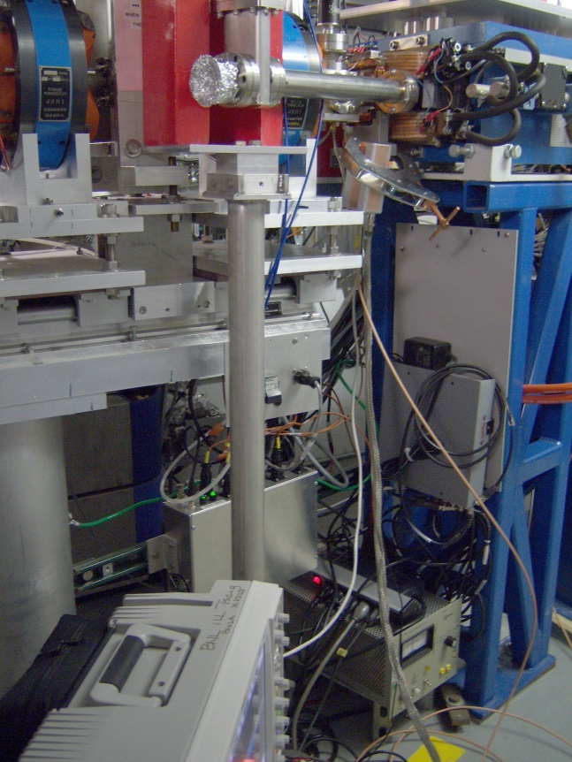
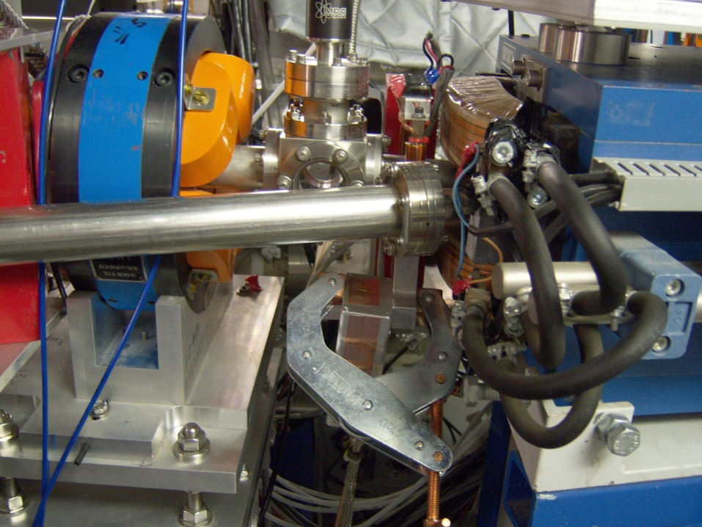
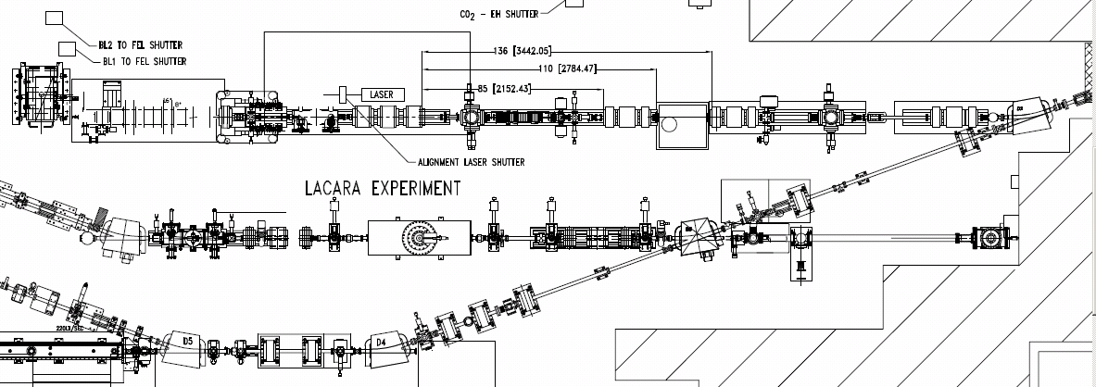
Second ATF beam test is at beam line #2 on 3/29/2013.
Location #2
A
A
Location of test in 2010

Slide 3
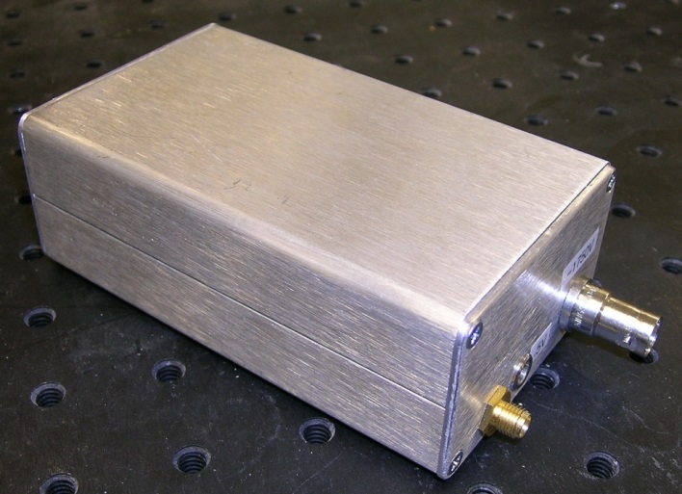
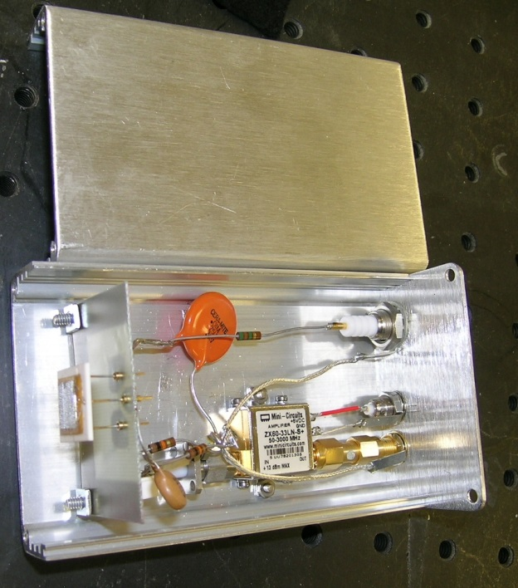
APD test box
The APD test box includes a 64 mm² mesh APD, a ZX-60 amplifier. 5V power is provided by Agilent scope’s USB port via a 6-ft-long LEMO cable.
HV connector
5V DC power from scope USB port
64 mm² mesh APD
ZX60 amplifier
Amplifier output SMA connector

Slide 4
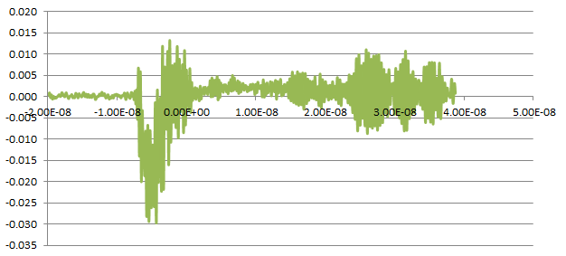
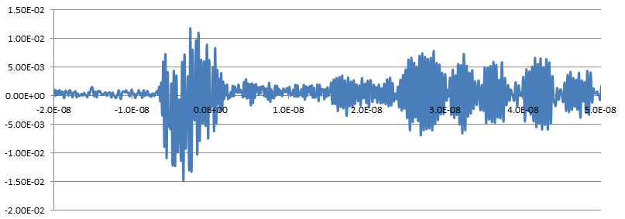
RF pickup noise in various test situations
(1) Test box w/o aluminum foil wrap
Clamp the test box at the location A (slide #2, red circle), connect a 5-ft-long double shielded cable between the test box and Agilent scope channel #3. Scope ch#1 and #2 are connected to strip line horizontal & vertical ports.
Beam related RF pickup noise,
Vrms = 5.5mV, still having serious RF pickup for the new test box!
Overlap of beam related RF pickup noise and a particle signal.

Slide 5
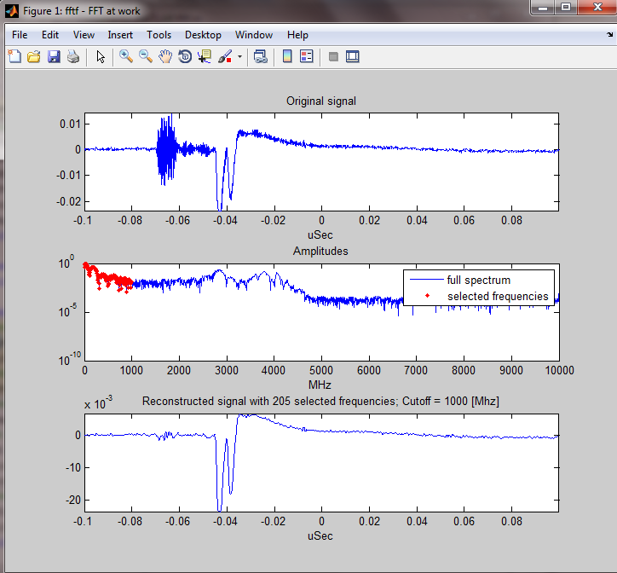
Test box only – FFT filtering
Use Matlab Fast Fourier Transform Filtering (FFTF) technique to filter out higher frequency components (> cutoff frequency) and reconstruct the remaining signal.
Original signal out of APD box in time domain;
Frequency domain spectrum of the signal;
Only select the frequencies < 1 GHz (in red color part), remove the higher frequency components, reconstruct the signal. We can clearly see the RF noise has been greatly reduced, and the fidelity of the signal due to particle is well preserved.

Slide 6
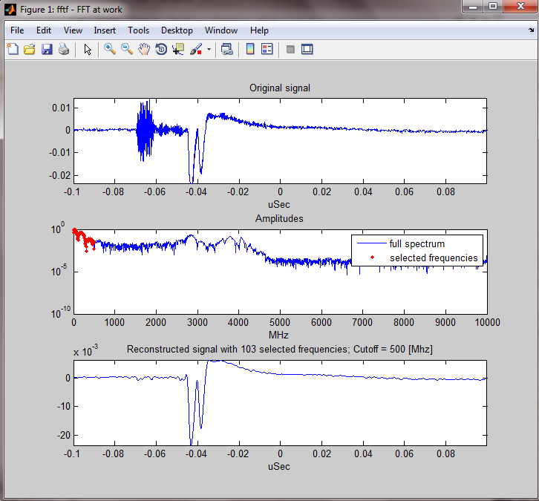
FFT filtering (cont’d)
Reduce the cutoff frequency further down to 500 MHz, the reconstructed signal looks even better. Serious RF pickup noise almost completely disappeared!
By eliminating the waveform’s bandwidth we can achieve noise reduction and preserve the signal’s shape with high fidelity.
⇒ Can we change scope’s bandwidth to reach same result?

Slide 7
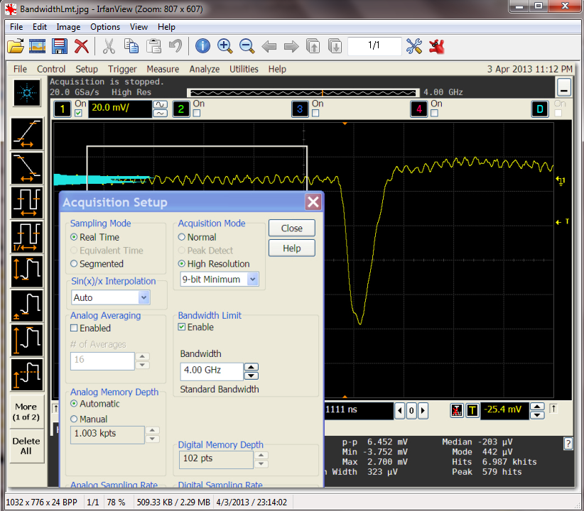
Agilent scope bandwidth study
We set the scope at various bandwidths to check this idea.
Sr-90 as the signal source, LeCroy pulser set at frequency 250 MHz, leading and trailing edge 0.25 ns, pulse width 2.5ns, connect a coil to the signal cable and place it in front of APD test box window to mimic the RF noise, thus we can get the RF noise and signal overlapped together as shown on left.

Slide 8
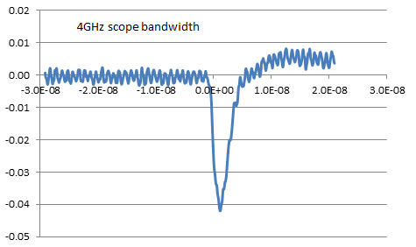
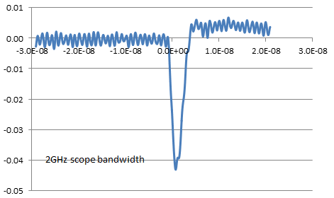
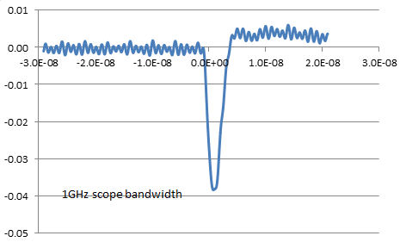
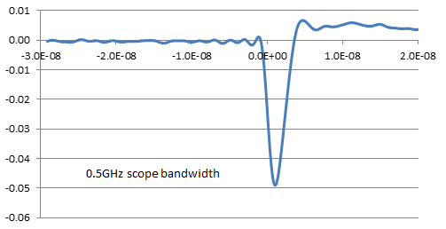
Noise reduction thru scope’s bandwidth limit
Since the leading and trailing edges of the LeCroy pulser were set at 0.25 ns, the relationship between risetime and bandwidth is: 0.35/0.25 ns ~ 1.4 GHz. So cutoff frequency above 1.4 GHz has no effect on the RF noise reduction.
Cutoff frequency below 1.4 GHz clearly reduces the RF noise.

Slide 9
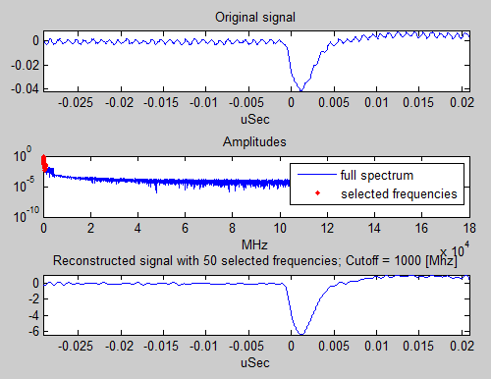
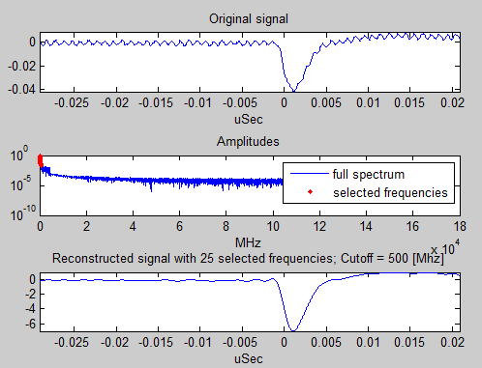
FFT filtering to limit the bandwidth
We also can use FFT filtering software to limit the bandwidth and achieve same RF noise reduction result. 0.5 GHz and 1 GHz cutoff greatly reduced the RF noise.
Original signal
Original signal
Noise filtered signal
Noise filtered signal

Slide 10
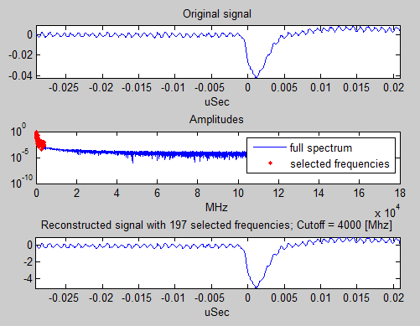
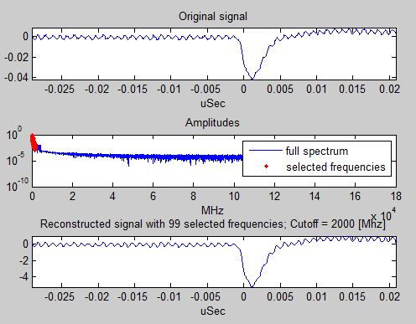
FFT filtering to limit the bandwidth (cont’d)
Setting the cutoff frequency at 2 GHz or 4 GHz has no effect on the reconstructed signal:
The RF noise for the reconstructed signal remains same.

Slide 11
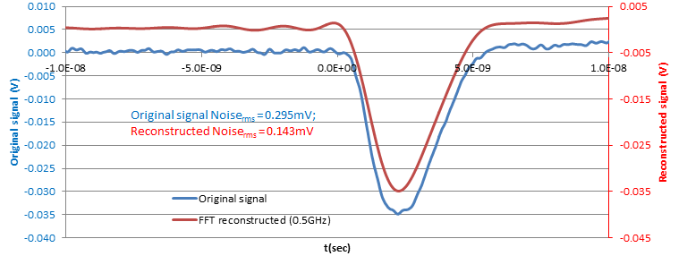
(2) Test box with aluminum foil wrapping
Double shield principle applies to the APD test box as well: wrap the test box with two layers of aluminum foil, almost all the RF noise is eliminated:
Leading edge falling time ~1.25ns
Go thru the FFT filtering @ 0.5 GHz cutoff frequency the noise can be further reduced as shown by the red waveform.

Slide 12
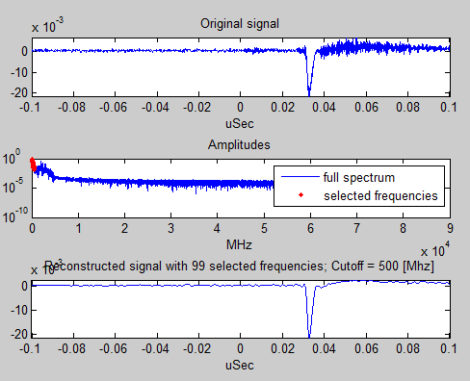
(3) Remove the aluminum foils from optical windows in the beam line, APD test box is still wrapped by aluminum foil
RF noise keeps same:
Vnoise rms ≅ 0.28 mV
Passing the data thru FFT filtering @ 0.5 GHz cutoff frequency, it further reduces the RF pickup:
Vnoise rms ≅ 0.132 mV

Slide 13
Summary of ATF beam test (2)
RF pickup noise can be effectively reduced by the following techniques:
Place the amplifier inside the metal APD test box, both of them are housed in a single metal box;
Use double shielded cable to connect the APD test box output to the scope;
Reduce the DAQ system bandwidth to below 1GHz, which can be implemented either by scope bandwidth reduction or FFT filtering algorithm in the data analysis.
Measured Vnoise rms ~ 0.132 mV @ 500 MHz bandwidth, cosmic ray test shows Vaverage ~ 23 mV,
⇒ S/N ~ 170,
Leading edge slope ~ 1.25 ns
⇒ dt ~ 1.25 ns/170 ~ 7.5 ps
If there were no time walk for
64mm² APD, 10 ps time resolution
would be reachable! W/o tracking
information, we can expect the time resolution would be dominated by time walk.

