Slide 1

ATF Beam test report (1)
C. Lu, K. McDonald
Princeton University
T. Tsang
Brookhaven National Lab
3/15/2013

Slide 2
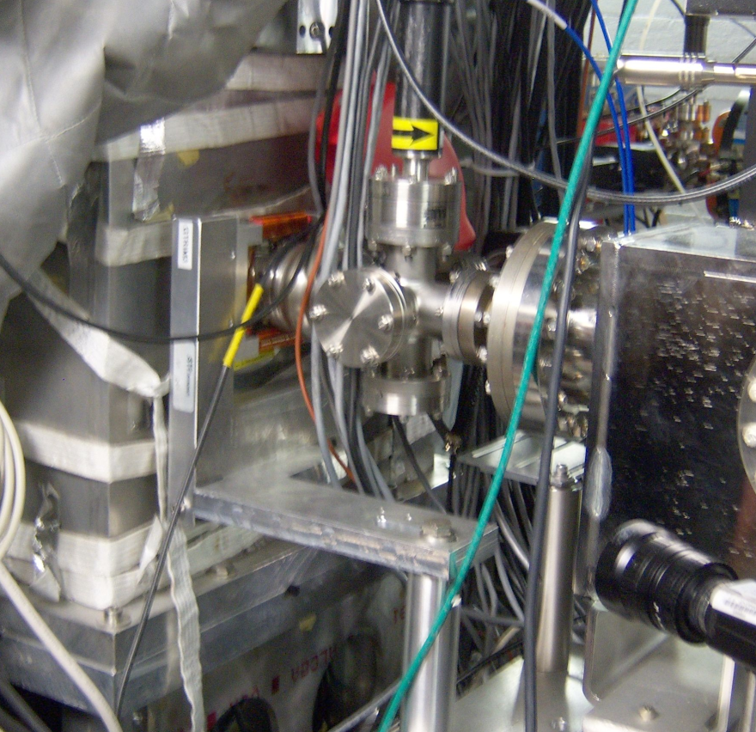
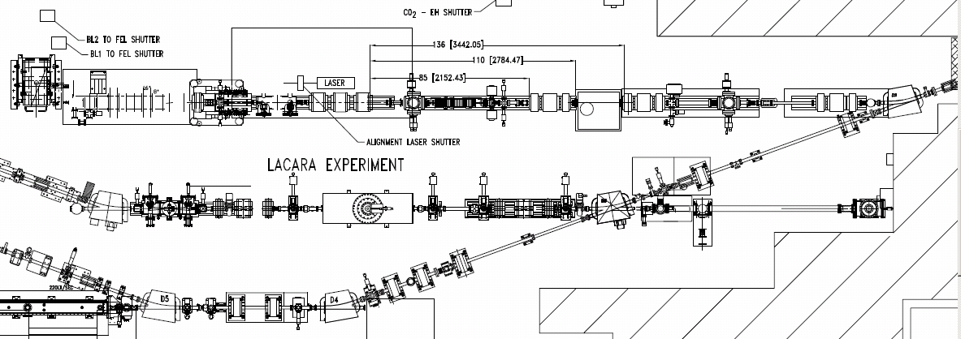
ATF laser beamline used for this test run.
We considered two locations for the APD
in this beamline:
Horizontally to the east of the
6-way cross
(2) Vertically underneath the cross.
The stripline monitor was ~ 2 m upstream.
Location #2
Location #1
Location of test in 2010

Slide 3
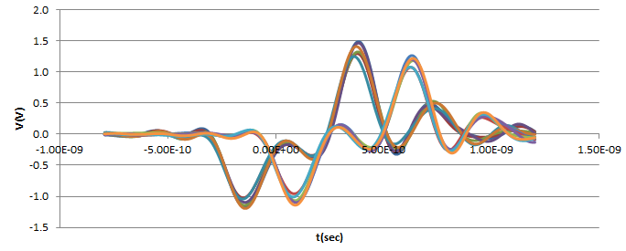
Stripline Signals
Two stripline signals (vertical and horizontal) were connected to Agilent scope channel #1 and #2.
We recorded 500 beam events. The following plot shows 5 overlapped triggered events.
Stripline #1
Stripline #2

Slide 4
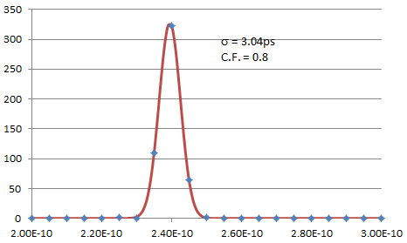
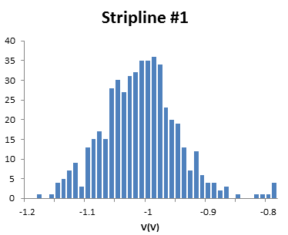
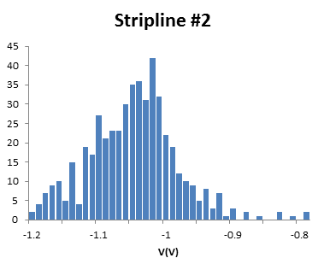
Time Resolution
Analysis ot the two stripline signals, using constant-fraction algorithm to define the times of the two signals.
The time difference between them is plotted in the histogram to the left.
σ = 3.0 ps, which is good enough for next step in the APD time resolution test.

Slide 5
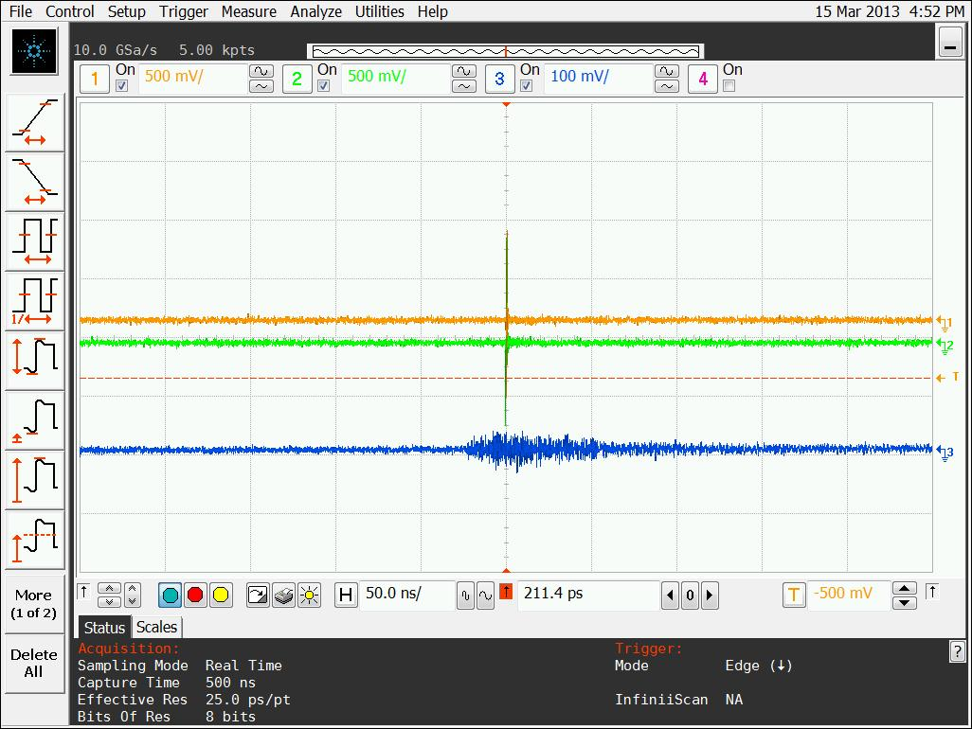
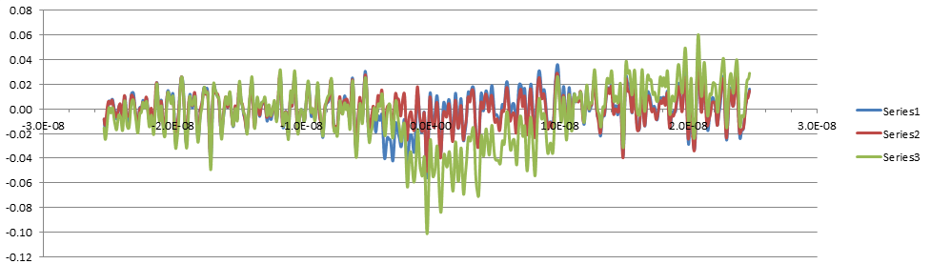
Serious RF Pickup by the APD
RF pickup by the APD (8x8 mm² with mesh) was very serious; initially the peak-to-peak size of the pickup was ~ 100 mV (while 1 MIP was expected to be ~ 10 mV).
We shielded all optical ports that we could find with aluminum foil, wrapped the APD box with foil, and wound the preamp DC voltage leads into a twisted pair, which cut the noise level down to 20 mV.
The shape of the pickup signal is quite reproducible from trigger to trigger.
Left: Top 2 traces = striplines; bottom trace =
= RF pickup (50 ns/div, 100 mV/div).
Above right: 3 pickup-noise waveforms overlapped; their fine details are quite similar, except for the particle signal near middle of traces.

Slide 6
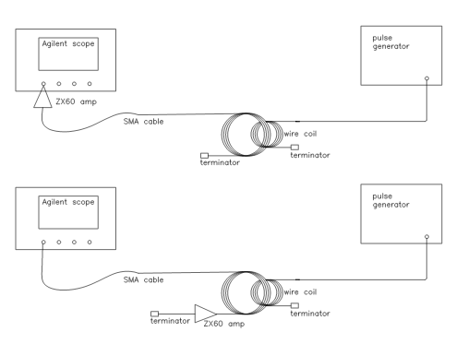
RF Pickup Study and Solution
We use a pulse generator to generate 1MHz square waves, 5V p-p, a BNC cable connected to the pulser, other end connects a coil, which is made of thick wire, 4 turns, ~5cm in diameter. Thru this coil emits noise-like signal to the space.
To test the RF- immunity of a device we can move this coil closer to it, to see how pickup changes.
We have tested two types of SMA cables: double shielded and single shielded; test two amplifier locations: at the detector end of the cable and scope end of the cable.; two amplifier operation modes: battery and external DC power supply.

Slide 7
RF Pickup Study and Solution (cont’d)
Best configuration:
Double shielded cable
Amplifier closer to detector
Worst configuration:
Single shielded cable
Amplifier closer to scope

Slide 8
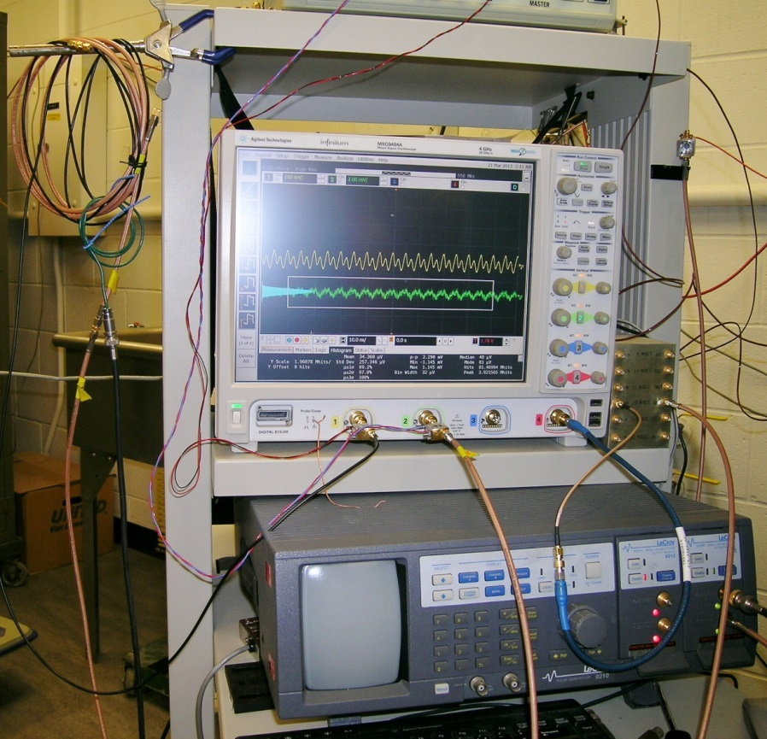
RF Pickup Study and Solution (cont’d)
Switch to LeCroy pulse generator, adjust to 200MHz pulse.
Brown double shielded cable (stiffer)
Black single shielded cable (softer)
Wire coil
BNC cable carry signal from LeCroy pulser
LeCroy pulse generator

Slide 9
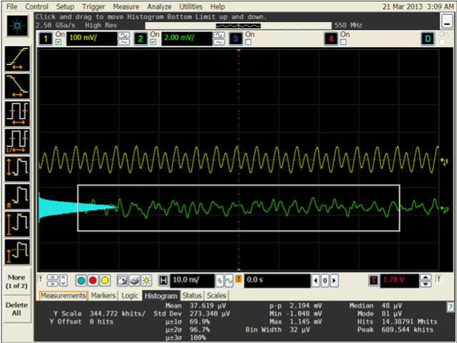
RF Pickup Study and Solution (cont’d)
Double shielded cable picks up noise from the wire coil, Vrms = 0.273mV.

Slide 10
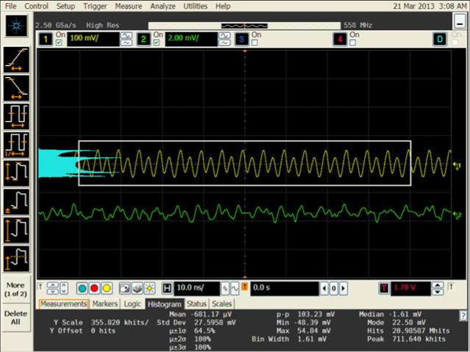
RF Pickup Study and Solution (cont’d)
Single shielded cable picks up huge noise from the wire coil, Vrms = 27.5mV, it is around 100 times larger than double shielded cable.

Slide 11
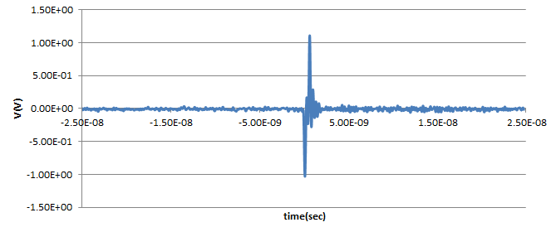
Suggestions to next ATF beam test
Must use double shielded cable for the beam test;
Mount the amplifier direct to the APD box;
Battery operated amplifier shows no advantage comparing with external DC power supply, we can get 5V DC power from Agilent scope USB connector.
It is possible to reduce the RF noise level down to ~200μV. If MIP signal ~20mV, we can get S/N ~ 100, similar to stripline S/N, as shown below:
rms noise of the baseline ~0.01V, stripline signal ~ 1V.

Slide 12
Estimation of ATF beam test APD time resolution
Stripline signal leading edge rise time ~ 0.15ns.
S/N ~ 100 ⇒ expecting 1.5ps time resolution, we measured 3ps time resolution.
~0.15ns
4mm^2 APD/ZX60, VCSEL laser pulse produced signal, signal leading edge rise time ~1ns. S/N ~ 100 ⇒ expecting 10ps time resolution, so 20ps might be reachable.

