Slide 1

ATF Beam test report (1)
C. Lu, K. McDonald
Princeton University
T. Tsang
Brookhaven National Lab
3/15/2013

Slide 2
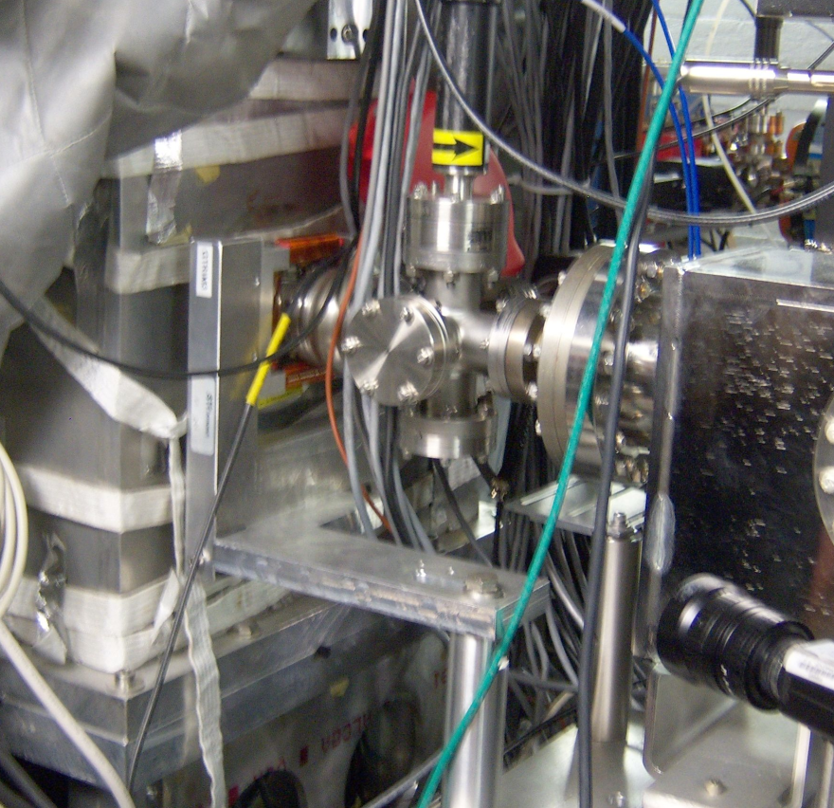
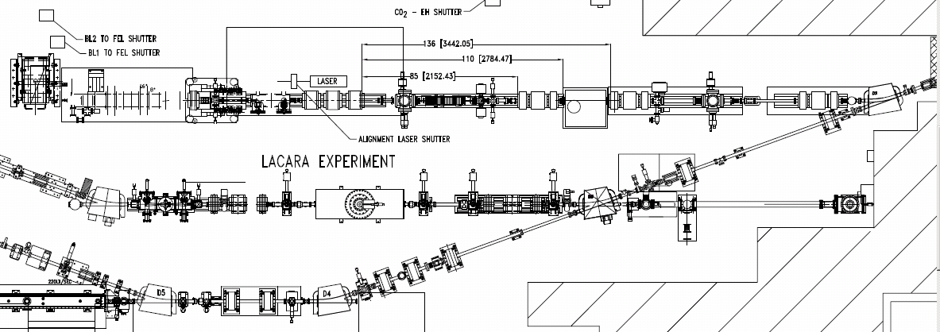
ATF laser beamline used for this test run.
We considered two locations for the APD
in this beamline:
Horizontally to the east of the
6-way cross
(2) Vertically underneath the cross.
The stripline monitor was ~ 2 m upstream.
Location #2
Location #1
Location of test in 2010

Slide 3
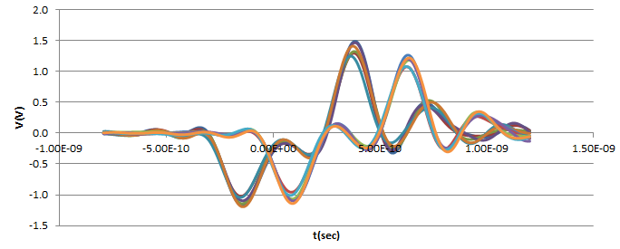
Stripline Signals
Two stripline signals (vertical and horizontal) were connected to Agilent scope channel #1 and #2.
We recorded 500 beam events. The following plot shows 5 overlapped triggered events.
Stripline #1
Stripline #2

Slide 4
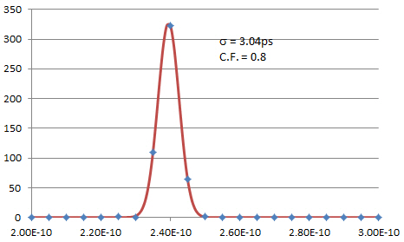
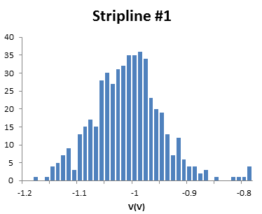
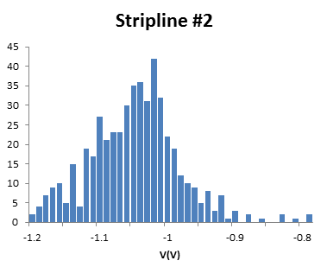
Time Resolution
We analyzed the two stripline signals, using a constant-fraction algorithm to define the times of the two signals.
The time difference between them is plotted in the histogram to the left.
σ = 3.04 ps, which is good enough for next step in the APD time resolution test.

Slide 5
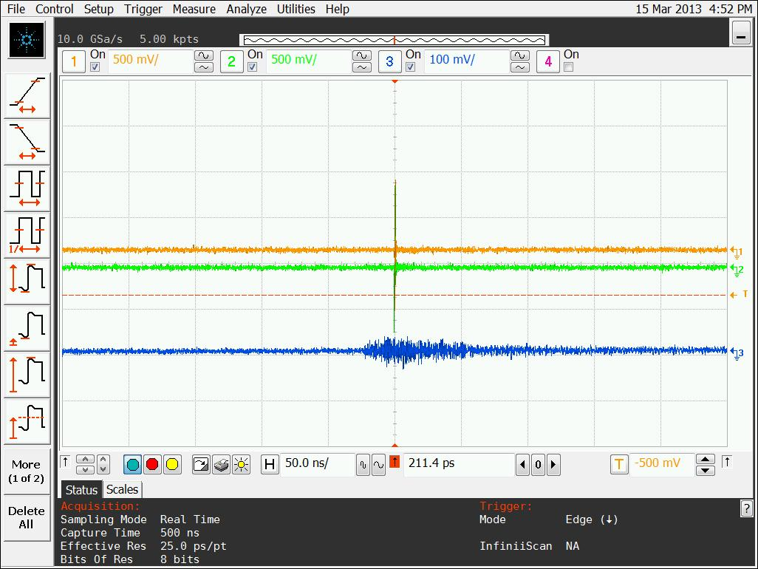
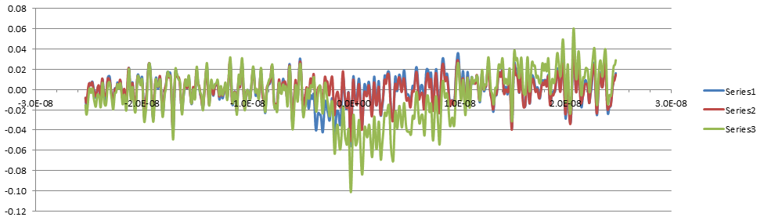
Serious RF Pickup by the APD
RF pickup by the APD (8x8 mm² with mesh) was very serious; initially the peak-to-peak size of the pickup was ~ 100 mV (while 1 MIP was expected to be ~ 10 mV).
We shielded all optical ports that we could find with aluminum foil, wrapped the APD box with foil, and wound the preamp DC voltage leads into a twisted pair, which cut the noise level down to 20 mV.
The shape of the pickup signal is quite reproducible from trigger to trigger.
Left: Top 2 traces = striplines; bottom trace =
= RF pickup (50 ns/div, 100 mV/div).
Above right: 3 pickup-noise waveforms overlapped; their fine details are quite similar, except for the particle signal near middle of traces.

Slide 6
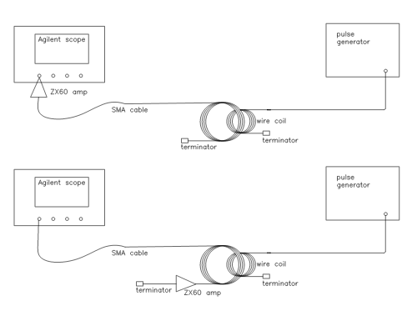
RF Pickup Study
We use a pulse generator to generate a noise-like signal: 1-MHz square waves, 5V p-p, that drives a cable whose far end is connected to a coil, 4 turns, ~ 5 cm in diameter.
To test the RF-immunity of a device we can move this coil closer to it, to see how the pickup changes.
We have tested:
Two types of SMA cables: double-shielded and single- shielded;
Two amplifier locations: at the detector end of the cable and scope end of the cable;
Two amplifier-operation modes: battery and external DC power supply.

Slide 7
RF Pickup Study (cont’d)
Best configuration:
Double-shielded cable;
Amplifier closer to detector
Worst configuration:
Single-shielded cable;
Amplifier closer to scope

Slide 8
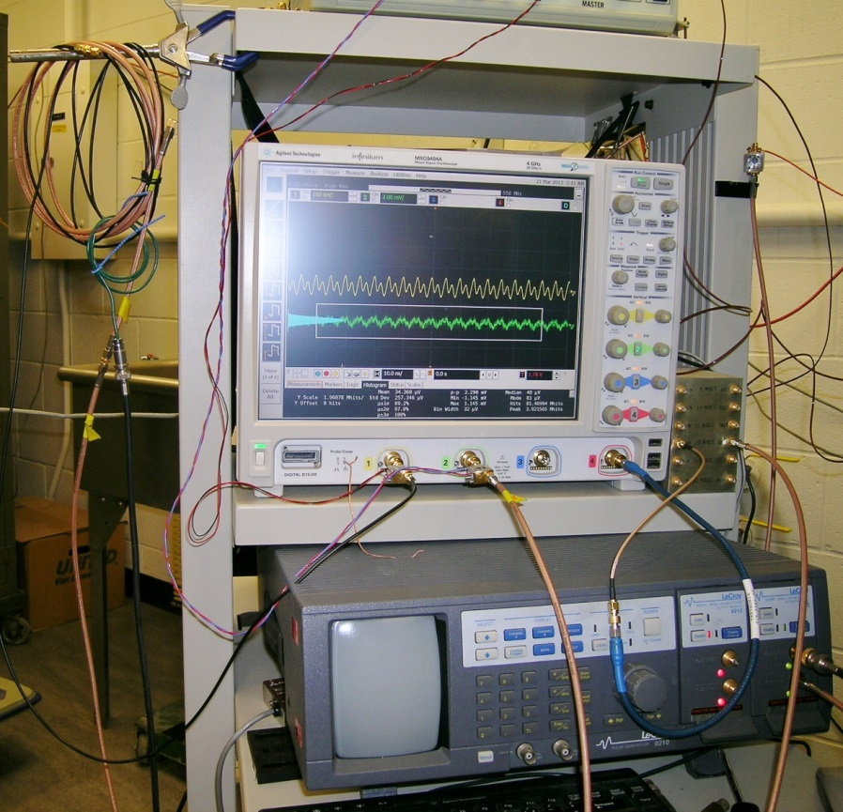
RF Pickup Study (cont’d)
Switch to LeCroy pulse generator, adjust to 200-MHz pulse.
Brown double-shielded cable (stiffer)
Black single-shielded cable (softer)
Wire coil
BNC cable carries signal from LeCroy pulser
LeCroy pulse generator

Slide 9
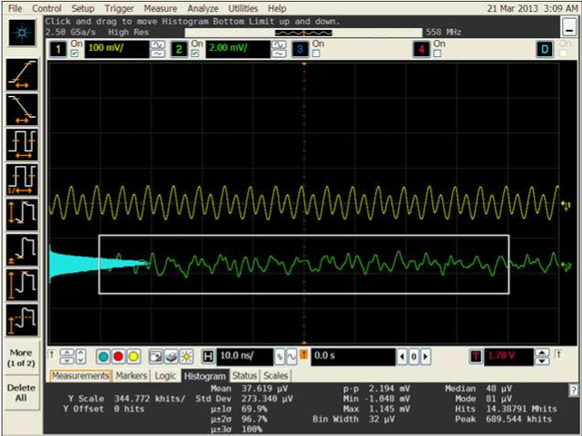
RF Pickup Study (cont’d)
Double-shielded cable picks up noise from the wire coil, V_{rms} = 0.273 mV.

Slide 10
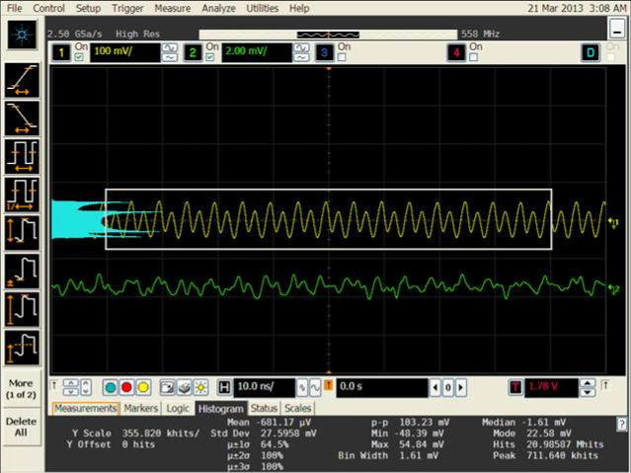
RF Pickup Study (cont’d)
Single-shielded cable picks up huge noise from the wire coil, V_{rms} = 27.5 mV;
This is around 100 times larger than double-shielded cable.

Slide 11
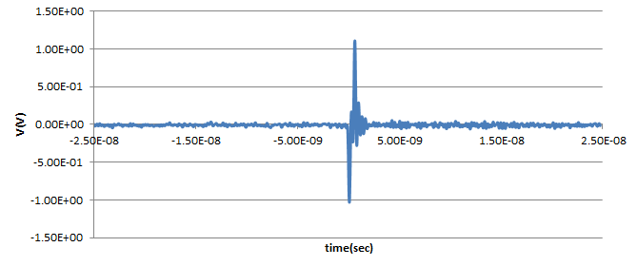
Suggestions for Next ATF Beam Test
Must use double-shielded cable for the beam test;
Mount the amplifier inside the APD box;
Battery-operated amplifier shows no advantage compared to use of an external DC power supply; we can get 5 V DC power from Agilent scope USB connector.
It is possible to reduce the RF noise level down to ~ 200 μV. If MIP signal ~ 20 mV, we can get S/N ~ 100, similar to stripline S/N, as shown below:
rms noise of the baseline ~ 0.01 V, stripline signal ~ 1 V.

Slide 12
Estimate of ATF Beam-Test APD Time Resolution
Stripline signal leading edge rise time ~ 0.15 ns.
S/N ~ 100 ⇒ expect 1.5 ps time resolution;
We measured 3 ps time resolution (scope limited).
~0.15ns
4 mm² APD/ZX60 with VCSEL laser-pulse-produced signal,
⇒ signal leading-edge rise time ~ 1 ns.
S/N ~ 100 ⇒ expect 10 ps time resolution (so 20 ps might be reachable).

