Slide 1
BNL ATF Beam Test Results
C. Lu, K.T. McDonald, Princeton
M. Fedurin, T. Tsang, BNL
May 2, 2013
We report on the sets taken 4/24 and 4/26.
The beam test was under the following condition:
  Stripline #1 ⎯ Scope channel #1,
  Stripline #2 ⎯ Scope channel #4,
  8x8 mm² mesh APD ⎯ Scope channel #2, -1800V,
  Same APD as studied in http://puhep1.princeton.edu/~mcdonald/LHC/Tsang/APD_8x8mm_mesh_screen_111512.ppt
  2x2 mm² APD ⎯ Scope channel #3, -1830V.
Beam charge ⎯ ~ 5pc (4/24) and ~100pC(4/26).
Lead brick ⎯ On 4/26 one lead brick was placed upstream of the detector.
Trigger setting:
Stripline #1 only (4/24), Stripline #1 AND 2x2 APD (4/26).
The next two slides show some events with all four waveforms from 4/26 data:

Slide 2
Waveforms from 4/26: 1 = stripline #1, 2 = 8x8 mm² APD, 3 = 2x2 mm² APD

Slide 3
Waveforms from 4/26: 1 = stripline #1, 2 = 8x8 mm² APD, 3 = 2x2 mm² APD

Slide 4
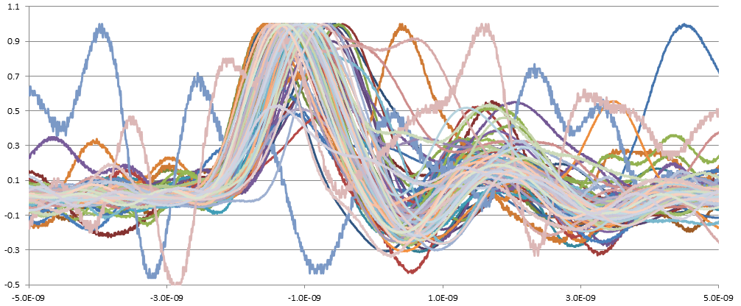
Overlap of normalized 8x8 mm² APD waveforms. for first 100 events.
The normalization factor = peak (negative) value of the waveform, so the normalized waveforms have positive polarity.
The scope is triggered by stripline #1 AND 2x2 mm² APD, the time reference is relative to stripline signal.
The 8x8 mm² APD signal spread indicates its time resolution is very poor.
First 100 waveforms
2ns/major division

Slide 5
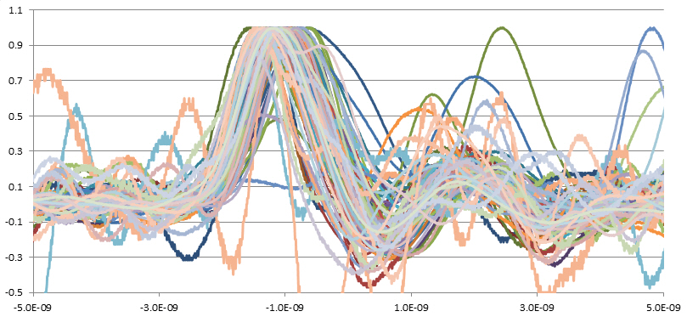
Next 100 events:
2ns/major division

Slide 6
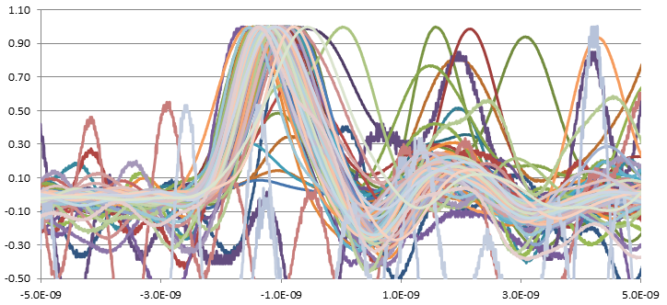
Last 100 events
2ns

Slide 7
Pulse amplitude distributions
They do not look like a single MIP going thru silicon layer;
otherwise the amplitude distribution should have a narrower Gaussian distribution.

Slide 8
Distribution dt of time of peak signal in the 8x8 mm² APD peak point vs. time reference from the stripline.
Plot only APD signals > 5 mV.
σ ~ 198ps !!

Slide 9
Scatter plot of dt vs. V
No obvious structure, so we can’t expect that cuts in these variables will improve the time resolution.

Slide 10
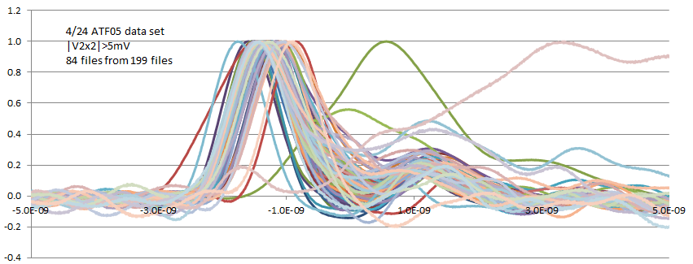
Why is the time jitter so bad for the 8x8 mm² APD?
Our Laser Diode test showed that except near its the edges, the 8x8 mm² mesh APD has much smaller time walk. http://puhep1.princeton.edu/~mcdonald/LHC/Tsang/APD_8x8mm_mesh_screen_111512.ppt
In the 4/26 data set since we used the 2x2 mm² APD to define the beam on the 8x8 mm² APD, so we expected much smaller time jitter for 8x8 mm² APD, but the test result is opposite to this expectation.
We analyze data from 4/24 with same methodology as above; trigger on stripline signal.
The 2x2 mm² APD was directly facing the target, and the 8x8 mm² APD was removed.
Normalize the APD signals to their peak value; the 199 normalized waveforms are shown below.
For |V| > 5 mV, 84 triggers remained.
The time jitter of the 2x2 mm² APD is similar to that seen in the 4/26 results for the 8x8 mm² APD.
It is not surprising that 2x2 mm² APD has large time jitter due to its time walk for signal near the edge of the APD.

Slide 11
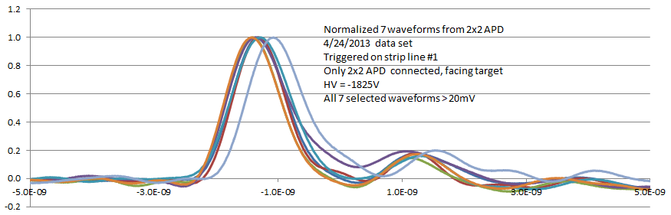
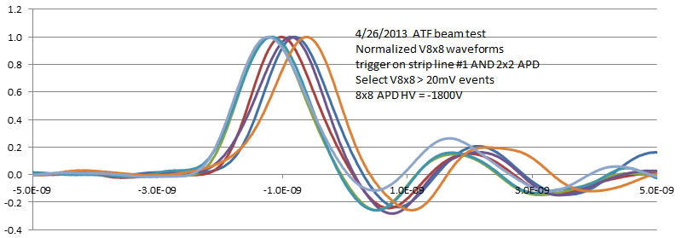
Search for clue (cont’d)
For a closer look at the waveform time jitter for 2x2 and 8x8 APDs, we select first 7 events with |V| ~ 20mV from each data set.
The plots below give strong indication that 8x8 APD, supposedly with electrons restricted to a small region defined by the 2x2 APD, is not doing better than the latter! ⇒ We are likely not seeing single-electron events in the 8x8 APD; there are probably other particles hitting the entire face of the 8x8 APD, which ruins the time resolution.
2x2 APD
8x8 APD

Slide 12
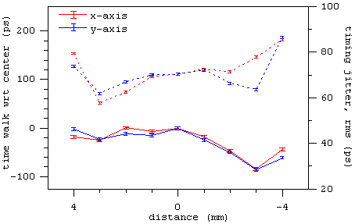
8x8mm^2 mesh APD time walk and jitter vs. position measured with VCSEL at BNL (Thomas, 11/29/2012):
Time walk
8x8mm^2 mesh APD time walk and signal amplitude vs. position measured with VCSEL at Princeton (2/28/2013):

Slide 13
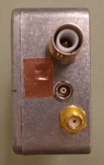
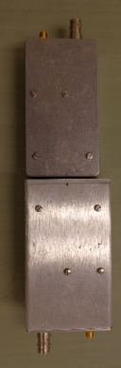
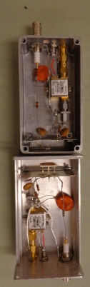
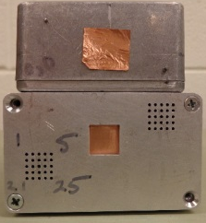
Test Boxes for the 2x2 and 8x8 APDs
Top of 2x2 APD box
e
Ground wire might have intercepted some of the e’s
Windows, with Cu tape
Bottom of 2x2 APD box
Top of 8x8 APD box
2x2 APD
8x8 APD
Alignment pins
In the beam, the boxes were wrapped in Al foil to suppress RF pickup. The e’s passed thru this foil.
Grids of aligment holes

