Slide 1

VCSEL-980nm Test for
RMD 4 mm² APD
Changguo Lu
Princeton U
Feb 8, 2013

Slide 2
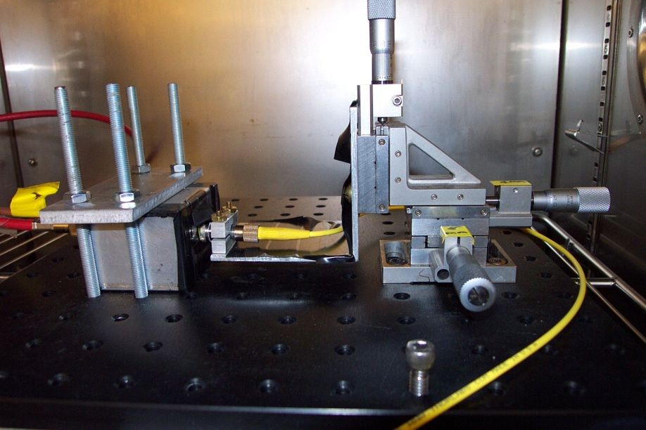
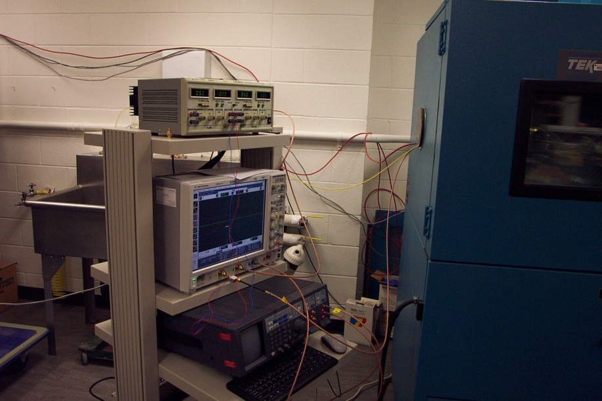
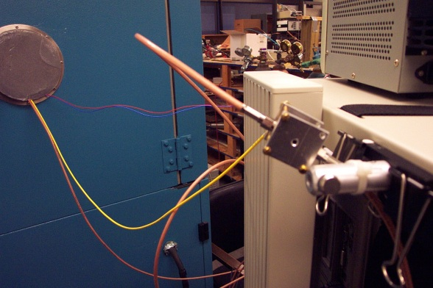
Test setup
An environmental chamber (EC) is employed to create a temperature controlled test environment.
In this test, the temperature was controlled to be close to 20°C.
The APD and VCSEL(980nm) laser diode are placed inside of the EC.
Internal view of the EC.
EC chamber
APD test box (4mm^2 APD)
Optical fiber
VCSEL laser diode box
Collimation lens (Thorlabs CFC-11X-B)

Slide 3
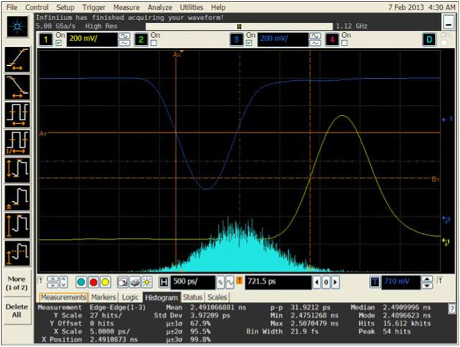
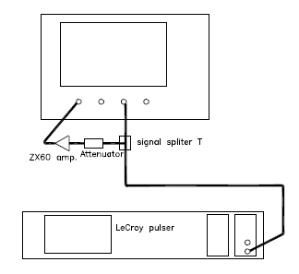
Screen Capture of the Instrument Response Test
dt_{inst} = 3.97 ps = combined resolution of scope and MiniCircuits ZX60 amplifier.

Slide 4
Linearity of Laser-Diode Beam Power vs. APD/ZX60 Signal Amplitude
Use Thorlabs PM100USB power/energy meter to measure the beam power.
The APD/ZX60 signal vs. power shows good linearity:
The neutral filters were employed to change the beam power.

Slide 5
Dependence of RMS Timing Jitter dt on APD Signal Amplitude (∝ V)
Plots of dt vs. 1/V and dt vs. 1/sqrt(V) show that better linearity in the former than the later. [But, see next slide.]
The instrument response contribution (3.97 ps) to dt has been subtracted in quadrature.

Slide 6
Dependence of RMS Timing Jitter dt on APD Signal Amplitude (∝ V), log—log plot
dt ~ 1/V
~ 1 MIP equivalent
From the log-log plot, it appears that dt scales as 1/V^{0.9} for laser signals smaller than 1 MIP equivalent, but the time resolution is almost independent of signal size for larger signals.
The instrument response contribution (3.97 ps) to dt has been subtracted in quadrature.

Slide 7
dt Dependence on # of MIPs
Since we already calibrated the laser beam power, we can convert the signal amplitude unit to equivalent MIPs:
Repetition rate of laser diode is R = 10 MHz, 980nm photon energy is E₉₈₀ = 2.03E-19 J, MIP equivalent # of photo-electron = 6000, and we assume that Q.E. of APD = 35%;
Therefore the conversion from laser beam power P(W) to # of MIP is:
# of MIPs = P(W)/R(Hz)/E₉₈₀ (J)*QE/6000 = P(W)*2.88E+7
1 MIP equivalent time resolution ~12ps

Slide 8
Thomas’ 12/5/2013 Test Result
Below is T. Tsang’s test result of 12/5/2012.
http://puhep1.princeton.edu/~mcdonald/LHC/Tsang/time_jitter_dependence_on_MIP.ppt
In the two scenarios, dt ∝ 1/MIP and 1/sqrt(MIP), neither shows good linearity for the entire tested range 0.4 ~ 11 MIP.
Probably above 1 MIP the linearity between dt and 1/sqrt(MIP) is better and below 1.7 MIP, 1/MIP is better.
> 1 MIP
< 1.7 MIP

