Slide 1
RMD APDs Test
Preliminary Results
Changguo Lu
Princeton University
March 15, 2012

Slide 2
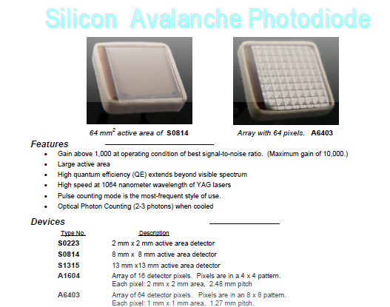
RMD APDs
Radiation Monitoring Devices, Inc.
We are testing these two types of APDs.

Slide 3
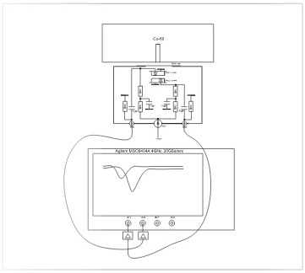
APD test setup
APD test box, mount two APDs face to face, Co-60 source is placed on top of the box.
APD signal through ZX60-33 (or ZVA-213) Mini-Circuits wideband amplifier connected to Agilent scope.
Agilent MSO9404A digital scope used as the DAQ system.
Back APD connected to channel#1 with ~0.4ns longer cable than channel#2. Front APD connected to channel#2.

Slide 4
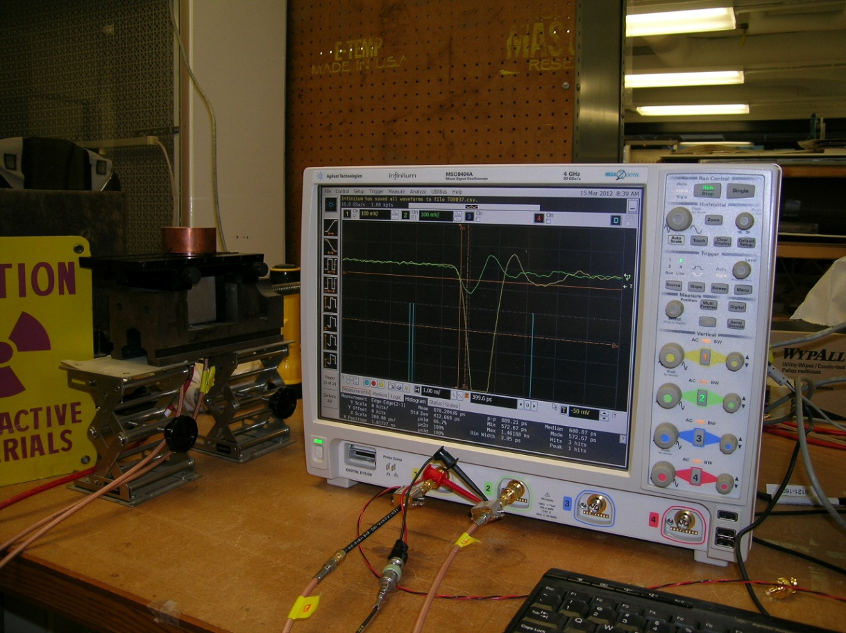
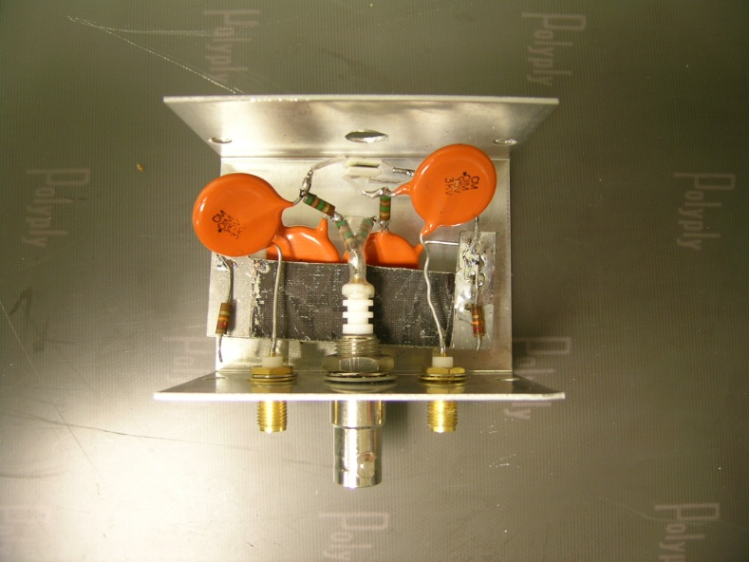
Test setup
Co-60 source
2 APDs in parallel
Fast amplifiers

Slide 5
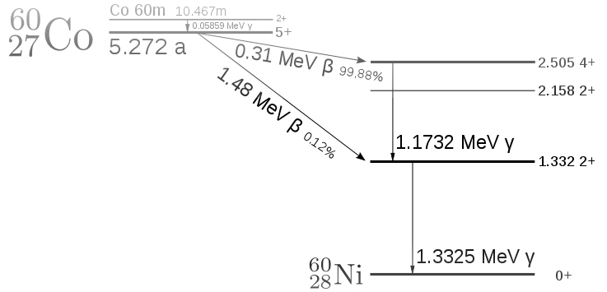
Co-60 decay chain

Slide 6
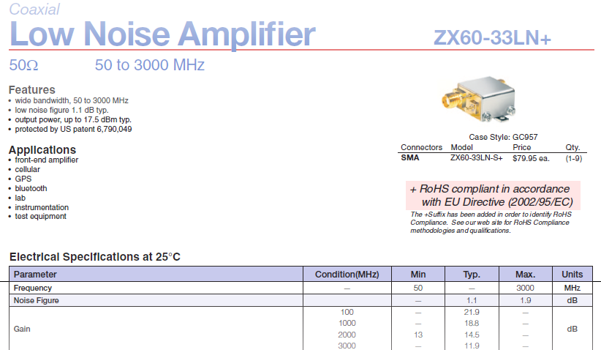
Cheaper version Mini-Circuits amplifier

Slide 7
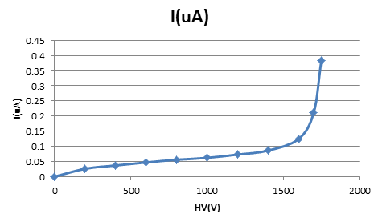
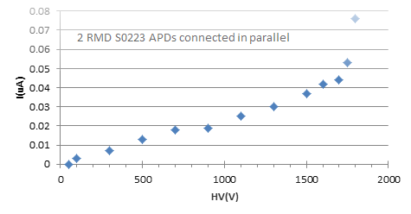
APD current vs. reversed bias voltage
Two APDs used in the test are RMD S0223 (S0814), 4mm2 (64mm²) active area. When we made this test, two APDs were connected in parallel, so the measured current is the sum of two APDs.
2 S0814 APDs connected in parallel
When the high voltage reaches -1800V (-1750V), the current increases sharply, we set our test at -1800V (-1750V).

Slide 8
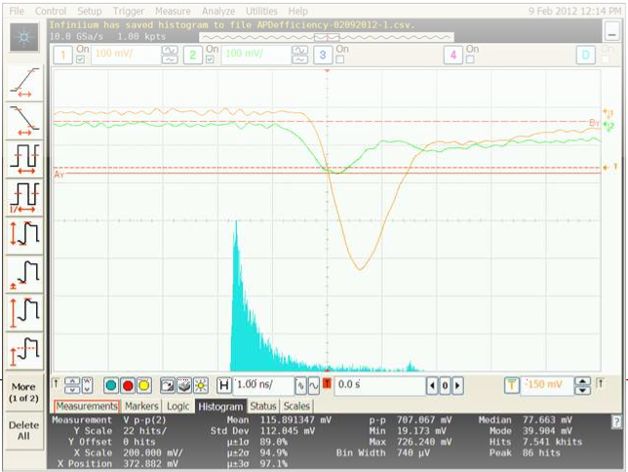
APD test with Co-60 source: signal amplitude spectrum
Test S0814 APDs
Triggered on channel #1 (brown trace) recorded the amplitude histogram of channel #2 (green trace). Notice the output signal shape from ZA60, it has clean falling edge, which can be used to measure the timing.

Slide 9
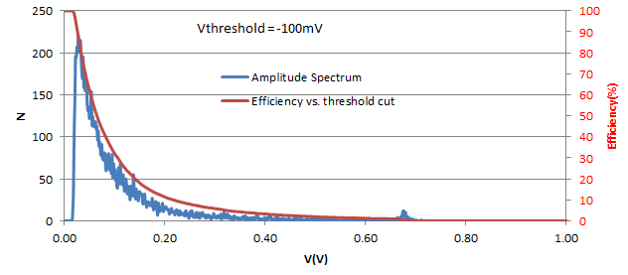
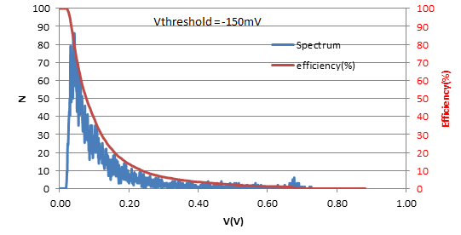
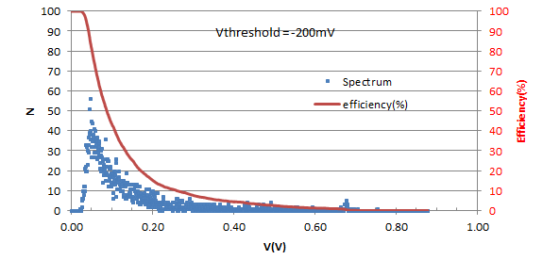
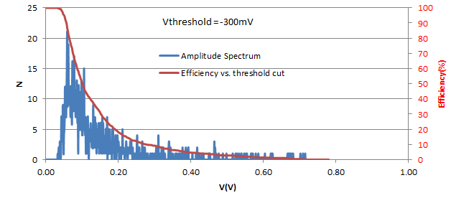
APD test with Co-60 source: signal amplitude spectrum
Triggered on the back APD, measure the amplitude of the front APD signal under the radiation of Co-60 source. We can change the back APD trigger threshold from -100mV up to -300mV.
The red line represents the efficiency vs. threshold voltage.

Slide 10
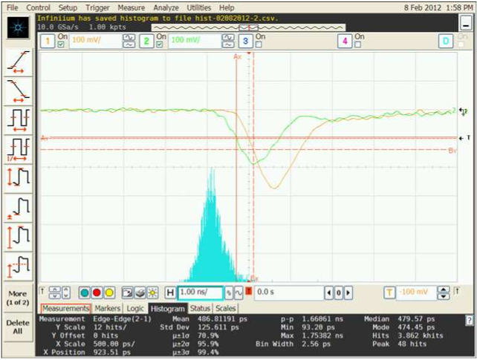
APD test with Co-60 source: time resolution
We also can use the scope to measure the time resolution of the APDs. We measure two channels from edge (channel 2) to edge (channel 1) on their leading falling edges at 50% amplitude. Accumulate for more than 3800 events, on the screen image of the scope we can see the typical pulse and accumulated histogram. ZA60 amplifiers were used in this test.
Measure the time at 50% of leading edges. Brown curve is channel #1 (back APD), green curve is channel #2 (front APD).

Slide 11
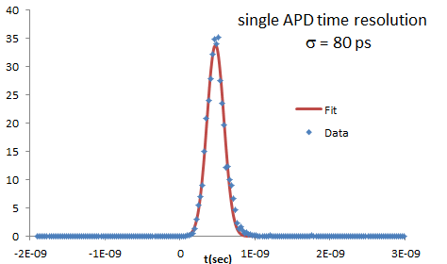
Fitted time resolution
The event’s trigger thresholds are set at -100mV for both channels. The fitted time resolution is 80ps.

Slide 12
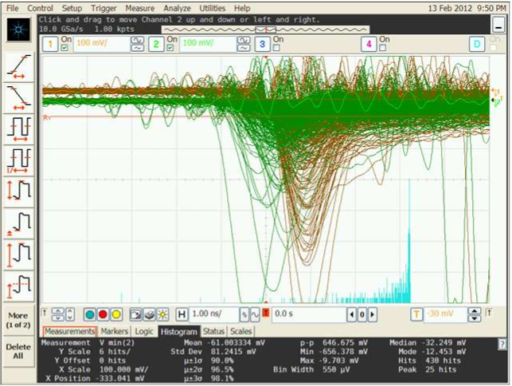
APD test with cosmic ray: signal amplitude spectrum
We also used cosmic ray to accumulate the signal amplitude spectrum. In 66 hours we obtained 431 events. Trigger on channel #1, threshold = -30mV, measure channel #2 amplitude.

Slide 13
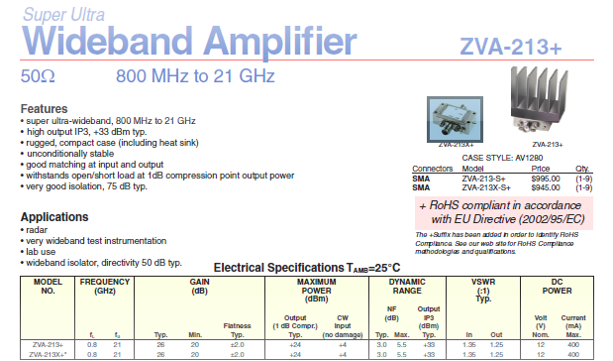
Mini Circuits fast amplifiers

Slide 14
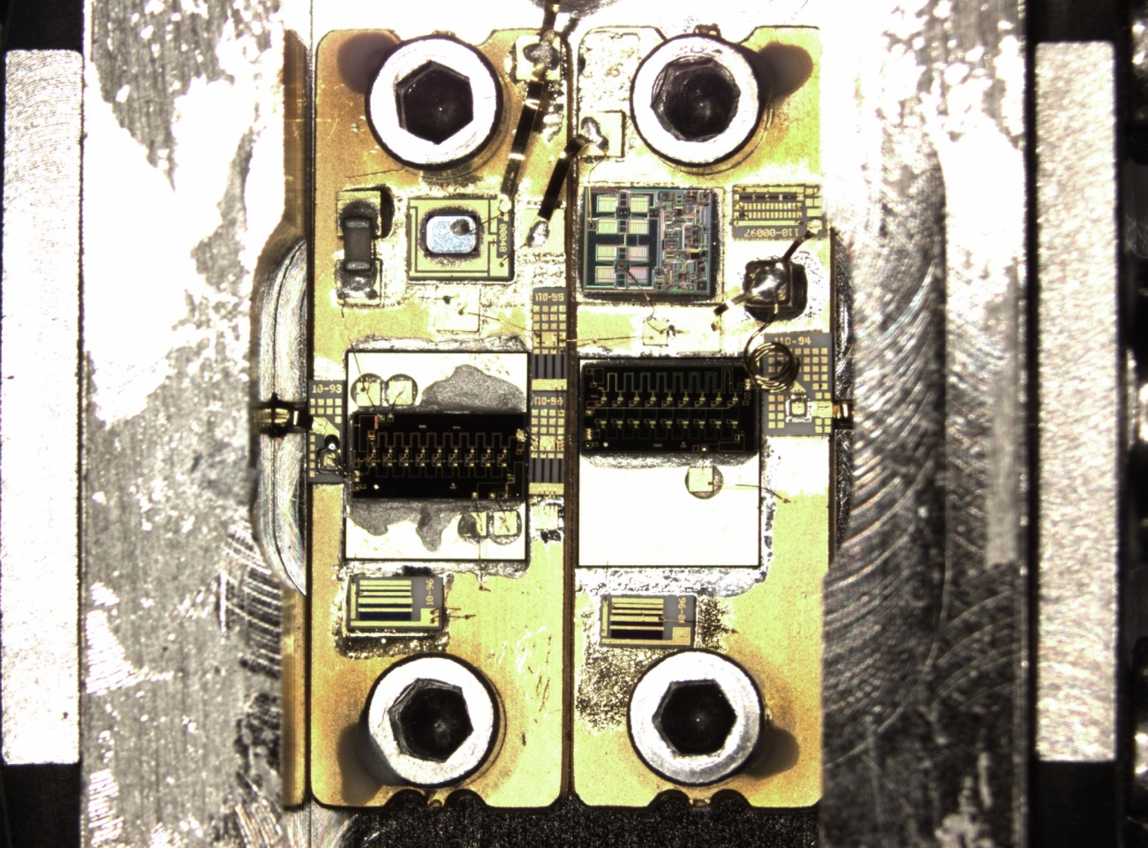
Fast amplifier (cont’d)
ZVA-213: Under microscope
Input SMA
Output SMA
2.2”
Input stage amplifier chip
Output stage amplifier chip
¾”

Slide 15

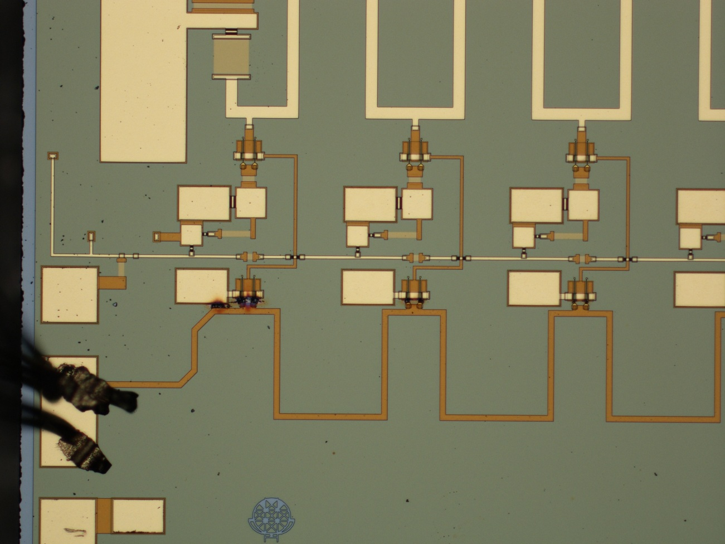
Burned fast amplifier chip: HITTITE HMC460
Burned first stage of the amplifier chip

Slide 16
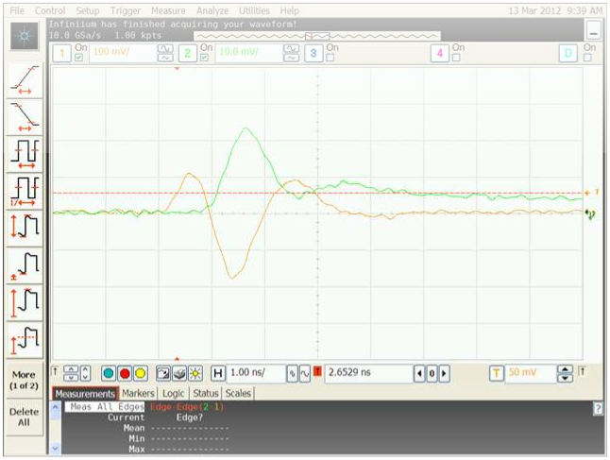
Time resolution with CO-60 source and ZVA-213 amplifiers
Green trace w/o amplifier, scale 10mV/div.
Brown trace w/ amplifier ZVA-213, scale 100mV/div.
The gain of ZVA-213 is ~ x10 to x11.

Slide 17
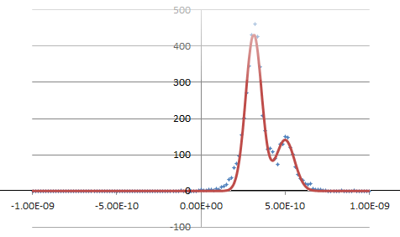
Time resolution with ZVA-213 amplifiers (cont’d)
The dT spectrum shows two peaks, fit it with 2 Gaussians the time resolution for two peaks:
σ1 = 47.6 ps
σ2 = 55.2 ps
Why 2 peaks? Don’t know yet.

