Slide 1
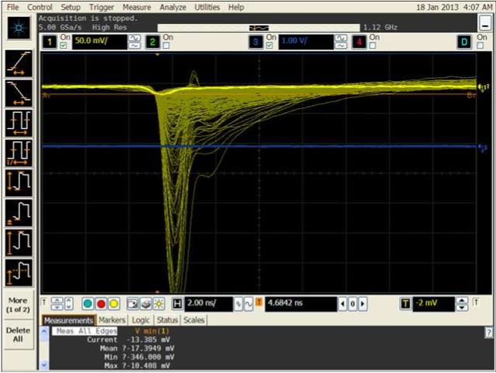
4mm^2 APD at -1750V, w/o Sr-90 and Laser beam there is no any signal can be seen, APD is very quiet. Laser beam signal and Sr-90 signal are shown below. The laser beam signal is much smaller than Sr-90.
Laser beam signal (bright yellow line)
Sr-90 source signal

