Slide 1








Development of Ultra-Fast Silicon Detectors for 4D Tracking
R. Arcidiacono^{1,5}, M. Boscardin³, N. Cartiglia¹, F. Cenna^{1,4}, G. F. Dalla Betta², M. Ferrero¹, F. Ficorella³, , M.Mandurrino1, L. Pancheri², G. Paternoster³, F. Siviero^{1,4}, V. Sola^{1,4}, A. Staiano¹
¹Istituto Nazionale di Fisica Nucleare, Torino, Italy
²Universita' di Trento, Trento, Italy
³Fondazione Bruno Kessler, Trento, Italy
⁴Universita' di Torino, Torino, Italy
⁵Universita' Piemonte Orientale, Torino, Italy
Amedeo Staiano, Istituto Nazionale di Fisica Nucleare, Torino
Milton Keynes 3-8 Sep 2017
University of Manchester

Slide 2
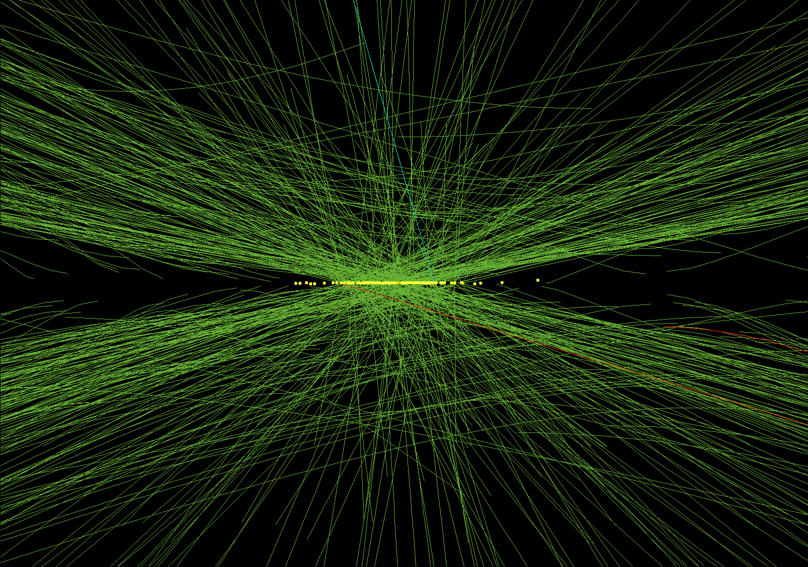
Timing at High Luminosity HEP Experiments
Time can be considered a 4th dimension coordinate in particle tracking in High Luminosity HEP experiments
Silicon Detectors provide excellent spatial resolution (~10μm), aim is to determine the timing of the passage of the particle with resolution ~10ps (current best performance in NA62, 300x300μm pixel Gigatracker with 150ps)
CMS 78 vertices reconstructed

Slide 3
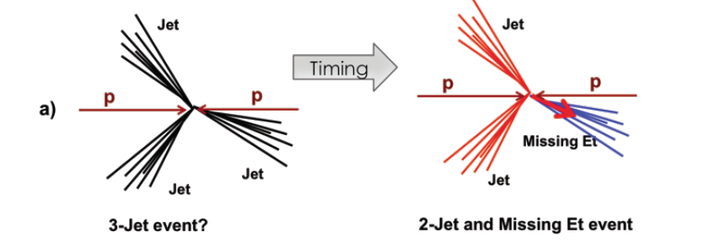
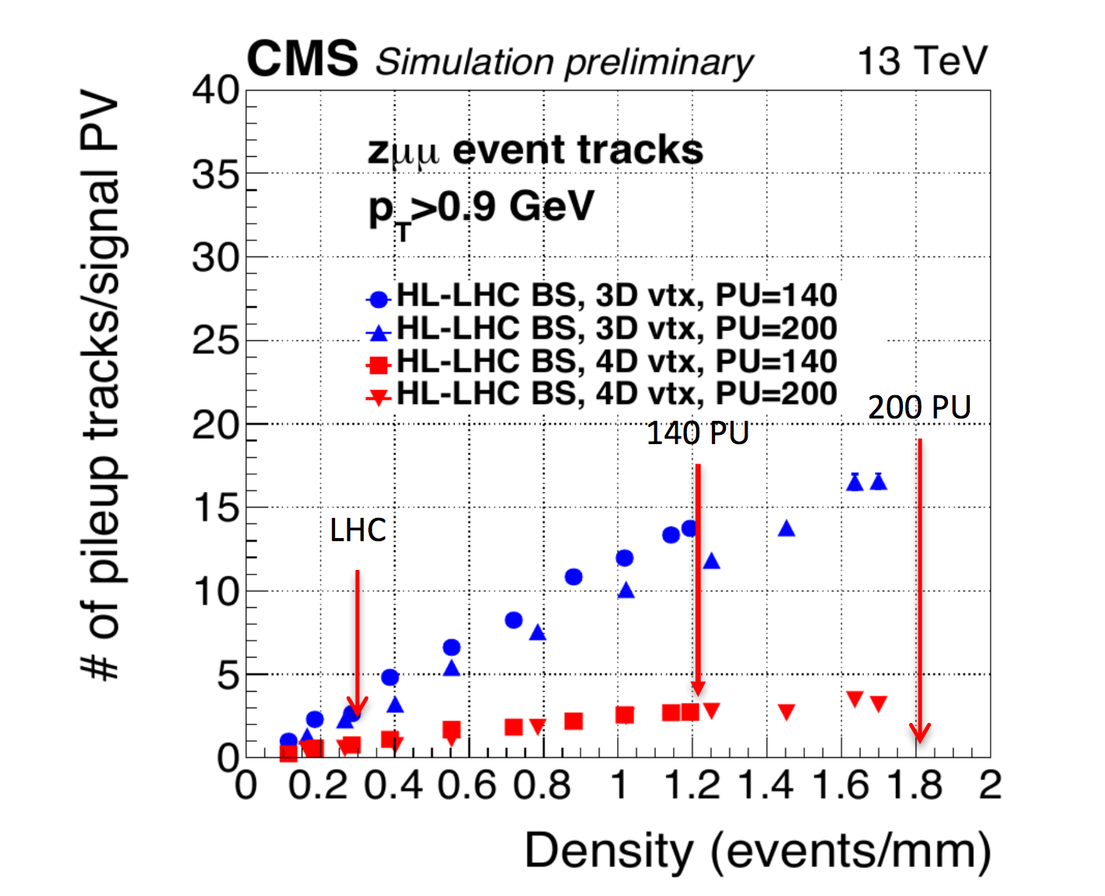
How to make use the timing information
Improve reconstruction by adding time information to each track point
Determine the correct vertex track assignment
Timing
Correct event reconstruction
Correct trigger assignment
IN HL-LHC
150-200 vertices / beam crossing
<Δz_{vertices}> = 500μm
<t_{vertex}>_{RMS}= ~200ps
a vertex separation resolution of
250-300μm ➔ 10-15% overlapping
2 events
4D = add 30ps timing information
~x5 pileup (@ PU=200) reduction in terms of associated tracks
Event loss = Luminosity loss
A. Apresyan | Americas Workshop on Linear Colliders 2017

Slide 4
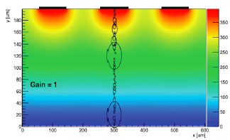
Silicon Detector Time Resolution
S
σ²_{t}= σ²_{Jitter} + σ²_{Time Walk} + σ²_{Landau Noise} + σ²_{Distortion} + σ²_{TDC}
threshold
Negligible
Optimize FE electronics
Negligible
Optimize RO electronics
t_{track}
time
σ_{Jitter}≈N/(dV/dt)≈t_{rise}/(S/N)
needs Gain to increase S
needs thin detector to decrease t_{rise}
I_{Ramo}≈ q v_{drift} E_{w}
Requires uniform v_{drift} and E_{w}
⬇
GOOD
BAD
Decreases with detector thickness
Intrinsic Limit σ_{Landau Noise} ≈ 20ps
NB: signal amplitude DOES NOT
depend on detector thickness

Slide 5
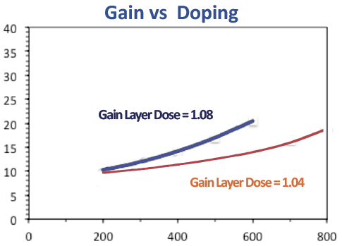
Ultra Fast Silicon Detectors
use Low Gain Avalanche Detectors layout (Gain ~5-20 in p⁺/n⁺⁺ junction with
E~300kV/cm) and optimize design in order to
use high E to saturate and uniform v_{drift}
high resistivity to have uniform E
use high density segmentation
low gain ➔ better uniformity, radiation hardness
gain ➔ thin detectors (~50μm) to have low signal t_{rise}
Gain
n⁺⁺
n⁺⁺
+ -
n-in-p
p⁺
n-in-p
+ -
N_{d}~10¹⁶ Boron/cm³
+ -
+ -
+ -
p
p
p⁺⁺
p⁺⁺
Breakdown Voltage (V)
Traditional Si detectors
Ultra Fast Si detectors
Gain very sensitive to doping
concentration (few %)

Slide 6
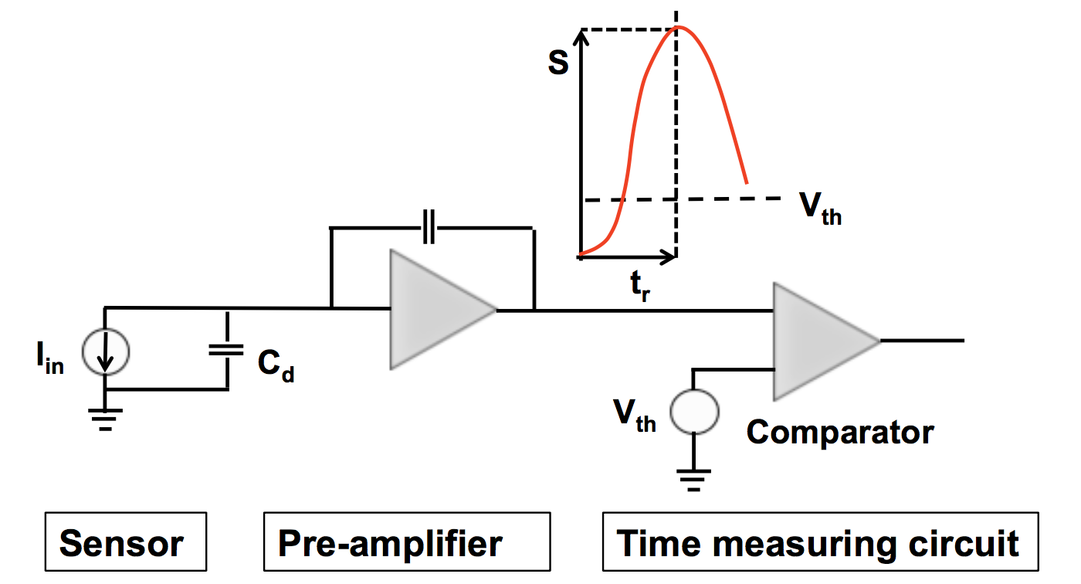
Characteristics of FE Electronics
Correct Time Walk by:
Time over Threshold
Current Amplifier
Constant Fraction Discriminator
Fast slew rate
Higher noise
Sensitive to Landau bumps
More power
Integrating Amplifier
Slower slew rate
Lower noise
Signal smoothing
Less power

Slide 7
An ASIC developed for UFSD applications

Slide 8
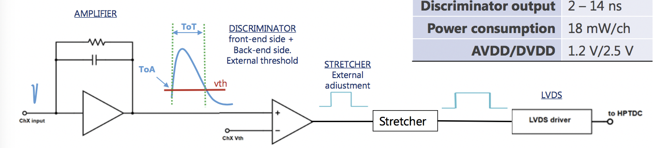
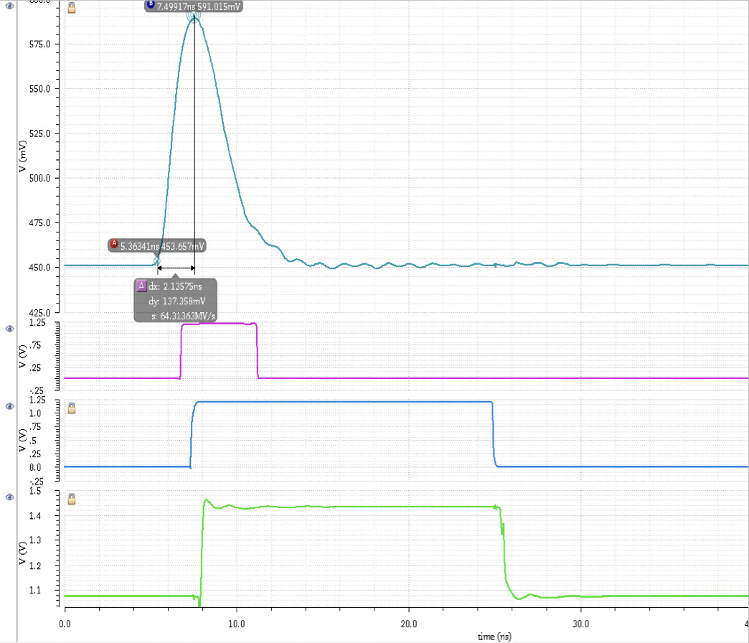
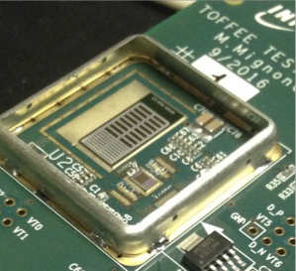
TOFFEE schematic
CMS CT-PPS UFSD detector
PSPICE simulation
TOFFEE

Slide 9
TOFFEE laser measurement
Ampl@70%=MPV
We measure a noise of 0.8 – 1 mV ➔ Jitter = 0.8/25mV/ns ➔ 30 ps

Slide 10
TOFFEE mV vs Q_{in}
The mV/fC is in line with expectation, 6.2 – 6.9 mV/fC

Slide 11
TOFFEE Beam Test measurement
Resolution of ~50ps @ 290V (Gain=25)
Jitter Slew Rate limited at ~35ps
Non uniformity charge dep. ~30ps
TOFFEE Gain measured 6mV/fC
TOFFEE behaves as expected on single
channel. Extra common noise when all
Channels bonded, to be understood.

Slide 12
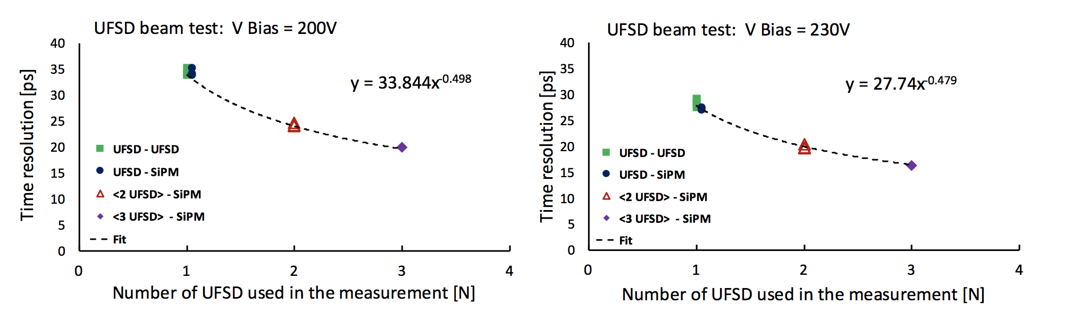
Time Resolution: Beam Test Measurements
3 CNM 45μm thin detectors, 1.7mm² single pad + 1 SiPM on quartz for timing crosscheck
Full Custom Hybrid Electronics (UCSC boards)
The time resolution of a single UFSD is measured to decrease with increased gain M like M^{-0.36} (from 34ps@200V to 28ps@230V)

Slide 13
Time Resolution: Measurements
Consistent with simulation and
CNM Beam Test Data (previous plot)

Slide 14
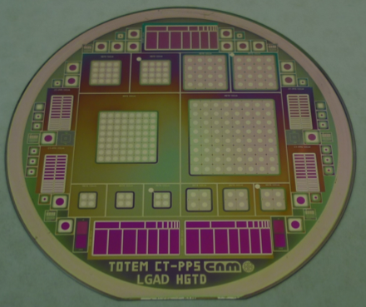
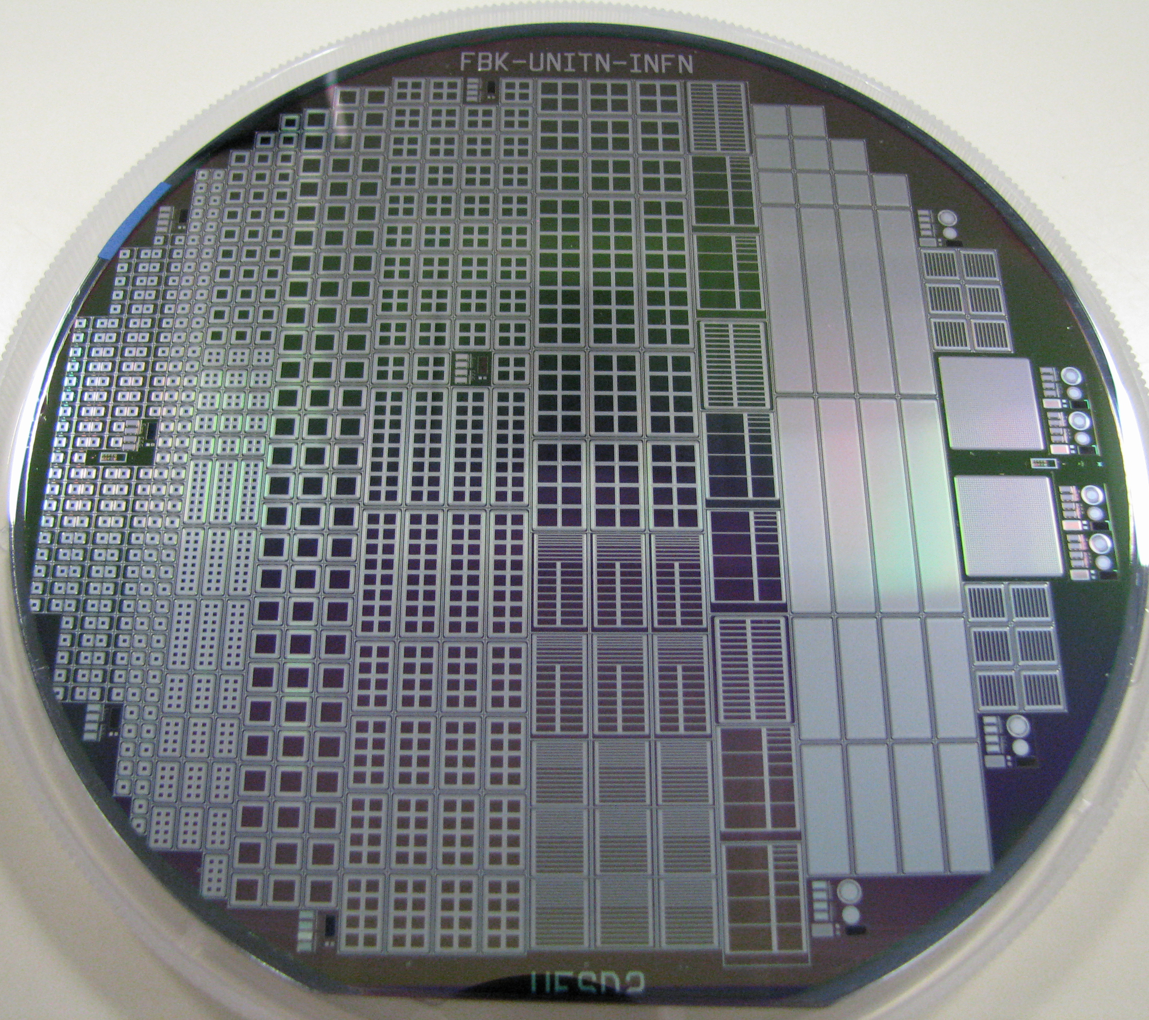
Sensor currently under test: new FBK production
CNM 75-micron
CNM 50-micron production
FBK 50-micron production (II FBK Run)
Very successful, good gain and overall behavior
Gain layer: Boron, Gallium, Boron+Carbon, Gallium+Carbon
x4 CT-PPS
x3 TOTEM
Medical Physics Timing Det. (MoveIT coll.)

Slide 15
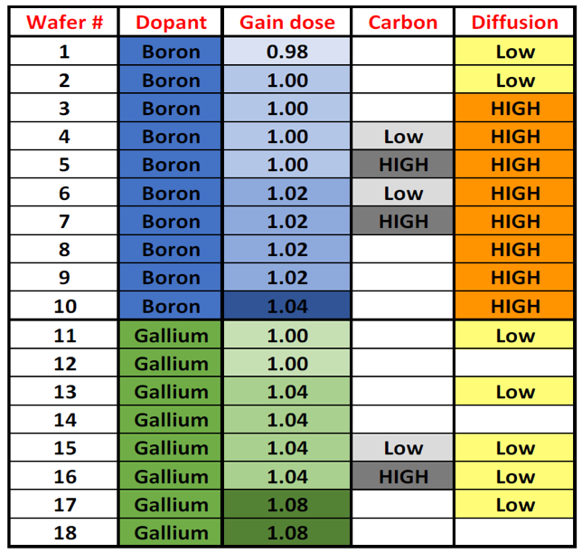
Sensor currently under test: new FBK production
On Test Beam

Slide 16
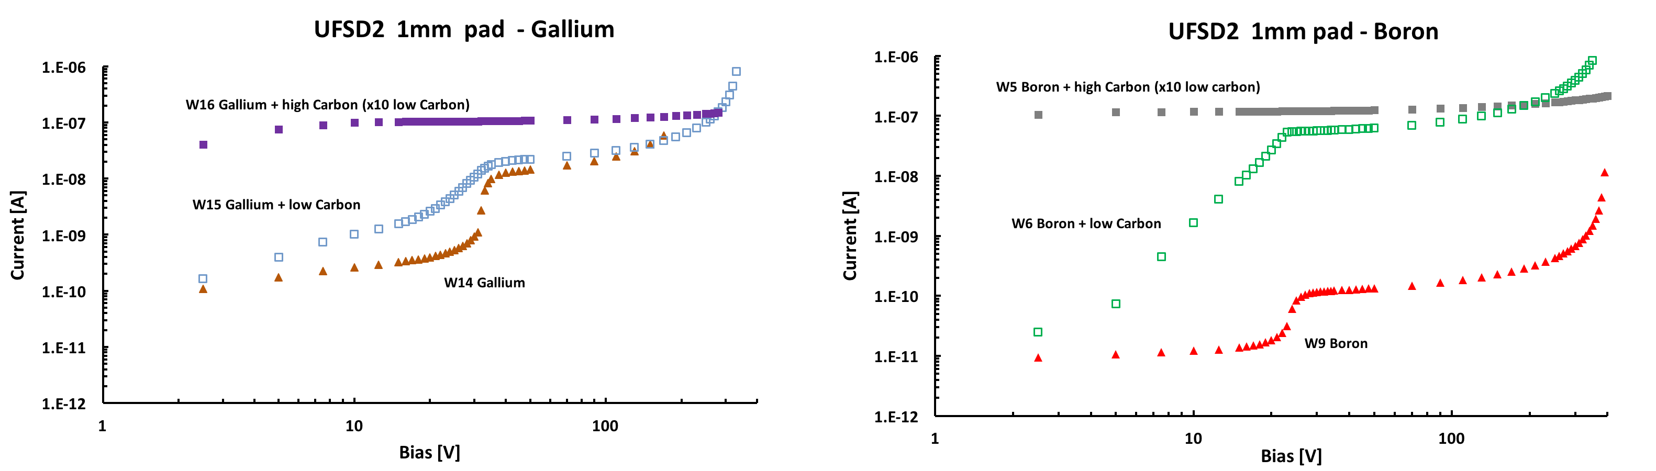
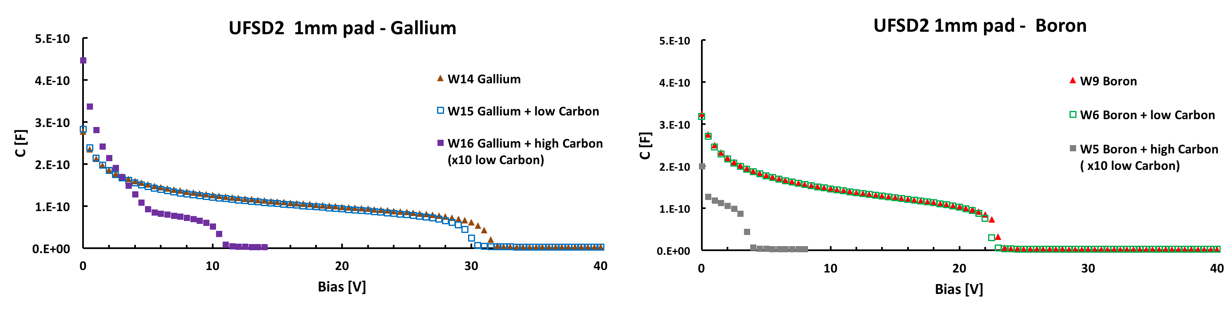
Sensor currently under test: new FBK production, Ga, B and C

Slide 17
Sensor currently under test: comparison with TCAD
Best fit van Overstraeten - de Man
model

Slide 18
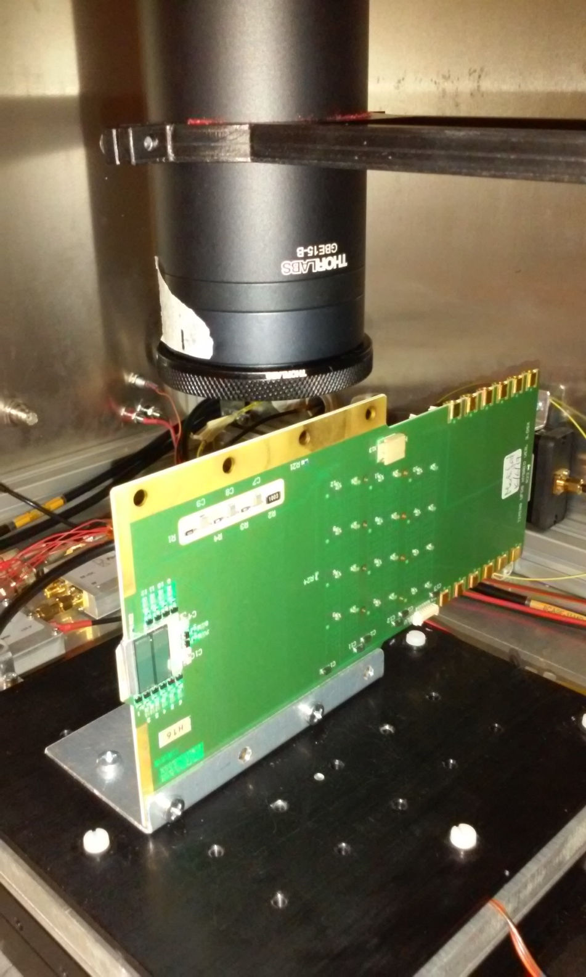
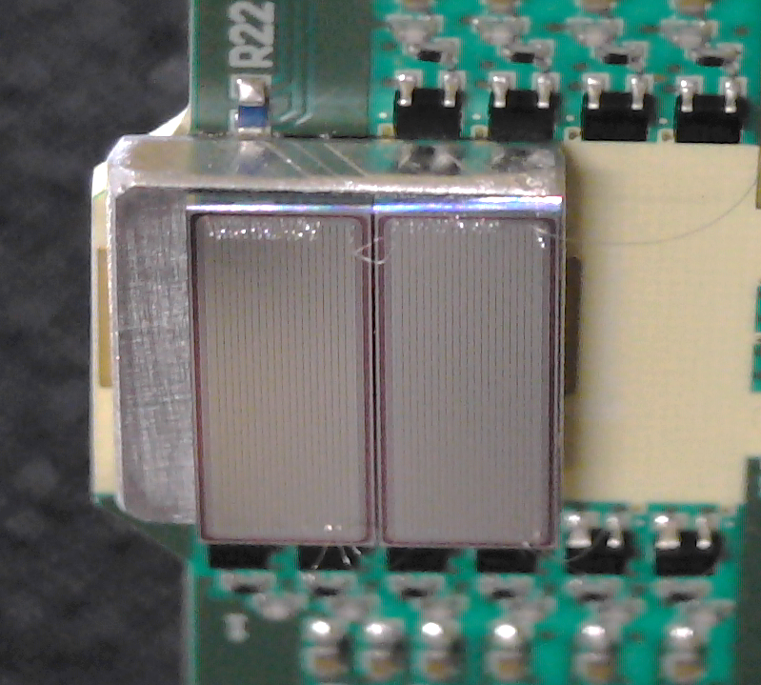
Sensor under test: 215μm strip pitch
2 sensors from W8 (B- High diff.), one with gain and the neighbour without.
Amplifier Pilsen Board (CMS CT-PPS)
Sensor shifted to allow laser scan along the strip edge
MoveIT Torino
Collaboration (Hadron-Therapeutic beam monitoring)
R.Cirio, S.Giordanengo, V.Monaco, R.Sacchi, A.Staiano, A.Vignati, Omar
Hammad Ali, Zahra Ahmadi Ganjeh, Serena Ponzio, Matteo Inglese, Federico
Fausti
20 strips

Slide 19
Sensor under test: 215μm strip pitch
Laser spot 15μm
MoveIT Torino
Collaboration
TCAD simulation, takes into account n-well and p-stop
profiles

Slide 20
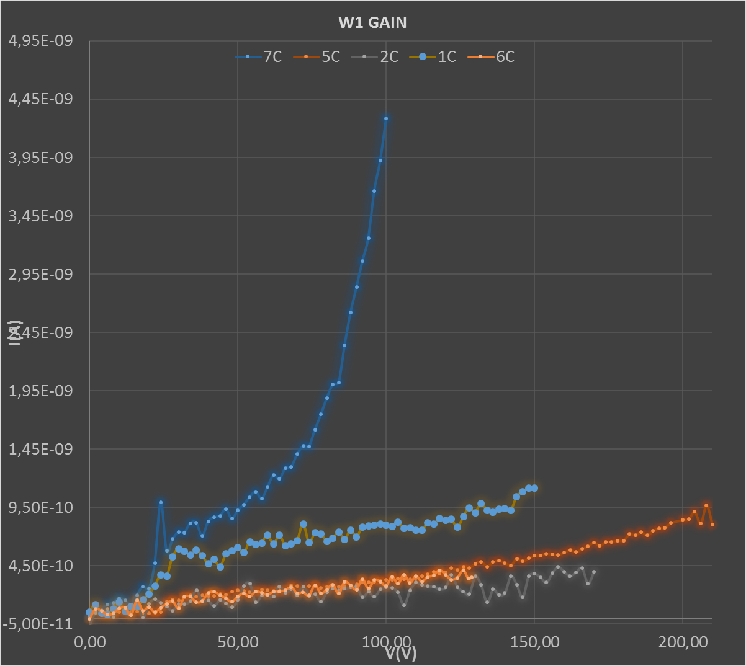
Sensor under test: 20 215μm strip pitch, Leakage current uniformity
MoveIT Torino
Collaboration
Each point
is average of
20 strips current

Slide 21
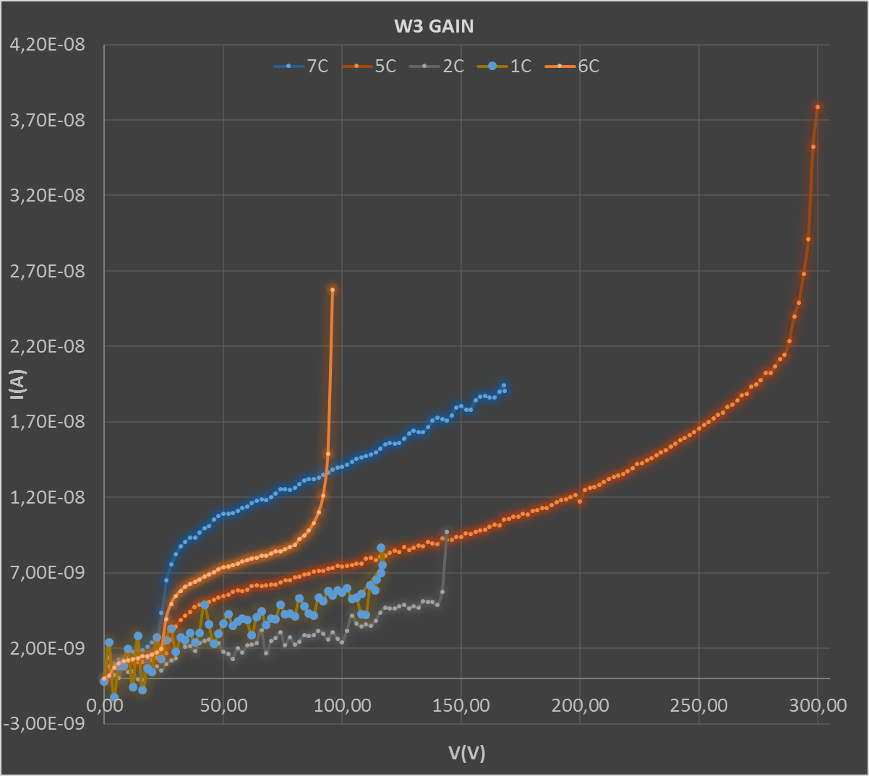
Sensor under test: 215μm strip pitch, Leakage current uniformity
MoveIT Torino
Collaboration

Slide 22
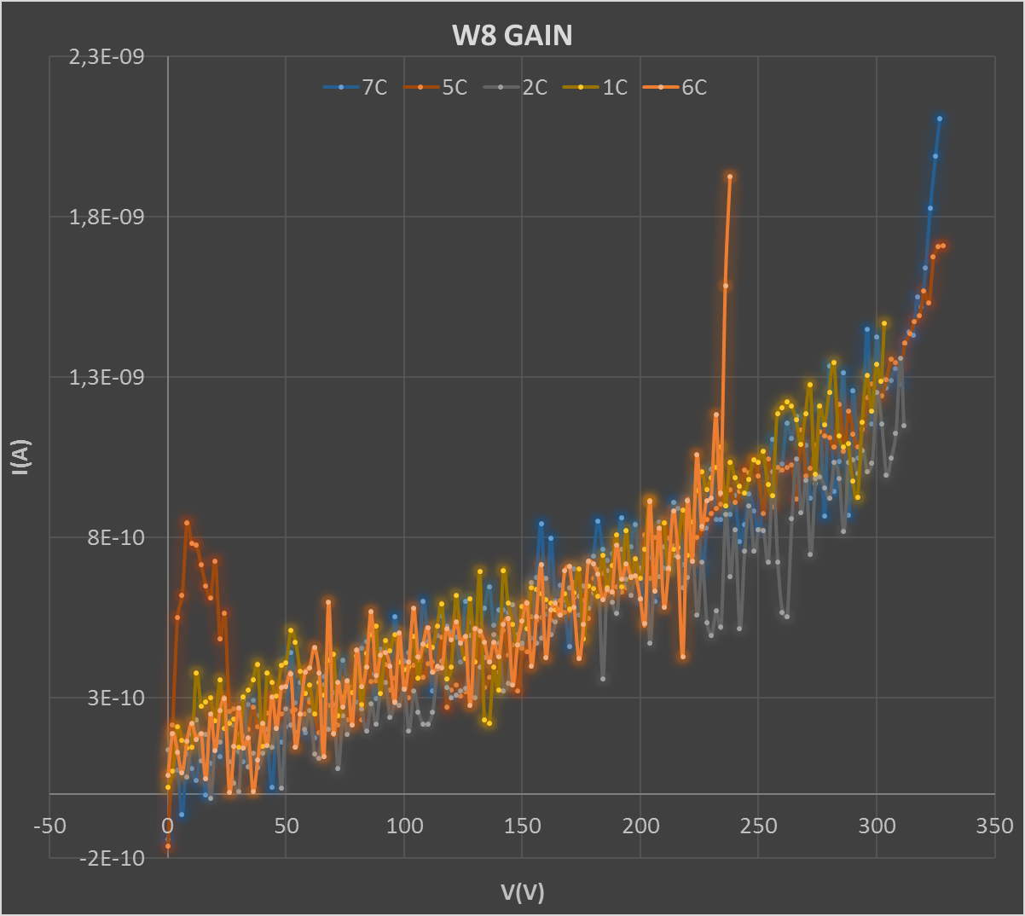
Sensor under test: 215μm strip pitch, Leakage current uniformity
MoveIT Torino
Collaboration

Slide 23
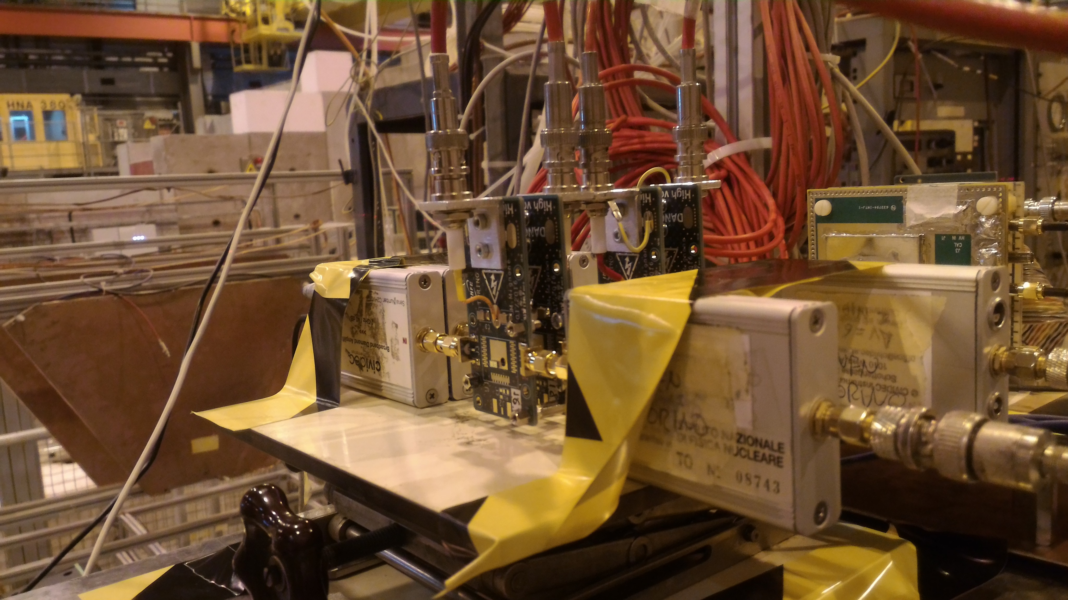
August 2017 FBK-UFSDII Beam Test
W1 Trig W8 W15
CERN
180 GeV/c π beam
BB
40dB
UCSC
+ BB
20dB
BB
40dB
BB
40dB
Trigger Logic: UCSC .AND. (W1.OR.W8.OR.W15)

Slide 24
August 2017 FBK-UFSDII Beam Test
W1
W8
W15
Trigger

Slide 25
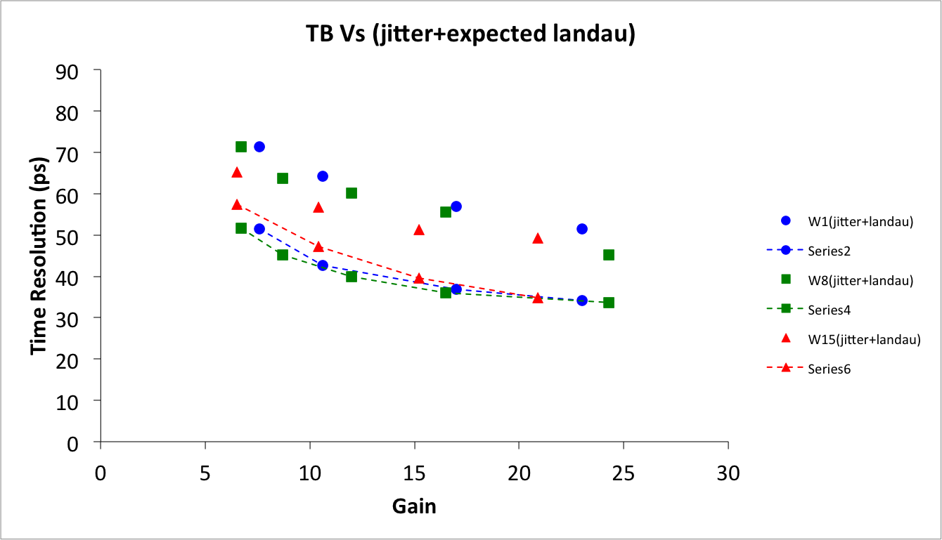
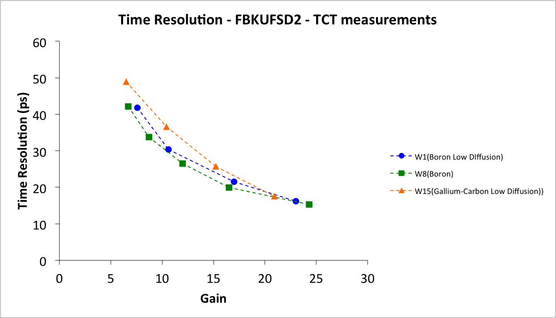
August 2017 FBK-UFSDII Beam Test
TB data
Time Jitter (from laser time measurement in lab) + 30ps estimated
Landau contribution. 20ps offset to be understood.

Slide 26
UFSD Summary
Good results on timing capabilities (~30ps from beam test)
Preliminary TB results from TOFFEE VLSI, a fast ToT amplifier with 50ps resolution
Preliminary promising results from UFSD II run from FBK with B, Ga and C splits (pads and microstrips)
Good results after NIEL at 6 10¹⁵ neq/cm², levels to be considered in HL-LHC. New implants (Ga, C) currently under test (last FBK run)
Good agreement with simulations (WF2 and TCAD)
Technological interest, many manufacturers (CNM (Spain), FBK (Italy), HPK (Japan), Micron Semiconductor (UK))

Slide 27
Acknowledgments
Thank you for your attention !
This work was supported by the European Union’s Horizon 2020 Research and Innovation funding program, under Grant Agreement no. 654168 (AIDA-2020) and Grant Agreement no. 669529 (ERC UFSD669529), and by the Italian Ministero degli Affari Esteri and INFN Scientific Commettee V.

Slide 28
BACKUP SLIDES

Slide 29
Radiation Tolerance
LGAD radiation tolerance studied within the CERN RD50 collaboration
Radiation fluences requested to operate at HL-LHC ~5 10¹⁵ particles/cm² , radiation doses of 150Mrad (primarily due to Non-Ionizing Energy Loss)
Effects:
Same effects of standard n-p Si detectors: increase of Leakage Current (decrease T), increase of V_{BD} and V_{FD,} due to increase of doping concentration. Creation of trapping centers (minimize the effect going to thin sensors (!))
In LGAD:
  Further increase of leakage current (and power) due to gain layer: go thin, keep gain low
  Gain loss due to gain layer acceptor removal. Boron atoms are displaced and become interstitial, thus not contributing to the doping profile: increase V_{bias}, change acceptor (add Carbon to decrease interstitial phase space, and replace Boron with Gallium)

Slide 30
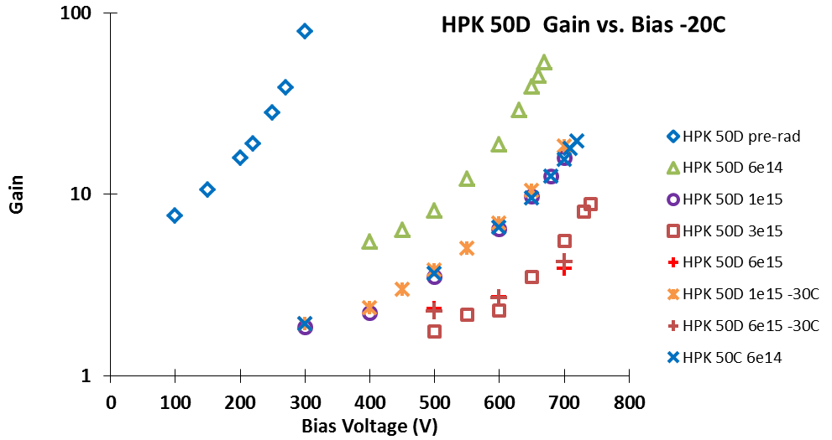
Radiation Tolerance
Measurements from 50μm
thin HPK detectors, fully consistent with simulation expectations:
gain decreases with increasing fluences and it is partially recovered by increasing V_{Bias}

Slide 31
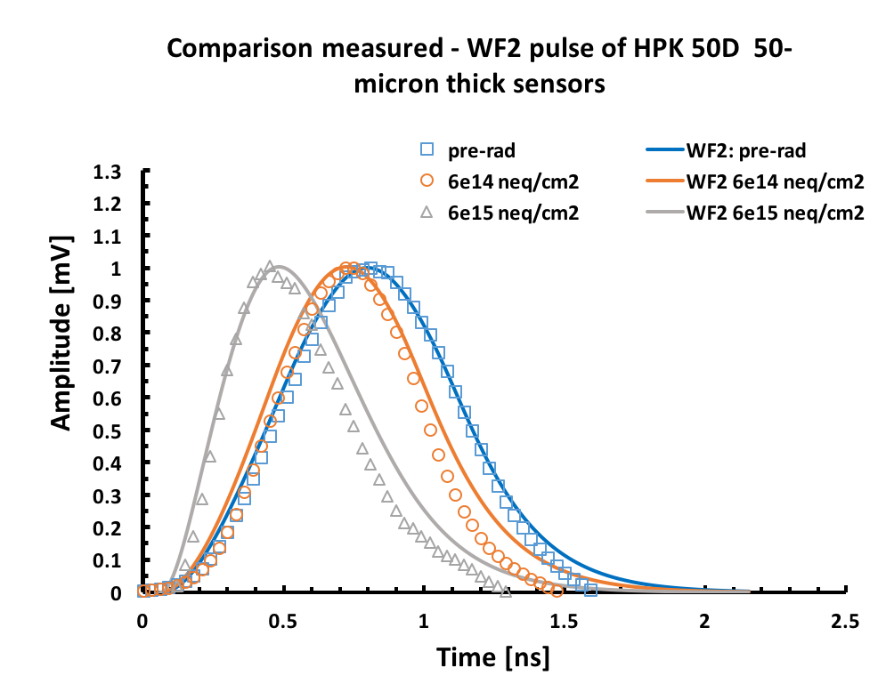
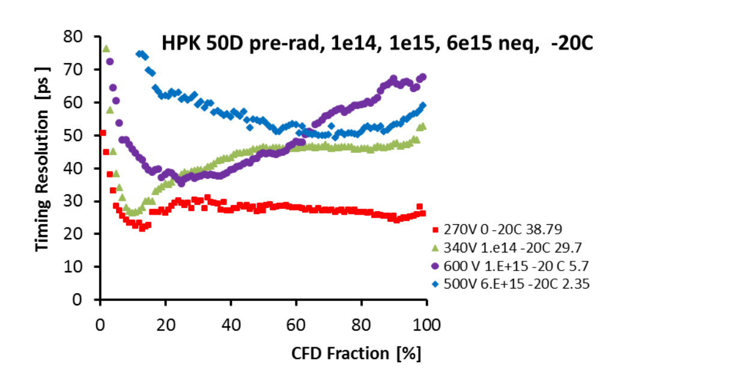
Radiation Tolerance
Excellent agreement of signal simulation (WF2) with data.
High fluence increase dV/dt and shorten the signal. This makes preferable CFD, provided it is tuned vs fluence, over ToT time measurement.
See Gregor’s Talk

Slide 32
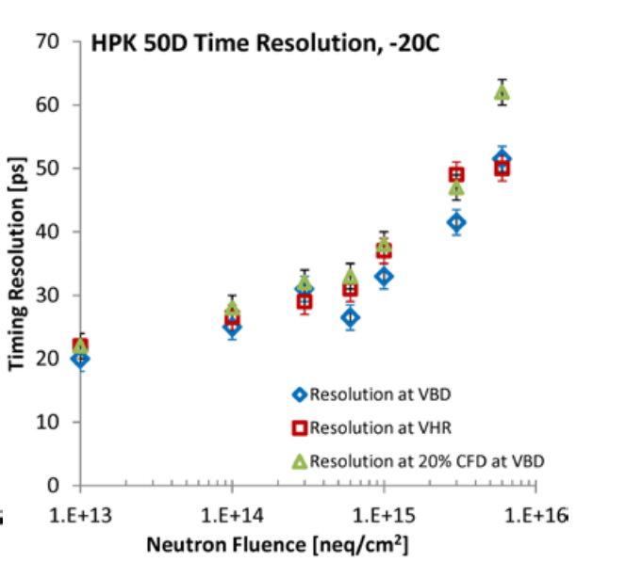
Radiation Tolerance
Increasing the fluence:
Break Down Voltage increases (from 300V at pre-irradiation to 750V at highest tested fluence
Gain at V_{BD} decreases
For a CFD fraction optimized for each fluence and bias, the time resolution increases from 20 ps pre-irradiation to 40 ps at 1 10¹⁵ n/cm² up to 50 ps at 6 10¹⁵ n/cm²
Even if the gain at large fluences decreases, the increase of the rise time in the pulse height still compensates and guarantees good time resolution
Reducing the temperature from -20C to -30C improves the timing resolution by 10% at large fluences where the gain is reduced to below 3.
The “headroom” between the breakdown voltage and an operating condition at lower bias causes a reduced timing resolution of a few ps.

Slide 33
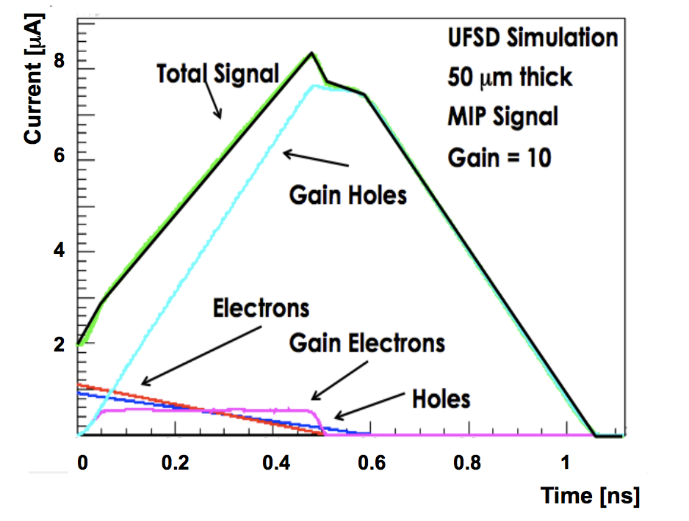
LGAD Signal
Signal rise-time is given by electrons drift time
Charge formation and multiplication takes a considerable fraction of time.
Gain Holes dominate the signal, whilst Gain Electrons current contribution is negligible.
Weightfield2 Simulation

Slide 34
Possible Choices of Preamplifier
Current Amplifier
Fast slew rate
Higher noise
Sensitive to Landau bumps
More power
Current signal in a 50 mm sensor
Integrating Amplifier
Slower slew rate
Lower noise
Signal smoothing
Less power

Slide 35
Time Resolution Optimization
As expected, the jitter contribution follows the inverse of the signal derivative: at the start and at the end of the pulse the
contribution decreases, as the pulse shape is less steep. The effect of gain is rather predictable: higher
gains yield to lower jitter. The Landau noise term, on the other hand, is rather insensitive to the gain
value, but shows a clear dependence upon the CFD settings: it is minimized using the minimum
possible threshold.

Slide 36
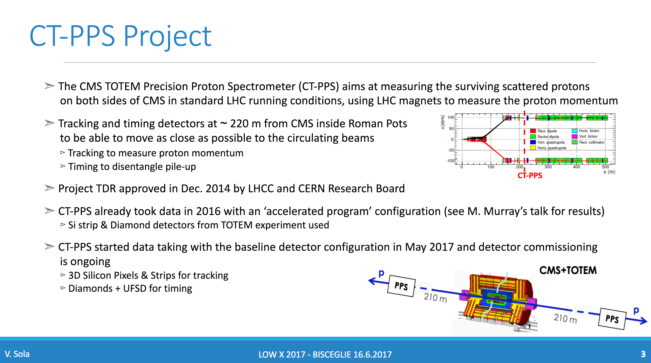
UFSD in HEP Experiments: CMS Totem Precision Proton Spectrometer

Slide 37
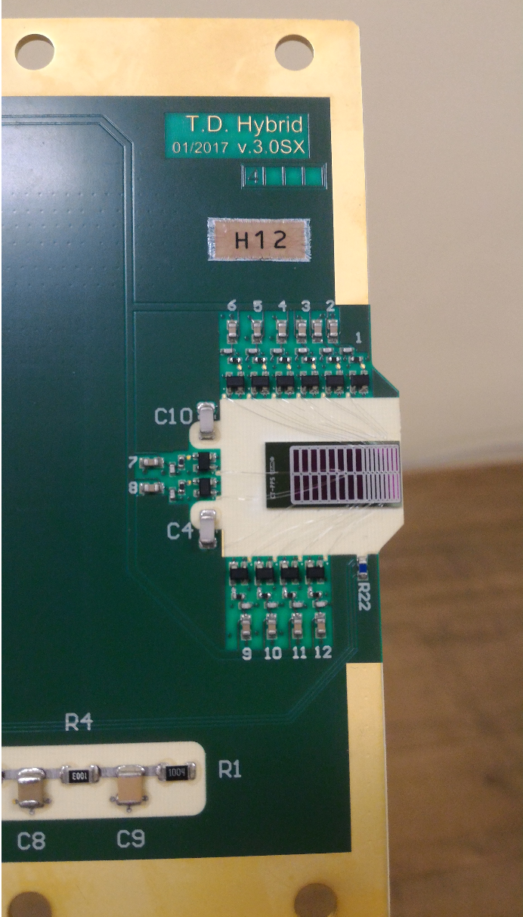
CT-PPS UFSD Timing Detectors
1 UFSD Plane installed (first prototype on HEP experiment!)
8 0,5x6mm² and 4 1x3mm² pads
Expected time resolution 35ps/plane
FE electronics on TOTEM custom hybrid
RO with NINO chip and HPTDC
Timing signal to be compared with a parallel scCVD Diamond detector
Installation completed in April 2017 and system currently taking data

Slide 38
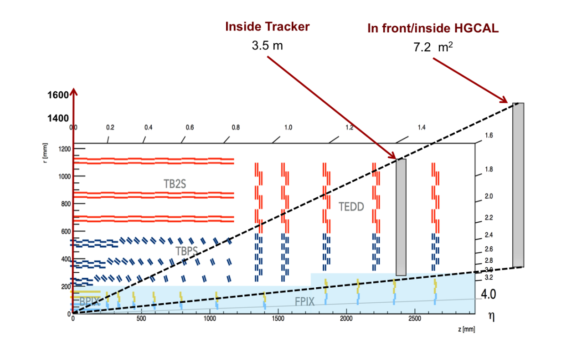
Proposal for a Forward Timing Layer for CMS HL-LHC
ATLAS and CMS are discussing the possibility to equip the experiments with a large area Timing Layer made of UFSD.
In CMS would cover the region 1.45 < η < 3
keep occupancy < 1%
low pad surface area (low leakage current to allow increased V_{Bias}, tipically <3mm²)
Low Gain to keep Low noise (Gain<20)
minimize dead area
sustain fluxes up to ~10¹⁵ particles/cm²
total detector area ~10m²

