Slide 1
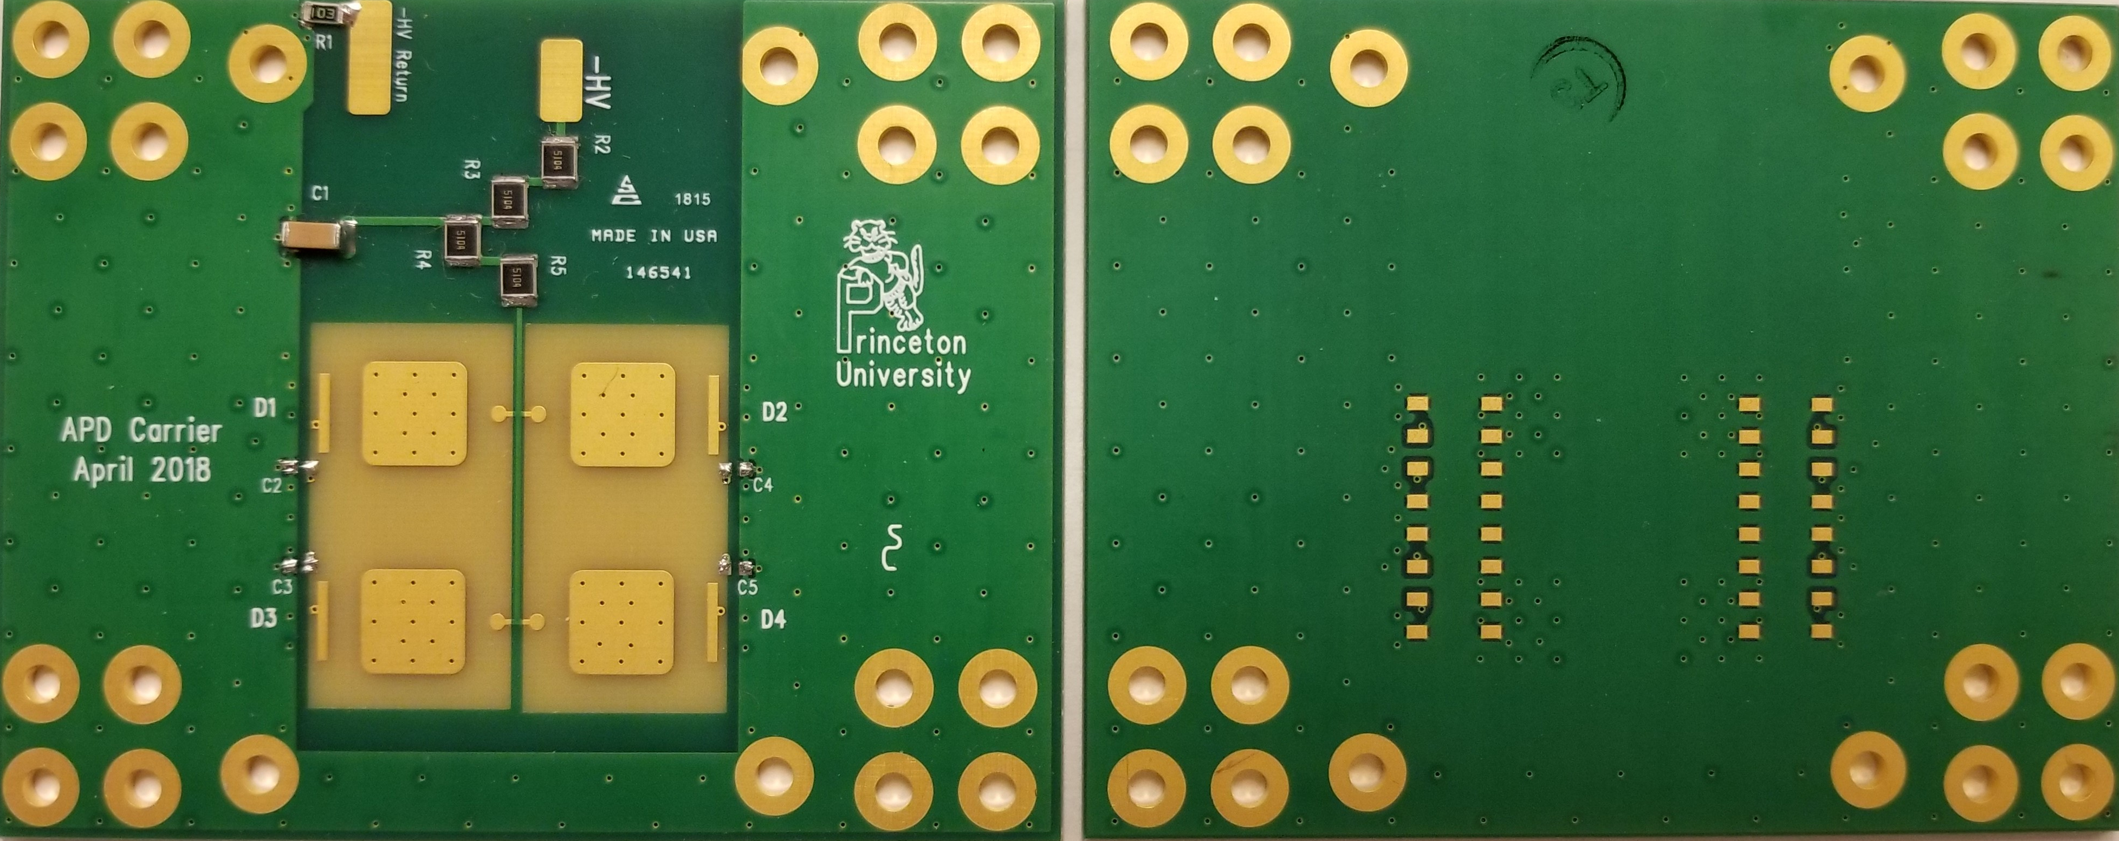
Carrier Board Tiling for RMD 8x8 mm² APDs
K. McDonald
Mar. 7, 2019
4-channel carrier board, for use with Penn ASICs.
Designed by Stan Chidzik.

Slide 2
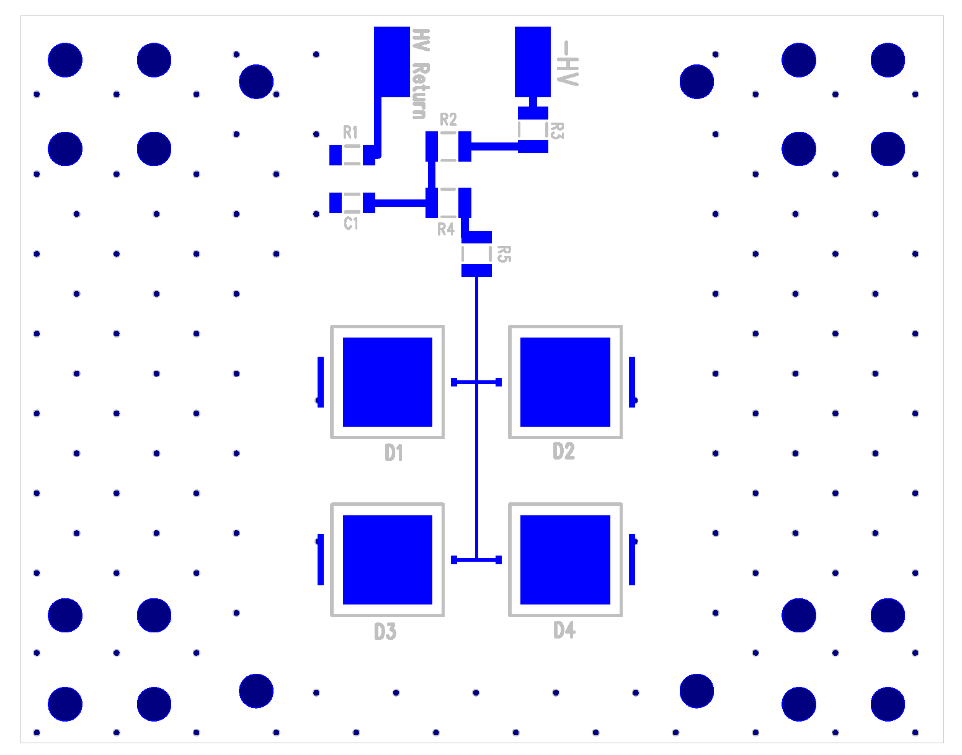
Four sets of mounting holes permit stacking 4 carrier boards with offsets so as to tile a plane with 100% coverage.
4 x 4 APD array, made from 4 4-channel carrier boards.

