Slide 1
G10 Carrier Board for RMD 8x8 mm² APDs
B. Harrop, K. McDonald, M. Newcomer
Apr. 4, 2017
G10 carrier board is 14x22 mm².
APDs have 10x10 mm² total area, mounted on the top of the carrier board.
APD bottom contact is 7.5x7.5 mm².
All vias are plated thru, and have pins, soldered on the bottom side.
Wire bonds connect the HV and S (signal) solder pads to the APD.
The HV pad, and the HV wire bond, are encased in conformal coating, on both top and bottom of the carrier board.
First try at a layout, 3/22/17:
APD

Slide 2
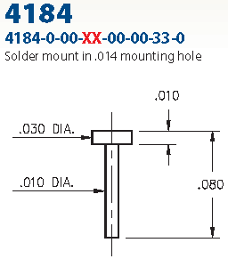
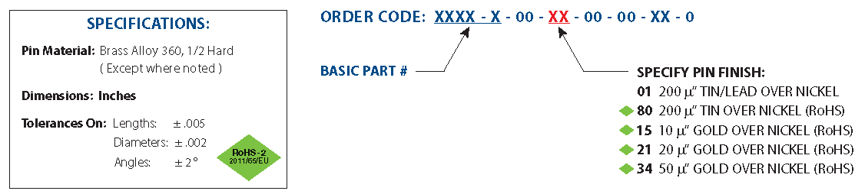
Pins
Pins to be Mill-Max 4184-0-00-15-00-33-0 “nail head” type, for 0.014” holes.
https://www.mill-max.com/assets/new_products/PCB%20Pins.pdf
Wire bonds will be made to the flat top of the pin.
Soldering of the pins to the carrier board should be done on its bottom (so no solder on top.)

Slide 3
Tiling
The active area of an APD is 8x8 mm².
So, to make a square tiling of such APDs, they could be on a carrier board that is 16x16 mm², with 25% active area per layer of tiling, and 4 tiling layers for 100% active area.
The carrier board:
APD active area 8x8 mm²

Slide 4
Tiling, II
A single tiling layer, with a 4x4 array of APDs; active area is 25%.
One APD on each of 4 tiling layers,
showing how 100% coverage is thereby obtained
The Penn preamps would be laid in a similar array, with external HV, DC and signal connections along, say the left edge. A multilayer board would facilitate this.

Slide 5
Preamp
The present Penn preamp is shown below, together with an indication of the 16x16 mm² footprint of the proposed carrier board.
The surface-mount components of the preamp should be rearranged to fit within this footprint on bottom side of the preamp board, with the HV connection (and the sockets for the pins of the carrier board) on the top side.
The low-voltage power conditioning, and the signal and HV connectors, will be outside the footprint of the preamp itself, as on the present board. This items should be on the top side of the new preamp to facilitate stacking of the preamp + APD units into a relatively compact 4-layer detector.
The new preamp will include diode protection, and a test-pulse input.

