Slide 1
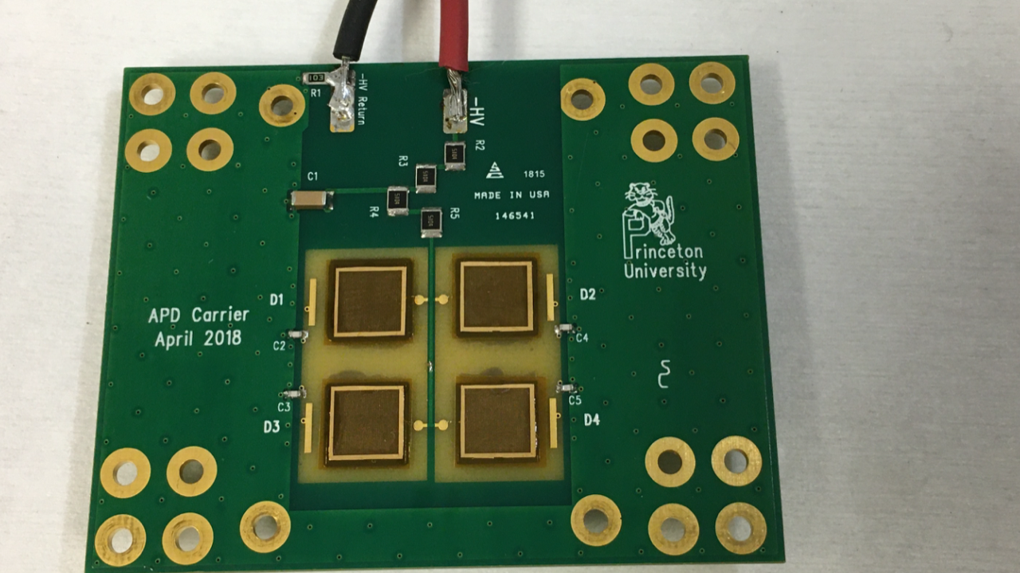
Proposed mod to the APD Carrier Board HV circuit K. McDonald, S. White Feb. 3, 2020
For each APD, add a 1 MΩ resistor, and make the wire bond from this to the APD.

