Slide 1
Failure of a 2nd RMD APD on a Penn Preamp Board
Notes Compiled by Kirk McDonald
March 13, 2017

Slide 2
Mesh APD Mounted at Princeton on a Penn Preamp, but then No Signal
Changguo Lu to Bert Harrop, Mar. 2.
Yesterday I did test the box, but very disappointed, I couldn't get any real signal. I also used the test pulse to check the amplifier, I didn't see the signal from the output. The amplifier might be bad. Sending it back to U Penn is the best option now.
Bert Harrop to Mitch Newcomer, Mar. 2.
The latest APD seems to be very stable under bias however Lu has had some issues getting an output. Initially with an Fe55 source it had seemed to work but then he seemed to lose the signal since. Being the APD is very stable it makes sense to me to send it back to U-Penn so Manny can take a look at it since if the amp need repair his approach to protect the APD is very nice.

Slide 3
First Tests at Penn after APD/Preamp Returned
Manny Morales to Changguo Lu, Mar. 9.
On Monday Mar. 6, I was able to get to take the APD to 1800V and saw that while the box is dark, there is about a 10uA draw from the high voltage supply, and was able to see some signals using a Cs137 source, but not enough from the Fe55 source to say that the amplifier/APD setup is working appropriately. The hits from the Cs137 source weren't as frequent as I saw them on previous setups, but after lowering the voltage to the amplifier from 4.1V to 3.1V, there was an increase in signals coming out of the amplifier.
Cs137
Fe55
Signals would be
negative if preamp
working properly.
As for the Fe-55 source setup, I was able to get a few signals, but the time between each signal was around 5 to 10 seconds between each, so there is a possibility that some of the pulses I recorded weren't from the Fe-55 source.

Slide 4
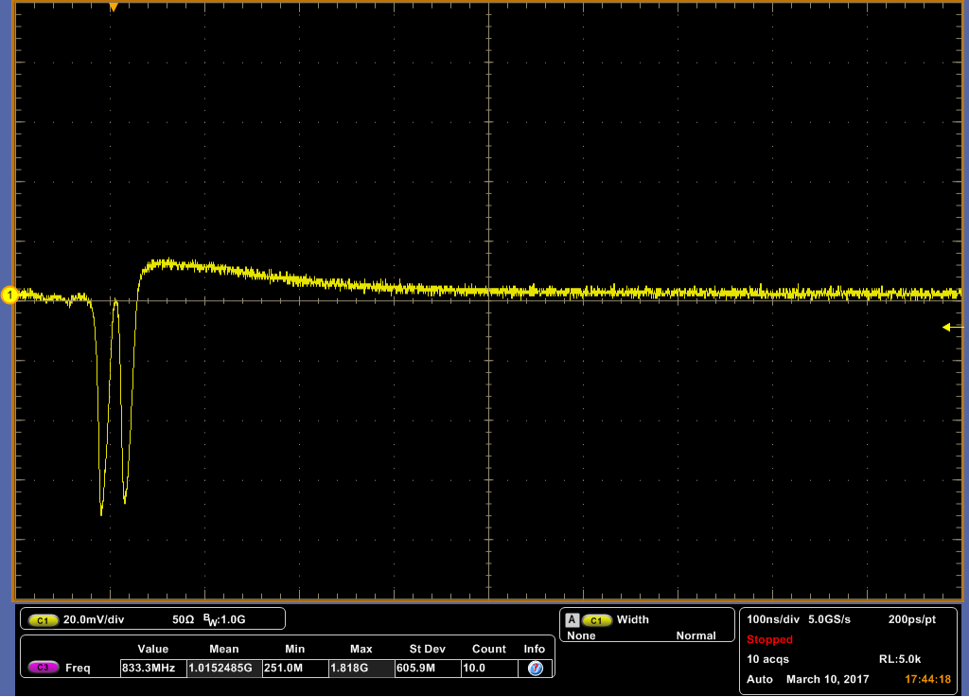
Notes from a visit to U Penn by Kirk McDonald, Mar. 13, 2017
Discussion with Manny Morales, Mitch Newcomer, Godwin Mayers, and Rick van Berg.
Manny described the sequence of events as
1. Mar. 6. Powered the APD to 1800V on arrival (with dead 1st transistor on the preamp)
With preamp power on, still could see occasional weak signals from a Cs source, probably associated with stray capacitance between the 2nd transistor and the APD output.
2. Mar. 10. Replaced the bad transistor, with the APD inside the Kapton tent.
3. Tested that the various voltages were OK when DC power applied to the preamp. At present, there is no means to apply a test pulse to the preamp to verify it OK,, Rather the APD must be powered to provide a test signal. In future board design, a test pulse input will be added.
4. Raised APD voltage to 1300 V, when occasional pulses were observed (none are expected in normal operation at this voltage). Signal was negative, ⇒ First transistor still alive. (Why the double pulse?)

Slide 5
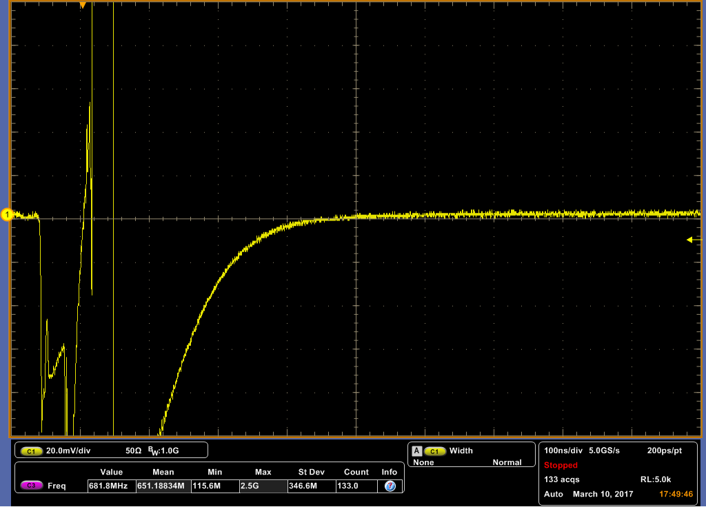
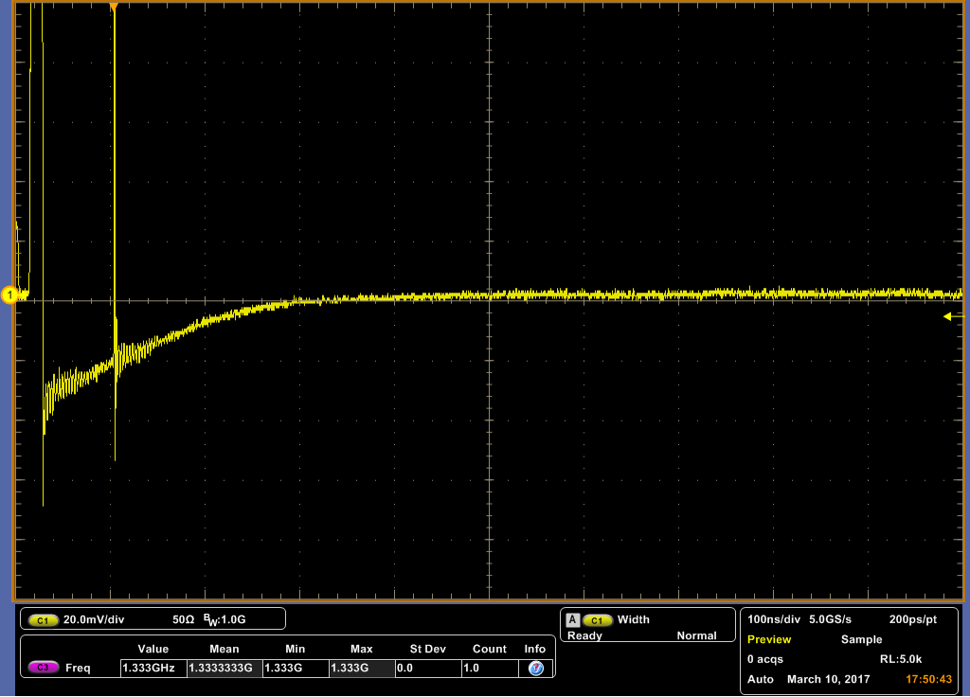
5. Raised APD voltage to 1500 V, when larger pulses were occasionally observed.
In retrospect, damage to the APD was probably occurring already in steps 4 and 5.
Signal still negative, ⇒ 1st transistor still alive.
6. Raised APD voltage to 1700 V, and now saw one large pulse, with wrong polarity.
This seemed to kill 1st transistor of the preamp, as the signal
was now positive.

Slide 6
Comments and Initial Followup
Rick van Berg reminds us to try use of some kind of "conformal coating" on the APD edges (where the spark breakdown seems to be occurring).
While we has discussed this, it has never been tried. Perhaps now we should.
Rick also encouraged us to reinstate diode protection for the preamp. We did then when using Wenteq preamps, but no protection diodes are in the present Penn preamp design.
Mitch Newcomer to Changguo Lu, Mar. 13.
We are installing a double diode on the input of the amplifier to improve its resistance to breakdown. Protection for negative going pulses is all we can easily install,

Slide 7



