Slide 1
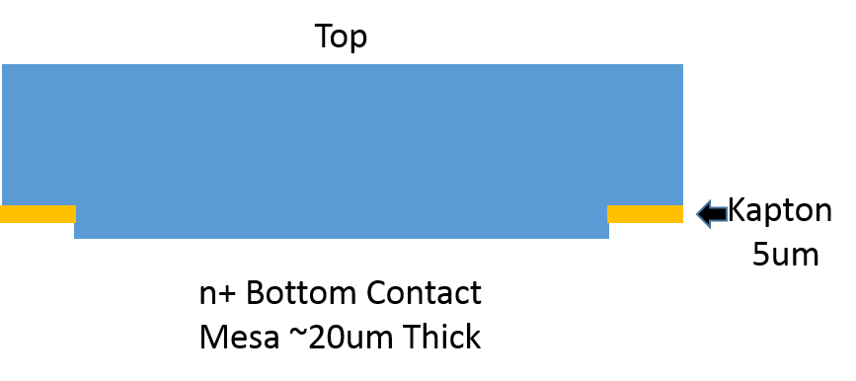
RMD APD Mounting Scheme K.T. McDonald Dec. 12, 2016
Bert’s sketch:
Saw-cut trench
Top
Existing 5-μm polyimide
APD bulk Si, ~ 10 mm wide, ~ 260 μm high
Conformal coating
New 5-μm Kapton
APD n+ mesa, ~ 7.5 mm wide, ~ 20 μm high
CU layer with trace to preamp
Silver epoxy
PC board

