Slide 1

RMD 8x8 mm² APD with Spark Damage
B. Harrop
Princeton University
Feb. 28, 2017

Slide 2
An RMD 8x8 mm² APD was recently packaged at Princeton, with a mesh top, and then silver epoxied to a Penn preamp.
This APD + preamp was powered at Princeton to 1800 V
However, on arrival at Penn, the APD drew significant current at 1400 V.
The APD + preamp was sent back to Princeton, where the large current draw at 1400 V was also observed.
Various images of the APD, slides 3-8, show spark damage, perhaps due related to various fractures observed along the sides of the APD
Other “bare” APDs recent obtained from RMD show similar fractures.
Chris Tully suggests using our laser dicer to trim the bare RMD APDs
before packaging.

Slide 3
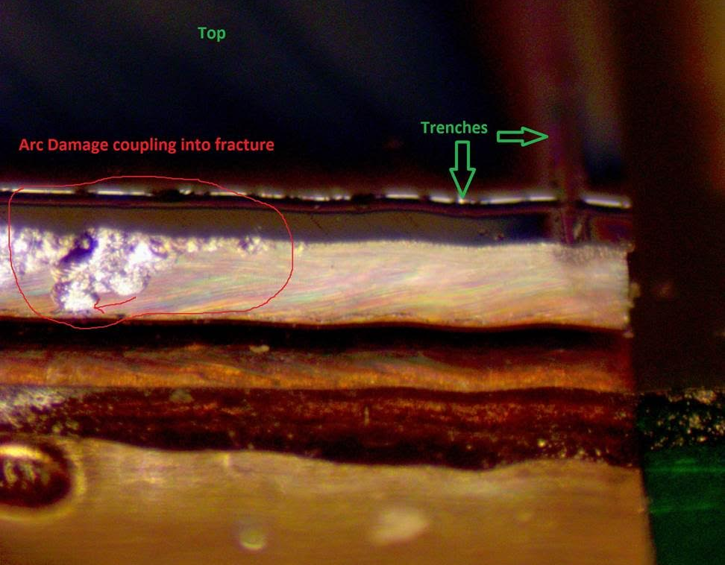
Spark damage is visible along one side of the APD, with large cratering near the top (p-side) edge, and damage extending down to the bottom edge (n-side)

Slide 4
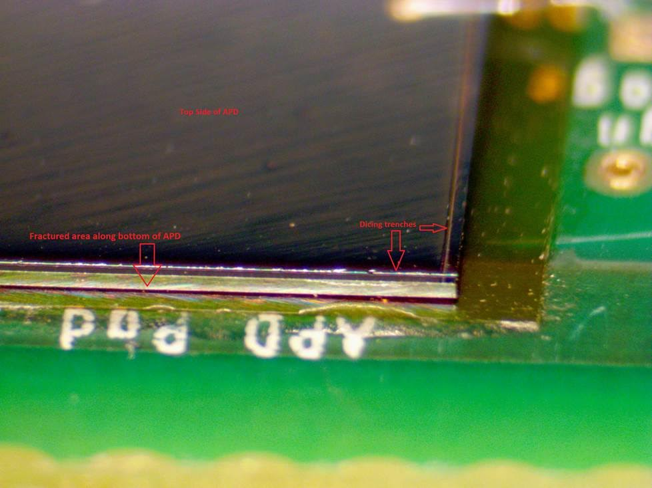
Location of the spark damage
For this image, the mesh on top of the APD has been removed.
The trenches in the top face are visible.
The damage occurred about 1 mm from an APD corner, but is not visible in this view.

Slide 5
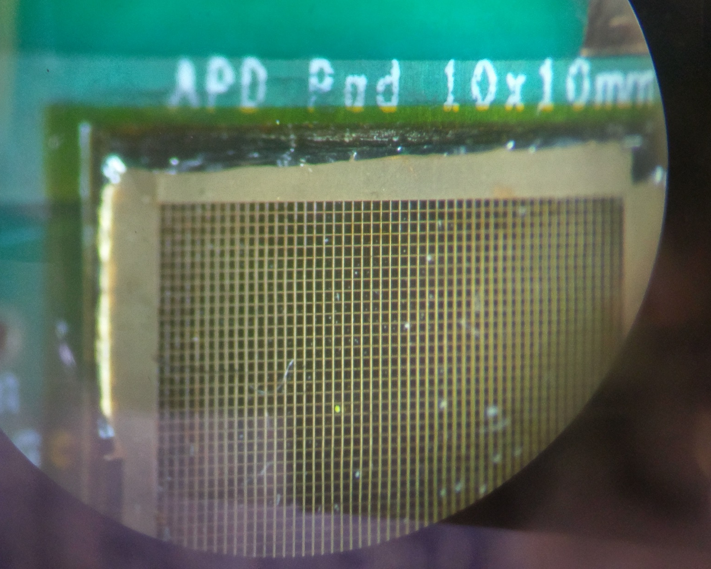
Location of the spark damage
This image was taken a U Penn, before the mesh on top of the APD was removed.
Lots of “dust” was visible on top of the APD,

Slide 6
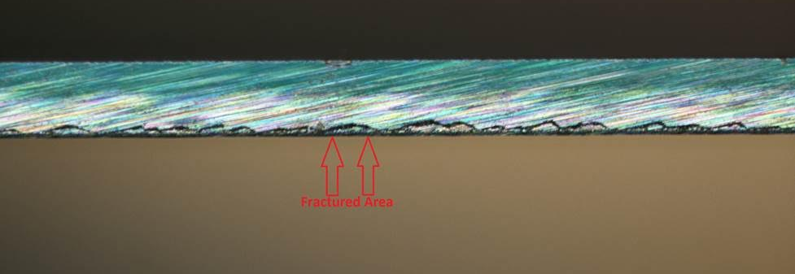
View of a portion of the APD side, away from the region of spark damage.
Considerable fracturing is visible along the bottom (n-side) edge.
Could such fracturing render the APD prone to spark damage?

Slide 7
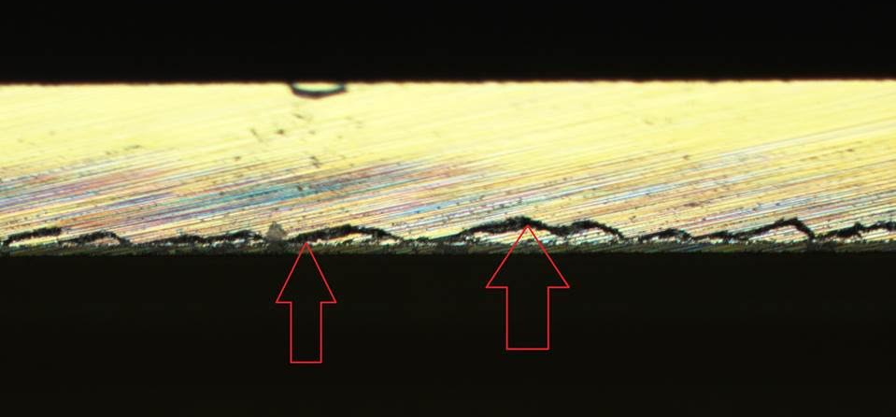
Closeup of the previous image, showing a fracture along the top edge.
Was this combination of top/bottom fractures close to sparking?

Slide 8
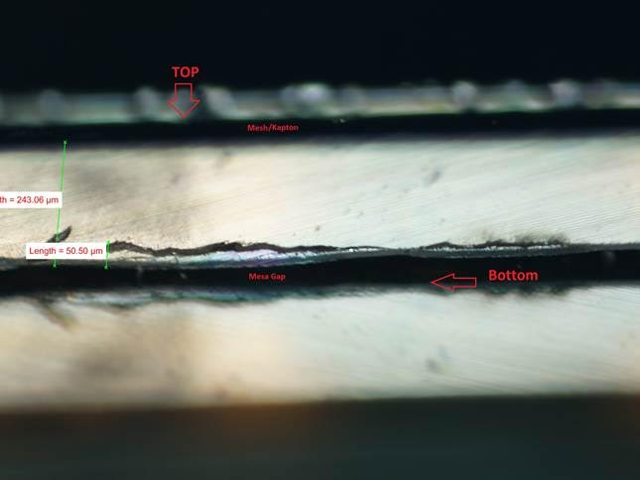
View of another region of the side of the APD

Slide 9
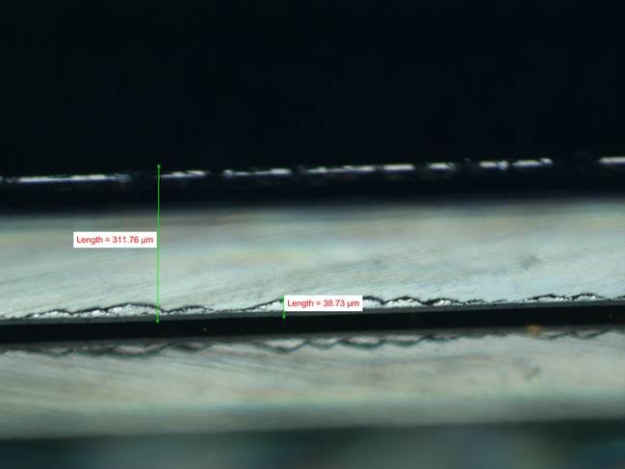
View of yet another region of the side of the APD

