Slide 1
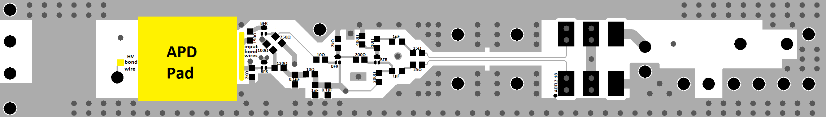
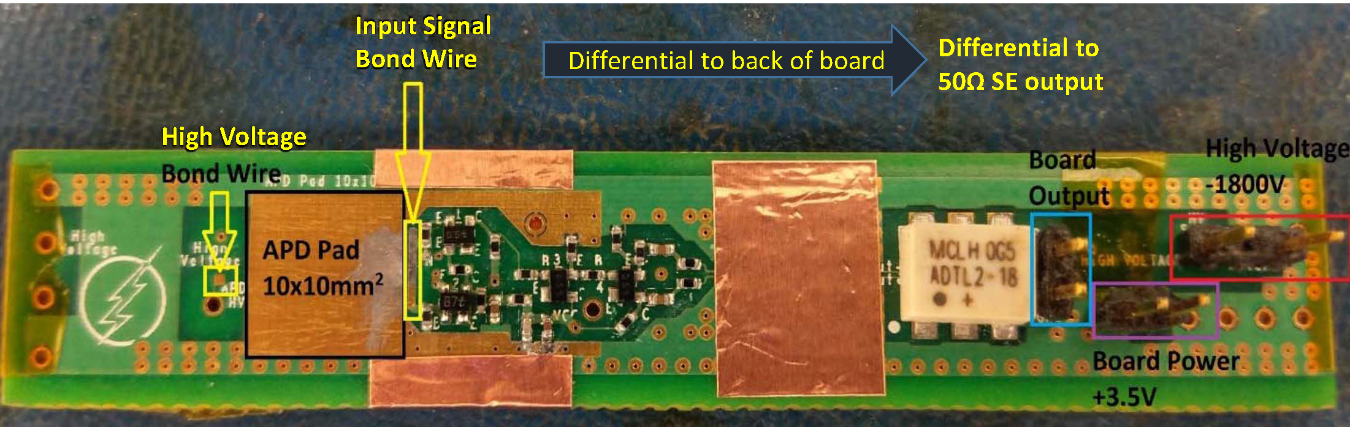
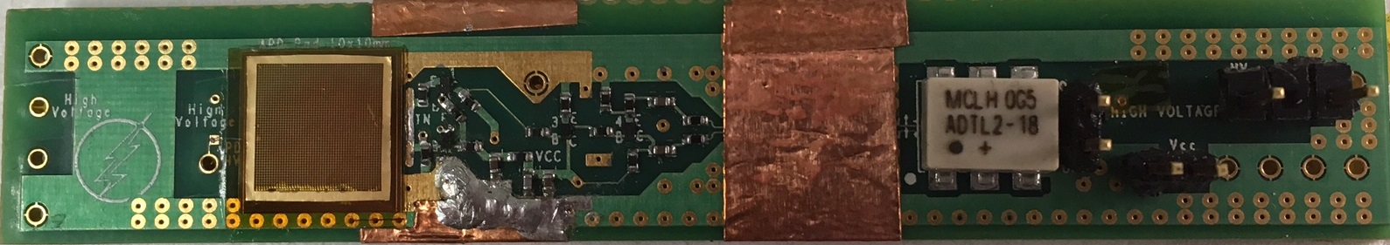
Packaging of RMD APDs with External Mesh Electrodes
on U-Penn Amplifiers
Bert Harrop
Princeton University
Mar. 17, 2017

Slide 2
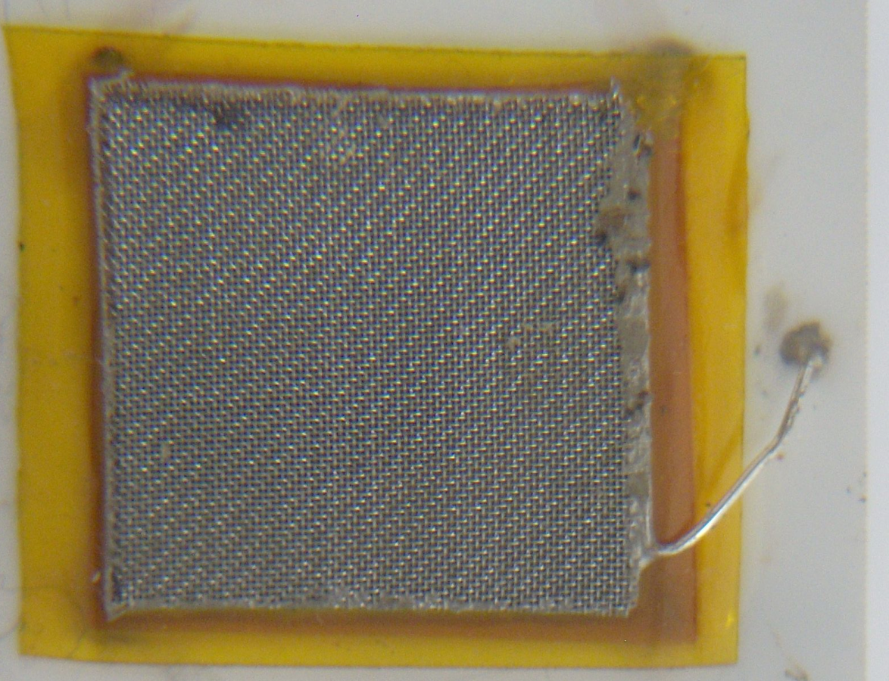
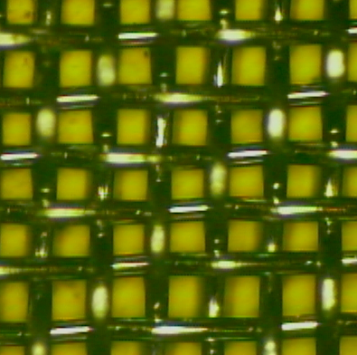
RMD 8x8 mm² APD – Al-mesh-screen scenario (Nov. 15, 2012)
http://physics.princeton.edu/~mcdonald/LHC/Tsang/APD_8x8mm_mesh_screen_111512k.ppt
Sketch by Thomas Tsang
Output to Scope
Mesh Screen (“top” side)
p⁺
Kapton Tape, 0.002 in.
- HV connected to “top” (p-side)
APD
n-side contact on original APD
Ground
n+
Sintered Au layer (“bottom” side)
Al₂O₃ Substrate
Contact between screen and n+ side made by Au epoxy thru hole in Kapton
McMaster 9227T417, 200 mesh, 33.6% open
Al mesh screen
connection
2-mil
Kapton
spacing
~ 128 µm
opening
~ 85 µm
(Kapton transmit > 93% 980 nm light)

Slide 3
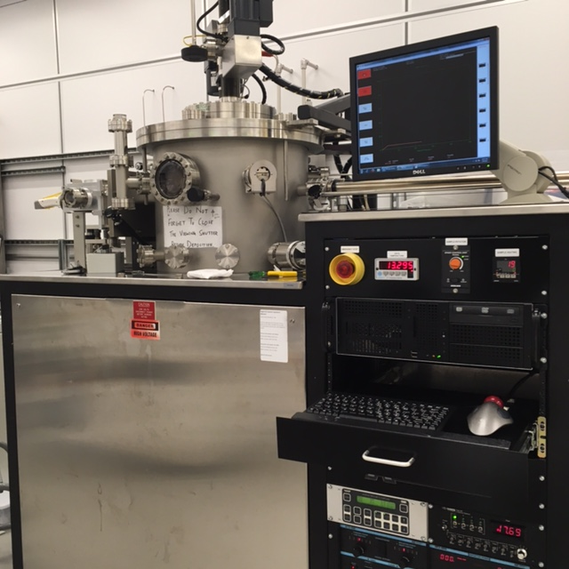
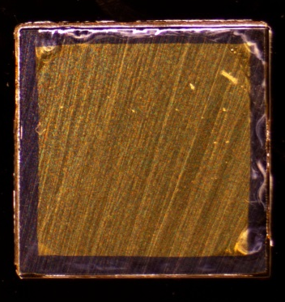
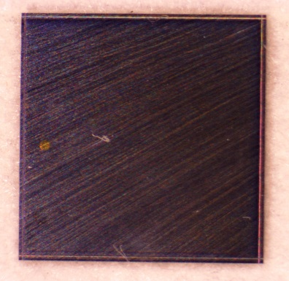
2017: Magnetron Sputtering of Top/Bottom APD Contacts
A bare RMD APD die is 10x10 mm².
The sensitive area is about 8x8 mm².
The top (p-side) is photosensitive.
A small electrical contact is made to the top side.
The bottom (n-side) has a 7x7 mm² “mesa,” which serves as a large electrical contact.
These contacts are made by sputtering
Ti/Au layers of 20/200 nm.
Bottom Contact (Mesa)
Top Contact (Dot)

Slide 4
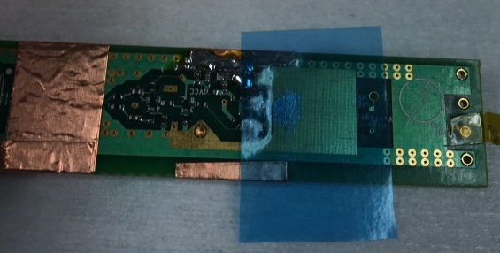
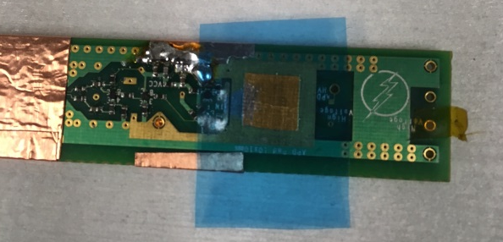
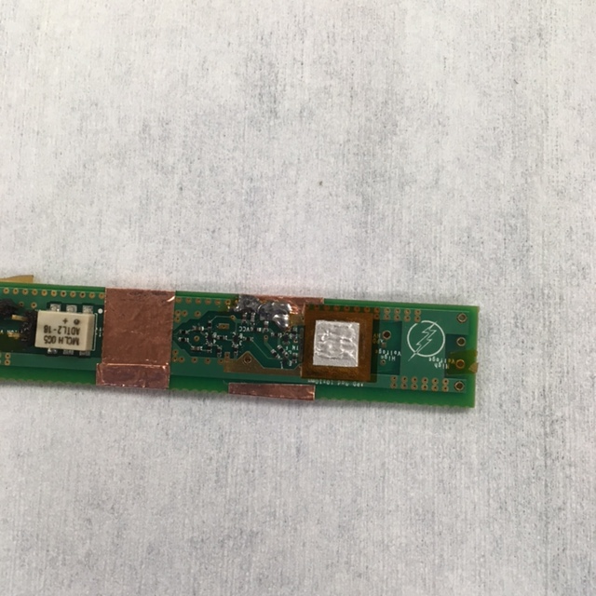
Applying the conductive H22E Epotek Silver Epoxy
to the 10x10 mm² Contact Pad of the Penn PCB
Apply Thin Film (50 μm) Adhesive
Create 7x7 mm² opening in Mask
Apply Silver Epoxy, Remove Mask

Slide 5
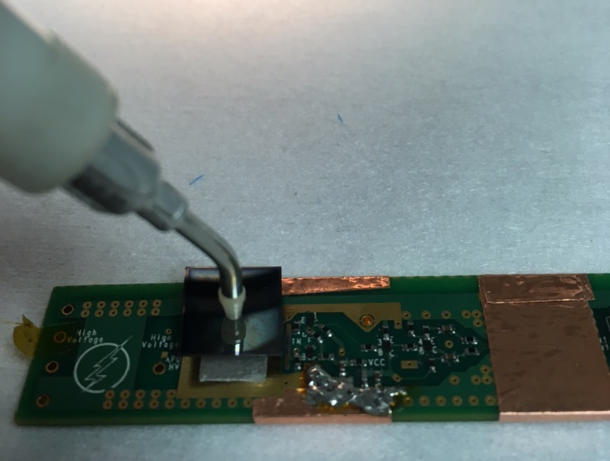
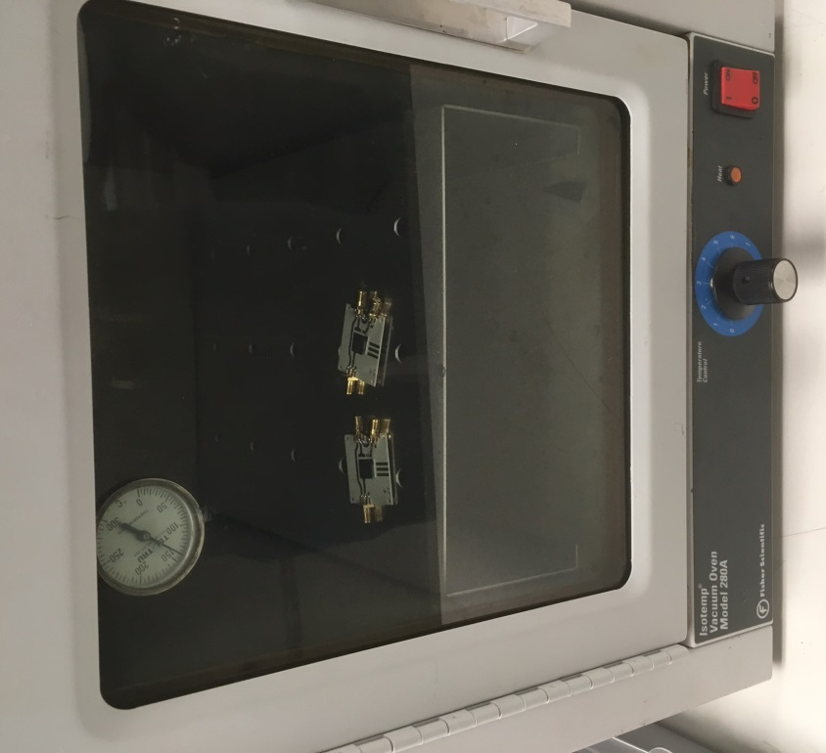

Die Bonding of the APD
Placing APD onto epoxy
Cure Epoxy in Vacuum Oven
5 Minutes @ 150C

Slide 6
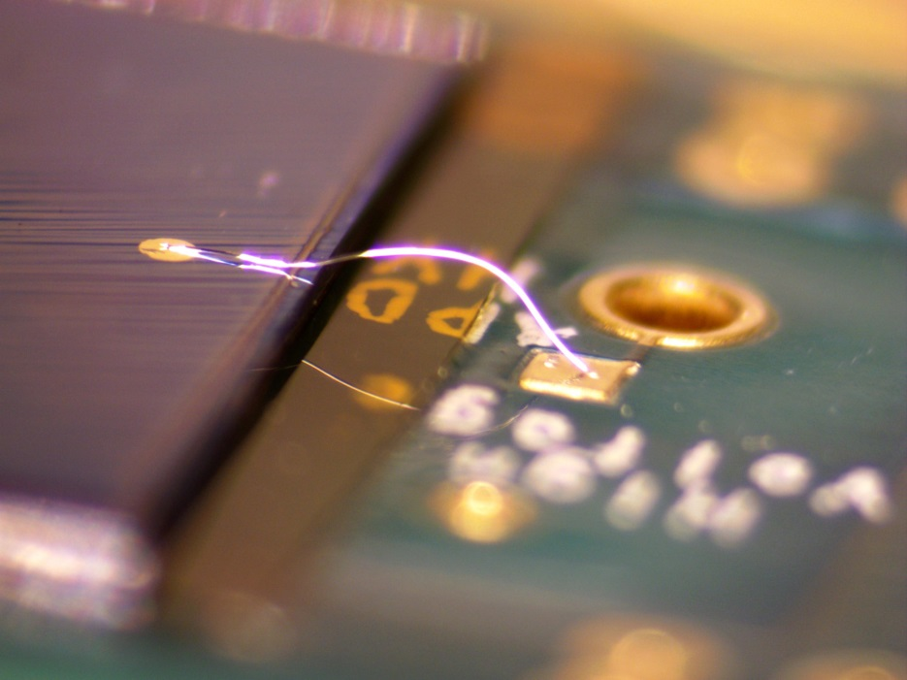
Wire Bond Top Contact (for –HV)
25-μm-Al Wirebond (Wedge)

Slide 7
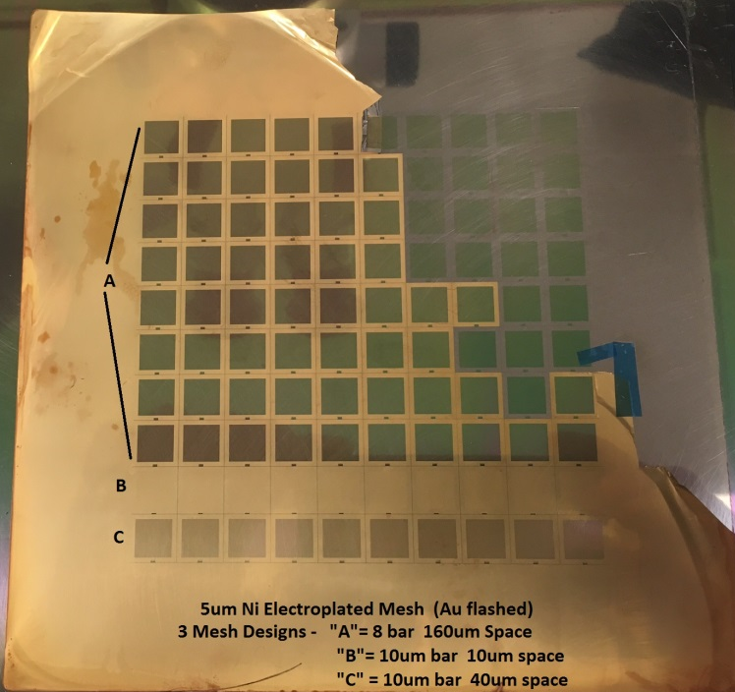
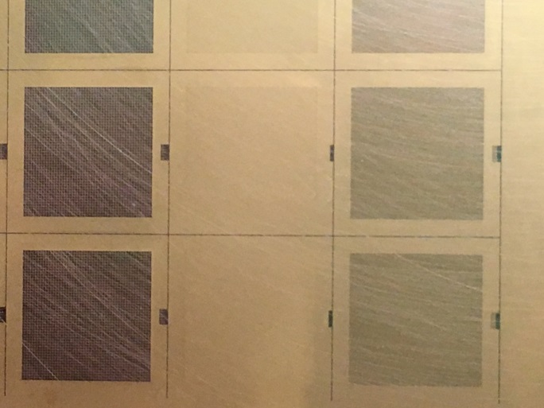
Electroplated Ni Mesh
5-μm sheet of 100 electroplated Ni meshes (Au flashed).
3 Mesh Designs:
A = 8-μm bar, 160-μm spacing, 90% open
B = 10-μm bar, 10-μm spacing, 11% open
C = 10-μm bar, 40-μm spacing, 64% open
A
B
C
We use the type A meshes now.

Slide 8
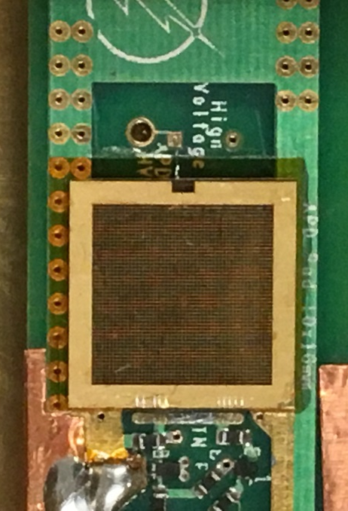
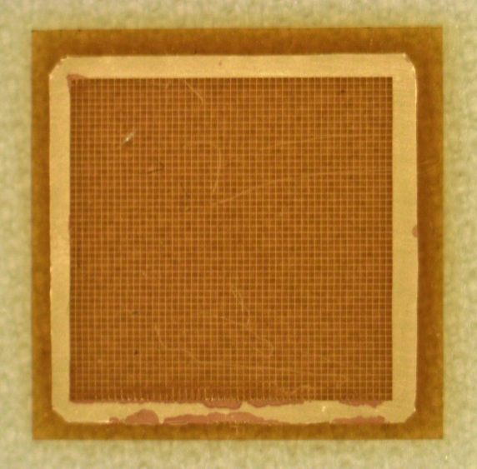
Mount Mesh on the APD
Type A Mesh mounted on 50-μm Kapton
(100-nm-Au flashed)
Mesh mounted on APD
First transistor of the preamp

Slide 9
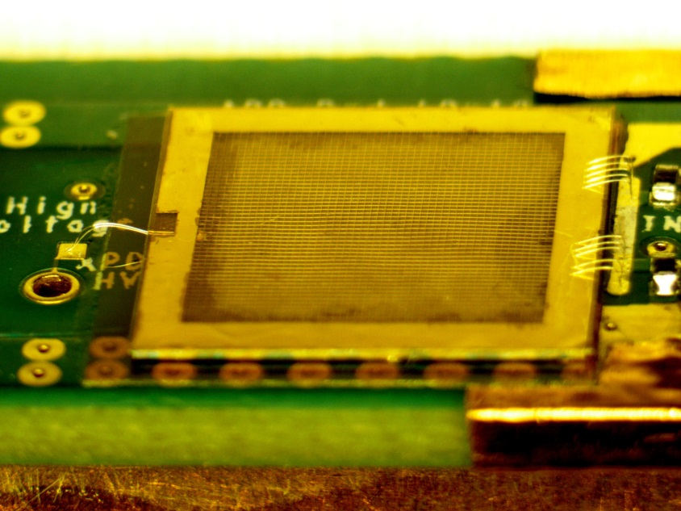
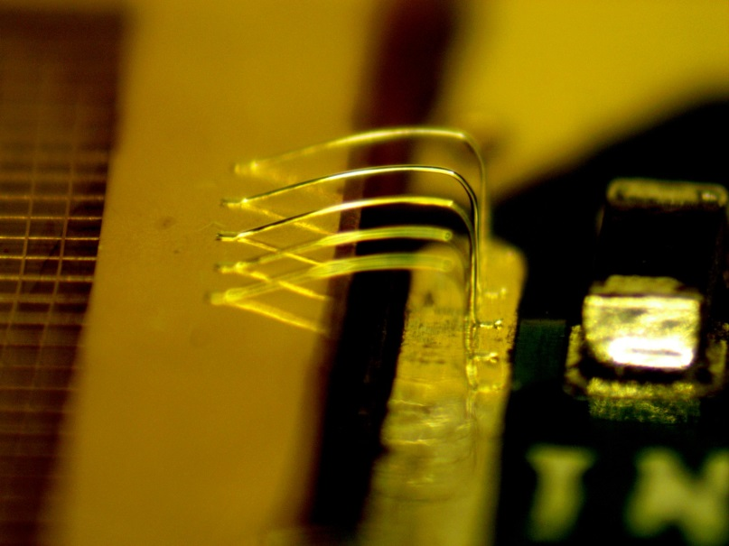
Wirebond Mesh to Amplifier Input
-HV Wirebond to top (p-side) contact
Mesh Signal Wirebonds
This version of the preamp/APD operates with the bottom side of the APD at ground, its top side at –HV, and the mesh at ground.

Slide 10
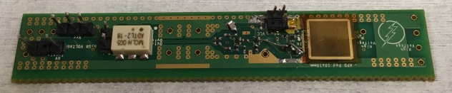
Completed APD / Amplifier

