Slide 1

RMD 8x8 mm² APD Packaging on CERN Alumina Test Boards
B. Harrop
Princeton University
March 9, 2017

Slide 2
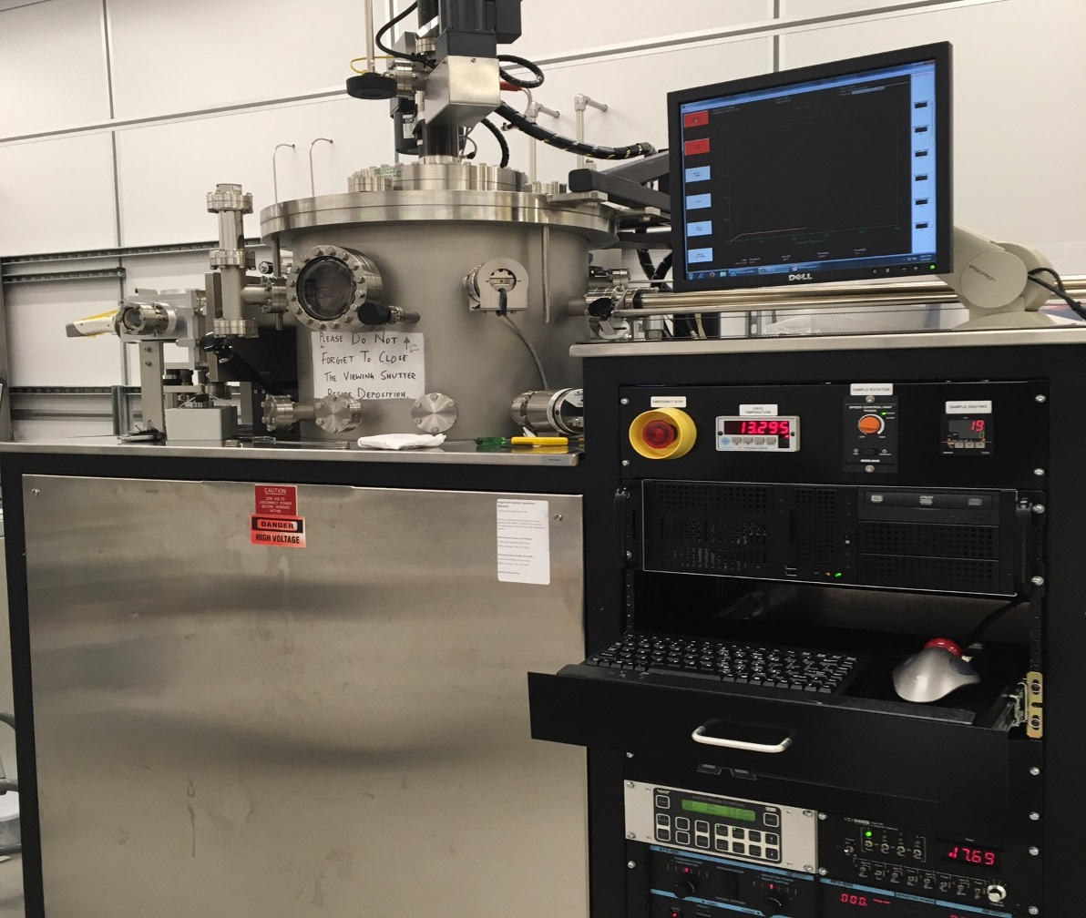
Magnetron Sputtering of the Titanium/Gold Contacts

Slide 3
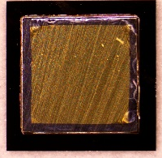
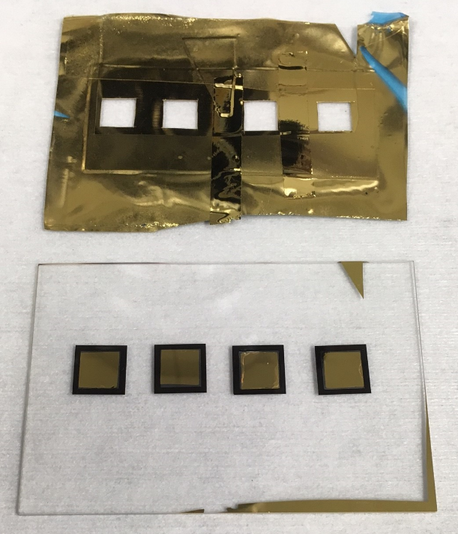
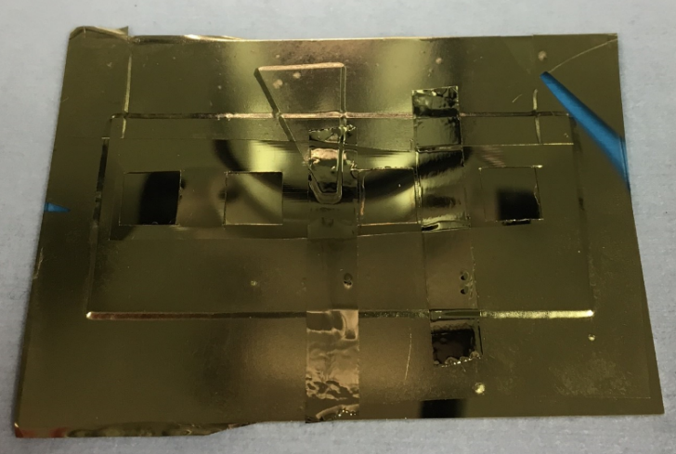
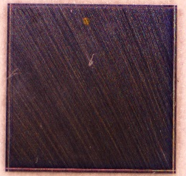
Magnetron Sputtering of the Titanium/Gold Contacts
(Continued)
50/200-nm Ti/Au
Back Contact
Top Contact
Shadow Mask
Mask Removal

Slide 4
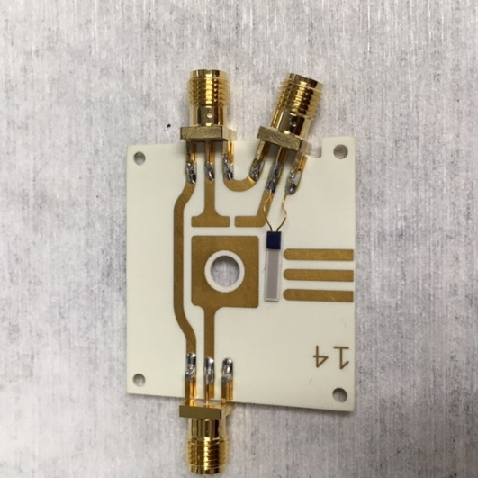
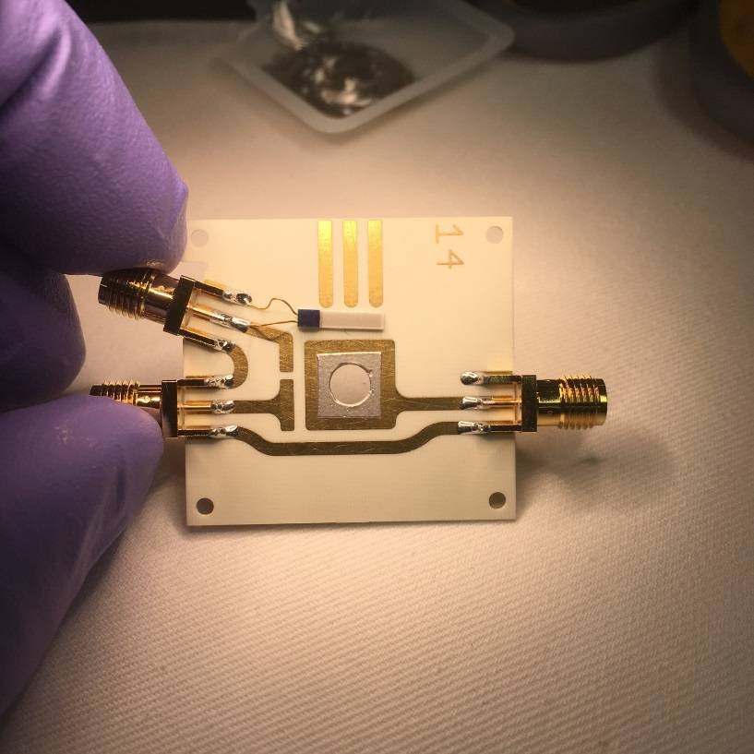
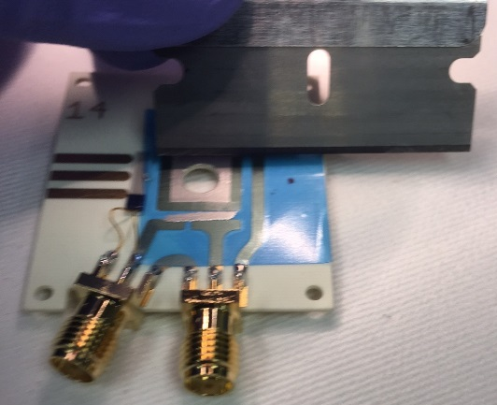
Mounting the APD to the Substrate with Epotek H22 Silver-Loaded Epoxy
CERN Alumina Substrate
Remove 50-μm Mask
Screen, 50 μm of Silver Epoxy

Slide 5
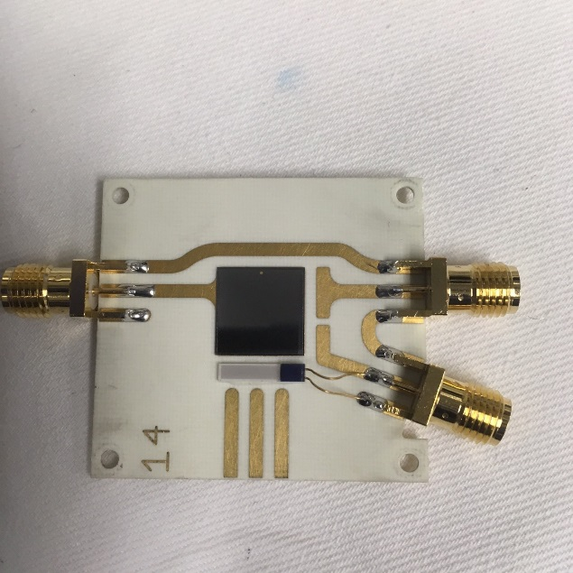
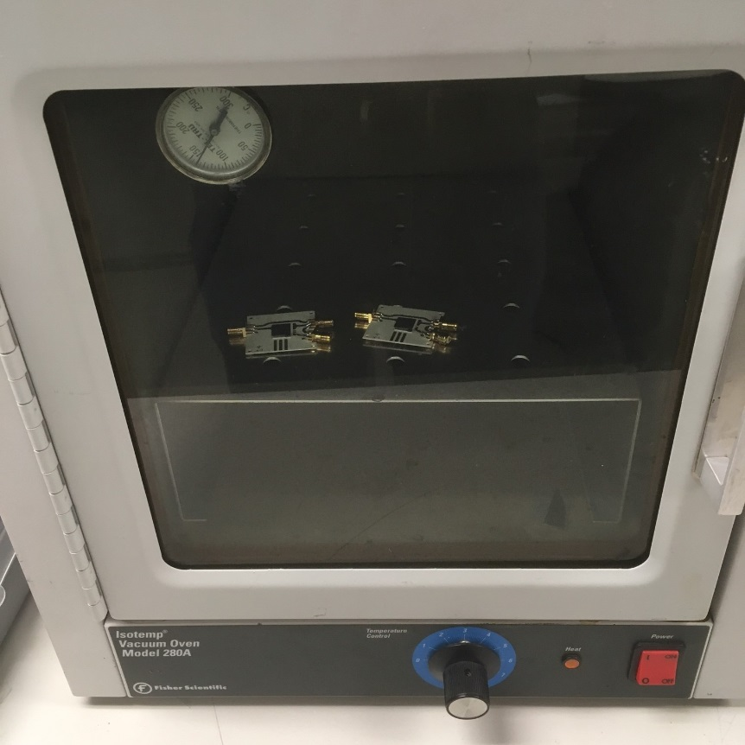
Mounting the APD to the Substrate with Epotek H22 Silver-Loaded Epoxy
(Continued)
Die Bond (Place) APD onto Silver Epoxy
Cure Silver Epoxy @ 150C, 5 minutes

Slide 6
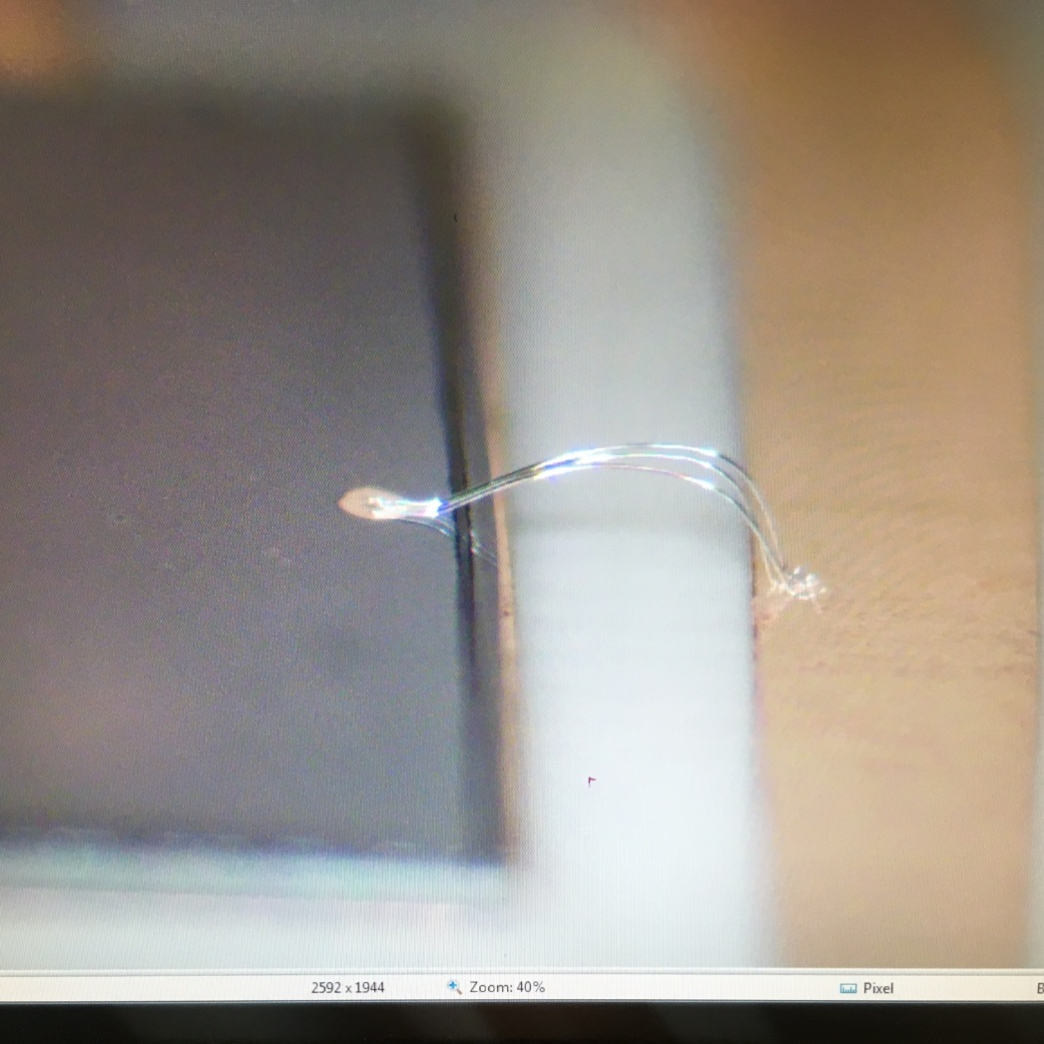
Ground 25-μm Aluminum Wirebonded Contact
To Top Side

Slide 7
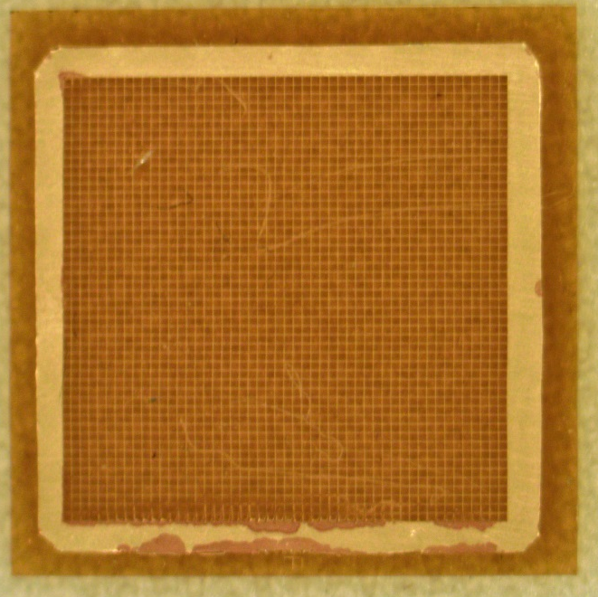
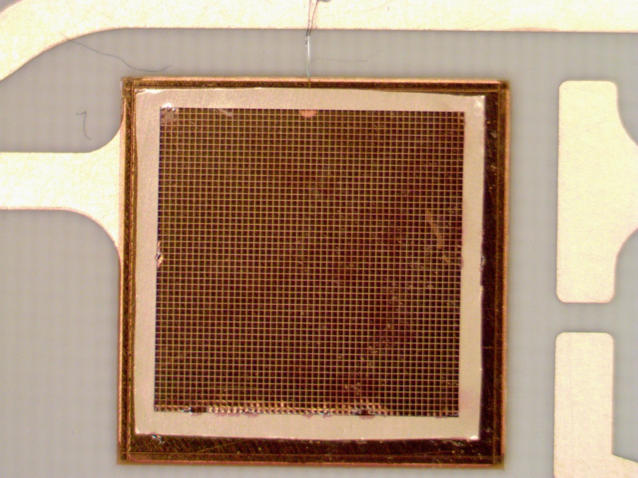
Bond the Mesh and Wirebond to the APD
Future version will have mesh fabricated on Kapton
Mounted Mesh on APD
APD is 10 mm square
Future version will have a notch
in the mesh/Kapton for
the top contact/wirebond
5-μm Nickel, Au-Flashed, 50-μm Kapton Mesh
Mesh is 9.5-mm square, 8/160-μm pitch
Kapton is 10.2-mm square

Slide 8
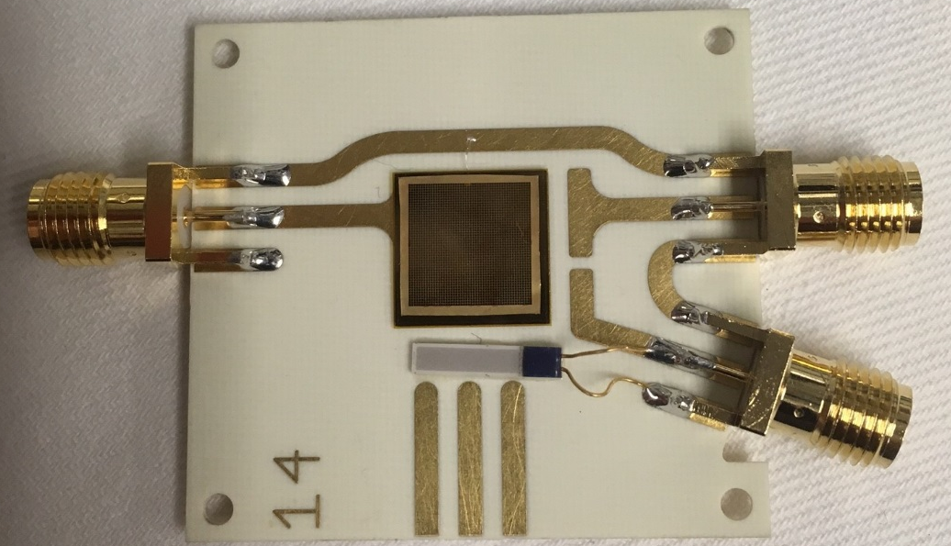
Completed Package
Except for wirebond to top right SMA
Wire bond to be added between mesh and signal pin
+HV connector to bottom side
Signal connector
Should add 10 MΩ protection resistor here (after cutting the trace to create a gap for the resistor)
Thermistor
In this scenario, the signal readout is between the mesh and the APD top contact, rather than between the mesh and the bottom contact. As such, time walk and signal uniformity will be poor, due to the “high” resistivity of the top contact. Should instead have capacitive coupling between the signal pin and the bottom side contact.

