Slide 1
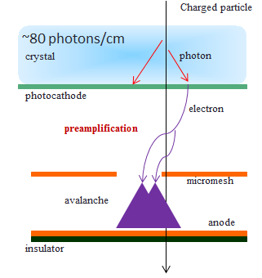
modelling timing Micromegas
(slightly refurbished compared to 1.5years ago)
D. Gonzalez-Diaz, F. Resnati, R. Veenhof,
CERN, 21/02/2017
T. Papaevangelou et al., arXiv:1601.00123v2

Slide 2
idea: develop a simple code for taking technological decisions
Obtain MC solutions from a 1D hydrodynamic formalism under ‘reasonable’ assumptions:
Diffusion and drift parameters taken from Magboltz.
Assume statistical equilibrium in between ionizing collisions (Legler model).
Assume uniform fields in both drift and Micromegas regions; characterize electron transmission between them by a single parameter (T), modelled as a simple binomial process.
Add exponential fluctuations during Micromegas amplification (G_{MM}).
Multiplication along the drift region (G_{D}) and transmission (T) estimated from comparison between data and COMSOL simulations.
Calculate the induced signal from Ramo theorem, include capacitance and FEE.
Produce waveforms and apply a pulse-shape analysis similar to what is done in data.
Magboltz (hydro input) + COMSOL (hydro average solution) + MATLAB (hydro stochastic solution)

Slide 3
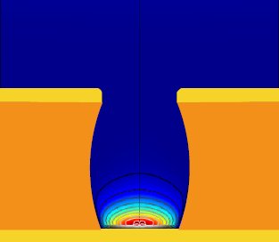
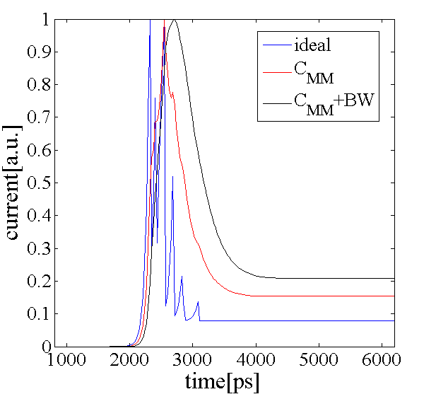
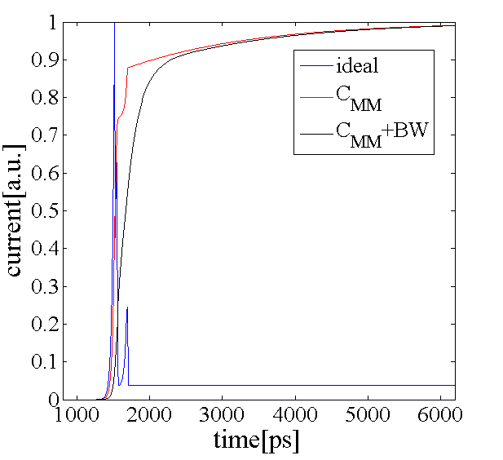

general hydrodynamic equations (field along z)
n: 3D electron density
z: direction of the electric field
$\frac{∂}{∂t}n={\left(α−η\right)nv_{d}+D}_{T} \left(\frac{∂^{2}}{∂x^{2}}n+\frac{∂^{2}}{∂y^{2}}n\right)+D_{L}\frac{∂^{2}}{∂z^{2}}n+v_{d}$ $\frac{∂}{∂z}n$
${D^{∗}}_{T,L}=\sqrt{\frac{2D_{T,L}}{v_{d}}}$ units: [length^{0.5}]
full 3D stochastic solution: computationally expensive
(use Garfield++ or, even better: Garfield++/microscopic)->R. Veenhof/S.Biagi
OR
stochastic solution from
1D-MC (‘a la Legler’)
average solution
(e.g. COMSOL)
bulk-MM
microbulk-MM
axi-symmetric model of microbulk micromegas (color code: electron density at a given time)
(single-electron induced signal)

Slide 4
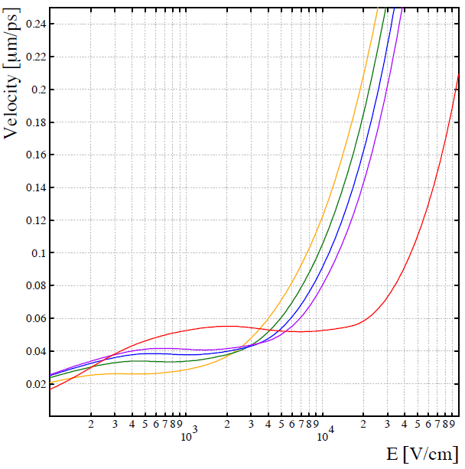
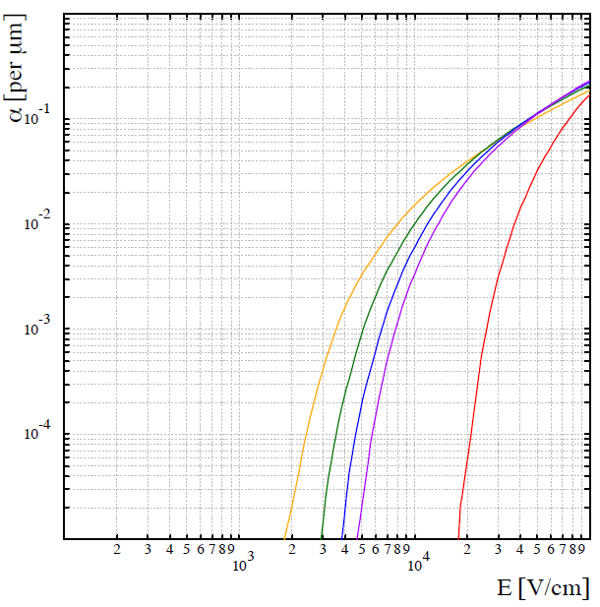
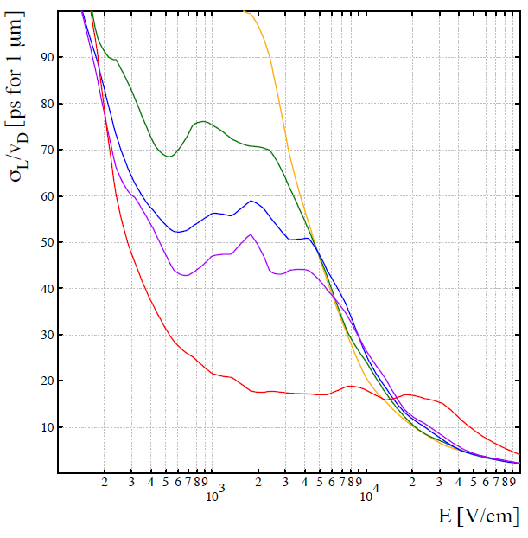
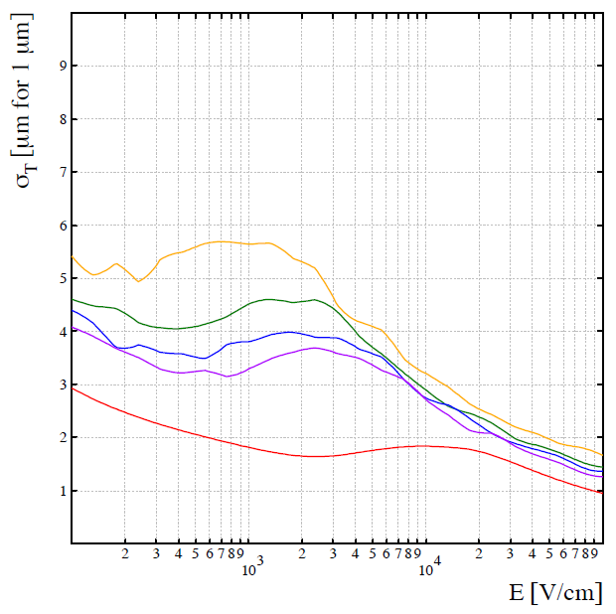
input parameters for simulations: Ne–C₂H₆ (Magboltz)
R. Veenhof
5% C₂H₆
α-η [μm⁻¹]
v_{d} [μm/ps]
10% C₂H₆
15% C₂H₆
20% C₂H₆
100% C₂H₆
D_{L}*/v_{d} [ps/√μm]
D_{T}* [μm /√μm]

Slide 5
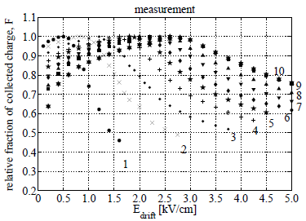
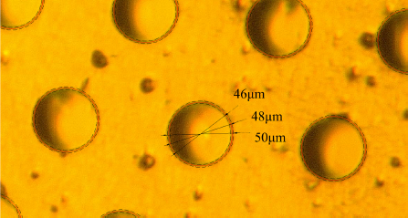
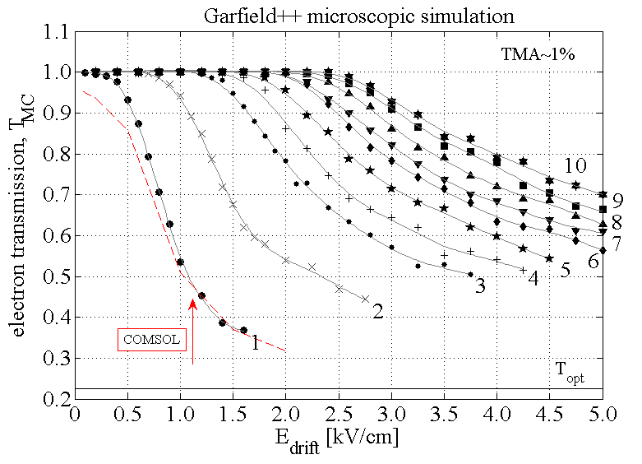
average solutions from hydro (benchmark)
F. Resnati
(Xe-TMA published data
with Garfield++/microscopic)
100μm
Modelling the behaviour of microbulk Micromegas in Xenon/trimethylamine gas
E. Ruiz-Choliz et al., NIM A, 799 (2015) 137-146.

Slide 6
average solutions from hydro

Slide 7
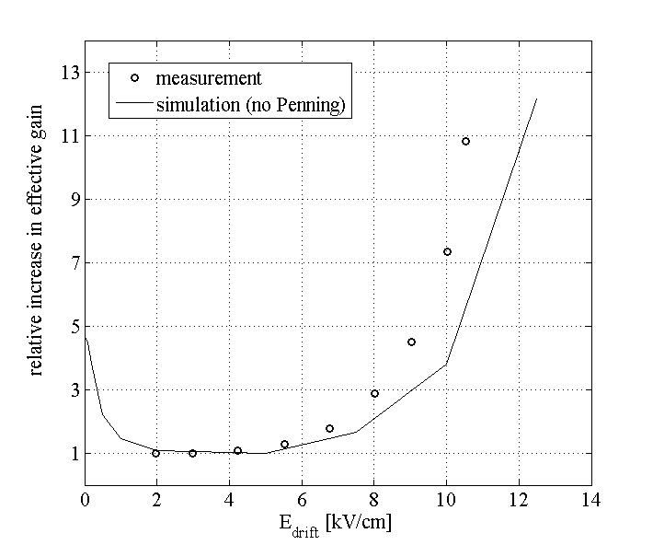
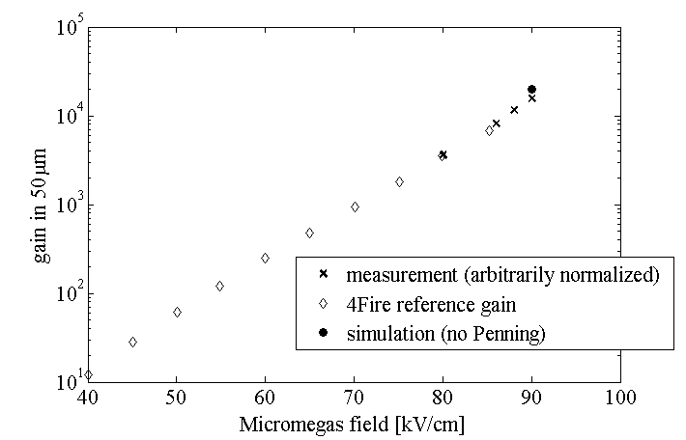
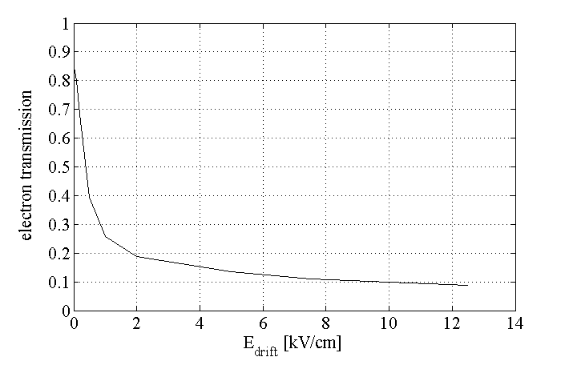
average solutions from hydro (transmission T and gain G_{D})
F. Resnati
transmission x pre-amplification (TxG_{D})
effective gain G*≈2x10⁵ (simulation)
G*(E_{drift})≈ T x G_{D} x G_{MM}
30μm
100μm
0.07
160
2x10⁴
gap: 50 μm
Micromegas gain at full transmission
(G_{MM} = G(T=1))
transmission (T)
(simulation turning off pre-amplification)
E_{MM}=90kV/cm
optical

Slide 8
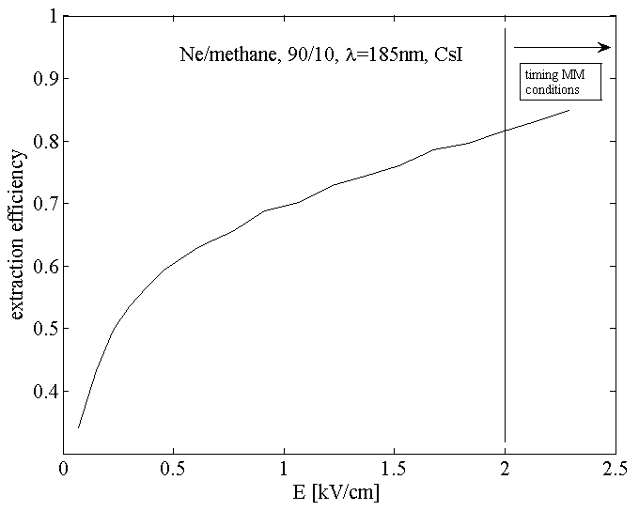
note 1 (what about extraction efficiency?)
G* = T(E_{drift}, E_{amp}) x G_{D}(E_{drift}) x G_{MM}(E_{MM}) x ε_{ext}(E_{drift} )
Measurements of photoelectron extraction efficiency from CsI mixtures of Ne with CH₄, CF₄, CO₂, N₂
J. Escada et al., JINST, 4(2009)P11025
Extraction efficiency probably just some 20%
shy of saturation at most.

Slide 9
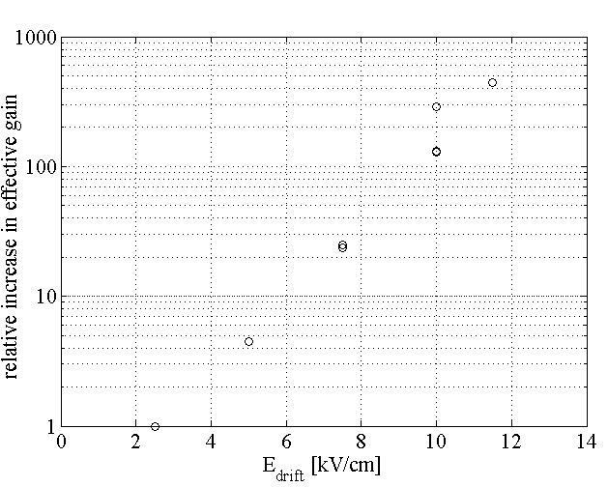
note 2 (what about bulk MMs?)
(no simulations yet)
microbulk-MM (50um)
bulk-MM (128um)
E_{MM}=90kV/cm
E_{MM}=40kV/cm
G*(E_{drift}=10kV/cm) ≈ T x G_{D} x G_{MM}
G*(E_{drift}=10kV/cm) ≈ T x G_{D} x G_{MM}
0.07
160
20000
0.8 (T_{opt})
160
~10⁴
assume these values in the following (if nothing else is said: E_{drift} = 10kV/cm)

Slide 10
stochastic solutions from 1D-hydro

Slide 11
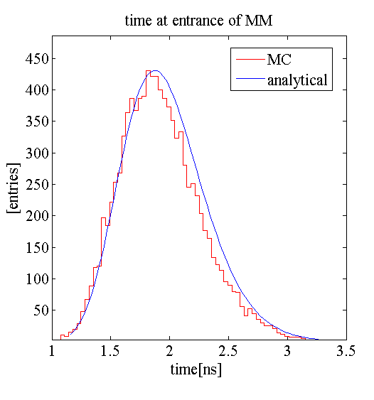
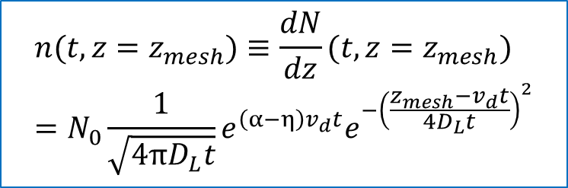
important MC technical information
$$n({t,z=z}_{mesh})≡\frac{dN}{dz}({t,z=z}_{mesh})=N_{0}\frac{1}{\sqrt{4πD_{L}t}}e^{\left(α−η\right)v_{d}t}e^{{−\left(\frac{z_{mesh}−v_{d}t}{4D_{L}t}\right)}^{2}}$$
The MC arrival times of the electrons at the MM (after a random walk in the drift) can be computed analytically. Note: even in absence of multiplication it is not a Gaussian, although its rms approaches D_{L}*/v_{d} √gap! (hereafter: ‘spread from diffusion’, or TTS).

Slide 12
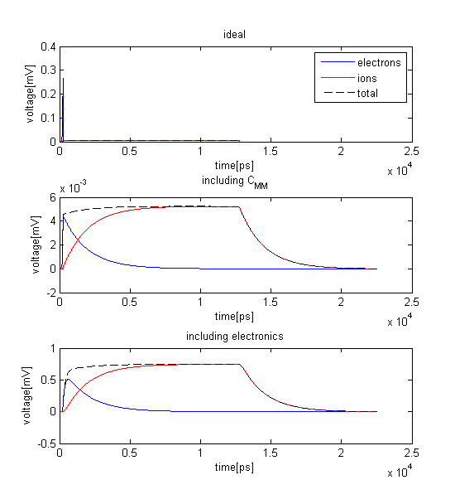
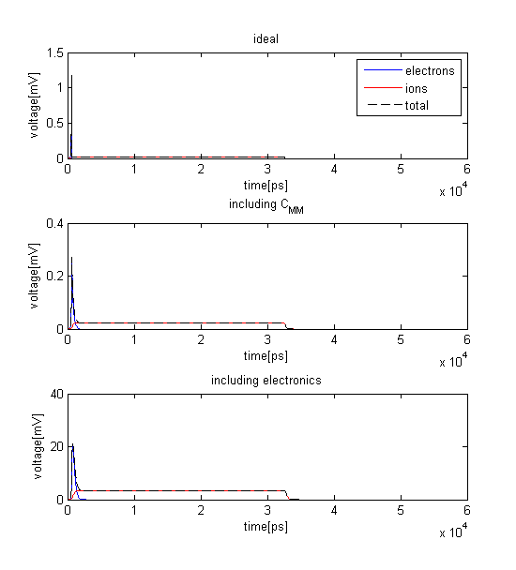
average voltage signals created by single electrons entering the MM
Microbulk (~standard conditions)
Bulk (~standard conditions)
not very far from experimental data!

Slide 13
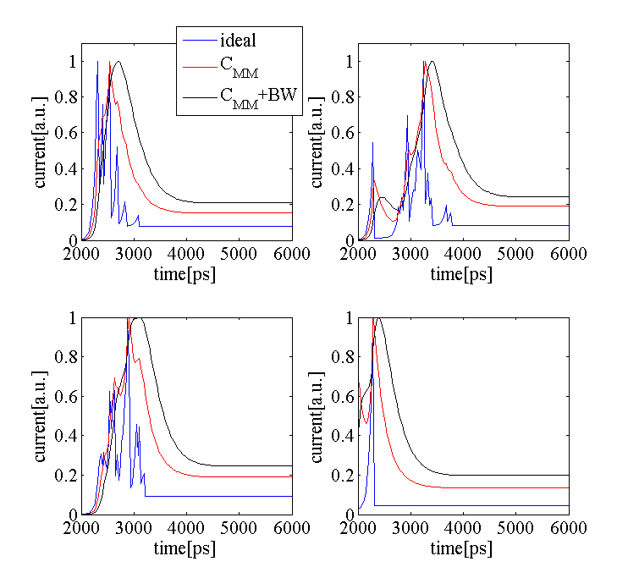
typical signals in the bulk detector (random selection)

Slide 14
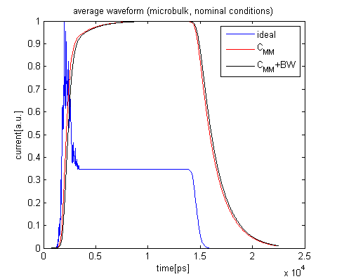
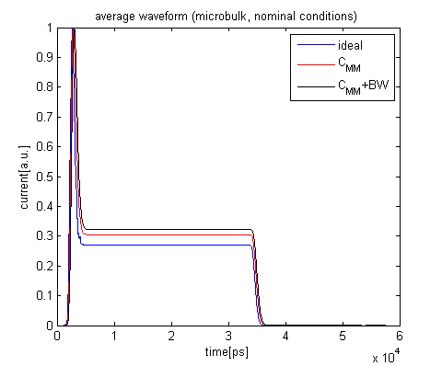
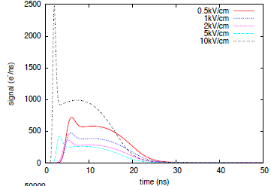
average over 1000 primary photo-electrons (E_{drift}=10kV/cm)
Microbulk
Bulk
COMSOL
(simple but nice consistency check!)

Slide 15
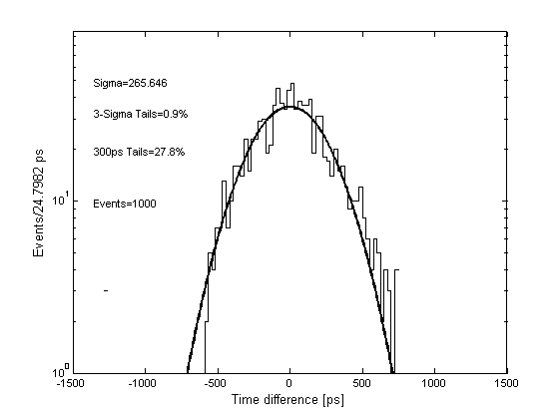
analysis example: typical fitting routine
some small 1-2% 3-sigma tails always present

Slide 16
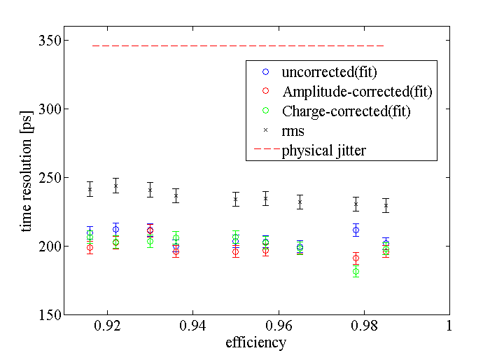
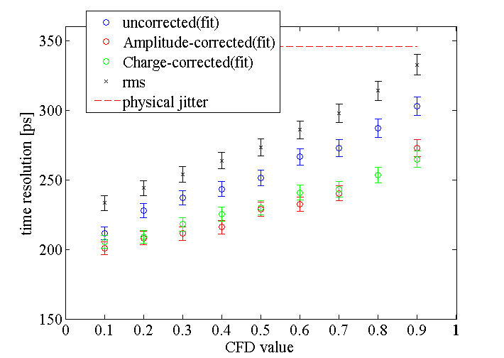
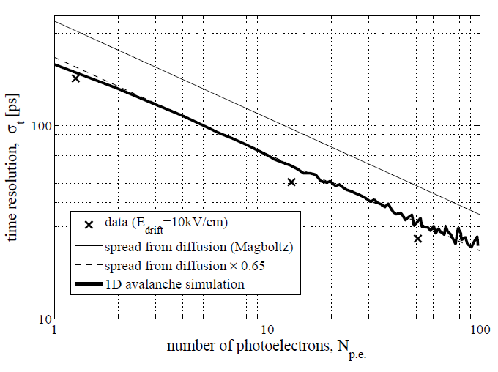

response for typical conditions (bulk) (some technicalities related to analysis)
fixed threshold
constant fraction
single-photoelectron
CFD introduces some correlation with amplitude
(from this point on, only shown the best time resolution attainable)
spread from diffusion == $σ_{diff}=\frac{D_{L}^{∗}}{v_{d}}\sqrt{gap}$ == ‘TTS’

Slide 17
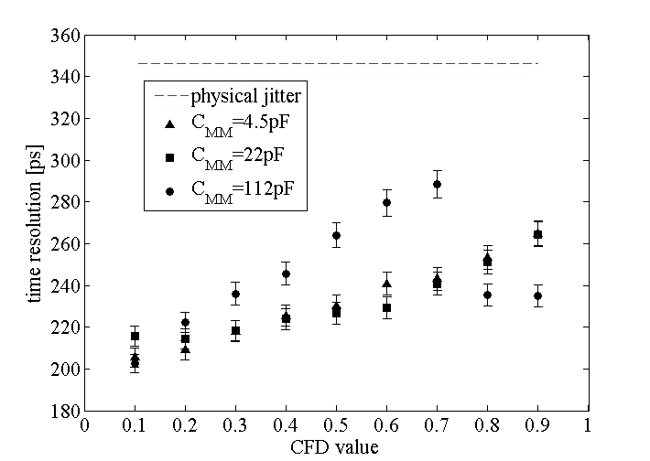
influence of the detector capacitance (C_{MM})
typical bulk value
typical microbulk value (35pF)
single-photoelectron
Note: signal integrity does not affect timing strongly, but S/N goes down by about 1/10!!

Slide 18
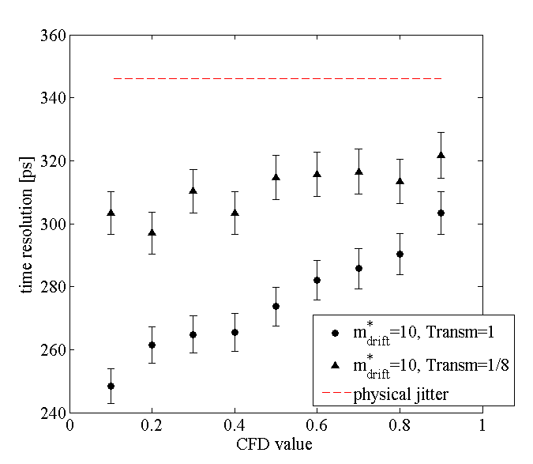
influence of the mesh transmission (T)
single-photoelectron
G_{D}*=10, T=1
G_{D}*=10, T=1/8

Slide 19
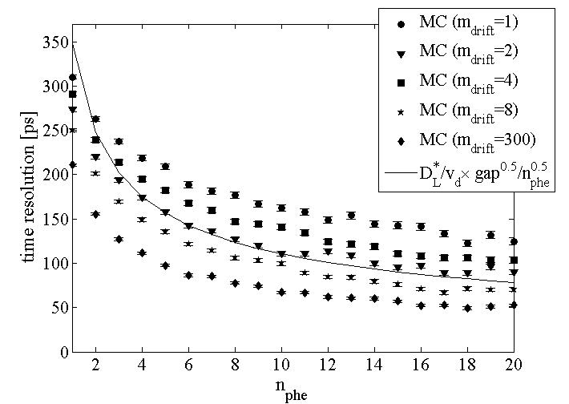

influence of the pre-amplification (G_{D})
(drift field kept constant!)
G_{D}
G_{D}
4
G_{D}
2
G_{D}
G_{D}
$$σ_{diff}/\sqrt{N_{pe}}$$
T=0.07

Slide 20
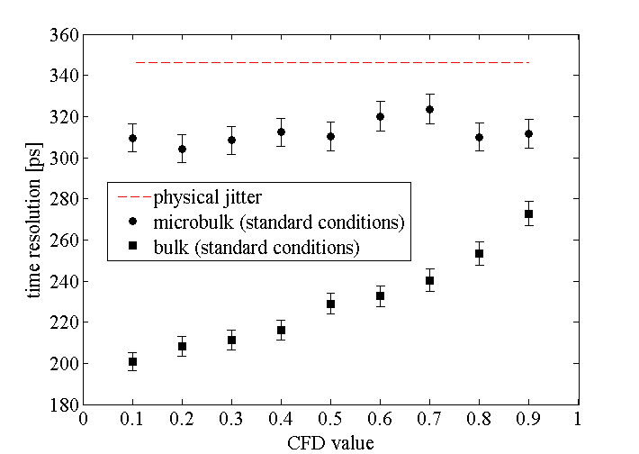
influence of the detector technology (microbulk vs bulk)
single-photoelectron

Slide 21
comparison with data (at fixed drift field)
bulk

Slide 22
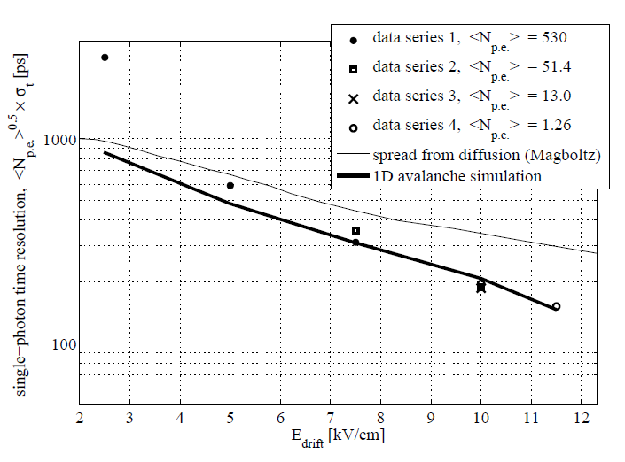
comparison with data (vs field)
bulk

Slide 23
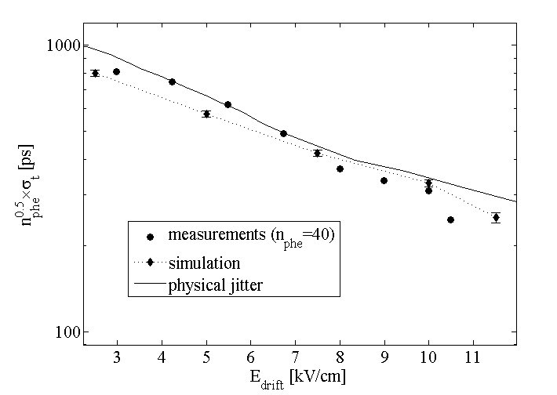
comparison with data (vs field)
micro-bulk
= 40

Slide 24
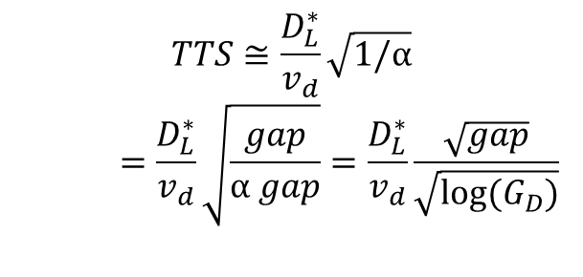
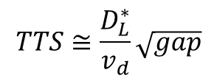

a simple analytical model (R. Veenhof/S. White)
photocathode
no pre-amplification
$$TTS≅\frac{D_{L}^{∗}}{v_{d}}\sqrt{gap}$$
pre-amplification
$$TTS≅\frac{D_{L}^{∗}}{v_{d}}\sqrt{1/α}$$
$$=\frac{D_{L}^{∗}}{v_{d}}\sqrt{\frac{gap}{α gap}}=\frac{D_{L}^{∗}}{v_{d}}\frac{\sqrt{gap}}{\sqrt{log⁡(G_{D})}}$$
$$1/α$$

Slide 25
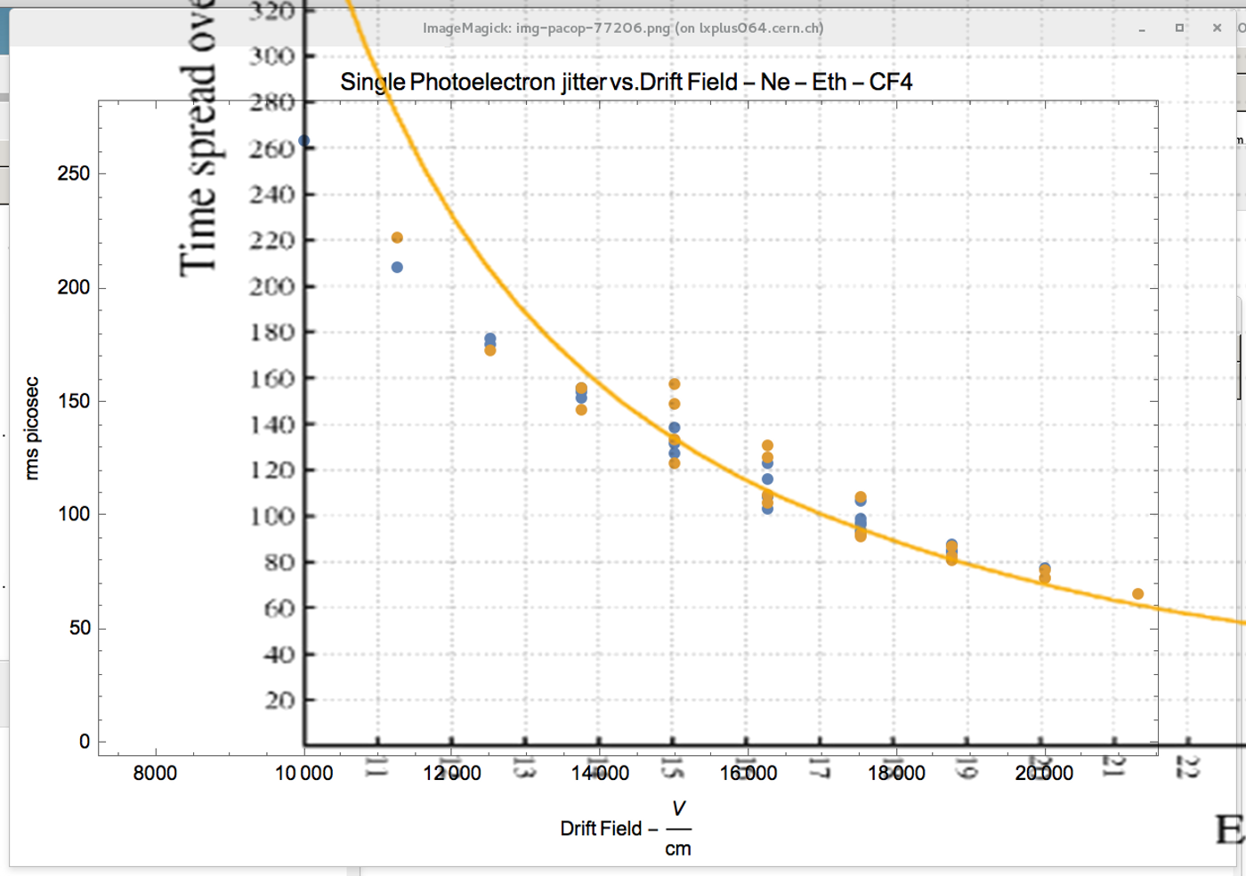
fast look at new laser data
R. Veenhof

Slide 26
conclusions
MC model allows computing the time response of timing Micromegas. It reproduces the correct time resolution scale, the approximate scaling with number of photoelectrons (~1/√N_{pe}), and the soft dependence with pre-amplification (~ √(log(gain)). Excellent reference for future 3D simulations!!.
The time resolution is nearly independent from capacitance (although signal shapes are strongly affected, sensitivity to single-photon might be lost). Time resolution starts to suffer for BW~100MHz.
Microbulk Micromegas shows worse performance than Bulk, due to lower transmission.
In the single photo-electron case, the CFD-technique introduces some small correlation with amplitude, that disappears for CFD<=0.3.
Operationally, the time response can be approximated through:
σ_{t} = TTS/√[N_{pe} x log(gain)]

Slide 27
next steps
Detailed comparison with new data (~few weeks scale):
  Evaluate different analysis methods (the software stores the complete waveforms!).
  Evaluate in detail the different scalings seen in data…
  Include mips.
What a full simulation (Garfield++) can bring in addition to this?
  Include the exact 3D field (expected to be a small effect, since the field close to the cathode dominates the detector behaviour).
  Include the initial electron energy (this is potentially important, since it drives the extraction efficiency –previous measurements suggest a small effect at present –rather high- operating fields, but things might be different in deep VUV).
  Exact description of the ions and signal waveforms (probably not critical, but nice).
  An exact description of the avalanche statistics is the most important ingredient missing (previous Garfield++ simulations indicate a narrow response for Ne-mixtures --good for single-photon detection. Pure quencher will show larger spreads.)

Slide 28
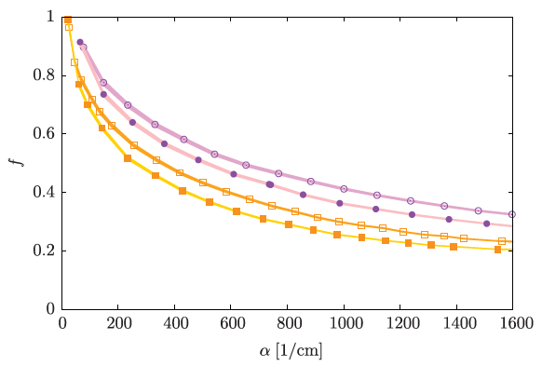
pure exponential (Furry)
Polya
Ar/CO₂
Ne/CO₂
G_{D}=100@200um

Slide 29
outlook

Slide 30
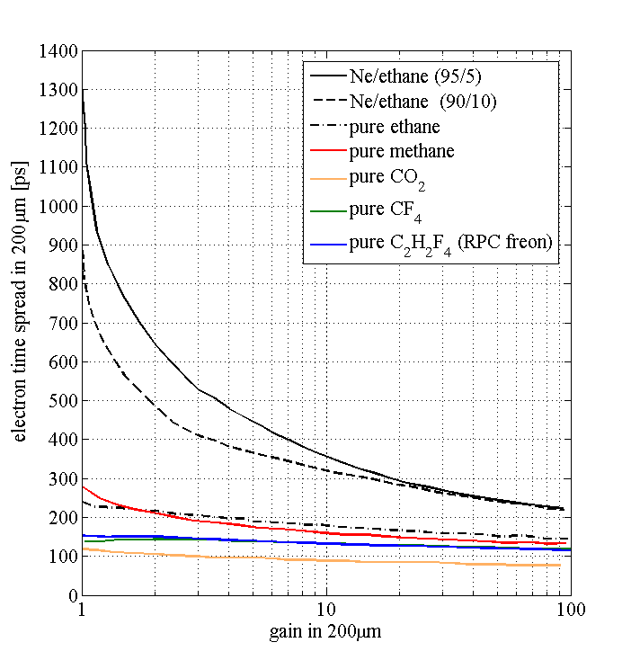
Optimum gas mixtures in timing Micromegas?
Look for the minimum time spread (‘fastest mixture’) at any given gain
Simulations from Rob Veenhof
(C₂H₂F₄ from data)
Notes:
Working fields in the MM for pure quenchers need to be about x2 higher. May limit the gain in case of defects.
Drift fields for pure quenchers need to be about x3 higher.
Dissociative attachment for CO₂ and freons expected to be compensated by gain. Additional fluctuations will appear. It needs to be verified.

Slide 31
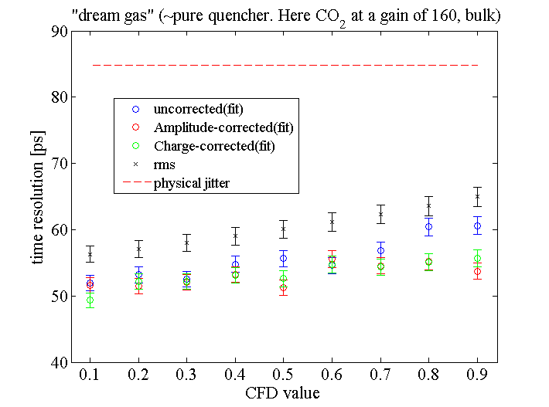
single-photoelectron
C₂H₂F₄, CF₄ anticipate a similar behaviour, but HV stability and photon-feedback need to be overcome!

Slide 32
appendix

Slide 33
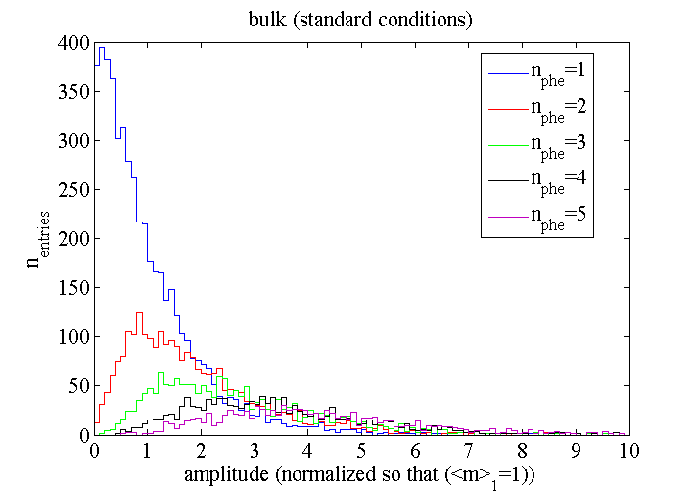
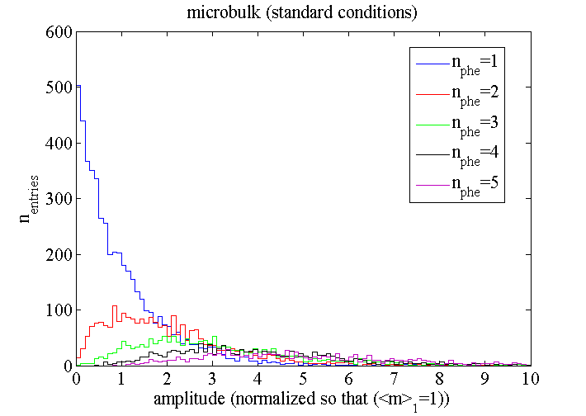
photo-electron distributions
Note: simulation assumes Furry statistics (Legler model), that is certainly not true for the
Micromegas amplification, but should be a reasonable assumption in the drift.
obtaining single-photon response with UV-lamp will be useful!

