Slide 1
APD simulations using Silvaco
Contribution from – Ranjit Dalal
Delhi Uni.
June 2, 2016

Slide 2
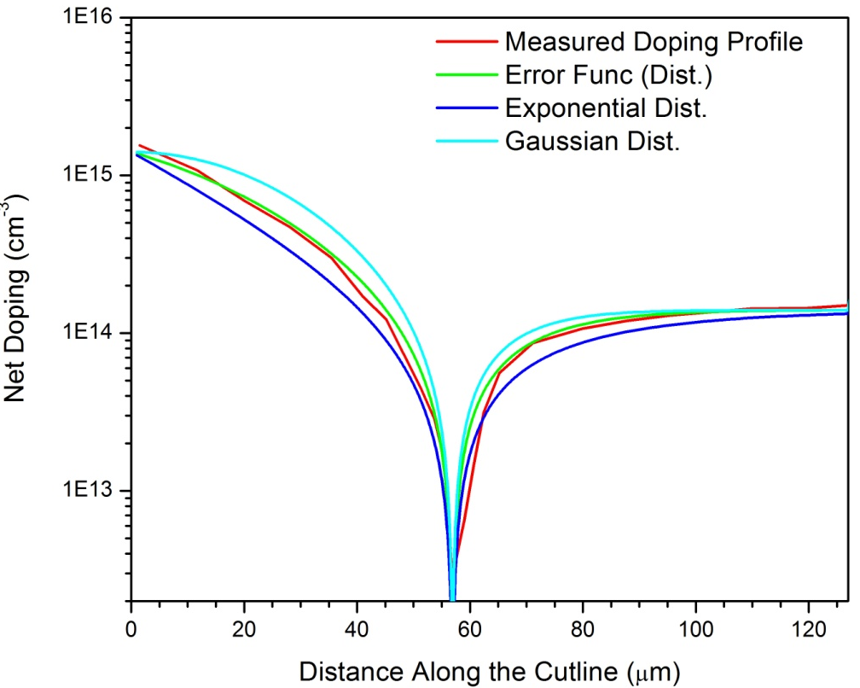
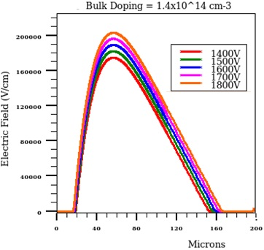
Simulation Structure
p⁺
n⁺
200 Micron Thick APD (p-in-n)
Error function doping profile (very similar to measured one)
  Junction Depth = 57 micron micron
- Bulk Doping - 1.4 x 10¹⁴ cm⁻³ (Measured value)
Three different type of lasers
  670nm, 980nm, 1060nm Lasers
External circuit (Bias T) is implemented for transient simulation
1x1x40 µm³ device
~15µm of front side is not
depleted

Slide 3
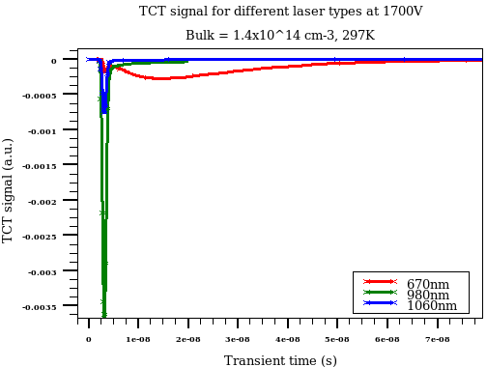
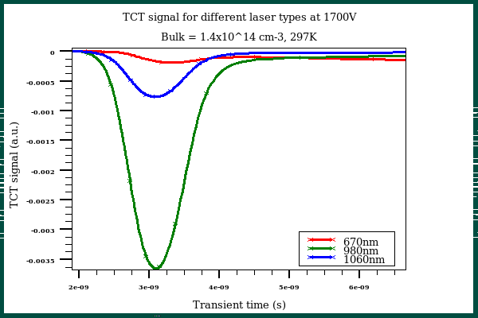
TCT Simulation for different Wavelengths
Very fast initial peak for all the laser wavelengths
  Due to drift component of current
Large (and slow) diffusion component for 670nm laser
  Almost all of the laser energy is deposited within few micron of front side
1060 nm laser is creating fastest signal
- Similar case is expected for charged particles

Slide 4
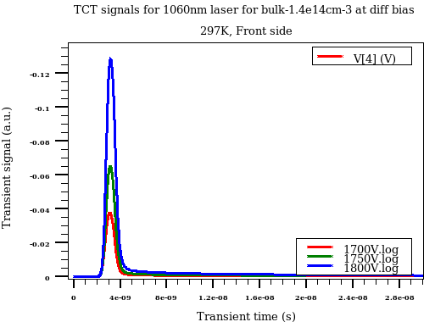
TCT signal for 1060nm front laser (Bias vary)
Bias Voltage vary
Extremely fast signal with about 2-3nm width
Signal will be compared with CERN measurements

Slide 5
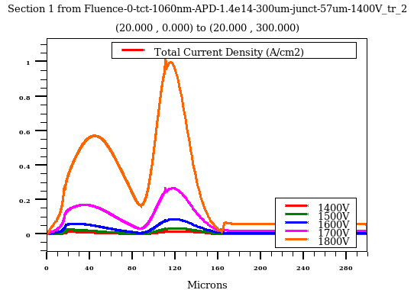
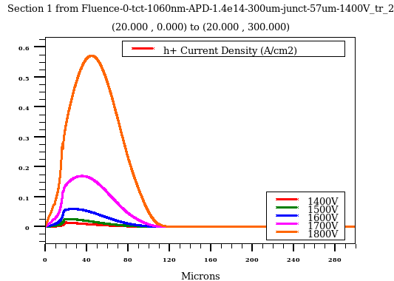
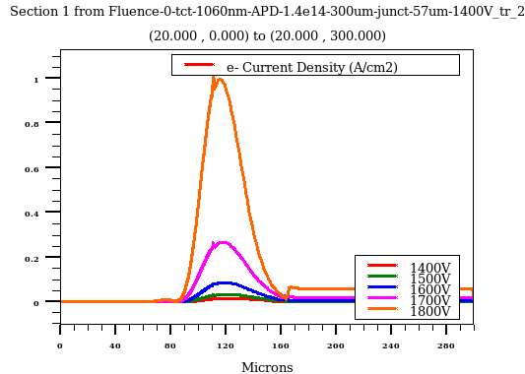
Signal evolution (after 1 ns of laser fire)
Total Current Density
Hole component
e⁻ component
- hole/electrons get separated within 1ns for infrared laser
- Similar evolution is expected for charged particles too

Slide 6
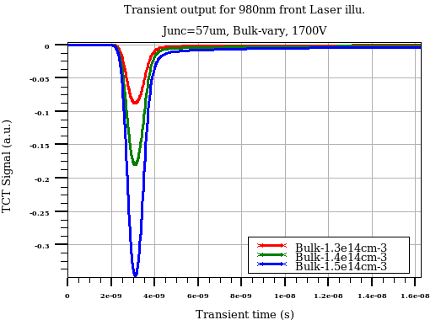
Effect of Bulk doping variation
Bulk doping vary
- Significant effect of bulk doping is seen

Slide 7
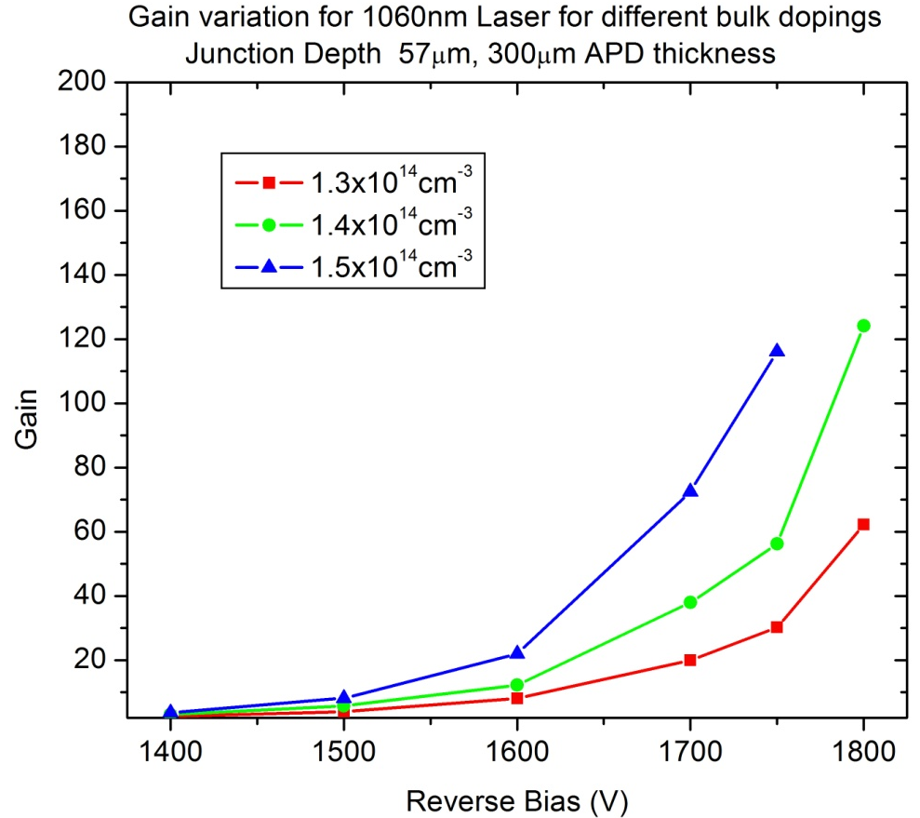
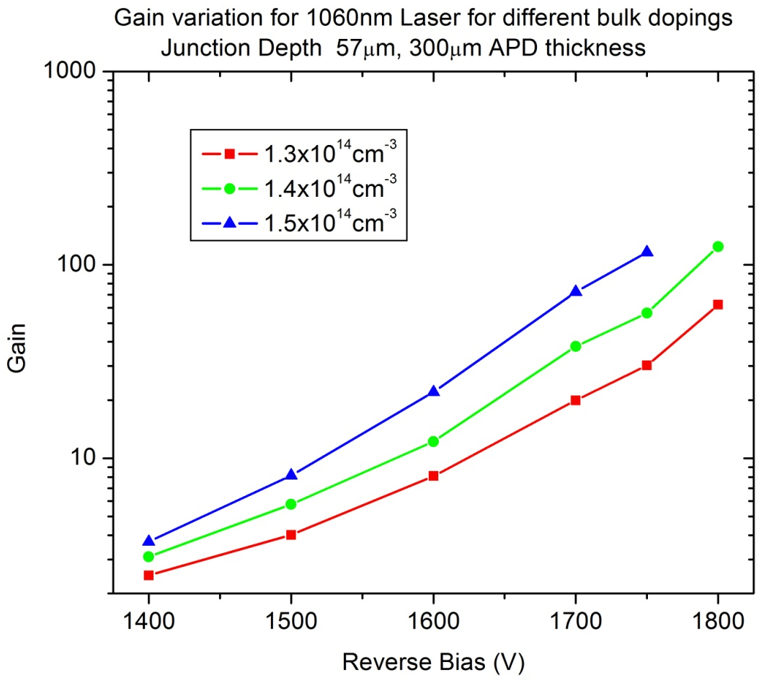
Gain vs bias for 1060nm laser (3 bulk dopings)
Linear Scale
Log scale
Significant effect of bulk doping on device gain
  Higher bulk doping results in narrow depletion region or higher electric field for a given bias
Slight different bulk doping can result in significant gain variation
Must be carefully tuned

Slide 8
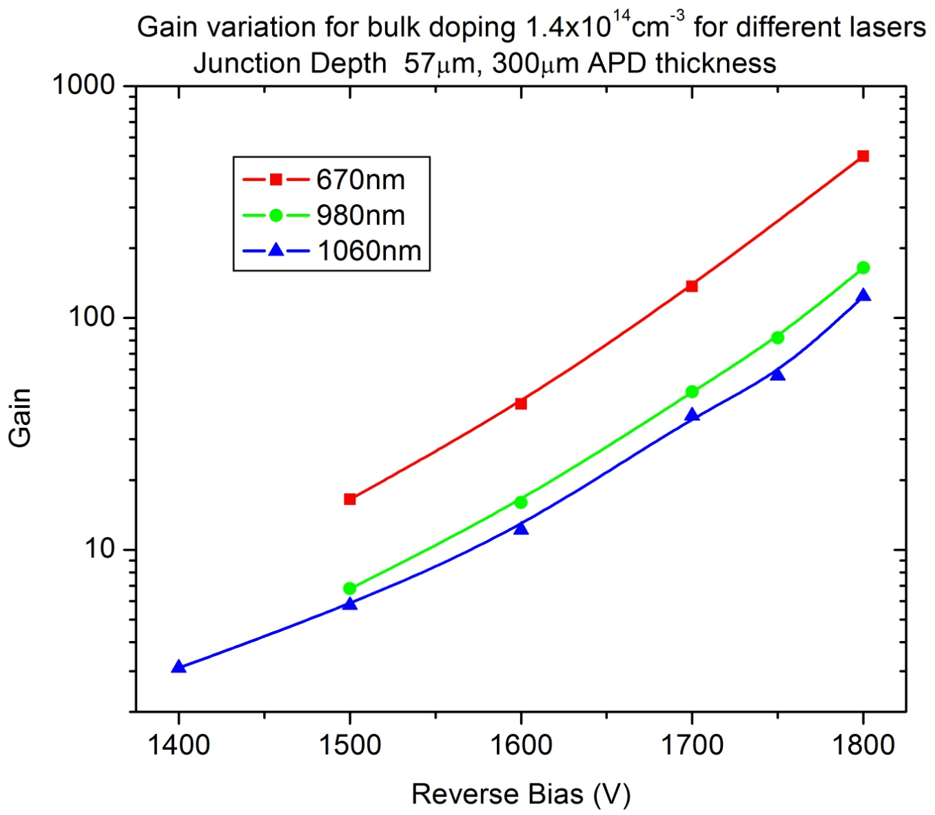
Gain vs bias for bulk 1.4x10¹⁴ cm⁻³
- Higher gain for 670nm, lowest for 1060nm!

Slide 9
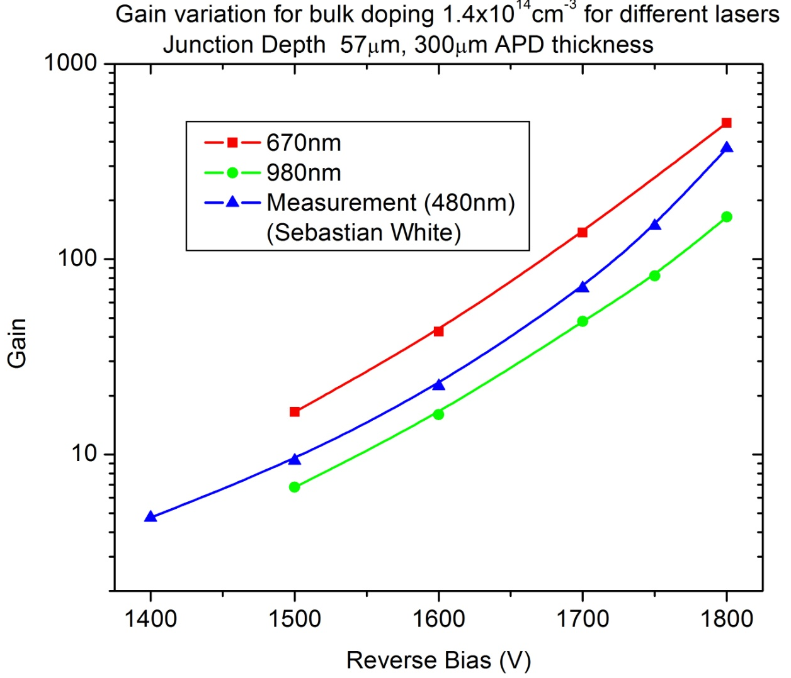
Gain vs bias (Simu. and measured result)
Simulation and measured values have similar trends and values
Remember, there can be slight variation in bulk doping (for different devices), different
way of calculating and measuring device gain and different baselines for gain calculating
(500V for measurement, signal without multiplication for simulation)

Slide 10
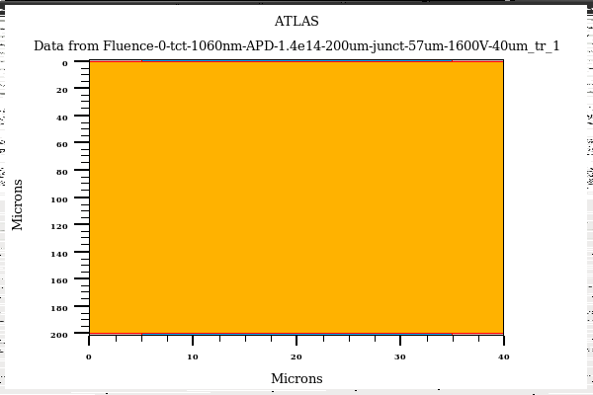
Edge-TCT for APD
APD Bulk = 1.4e14cm-3
Junction Depth = 57µm
Laser
Laser used
1060nm
Laser Width = 1 µm
Position = 1µm to 170µm (5 µm step)
(Since longer Laser rise time may affect APD signal
timing profile, All simulations are carried out with 1ps laser rise time
Gain = Total collected charge (with multiplication on)/ Collected charge (with multiplication off)

Slide 11
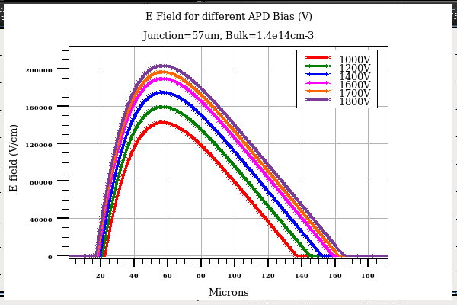
E field for different Bias
With increase in bias, Depletion region (mainly) expand in backside bulk
Should not expect much improvement with bias (for front diffusion component) !
No multiplication beyond 100 micron depth (this number depends on bias)

Slide 12
Bias = 1600V

Slide 13
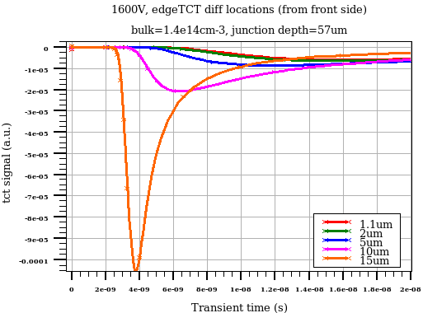
Signal evolution near front surface eTCT positions
Very slow diffusion component
Front side can be removed with impunity

Slide 14
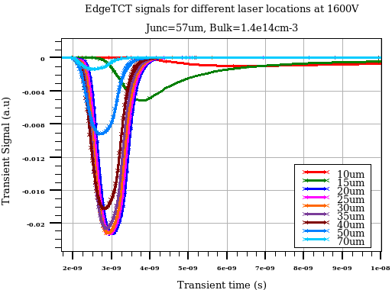
Signal evolution for different eTCT positions
Slow signal for 10-15µm location (diffusion component is significant)
Highest multiplication for 20-25µm laser position
Multiplication decreases for deeper locations
No multiplication after 90µm

Slide 15
Bias = 1700V

Slide 16
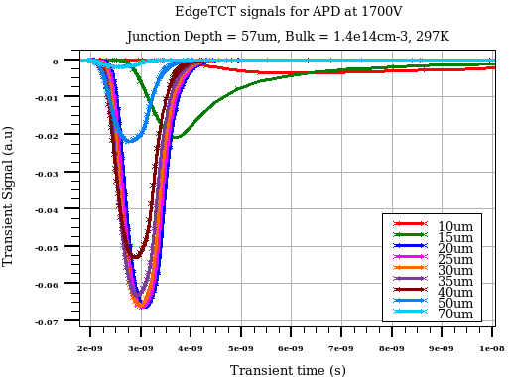
Signal evolution for different eTCT positions
Slow signal for 10-15µm location (diffusion component is significant)
Highest multiplication for 20-25µm laser position
Multiplication decreases for deeper locations
Almost no charge multiplication below 90µm location

Slide 17
Bias = 1800V

Slide 18
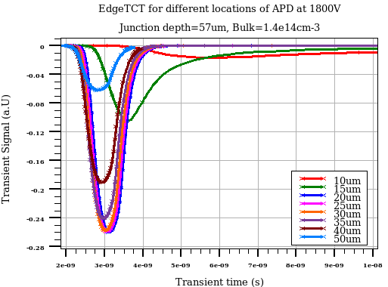
Signal evolution for different eTCT positions
Slow signal for 10-15µm location (diffusion component is significant)
Highest multiplication for 20-25µm laser position
Multiplication decreases for deeper locations
No multiplication after 90µm

Slide 19
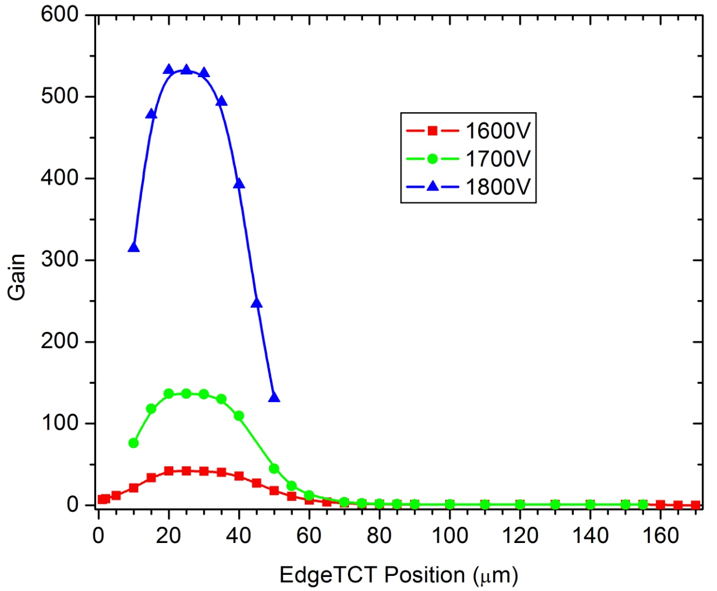
eTCT Gain Variation with Bias
- APD gain is practically coming from first 70-80 µm of device
- Some of the simulation points for 1800V are yet to be come

Slide 20
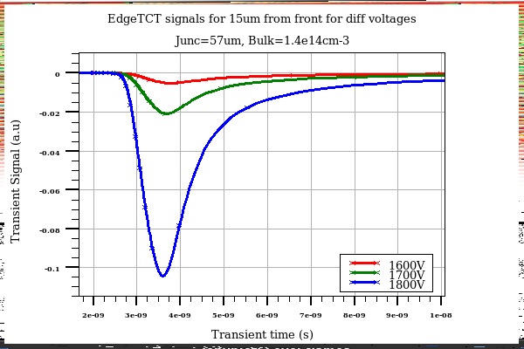
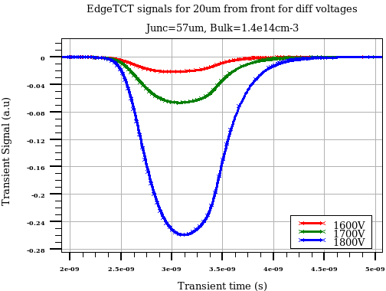
eTCT signal comparison for diff bias
15 Micron laser position
20 Micron laser position

Slide 21
backup

Slide 22
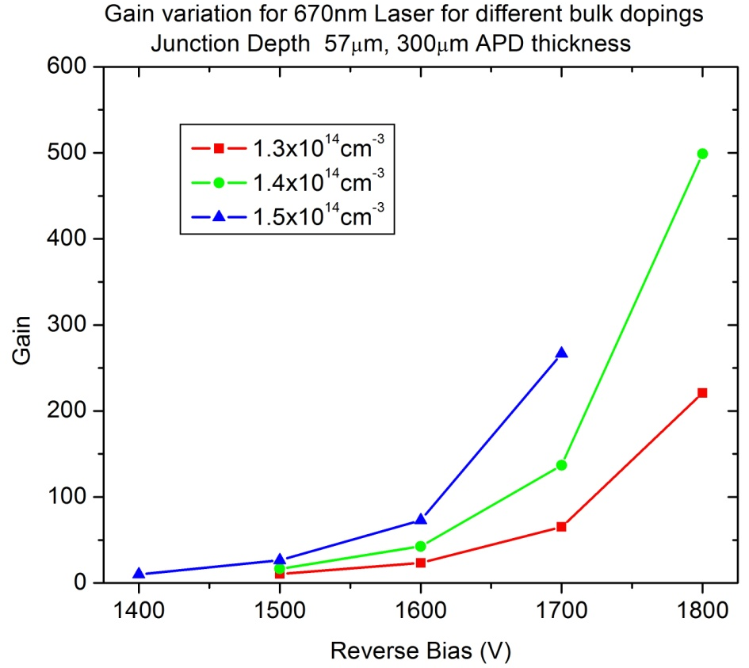
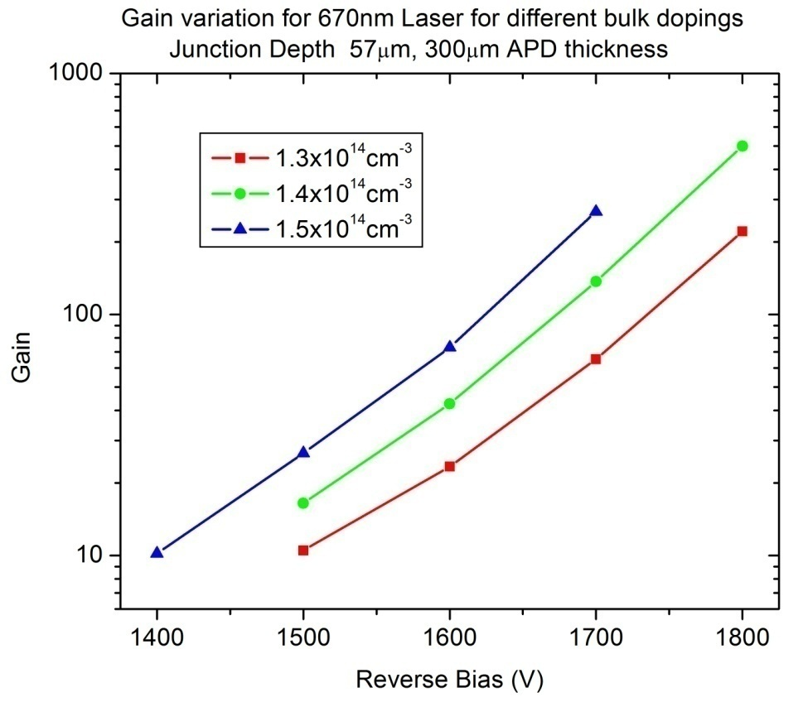
Gain vs bias for 670nm laser (three bulk doping)

Slide 23
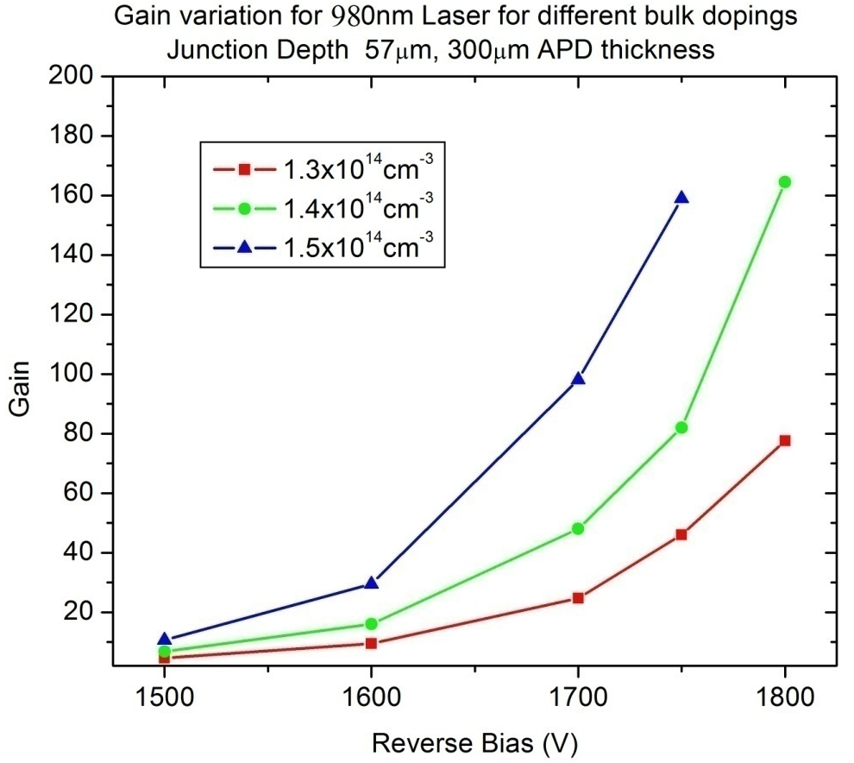
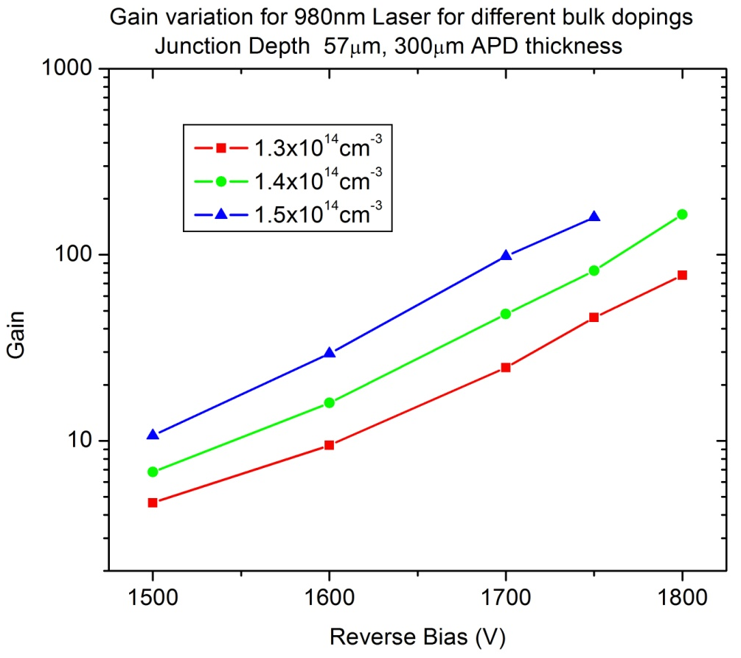
Gain vs bias for 980nm laser (3 bulk dopings)

Slide 24
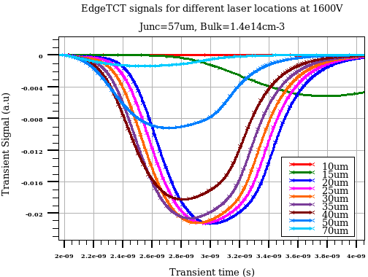
Signal evolution for different eTCT positions
2ns time window

Slide 25
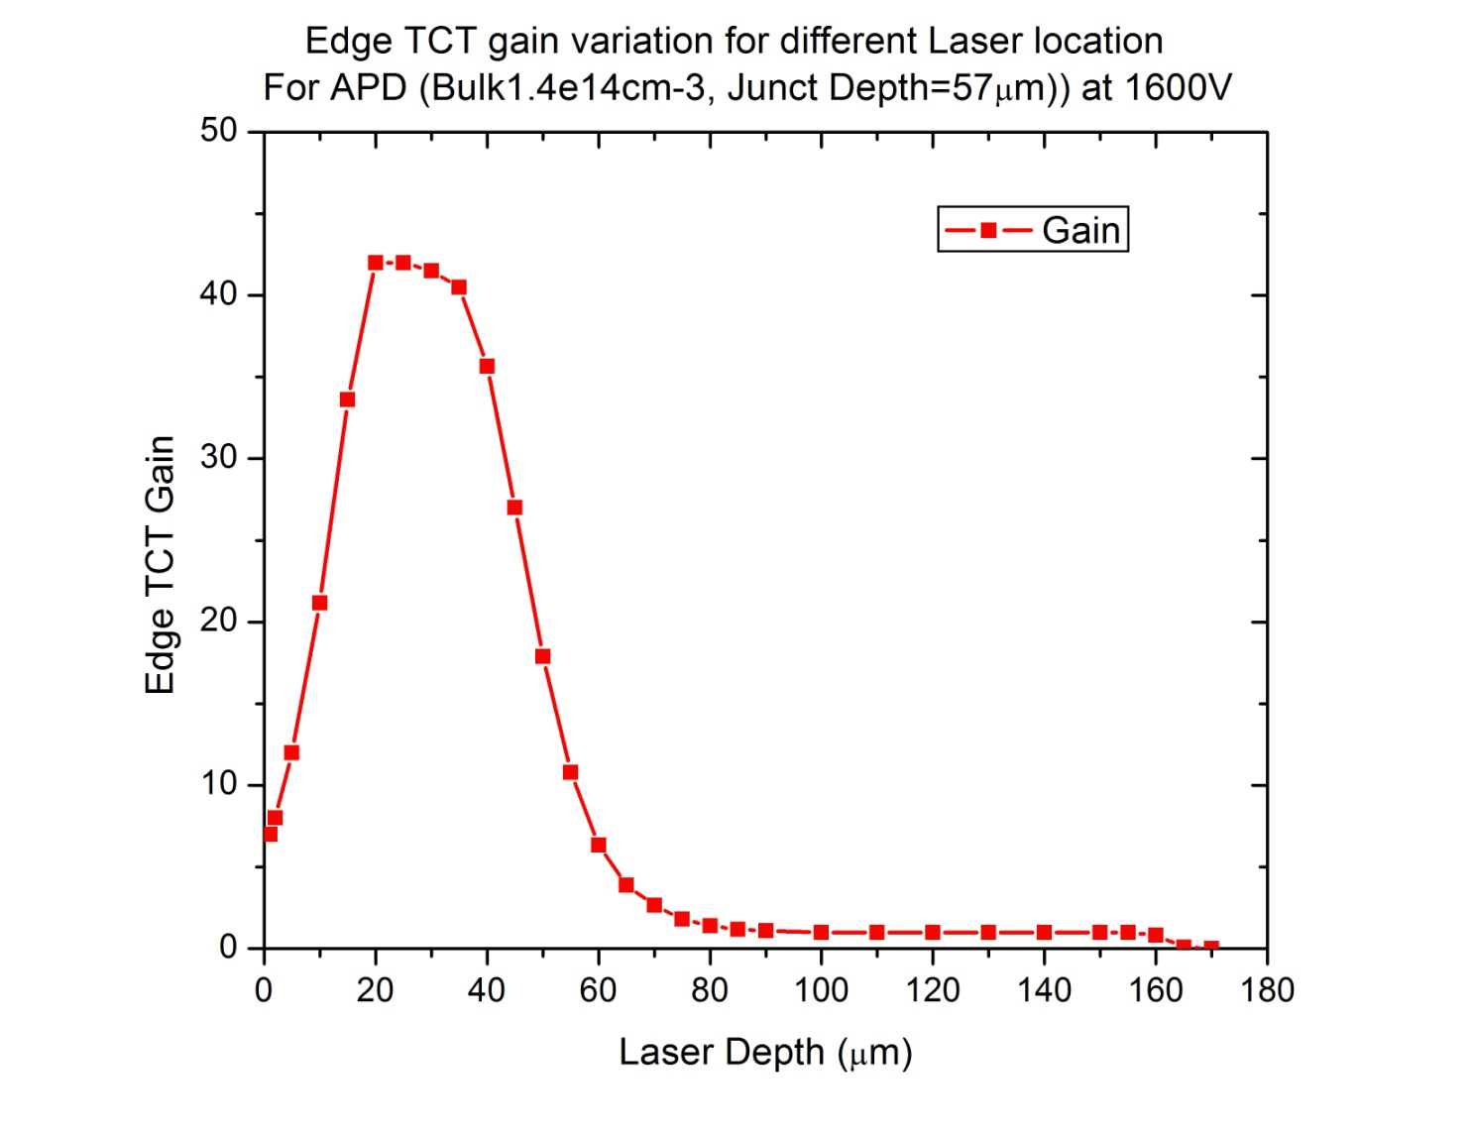
EdgeTCT gain for APD
Gain variation vs laser depth
eTCT profile for APD is very different from usual diodes
  Depend on drift and diffusion components
  Depends on multiplication

