Slide 1
APD simulations using Silvaco
Ranjeet Dalal
(Delhi Uni.)
13-1-2016 Meeting

Slide 2
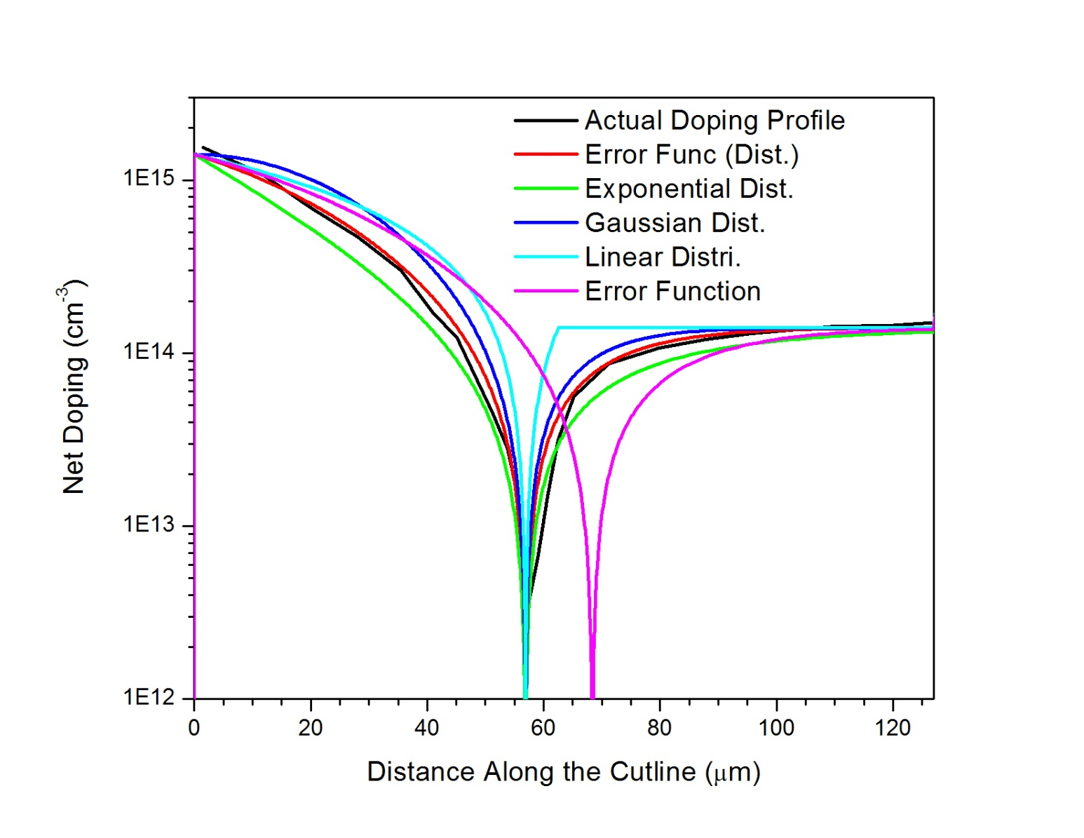
APD simulations using Silvaco at Delhi
Bulk =1.47e14cm⁻³
Device thickness = 130µm
Various analytical doping profiles available in Silvaco were used
Doping profile using Error Function (Dist.) is very near to actual doping profile
Error Function (Dist.) is used for all other simulations for 130 µm APD with junction depth
of 56.9 µm (assuming that 100 µm front is removed as described in paper) and later with 36.9 µm

Slide 3
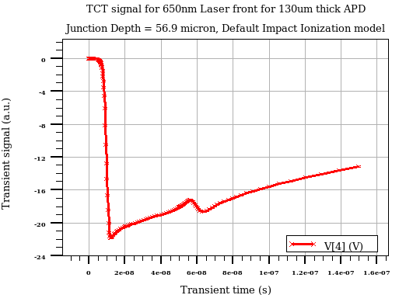
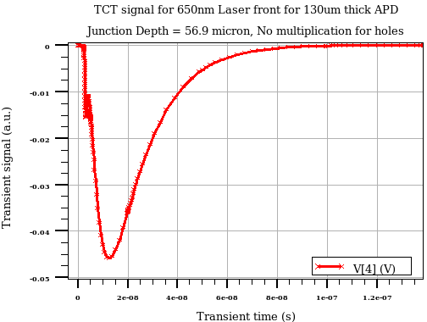
Tuning of Impact-Ionization model
Default parameters
No hole multiplications
Silvaco and Synopsis uses Selberher model for Impact ionization
Impact Ionization coefficients for holes and electrons are comparable (though somewhat lower
values of coefficient for holes than that of electron)
If default Selberher parameters are used, continuous avalanche are produced at higher biases.
Such a pulse at 1600V (above left) is shown for silvaco and similar result was seen for the
Synopsis
After switching off the hole multiplication, TCT pulse looks similar to measurements.
Hence, hole multiplication is switched-off for rest of the simulations

Slide 4
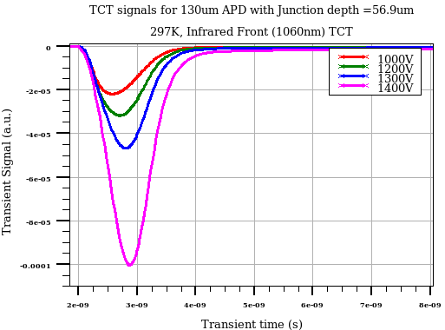
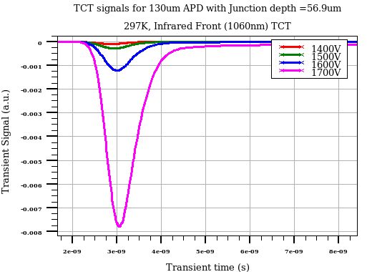
Infrared-Front TCT for Junction 56.9 µm
TCT signals are amplified with bias

Slide 5
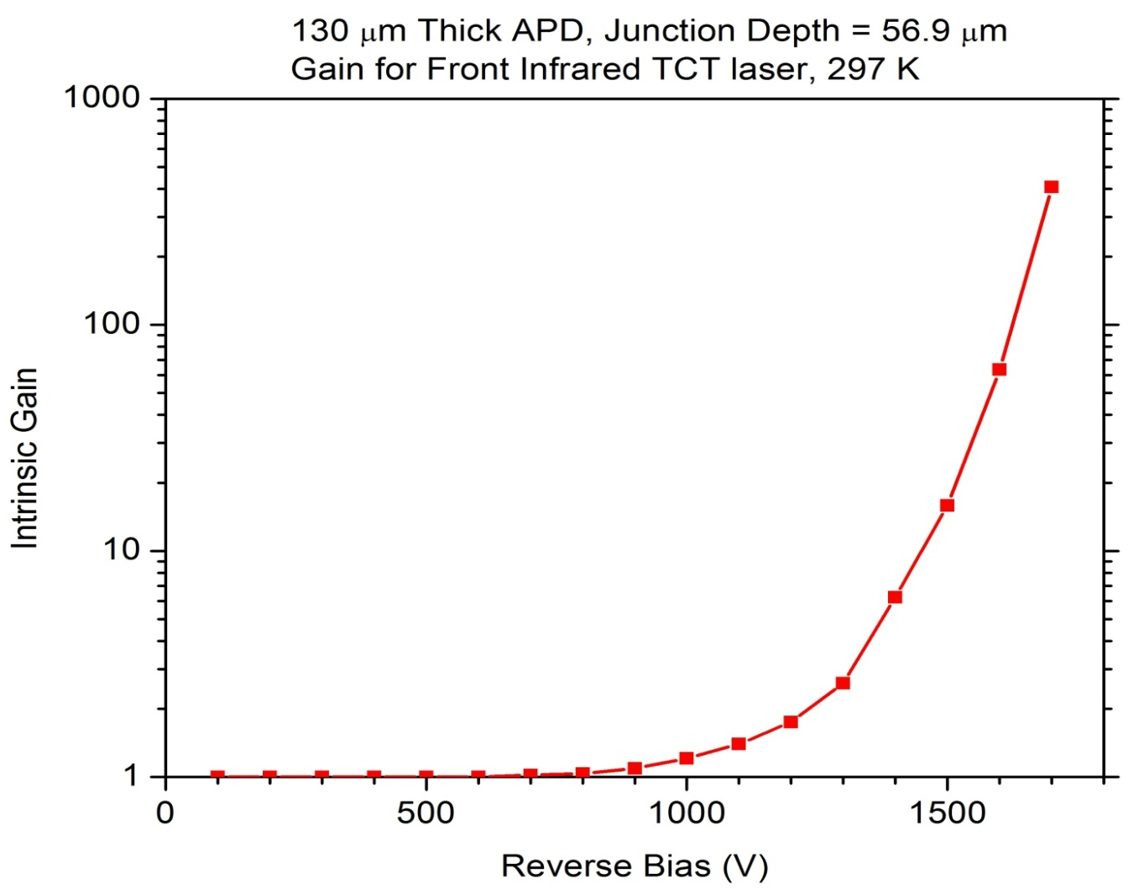
Gain for Infrared-Front (Junction 56.9 µm)
Gain curve for Infrared laser
Gain at a given bias is defined with respected to integrated signal of the same bias with no
no impact ionization. For example, integrated charge with impact ionization at 1700V is about
407 times higher that integrated charge without any charge multiplication case
- Plot is very much similar to plot number 7 of APD paper by Mickel et al.

Slide 6
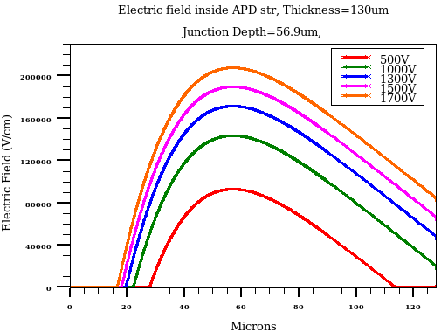
E field variation inside APD str.
Electric field plots shows that depletion have not reached to the front side
No signal obtained for 480 nm laser (with 0.1 micron as penetration depth) even at 1600V
This has been confirmed by running actual simulations too (results not shown here)
Either another 20 microns are to be removed from the front side or will have to reduce the doping of p-side
Next Step:
Reduced junction depth by 20 micron

Slide 7
Simulations with Junction Depth = 36.9µm
APD thickness - 130µm

Slide 8
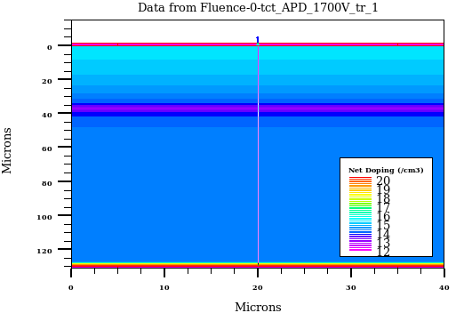
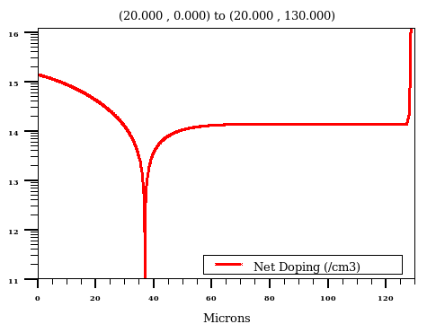
APD structure with junction depth = 36.9µm

Slide 9
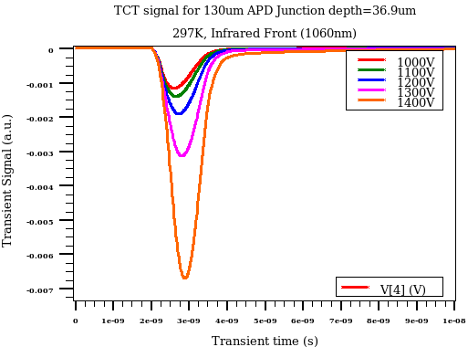
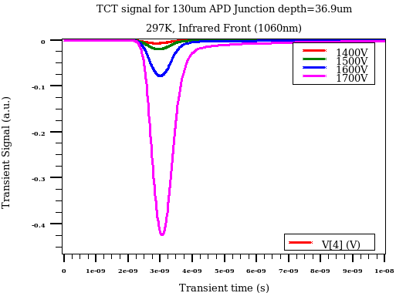
1060nm Front TCT for junction depth = 36.9µm
Fluence = 0
Temp = 297K

Slide 10
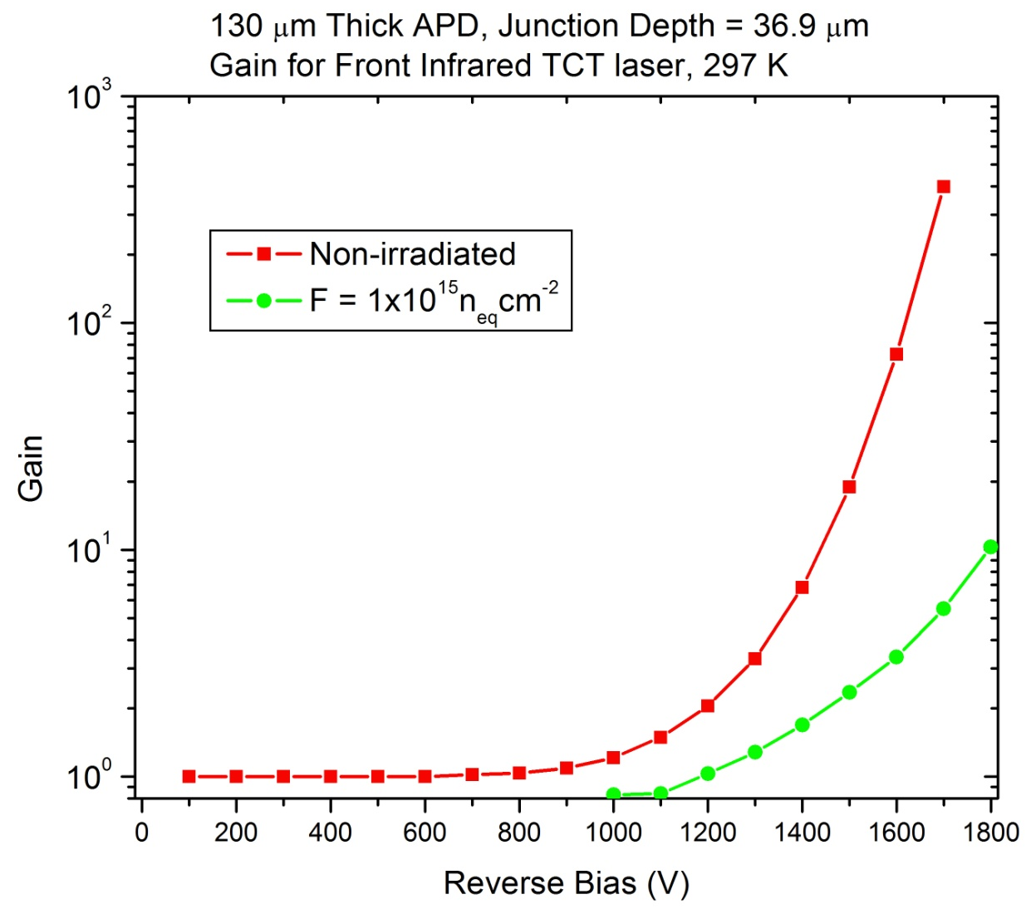
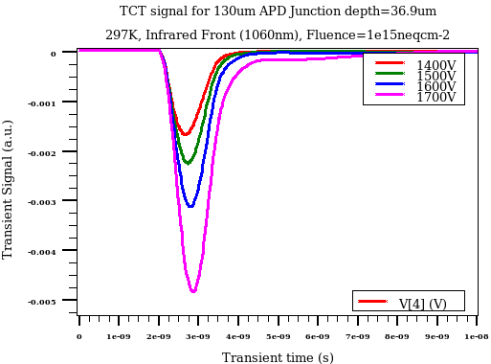
1060nm Front TCT for junction depth = 36.9µm
TCT signal for
F = 1e15neqcm-2
Fluence = 0, Temp = 297K
Fluence 1e15 neqcm⁻² , Temp = 253K
Gain is calculated w.r.t. signal without any Impact Ionization (keeping all other parameters
same)
Gain is a strong function of bias
Very significant effect of irradiation on APD gain is seen

Slide 11
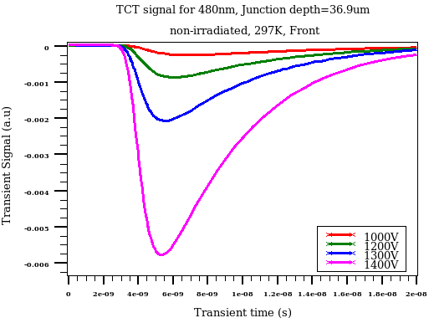
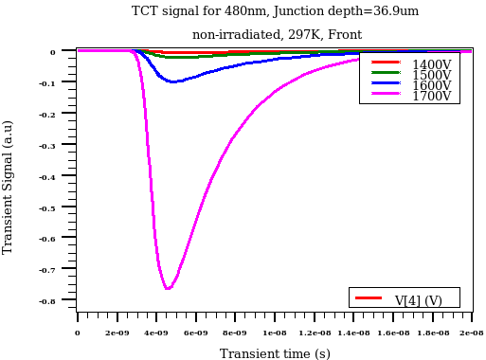
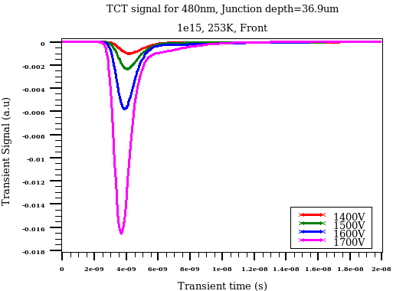
480nm Front TCT for junction depth = 36.9µm
Fluence = 0, Temp = 297K
Fluence 1e15 neqcm⁻² , Temp = 253K
Slow signal decay for non-irradiated case
Narrow peak after irradiation

Slide 12
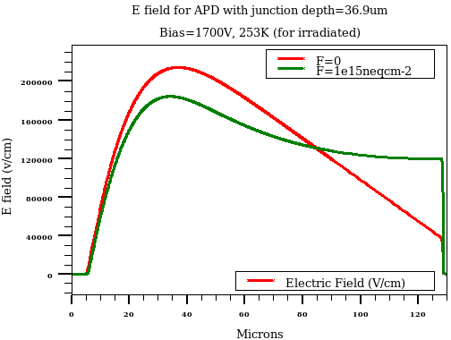
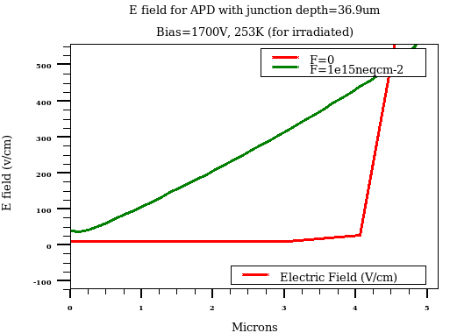
E field for junction depth = 36.9µm
Fluence = 0, Temp = 297K
Fluence 1e15 neqcm⁻² , Temp = 253K
Slow signal decay for non-irradiated (480nm) may be due to very low electric field near surface

Slide 13
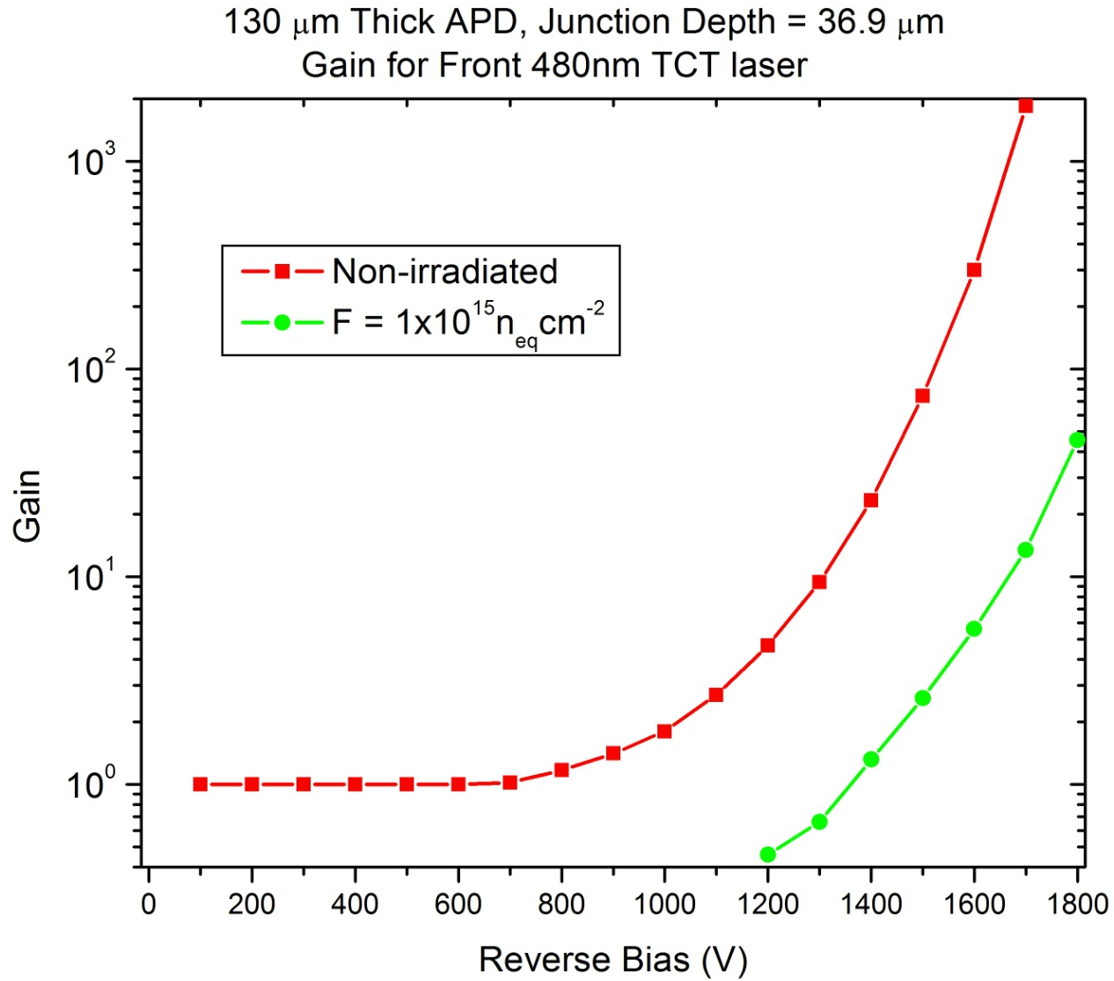
Gain for 480nm Front TCT for junction= 36.9µm
Fluence = 0, Temp = 297K
Fluence 1e15 neqcm⁻² , Temp = 253K
Gain is calculated w.r.t. signal without any Impact Ionization (keeping all other parameters
same)

Slide 14
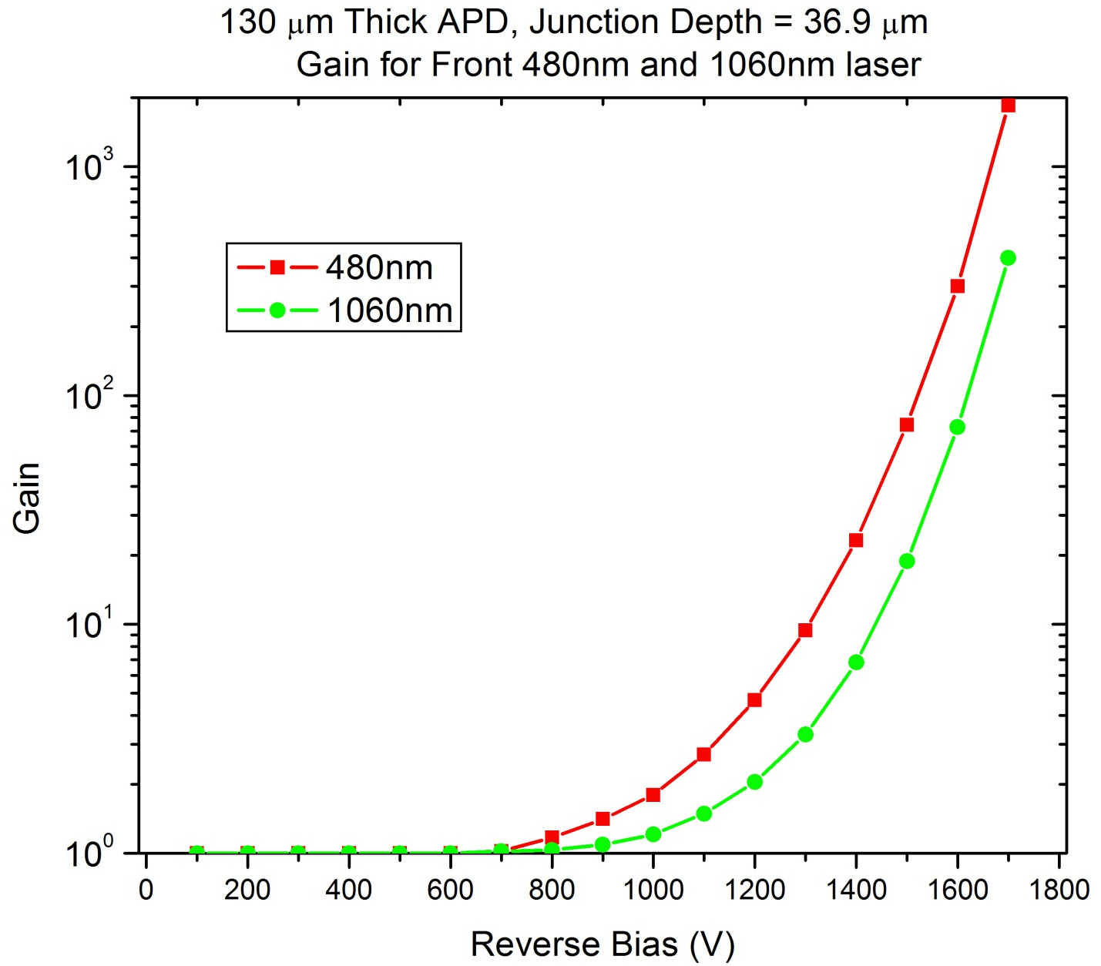
Gain comparison for 480nm and 1060nm laser
Higher gain is expected for 480nm as electrons travel whole of the sensor volume before
collection at backside

Slide 15
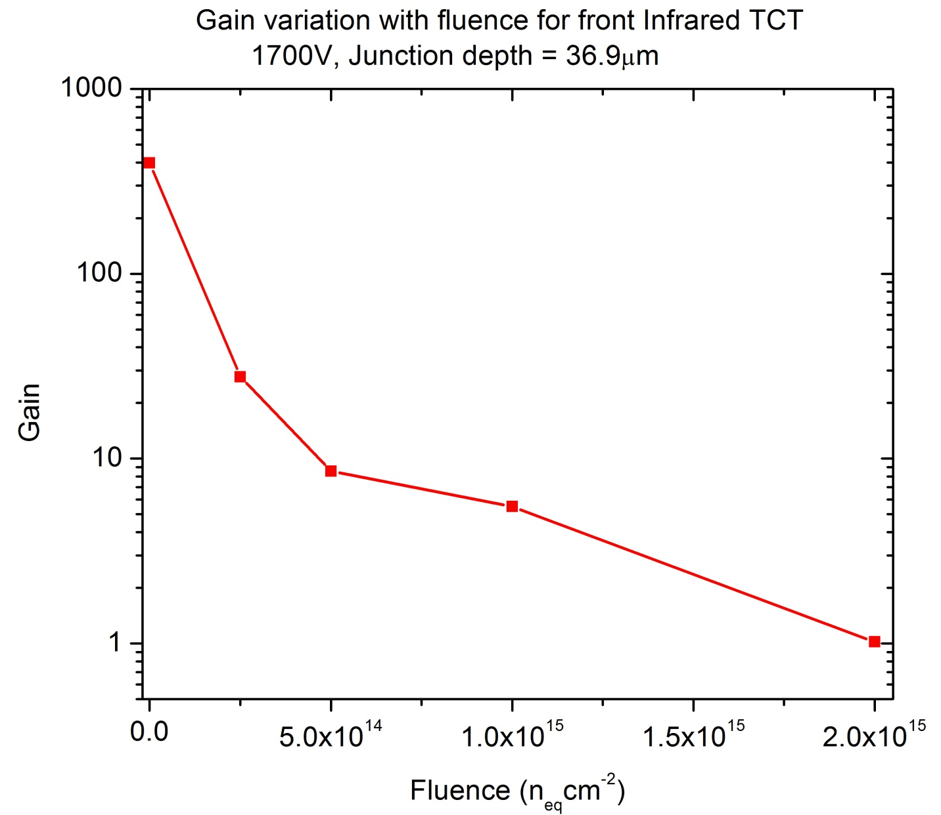
Irradiation effect
- Gain is strongly affected by irradiation
- Need to see the effect of dopings and junction variation !

Slide 16
Suggestions needed for further work!
- Thanks for your attention!

Slide 17
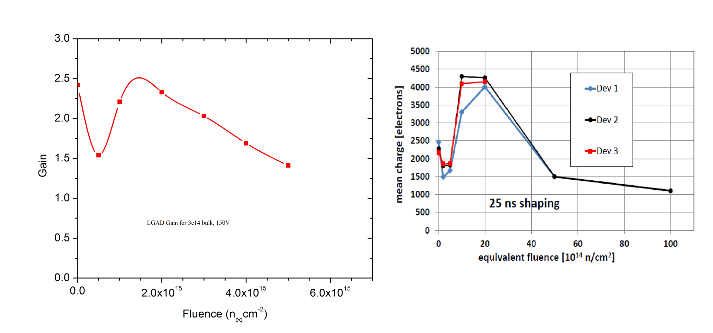
Some LGAD news
Bulk – 3e14 cm-3
P-well doping = 3e16 cm⁻³ (peak)
7micron depth
DU simulation for 50um LGAD
CMOS gain,
Kramberger, JINST 2015
LGAD radiation hardness is affected by bulk doping variation
Simulation indicate that the better radiation hardness is expected for higher bulk doping
LGAD Gain can vary with fluence similar to CMOS
Currently involved with thin LGAD and CMOS simulations too.

Slide 18
Irradiation effect
Radiation damage simulations are carried out using already published and tested two trap
model (R. Dalal et al., Vertex-2014)
  It was developed during HPK campaign for proton irradiation
  It creates correct amount of leakage current, full depletion voltage (or CV), double peak
  electric field profile and CCE for fluence at least up to 2e15 n_{eq}cm⁻²
No acceptor removal term have been used in these simulations
Simulations are carried out at 253K
No. | Trap | Energy Level | g_{int} (cm⁻¹) | σ_{e} (cm⁻²) | σ_{h}(cm⁻²)
1. | Acceptor | E_{c}-0.51eV | 4 | 2x10⁻¹⁴ | 3.8x10⁻¹⁵
2. | Donor | E_{v}+0.48eV | 3 | 2x10⁻¹⁵ | 2x10⁻¹⁵
Parameter table for two trap model used in present simulations

