Slide 1
APD simulations using Silvaco
Ranjit Dalal
(Delhi Univ.)
27-4-2016 Meeting

Slide 2
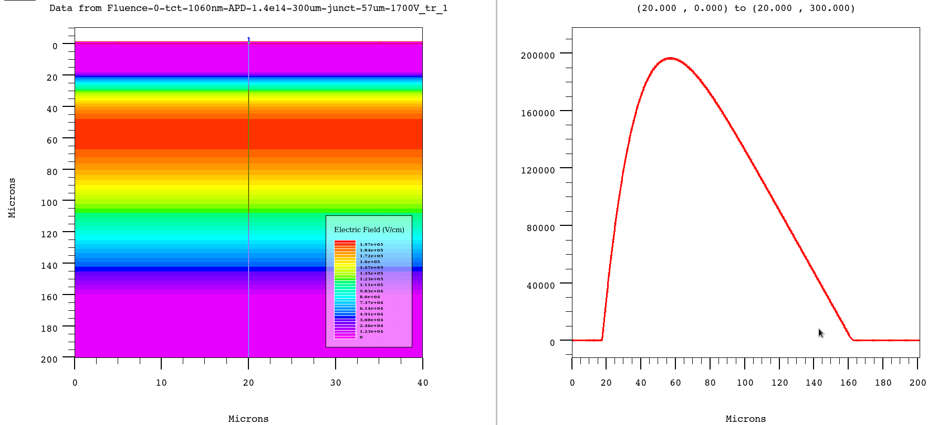
E-field distribution in 200 µm APD
- Junction depth 57 µm
Region from 0-20 µm (about) can contribute to slow diffusion component of signal
Region after 160 µm (about) can also be removed
New simulations with front 17 µm and back side 33 micron removed from the device

Slide 3
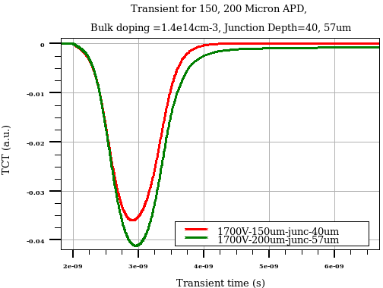
TCT signal comparison of thicker and thinner APD
At 1700V
- Slow diffusion component for 200 micron (Junction 5 micron) APD structure

Slide 4
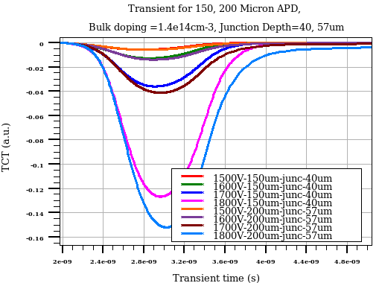
TCT signal comparison of thicker and thinner APD
N- Slow component for thinner APD structure (no diffusion component)

Slide 5
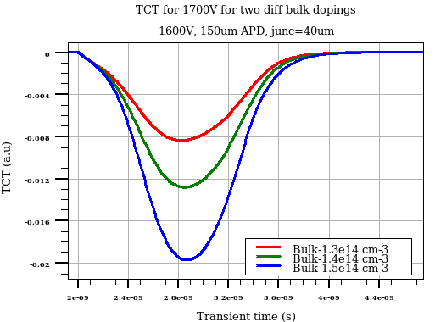
TCT signal comparison of thin APD structure for different bulk doping
Higher multiplication for higher bulk doping as there is higher E field
around junction for higher bulk doping case

Slide 6
Near future simulations…
Need for investigation for higher bulk doping
for example from 1.4e14 to 5e14 cm-3
(CMOS ranges !)
  Can we reduce the operating bias voltages for APD
  Without sacrificing the gain, timing etc ?
Polarity change (n-in-p) effect

