Slide 1
APD Discussion
Silvaco Simulation (Delhi Uni.)
Ranjit Dalal
Meeting Date : 23-2-2017

Slide 2
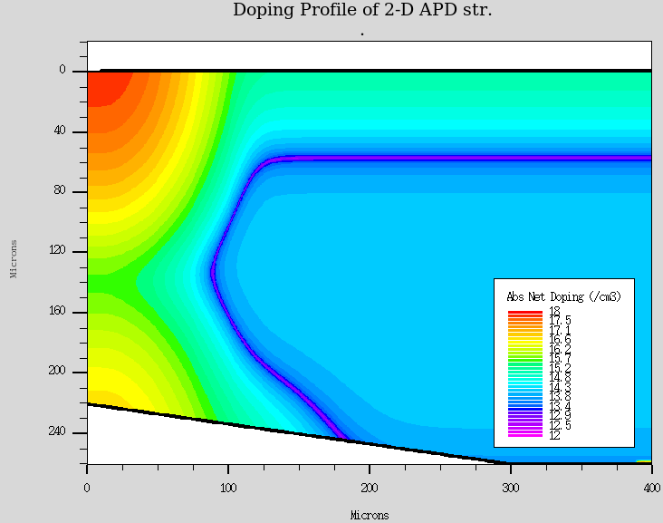
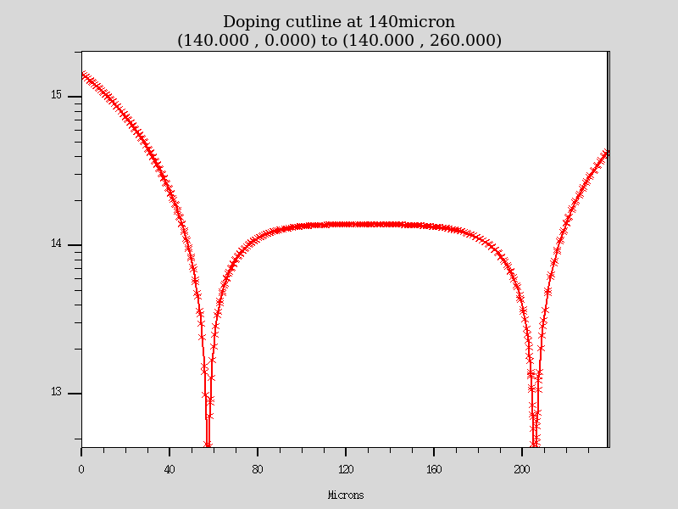
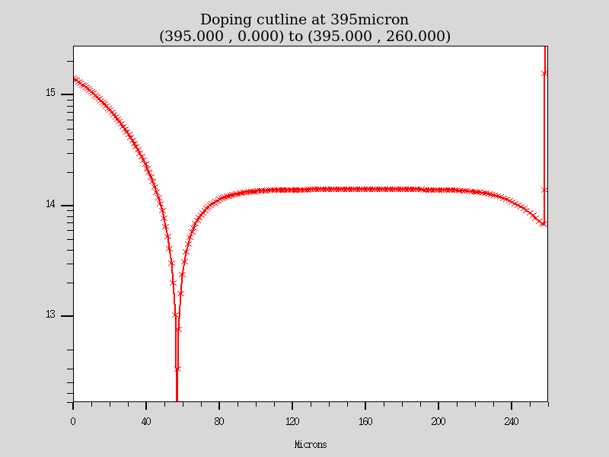
2D Doping Profile for APD
X=395 micron
X=140 micron
Backside p-type doping implemented
Bevelled str
Backside trench at Y= 275 micron, 10 micron wide
Have tried to implement the Doping profile of slide 19
(though could not implement the error function)

Slide 3
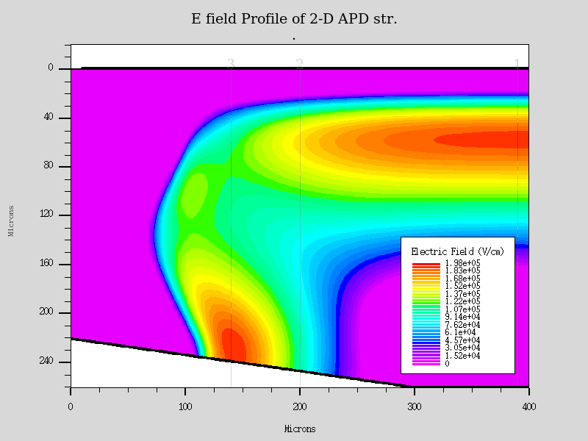
E Field profile : 1700V
Very high field near front side planar region and backside junction
All field variation is happening in about 250 micron or 0.25 mm

Slide 4
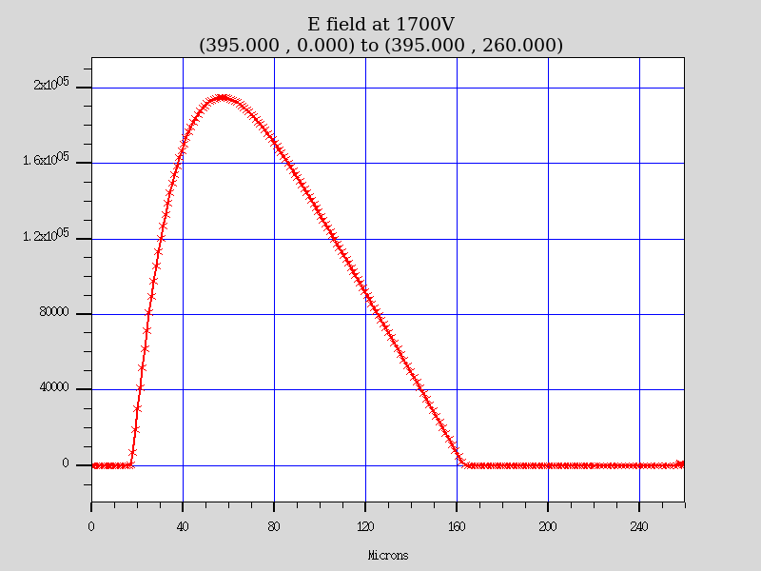
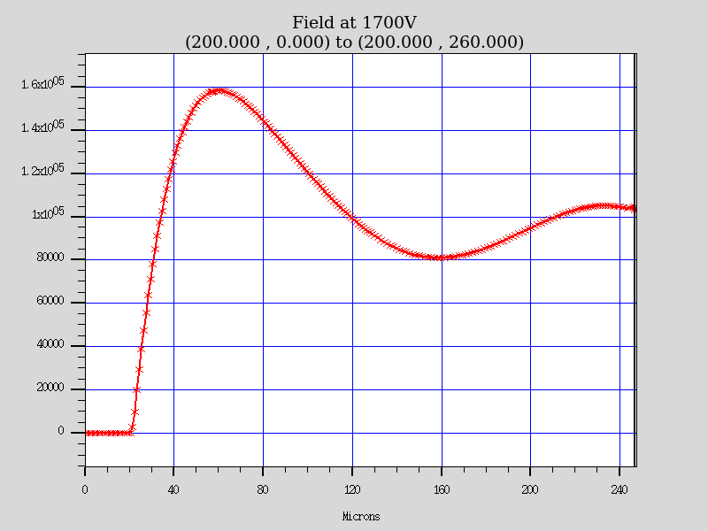
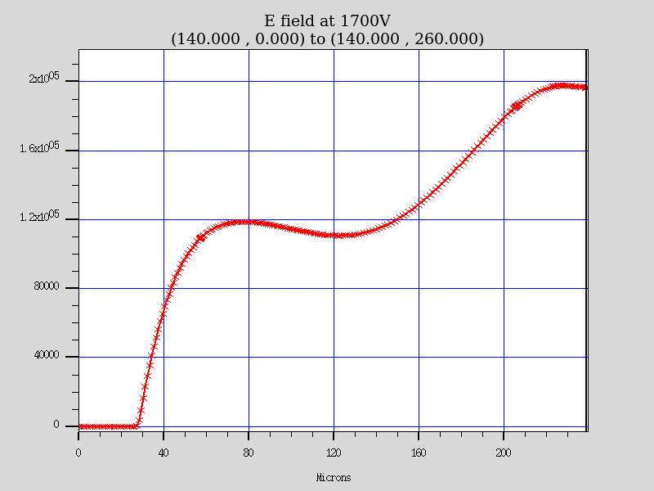
E Field profile : 1700V
x = 395 micron
X=200 micron
X=140 micron

Slide 5
Transient Signal at different locations of 2D str
Laser fired at X = 370, 300, 250, 200, 170, 140, 110, 80, 40 micron position
Signal is maximum for 370 micron position
Signal decreases with decrease in x-coordinate initially, but, bounce back again
(though, not able to recover fully) and peaked for 110 micron position again

Slide 6
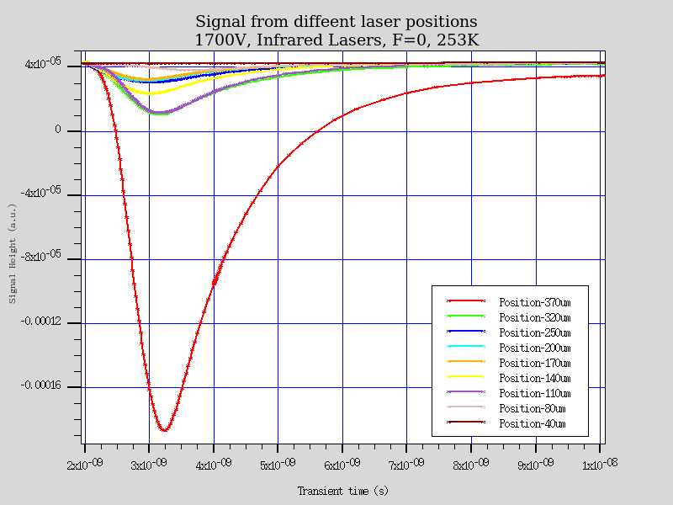
Transient Signal at different locations of 2D structure
Laser fired at X = 370, 300, 250, 200, 170, 140, 110, 80, 40 micron position

Slide 7
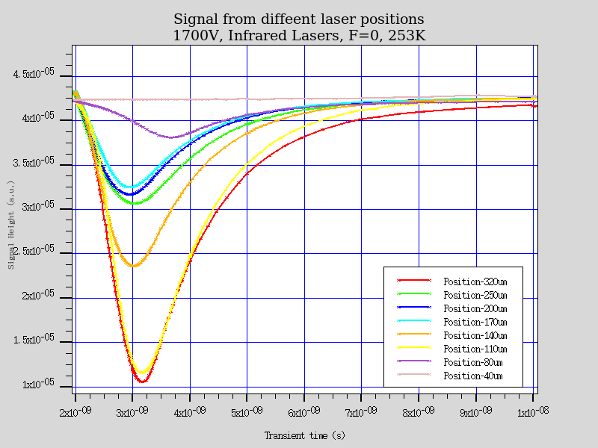
Transient Signal at different locations of 2D str
Laser position 320 and 110 micron
Laser fired at X = 370, 300, 250, 200, 170, 140, 110, 80, 40 micron position

Slide 8
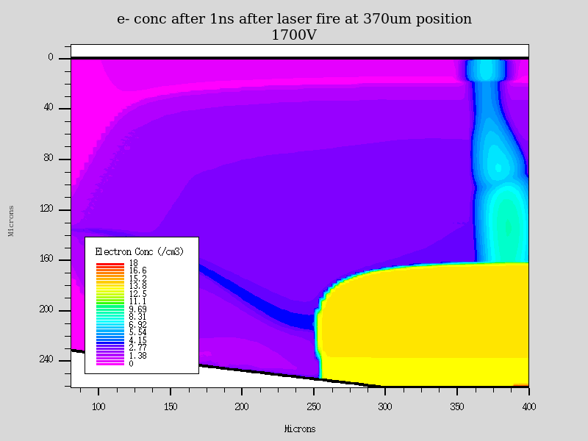
e- conc at 370 micron after 1ns of laser fire
Signal is maximum for 370 micron position
All the electrons in the multiplication region and slightly before that (due to diffusion collection)
are multiplied by avalanche mechanism

Slide 9
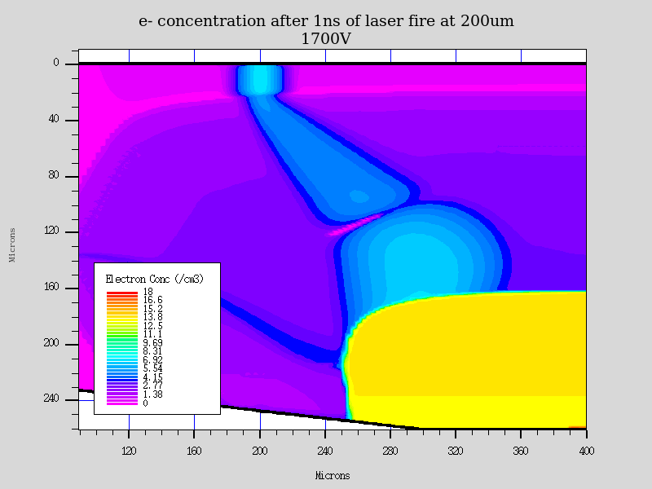
e- conc at 200 micron after 1ns of laser fire
Signal decreases with decrease in x-coordinate due to lower field in multiplication region

Slide 10
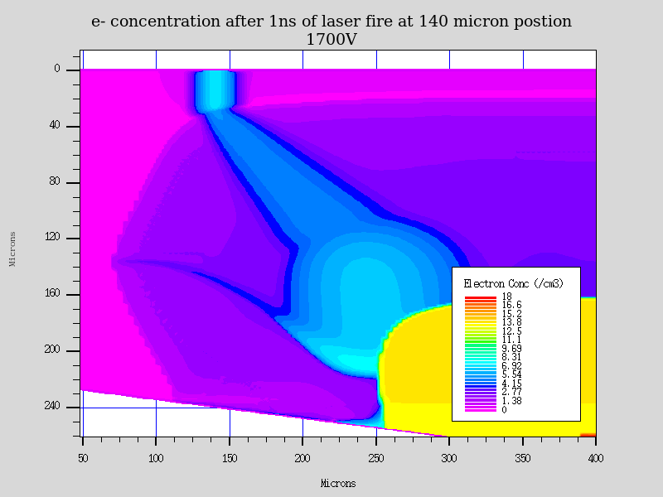
e- conc at 140 micron after 1ns of laser fire
Only e- created in the backside multiplication region (which is smaller than the front side
multiplication region) are effectively multiplied.

Slide 11
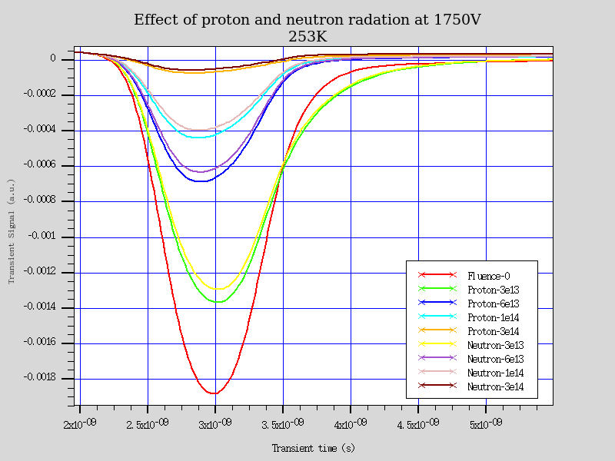
Effect of irradiation- Proton/Neutron
Simulations are indicating a strong effect of proton/neutron damage effect on CCE
Recently developed neutron damage model (which works nicely for diodes) and old proton
damage models are used
- Multiplication factor is reduced to 162 (for Fluence = 0) to about 14 (for fluence 3e14 neqcm-2)
- There can be some room for gain loss compensation by increasing the reverse bias

Slide 12
Thanks for your attention !

Slide 13
Backup!

Slide 14
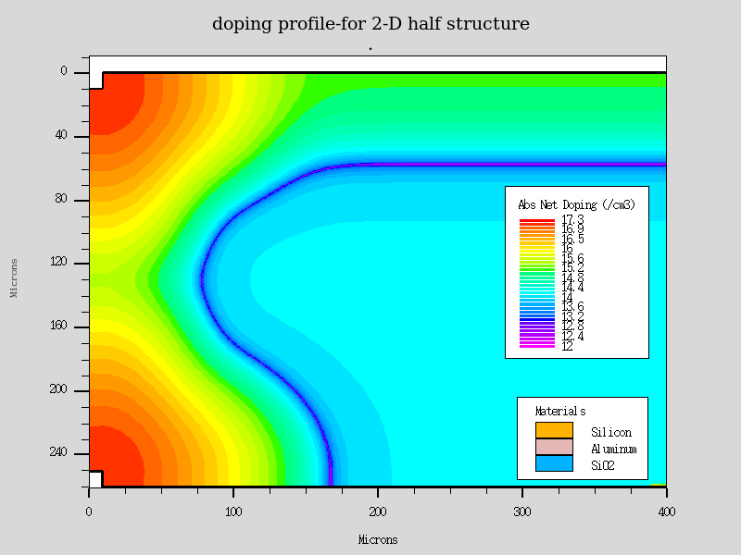
2-D Simulation Structure (shown in 8 Dec Discussion)
Angle ()between p-n junction and surface is 90 deg
Leading to higher field

Slide 15
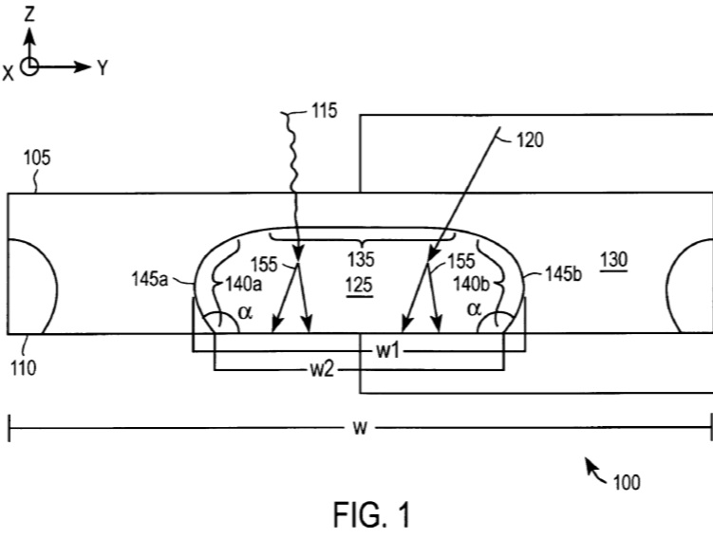
Actual Str.
-  is an obtuse angle, that would affect the field near surface significantly

Slide 16
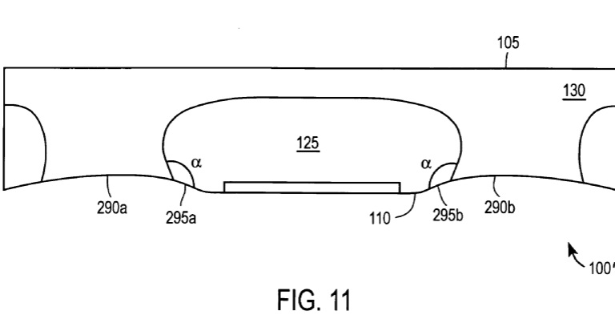
Actual str. (Variant)
Side portion of n-well and p-type doping are recessed which may further, decrease
field near surface

Slide 17
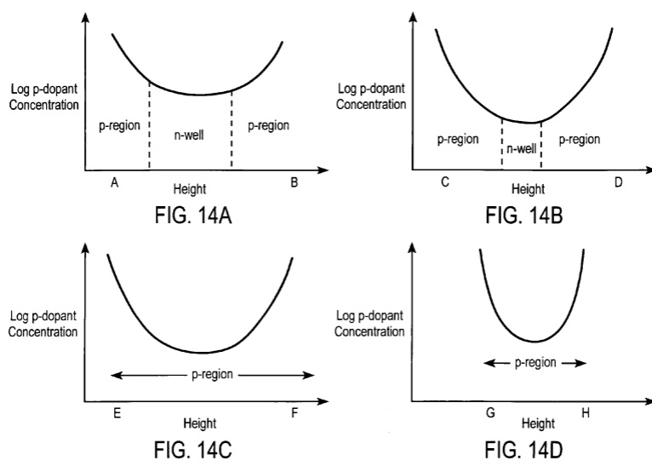
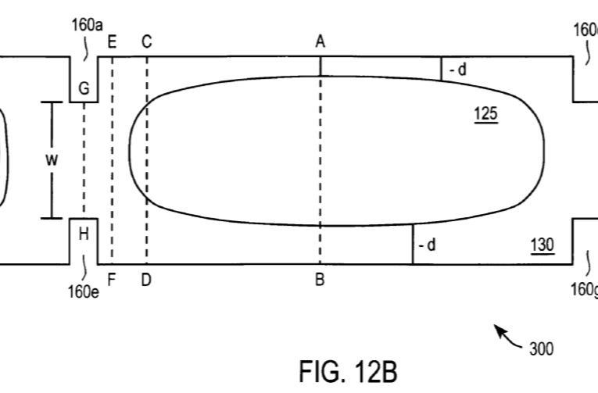
Doping Profile

Slide 18
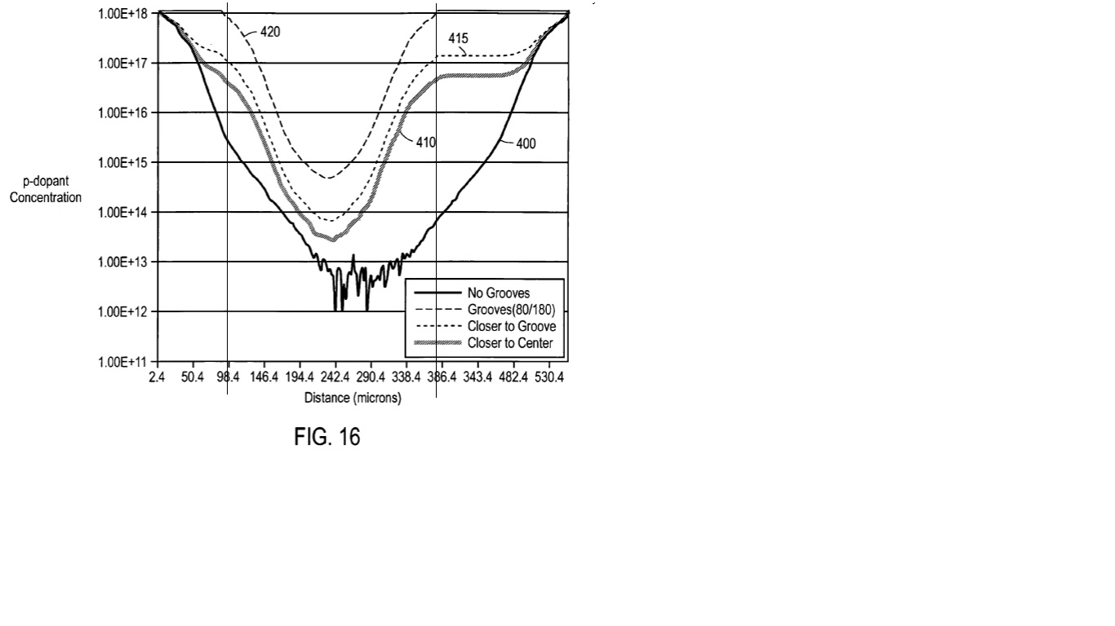
Doping profile
400 is Line along centre
There is significant value of p-type doping near backside of APD (denoted by vertical line
about 386.4)
That would change the effective doping density (of n-type bulk) near backside of APD
------> This, too, will reduce the E field near backside surface
(Remember, we have used a uniform n-type bulk)

Slide 19
Changes in Doping profile (simulation Str)
Value of  must be between 120-150 degree
Effect of recessed str.
Effect of backside p-type doping
These steps will be implemented through discussion in the
collaboration.

