Slide 1
APD leakage current
Simulation using Silvaco
Ranjeet Dalal
(Delhi Uni.)
16-11-2016

Slide 2
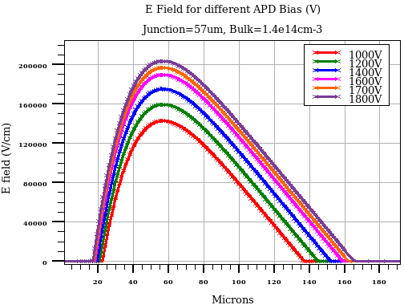
Structure
Two APD thickness are used for simulation
  1umx40umx260 micron
  1umx40umx200 micron
  Junction depth is kept at
  57 micron for both str
Leakage current calculated for the
2mmx2mm surface area
(Factor of 10⁵ is used)
Simulation at 253K
Two trap model is used for radiation
damage

Slide 3
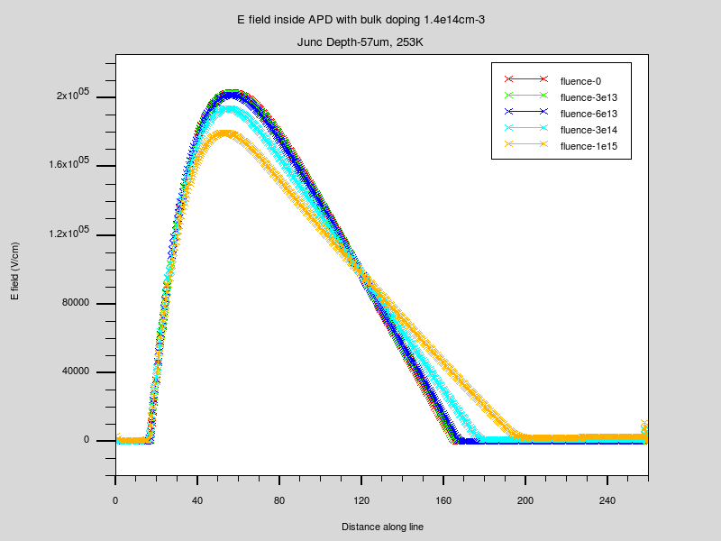
E field variation with fluence
1800V
Peak E field is decreasing with fluence that would result in lower multiplication
But charge carrier generation by trap levels would increase the leakage current

Slide 4
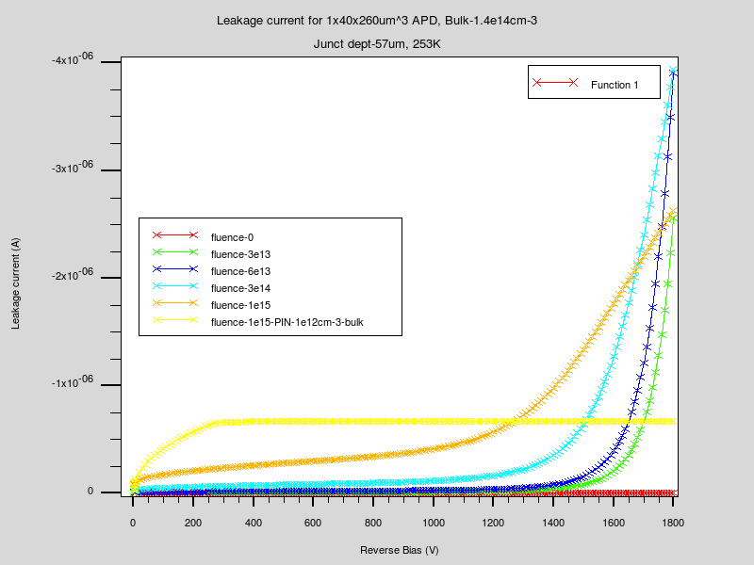
Leakage current variation with fluence
260 micron
Leakage current is not proportional to fluence (which is true in PIN diode)
Leakage current increases sharply for irradiated APD even below 1800V
Complex effect of charge carrier generation by traps and charge multiplication
by presence of high field around junction
Leakage current curve for higher fluence may be crossed by lower fluence current curve
for example, leakage current curve after fluence 1e15 neqcm-2 crosses the curve for fluence 3e14 neqcm-2

Slide 5
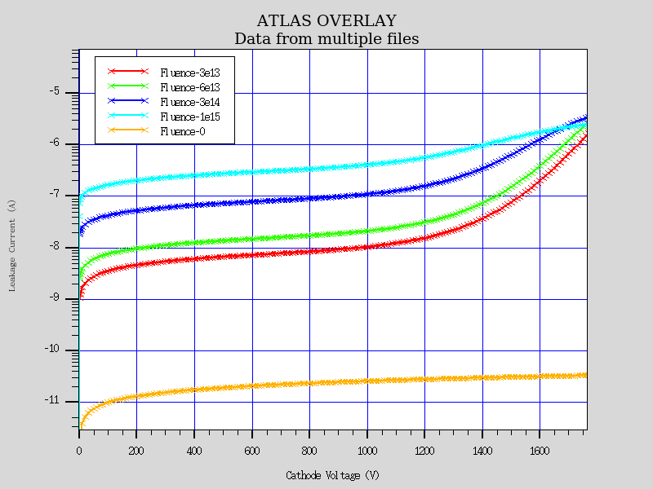
Log current scale for plot on last slide
- Y axis is simulated leakage current in power of 10 for 2mmx2mm active area

Slide 6
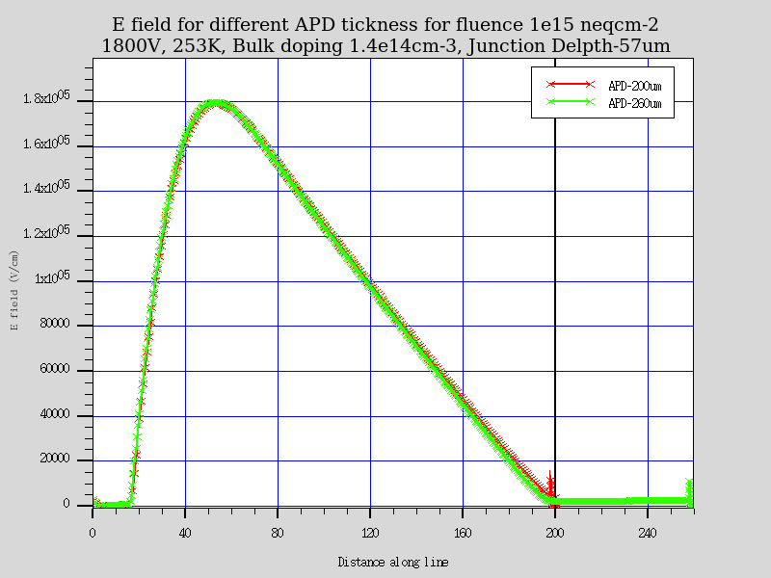
E field for different APD thickness
Only slight effect in Efield profile
Peak E field is very similar but there is slightly more field from 120-200 micron region
for 200 micron thick APD
- Leakage currents should not be very different for these thickness

Slide 7
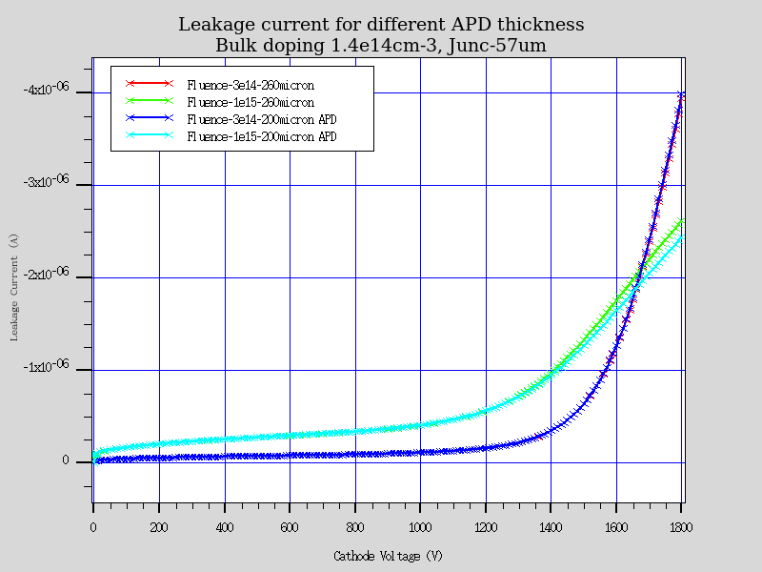
Leakage current for different APD thickness
Similar leakage current for 200 and 260 micron thick APD
Slightly higher leakage current for 260 micron thick APD for 1e15 neqcm-2

Slide 8
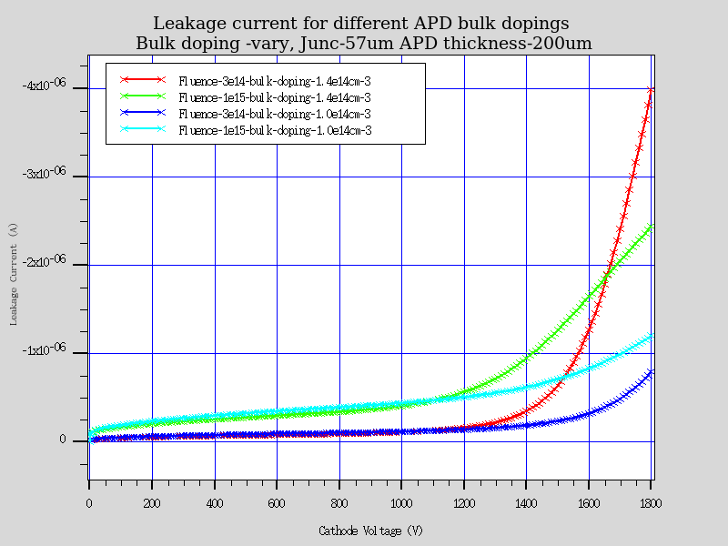
Effect of bulk doping on leakage current
Yes, it is !

Slide 9
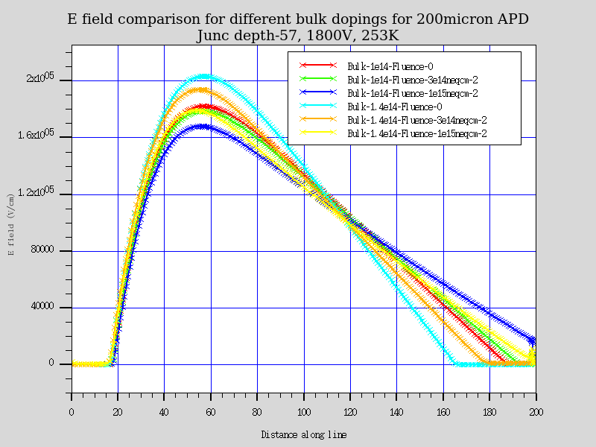
Effect of bulk doping variation
Lower field for lower bulk doping (red, green blue curves) or less charge multiplication
is expected for bulk doping 1e14 cm⁻³, compared to bulk doping of 1.4e14 cm⁻³

Slide 10
What next!
Gain simulation for these fluences
Effect of bulk doping and thickness on APD gain after irradiation
Tangible directions for best possible parameters ?

