Slide 1
APD Discussion
Simulation structure
Ranjit Dalal
(Delhi Uni.)
11-Jan-2017

Slide 2
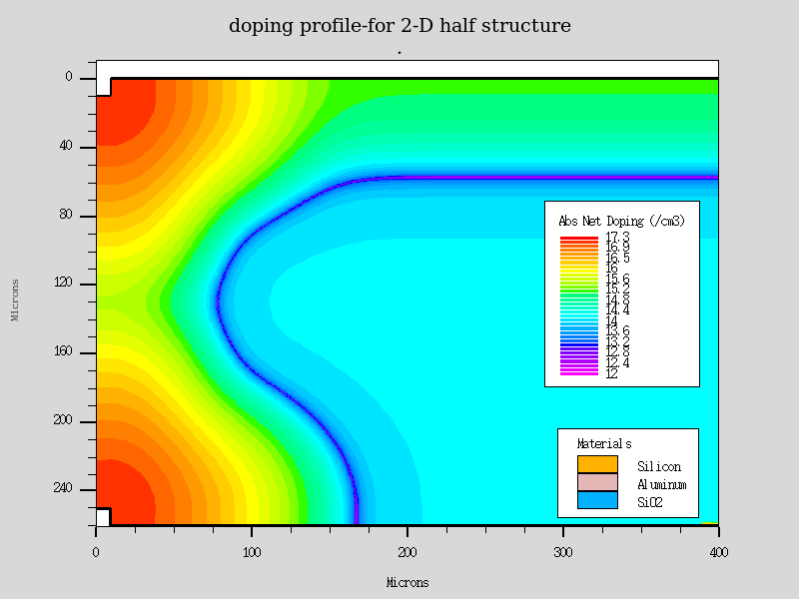
2-D Simulation Structure (shown in 8 Dec Discussion)
Angle ()between p-n junction and surface is 90 deg
Leading to higher field

Slide 3
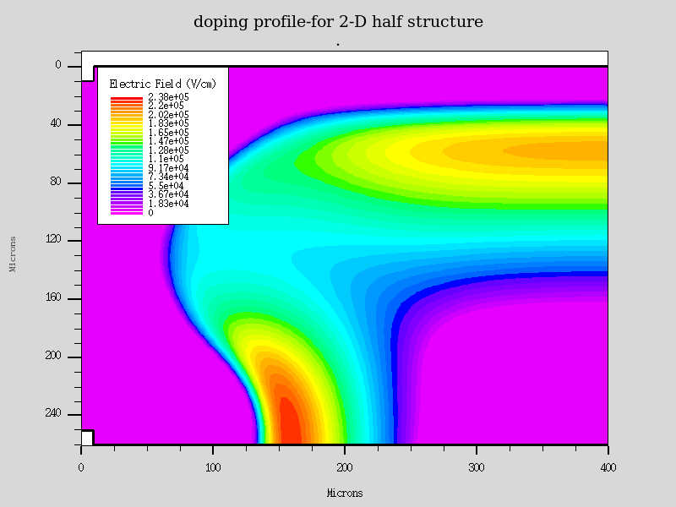
E field

Slide 4
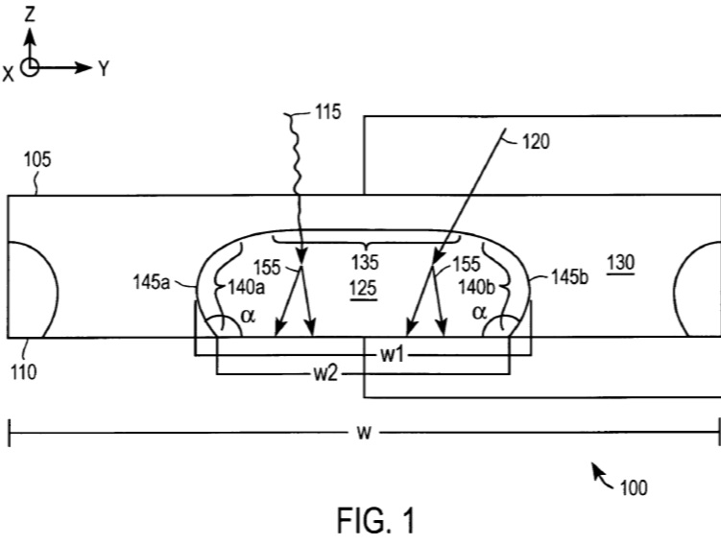
Actual Str.
-  is an obtuse angle, that would affect the field near surface significantly

Slide 5
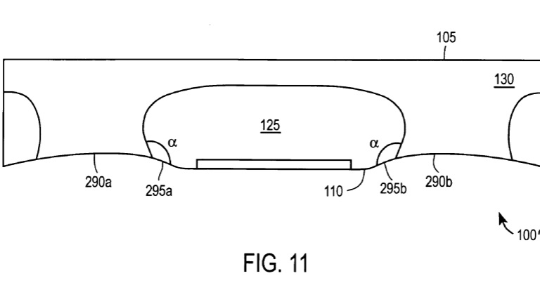
Actual str. (Variant)
Side portion of n-well and p-type doping are recessed which may further, decrease
field near surface

Slide 6
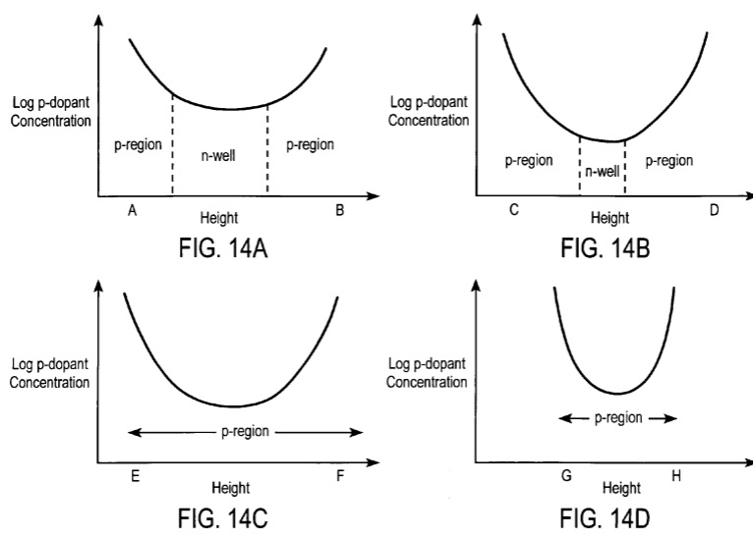
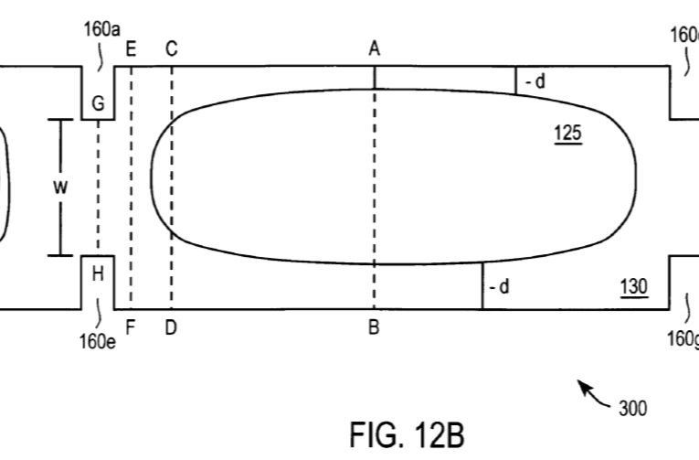
Doping Profile

Slide 7
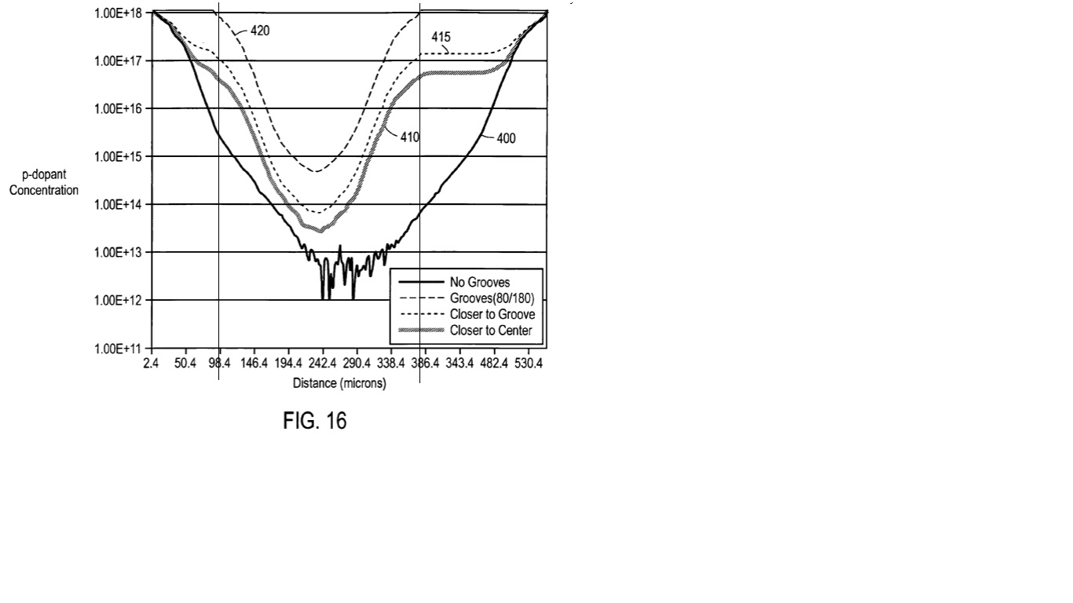
Doping profile
400 is Line along centre
There is significant value of p-type doping near backside of APD (denoted by vertical line
about 386.4)
That would change the effective doping density (of n-type bulk) near backside of APD
------> This, too, will reduce the E field near backside surface
(Remember, we have used a uniform n-type bulk)

Slide 8
Changes in Doping profile (simulation Str)
Value of  must be between 120-150 degree
Effect of recessed str.
Effect of backside p-type doping
These steps will be implemented through discussion in the
collaboration.

