Slide 1
APD simulations using Silvaco
Ranjit Dalal
(Delhi Univ.)
30-3-2016 Meeting
Updated 13-4-2016

Slide 2
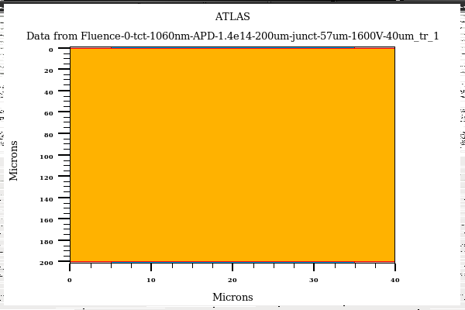
Edge-TCT for APD
APD Bulk = 1.4e14cm-3
Junction Depth = 57µm
Laser
1060nm
Laser Width = 1micron
Position = 10µm to 160µm (5 µm step)
(long Laser rise time may affect APD signal
timing profile)
All simulations are with 1ps laser
rise time
Gain=Total collected charge (with multiplication on)/ Collected
charge (with multiplication off in simulation)

Slide 3
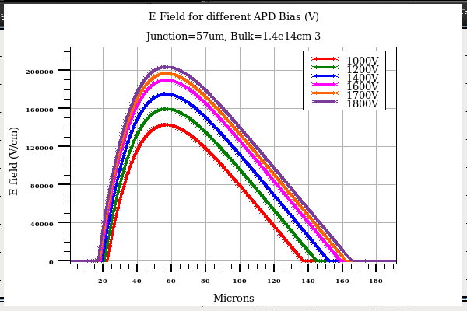
E field for different Bias
With increase in bias, Depletion region (mainly) expand in backside bulk
Should not expect much improvement with bias (for front diffusion component) !
No multiplication beyond 100 micron depth (this number depends on bias)

Slide 4
Bias = 1600V

Slide 5
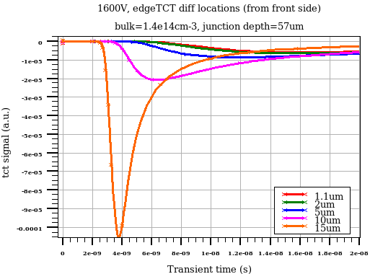
Signal evolution near front surface edgeTCT positions
Very slow diffusion component
Front side can be removed with impunity

Slide 6
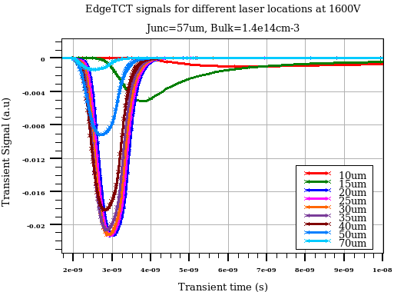
Signal evolution for different edgeTCT positions
Slow signal for 10-15µm location (diffusion component is significant)
Highest multiplication for 20-25µm laser position
Multiplication decreases for deeper locations
No multiplication after 90µm

Slide 7
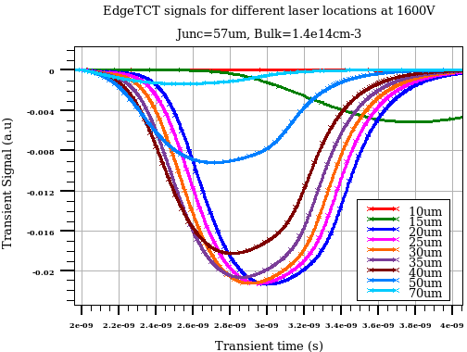
Signal evolution for different edgeTCT positions
2ns time window

Slide 8
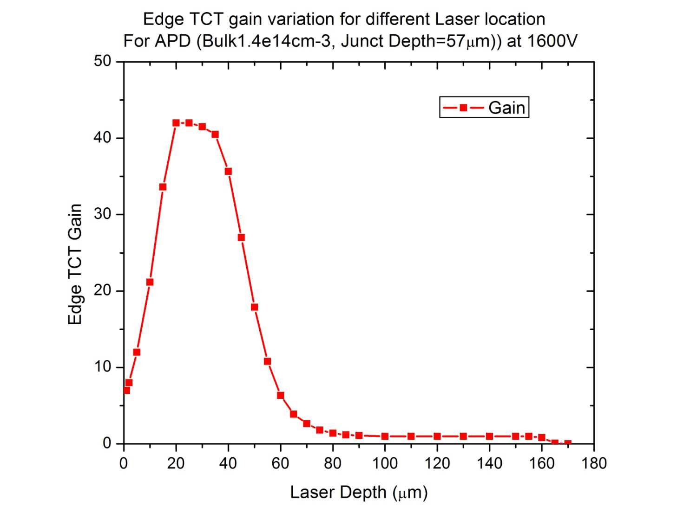
EdgeTCT gain for APD
Gain variation vs laser depth
eTCT profile for APD is very different from usual diodes
  Depend on drift and diffusion components
  Depends on multiplication

Slide 9
Bias = 1700V

Slide 10
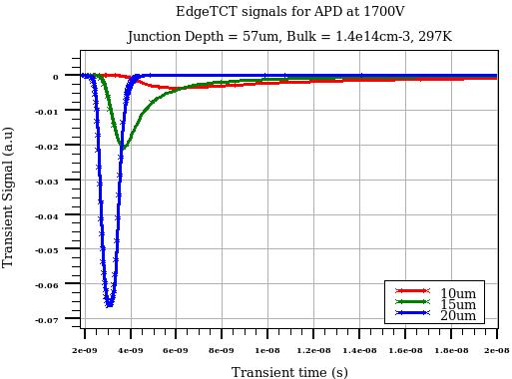
Signal evolution near front surface EdgeTCT positions
Very slow diffusion component
Front side can be removed with impunity

Slide 11
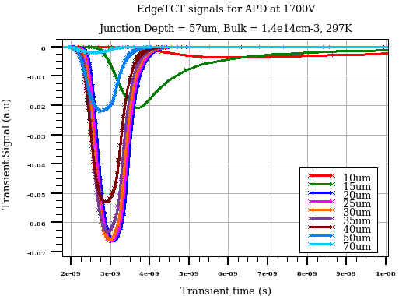
Signal evolution for different edgeTCT positions
Slow signal for 10-15µm location (diffusion component is significant)
Highest multiplication for 20-25µm laser position
Multiplication decreases for deeper locations
No multiplication after 90µm

Slide 12
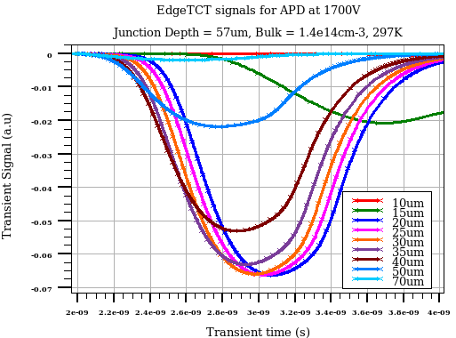
Signal evolution for different edgeTCT positions
2ns time window

Slide 13
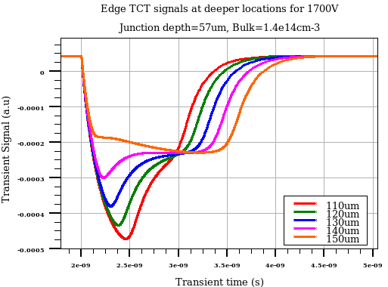
EdgeTCT for deep Laser locations (1700V)
Very different signal evolution for deeper locations
(though it is not a significant contributor to overall signal due to no signal multiplication)

Slide 14
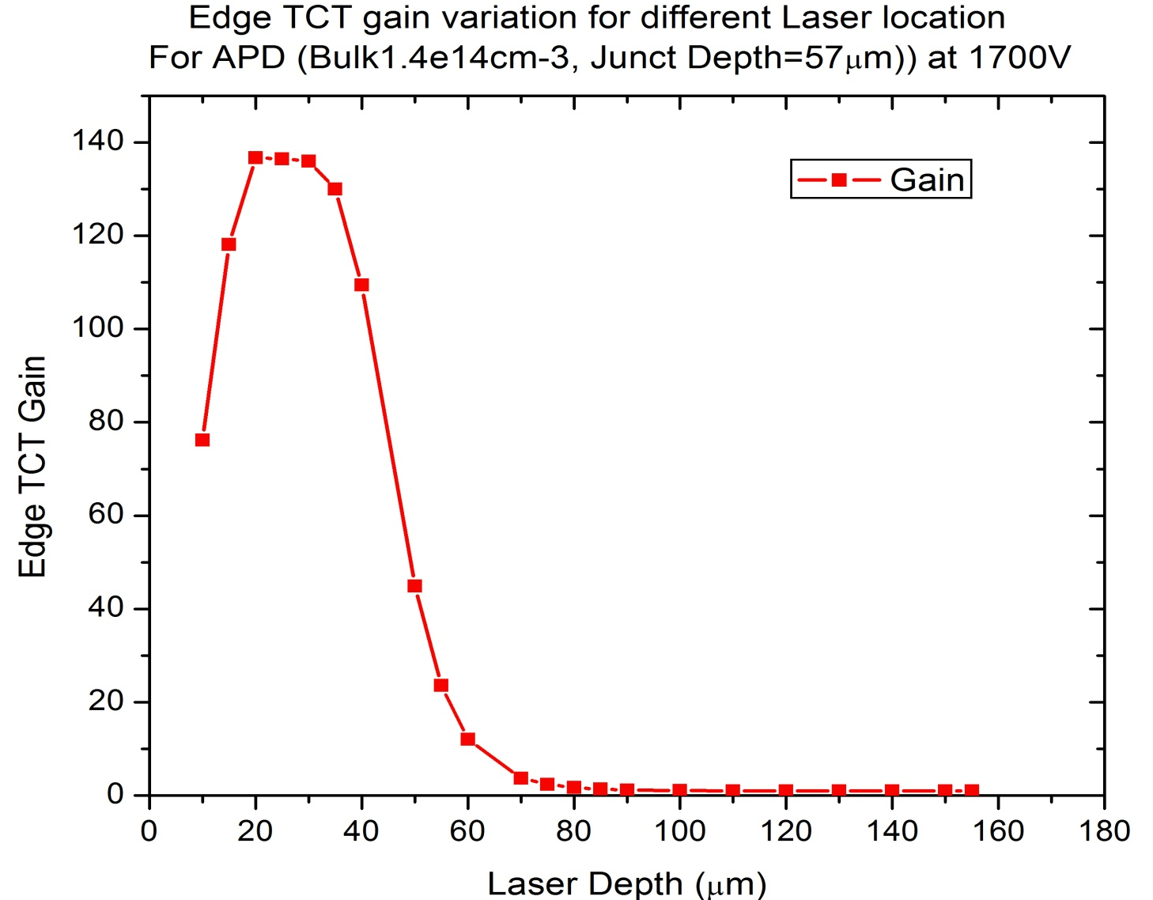
EdgeTCT gain for APD
Gain variation vs laser depth
Maximum gain is upto 136 at 1700V

Slide 15
Bias = 1800V

Slide 16
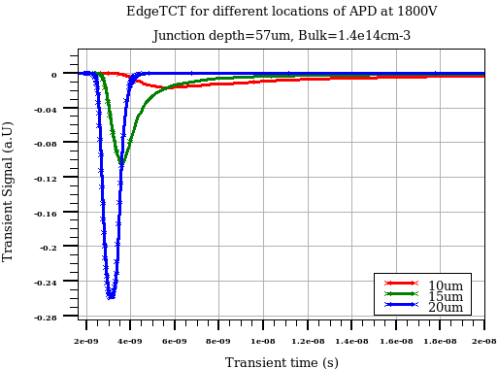
Signal evolution near front surface edgeTCT positions
Very slow diffusion component
Front side can be removed with impunity

Slide 17
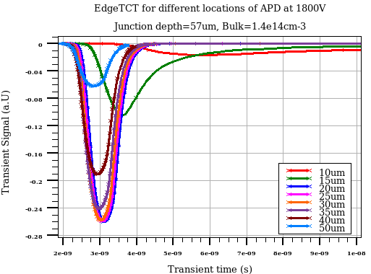
Signal evolution for different edgeTCT positions
Slow signal for 10-15µm location (diffusion component is significant)
Highest multiplication for 20-25µm laser position
Multiplication decreases for deeper locations
No multiplication after 90µm

Slide 18
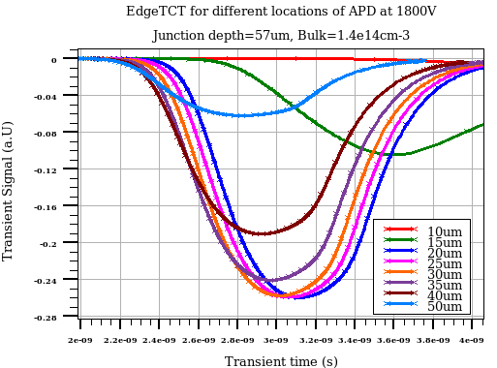
Signal evolution for different edgeTCT positions
Transient time scale from 2ns to 4 ns)

Slide 19
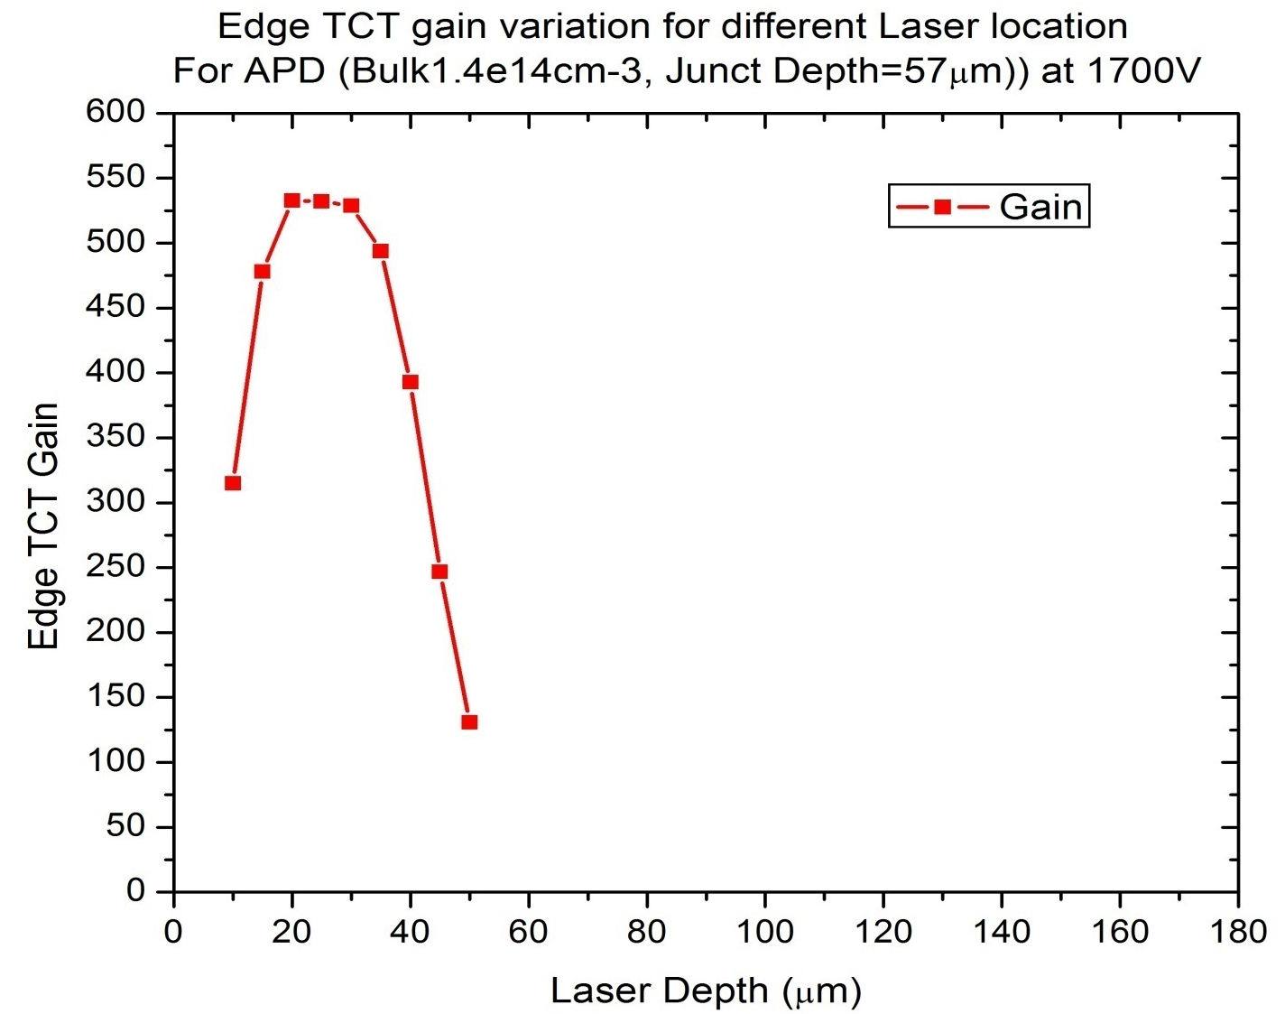
EdgeTCT gain for APD
Gain variation vs laser depth for 1800V
- Simulation is still running

Slide 20
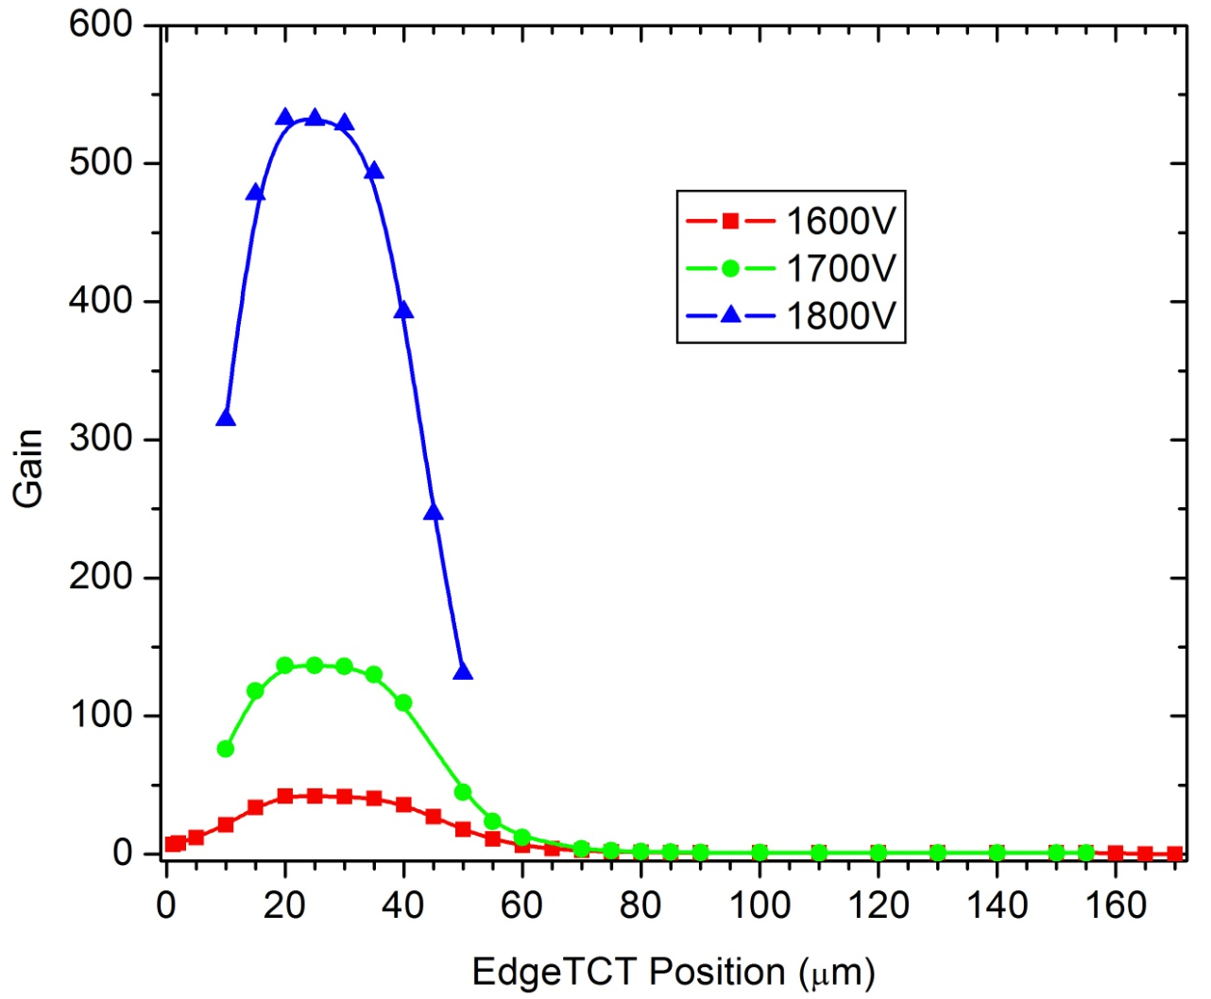
EdgeTCT Gain Variation with Bias
- Some of points for 1800V are yet to be come

Slide 21
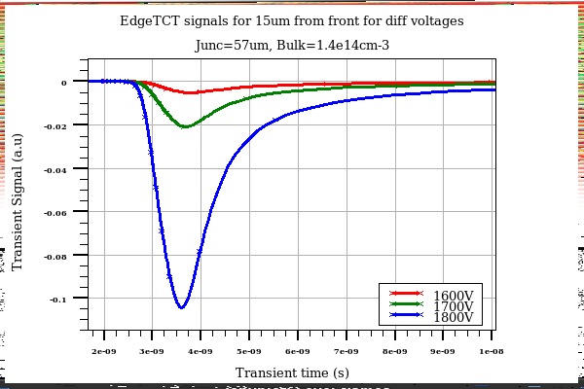
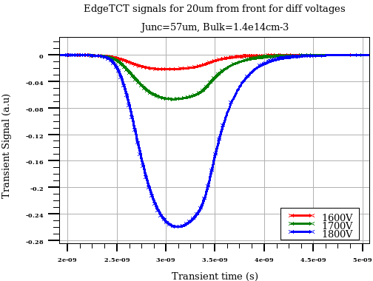
eTCT signal comparison for diff bias
15 Micron laser position
20 Micron laser position

Slide 22
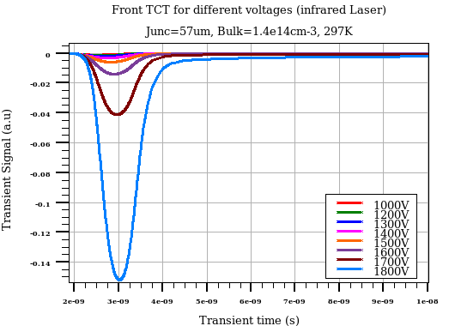
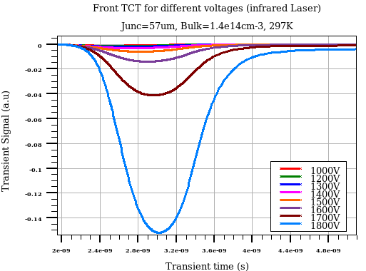
Front TCT (Infrared Laser) @ 1700V
Transient time scale from 2ns to 10 ns)
Transient time scale from 2ns to 4 ns)
3ps laser fired at 2ns
Peak of transient signal is at about 3ns
Long (but relatively small) tail present (probably due to diffusion component from front)

Slide 23
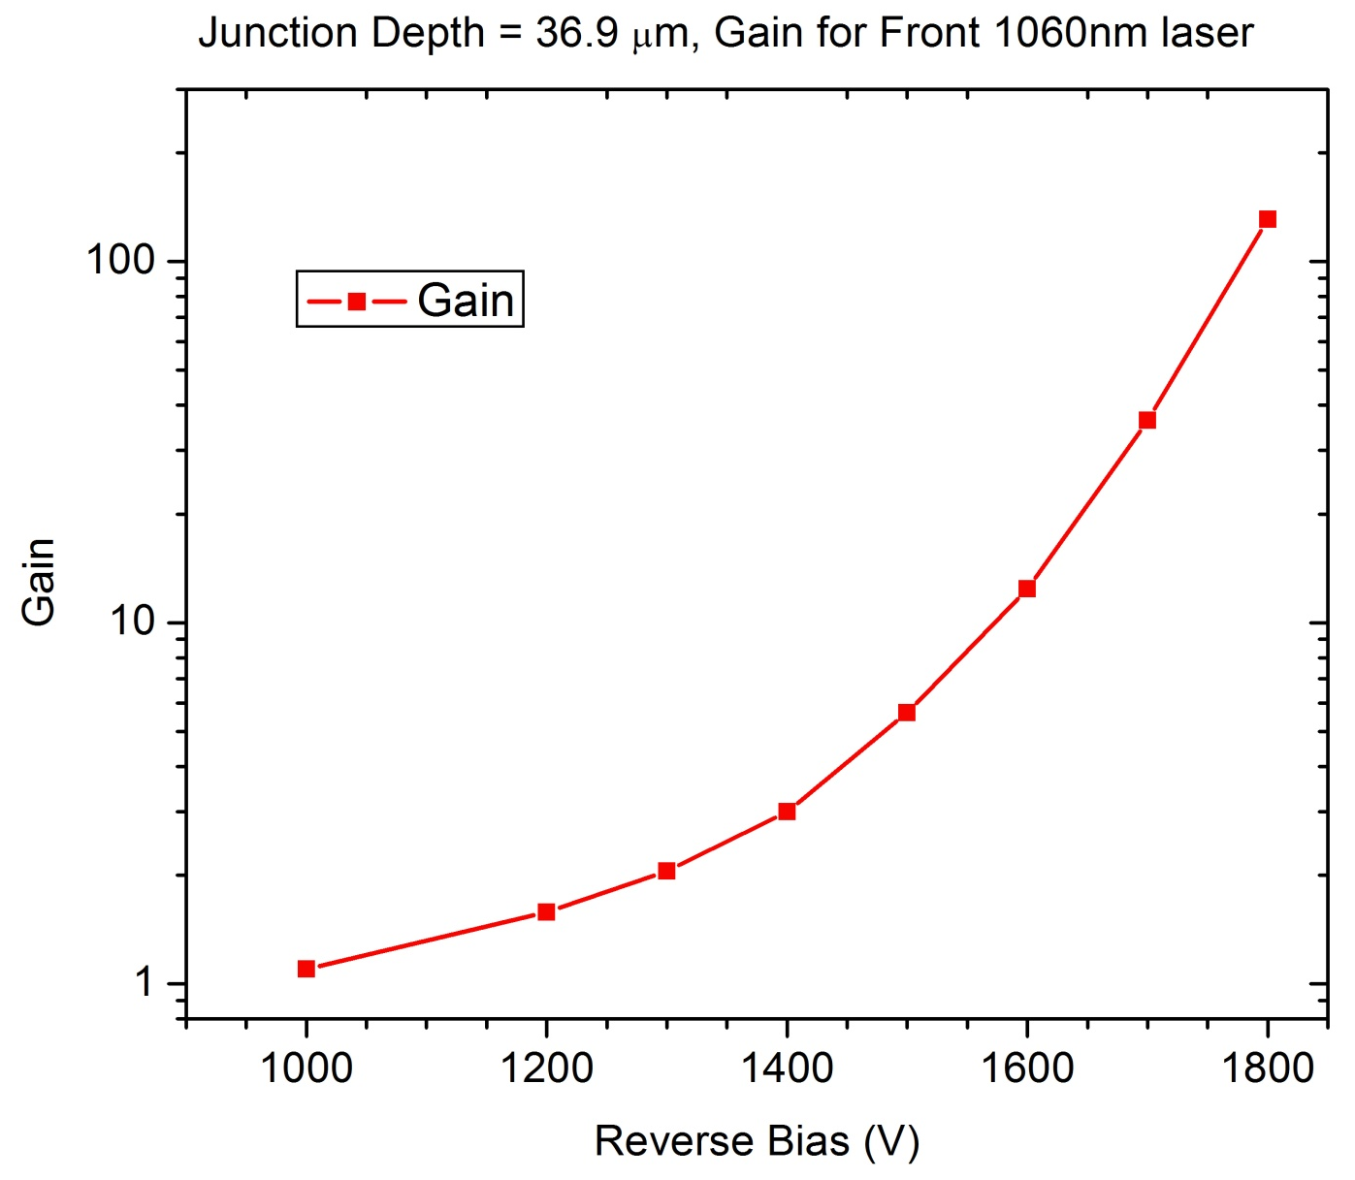
Front TCT Gain Variation with Bias
- Gain for front TCT is almost four times less to the maximum gain for Edge TCT

Slide 24
Summary
Edge TCT run for 1600, 1700 and 1800V bias will be complete soon
Future studies
  effect of front side removal (10-20micron)
  Effect of bulk doping
  Effect of polarity change
  Radiation damage effect
  (Can we benefit like CMOS)

