Slide 1
APD simulations using Silvaco
Ranjit Dalal
(Delhi Univ.)
16-3-2016 Meeting

Slide 2
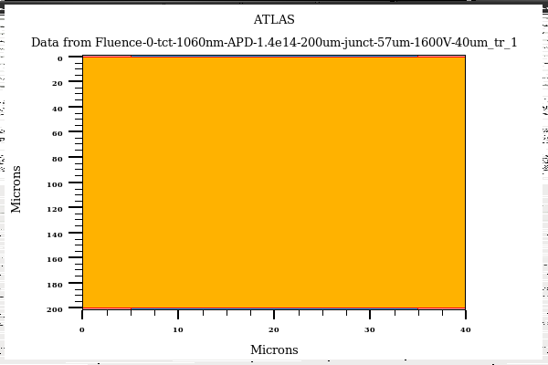
Edge-TCT for APD
APD Bulk = 1.4e14cm-3
Junction Depth = 57µm
Laser
1060nm
Laser Width = 1micron
Position = 10µm to 160µm
Bias = 1600V
Gain = Total collected charge (with multiplication on)/ Collected charge (without multiplication)

Slide 3
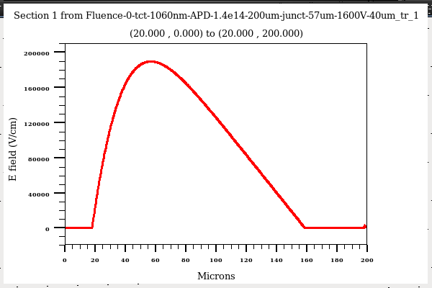
EdgeTCT for APD
p+
n+
E field inside APD bulk for 1600V
High multiplication is expected for eTCT locations near to surface
No multiplication for laser positions above 100µm (as electrons will be collected at n+ without
any multiplication)

Slide 4
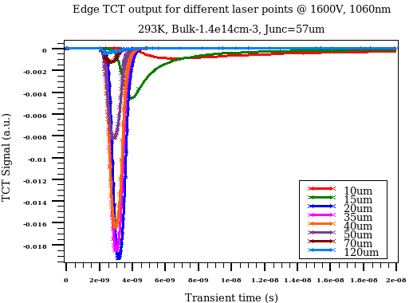
EdgeTCT for APD
Slow signal for 10-15µm location (diffusion component is significant)
Highest multiplication for 20-25µm laser postion
Multiplication decreases for deeper locations
No multiplication after 90µm

Slide 5
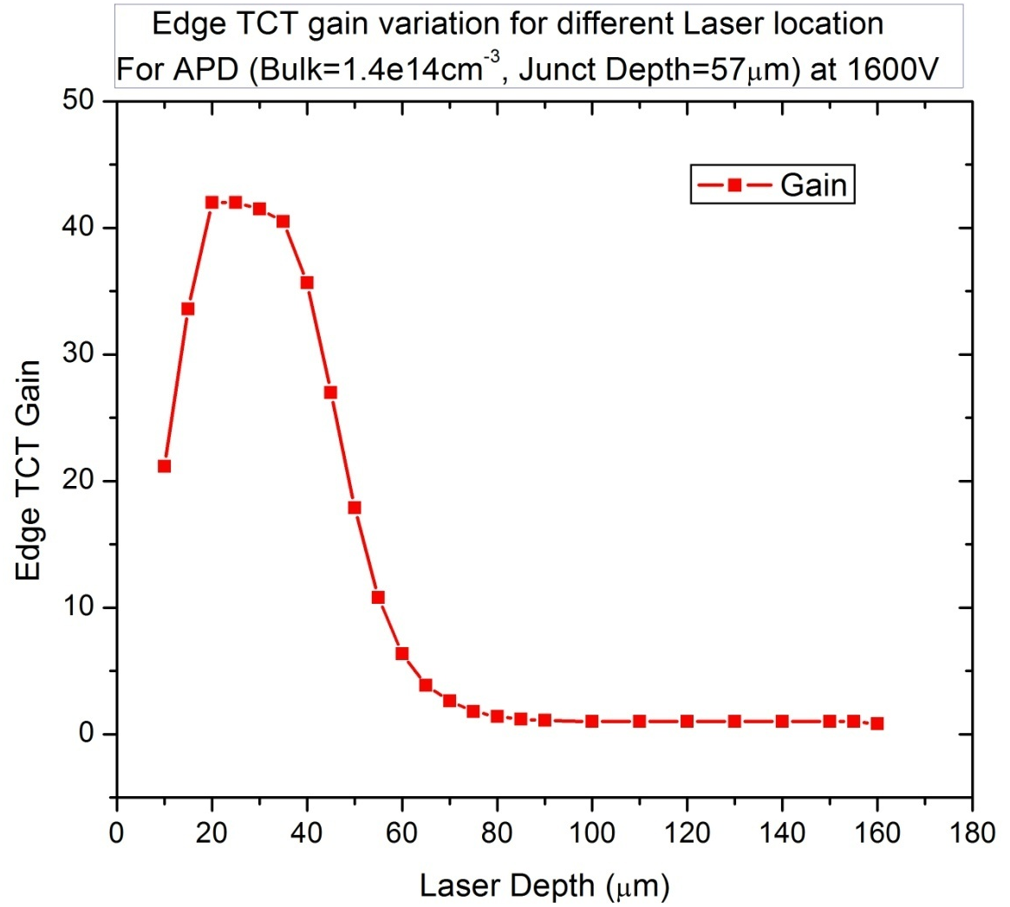
EdgeTCT for APD
Gain variation vs laser depth
eTCT profile for APD is very different from usual diodes
  Depend on drift and diffusion components
  Depends on multiplication

Slide 6
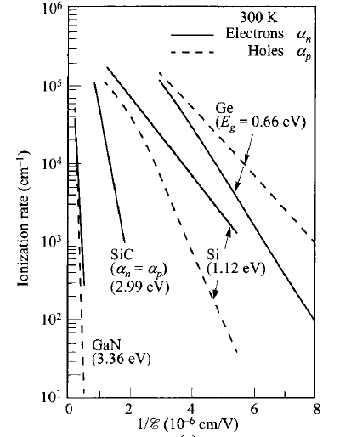
Ionization rate due to
e- are at least 20 times
More compared to holes
- Justify our approach
Ionization rate vs inverse of electric field at 300K
(S.M. Sze)

Slide 7
- Suggestions ?

