Slide 1
APD simulations using Silvaco
Ranjeet Dalal
(Delhi Uni.)
9-2-16

Slide 2
APD simulations summary
130 micron APD thickness was used for simulations
Initially, junction depth 57 micron was used for simulations
Gain curve trends were similar to the measurements (for infrared)
There was no signal for junction depth 57 micron using 480nm as reported in publication
Hence,
Reduced junction depth to about 37 micron
The simulated gain curve was higher than measurement
Significant irradiation effect observed
More simulations for understanding the device

Slide 3
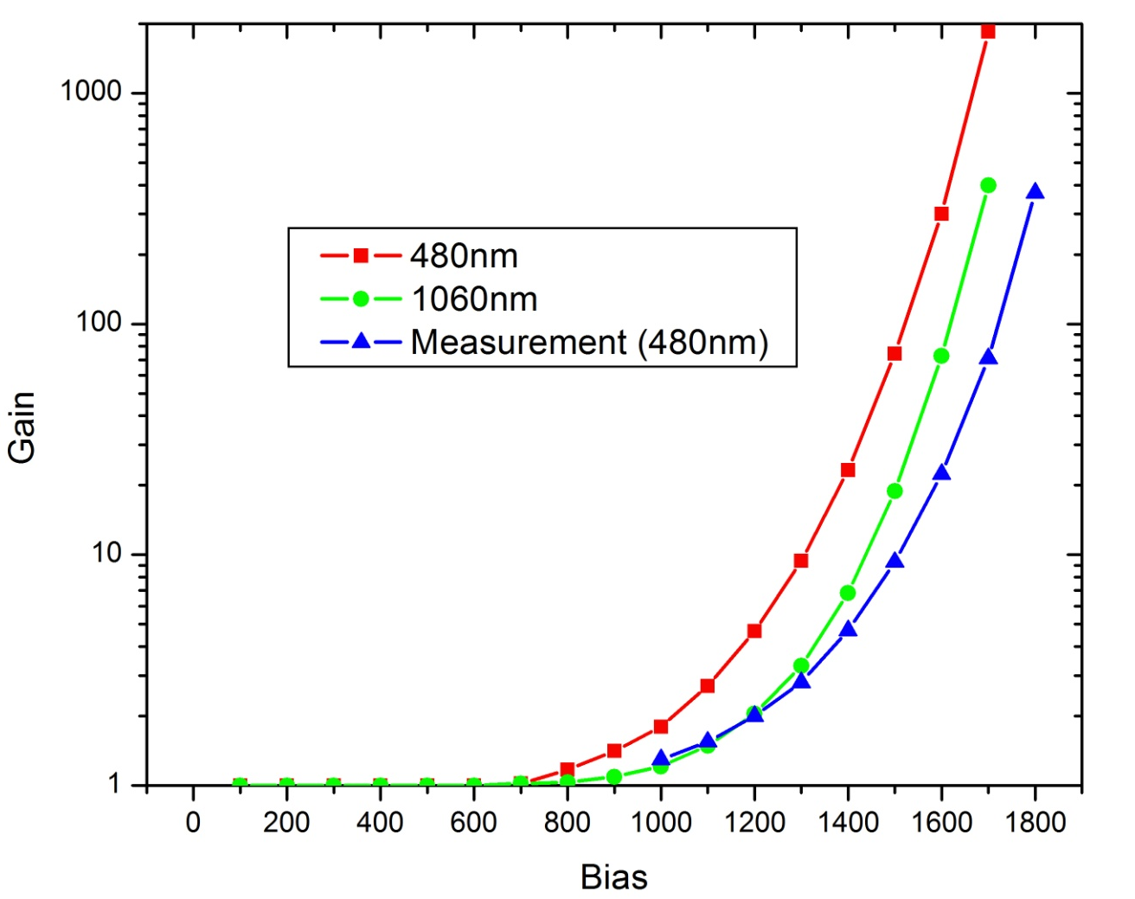
Gain Comparison with measurement
(with 37 micron junction depth on 13-1-2016)

Slide 4
Doping Profile
0.004 | 9.10E+16
14.001 | 5.57E+16
25.898 | 3.68E+16
39.895 | 2.21E+16
54.943 | 1.23E+16
70.695 | 5.80E+15
86.444 | 3.12E+15
101.495 | 1.55E+15
111.643 | 1.08E+15
120.046 | 6.89E+14
128.097 | 4.72E+14
135.451 | 3.00E+14
141.061 | 1.70E+14
145.096 | 1.23E+14
151.238 | 4.53E+13
153.748 | 2.82E+13
155.465 | 1.57E+13
156.186 | 7.47E+12
156.857 | 2.84E+12
158.987 | 6.55E+12
Doping profile provided by Sebastian
  100 micron is assumed to be removed
  Junction at about 57 micron
It was wrong to assume APD thickness equal to
130 micron
Bulk doping may be slightly different from
measurements (measurement errors!)
For 57 micron junction depth
Initial bulk doping of 1.55e15 is used
For junction depth equal to 52 micron
- Initial bulk doping of 1.30e15 is used

Slide 5
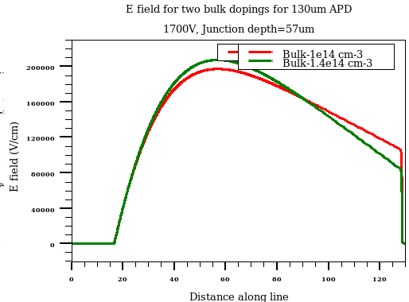
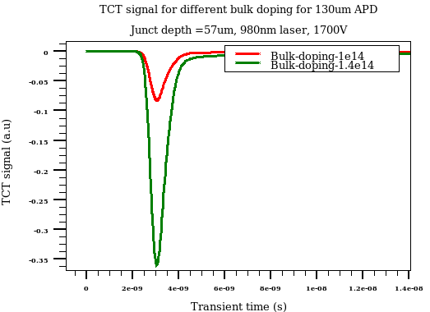
Effect of bulk doping (APD thickness -130 micron)
- Peak E field (around junction) is reduced for lower bulk doping
- Charge multiplication is significantly affected by bulk doping variation

Slide 6
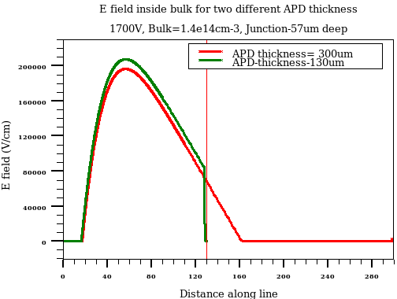
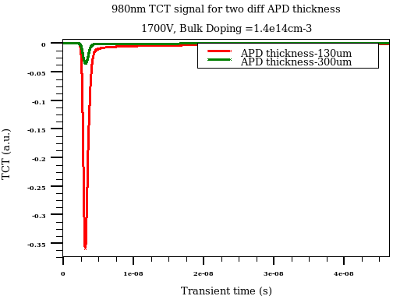
Effect of APD thickness
In 300 micron thick APD, Electric field is extended beyond 130 micron
  Results in lower field for multiplication region
Charge multiplication is much lower for 300 micron APD compared to 130 micron case
It was wrong to work with 130 micron APD !
All the subsequent simulations are done with 300 micron APD with bulk
Doping equal to 1.3e14cm-3

Slide 7
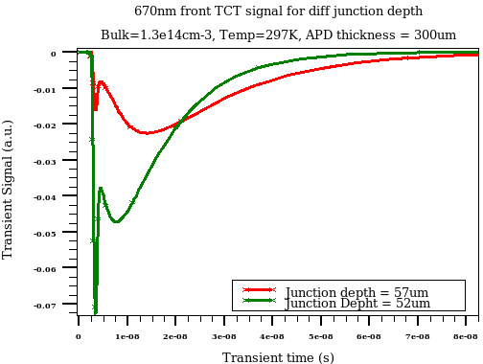
Junction depth effect on 670 nm TCT
670 nm TCT signal can be divided in two components
Initial fast Drift component
Slow diffusion component
Reducing junction depth increases the drift part significantly

Slide 8
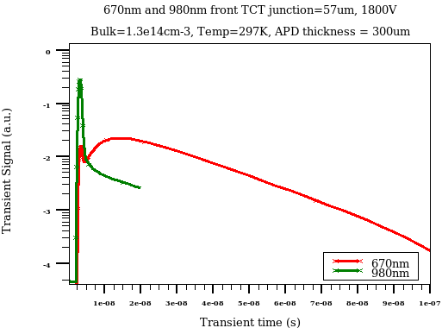
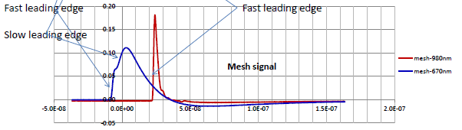
TCT signal for 670 and 980nm for junction depth 57 micron
TCT signal for 980 nm laser is having, mainly, drift component
TCT signal for 670nm laser is having mainly, diffusion component
- Log scale
Drift and diffusion components are
visible in C. Lu results too (27th Jan meeting)

Slide 9
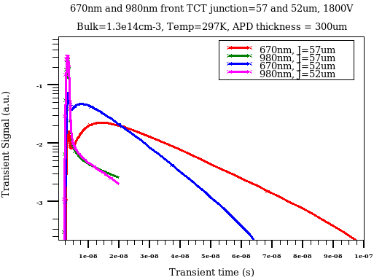
TCT signal for 670 and 980nm for junction depth 57 and 52 microns
57 micron junction is looking
good
Diffusion component is larger than drift on
similar to measurements (C. Lu)
-Log scale

Slide 10
Suggestions needed for further work!
- Thanks for your attention!

