Slide 1
APD simulations using Silvaco
Ranjit Dalal
(Delhi Uni.)
19-2-16 meeting

Slide 2
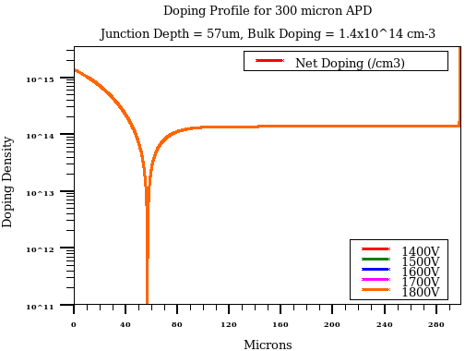
Simulation Structure
300 Micron Thick APD
Junction Depth = 57 micron micron
Error Function (Dist.) Doping profile (similar to actual device)
Three bulk Doping
  1.3 x 10¹⁴ cm⁻³
  1.4 x 10¹⁴ cm⁻³ (Measurement value)
  1.3 x 10¹⁴ cm⁻³
Three different type of lasers
670nm, 980nm, 1060nm
External circuit (Bias T)
Doping Profile for a typical structure

Slide 3
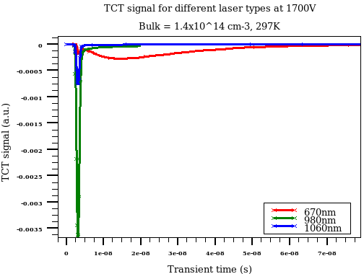
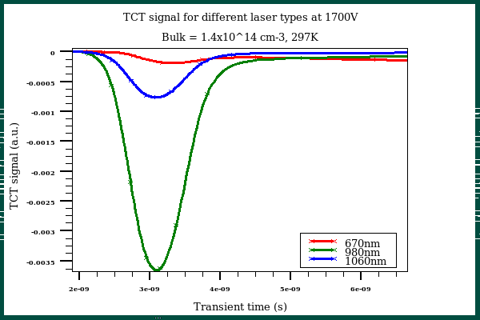
TCT signal
Very fast initial peak for all the lasers
Large (and slow) diffusion component for 670nm laser
1060 nm laser is creating fastest signal
- Similar case is expected for charged particles

Slide 4
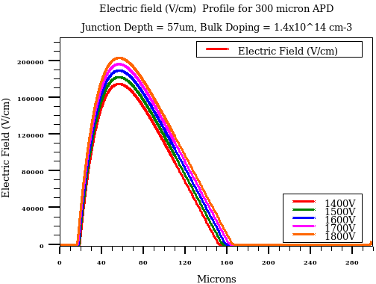
Electric field Profile
p+
n+
Higher field around junction
Width and height of field distribution increases with bias
  Increment is mainly inside bulk
Effectively, about 140 micron bulk is depleted at 1800V

Slide 5
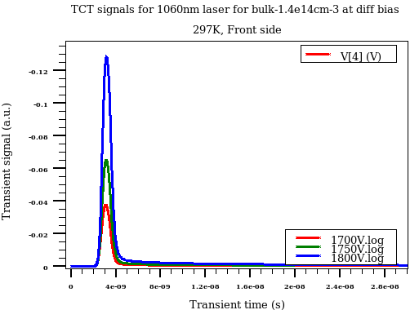
TCT signal for 1060nm front laser (Bias vary)
Bias Voltage vary
Extremely fast signal with about 2-3nm width
Signal will be compared with CERN measurements

Slide 6
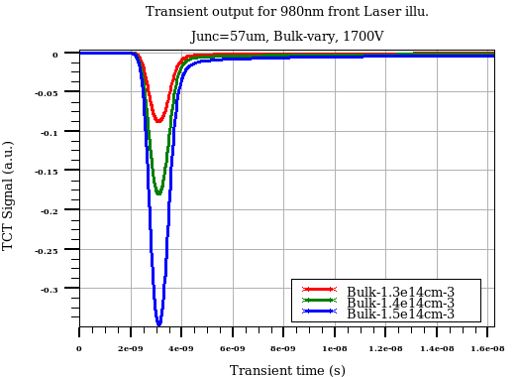
TCT signals for 980nm laser (Bulk doping vary)
Bulk doping vary
- Significant effect of bulk doping is seen

Slide 7
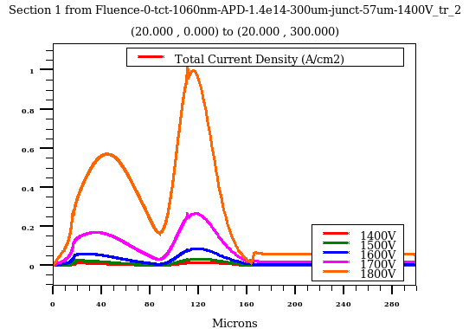
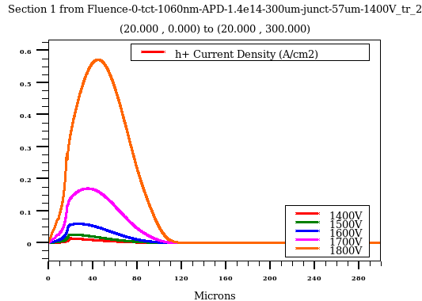
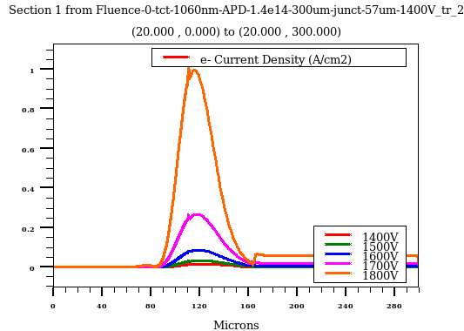
Signal evolution (after 1 ns of laser fire)
Total Current Density
Hole component
e⁻ component
- hole/electrons get separated within 1ns for infrared laser
- Similar evolution is expected for charged particles too

Slide 8
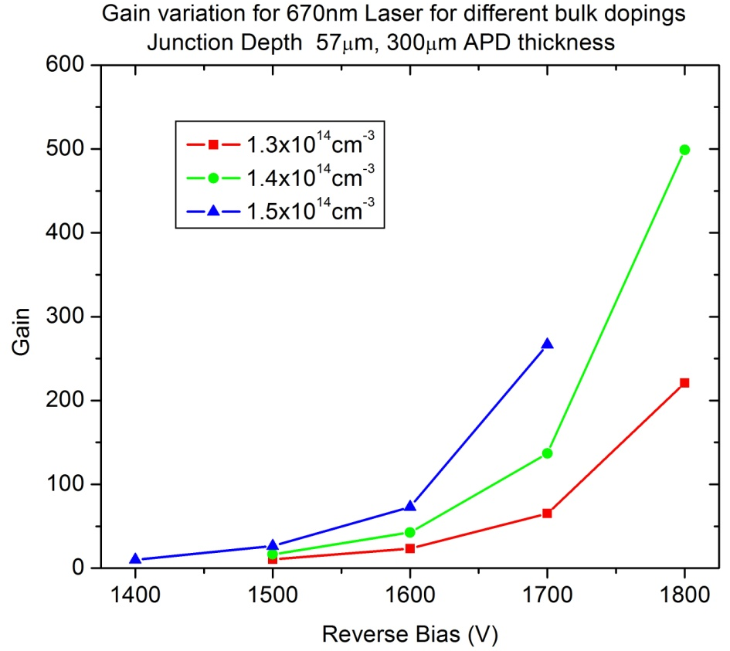
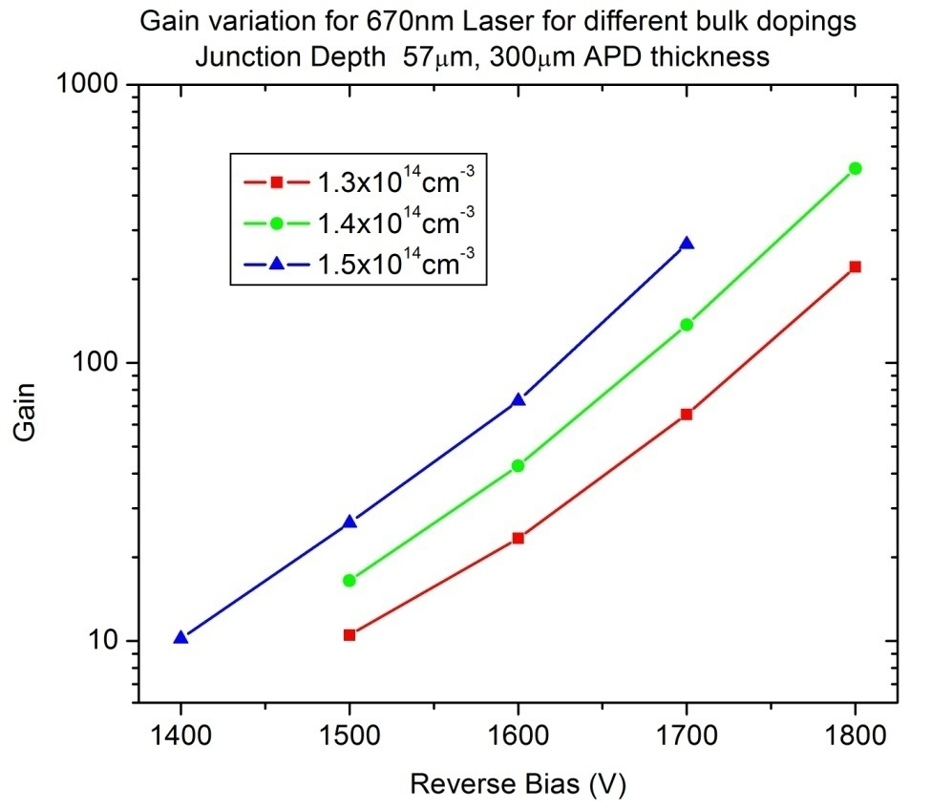
Gain vs bias for 670nm laser (three bulk doping)
Significant effect of bulk doping on gain
Higher bulk doping results in narrow depletion region or higher electric field for a given bias
  Higher bias results in higher gain

Slide 9
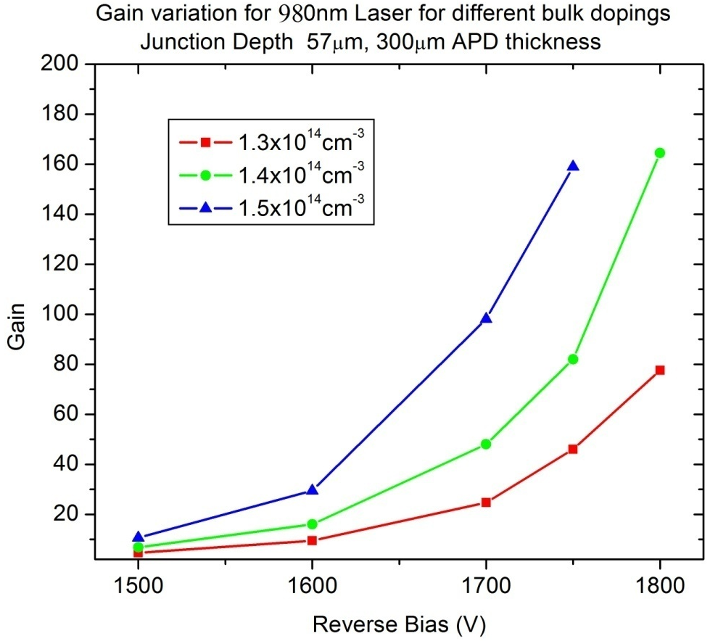
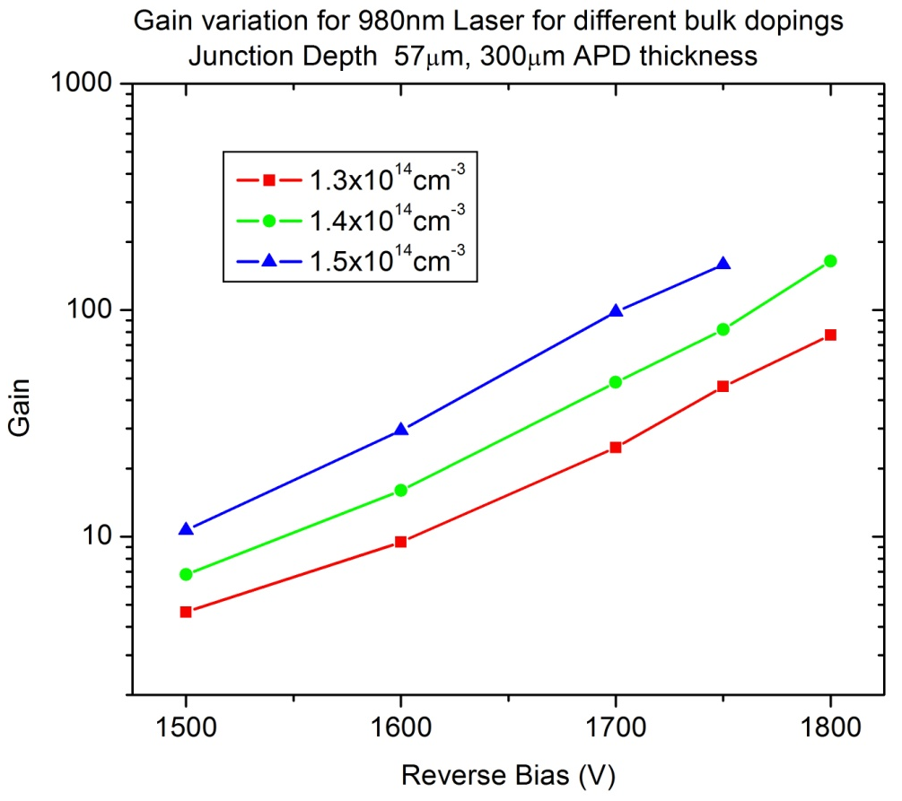
Gain vs bias for 980nm laser (3 bulk dopings)

Slide 10
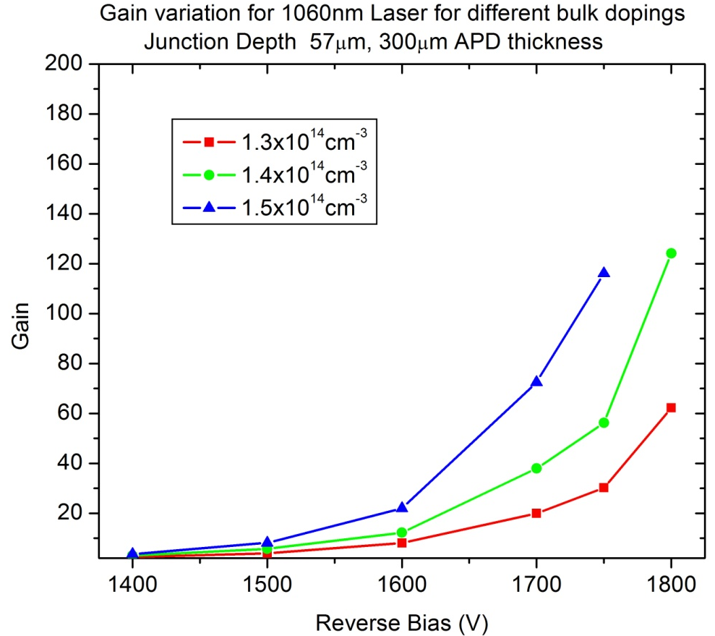
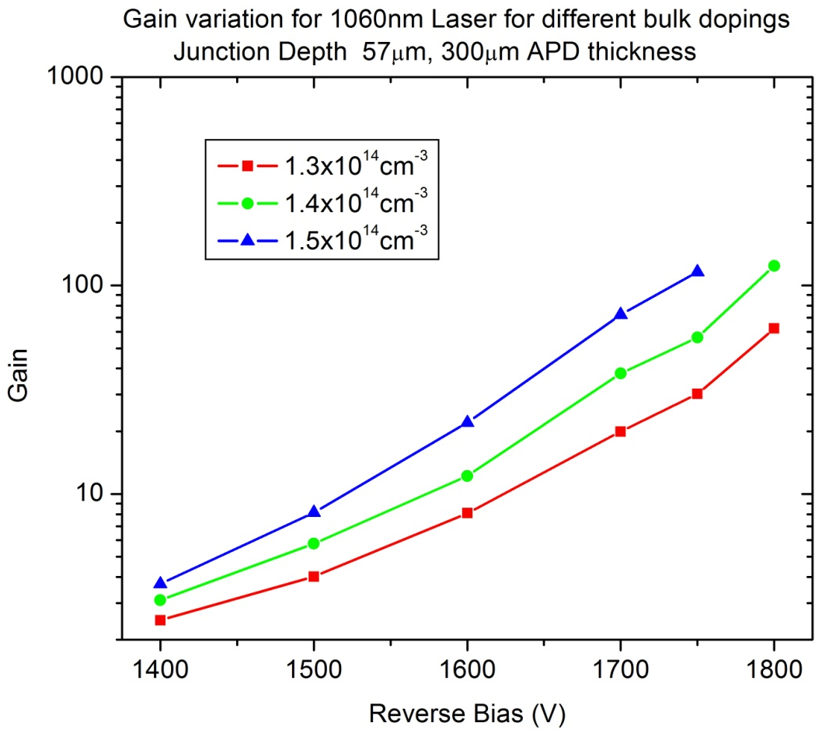
Gain vs bias for 1060nm laser (3 bulk dopings)
Slight different bulk doping can result in significant gain variation
Must be carefully tuned

Slide 11
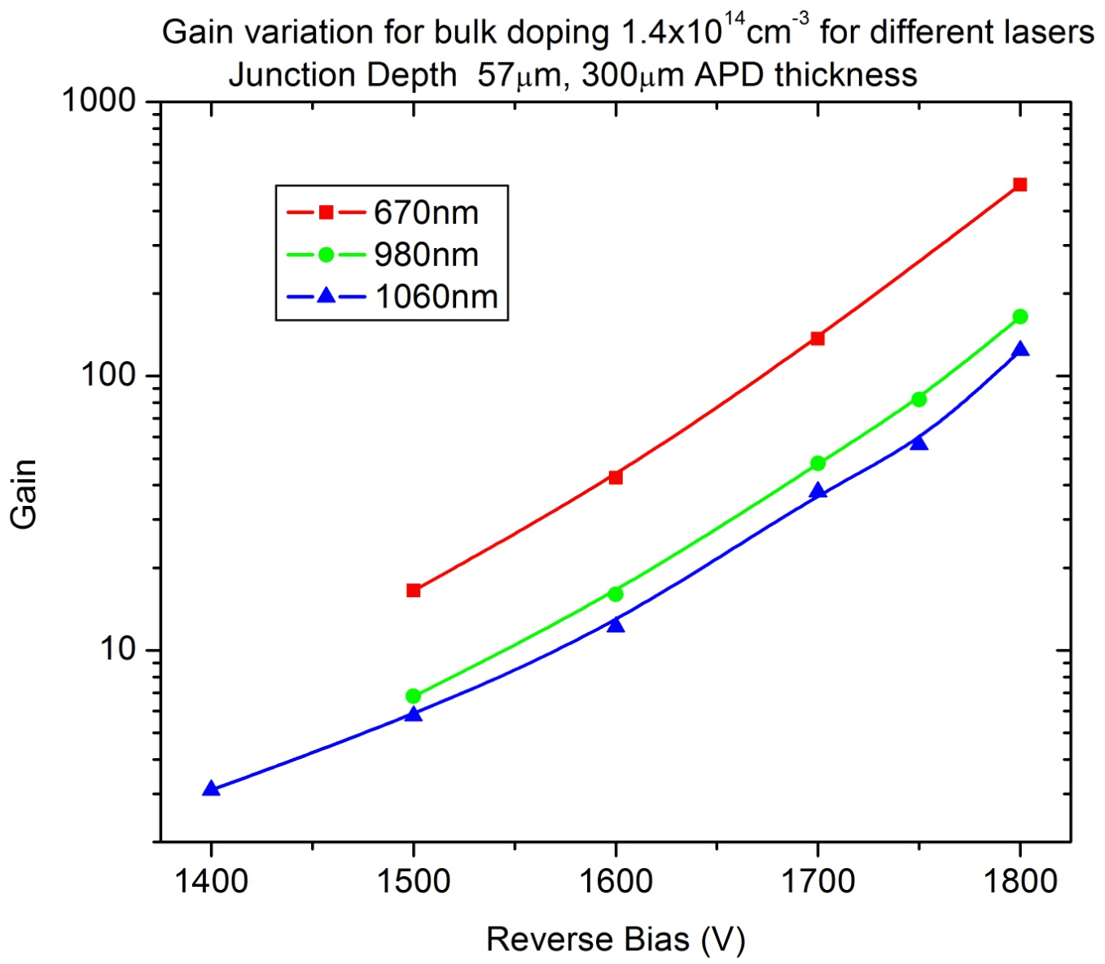
Gain vs bias for bulk 1.4x10¹⁴ cm⁻³
- Higher gain for 670nm, lowest for 1060nm!

Slide 12
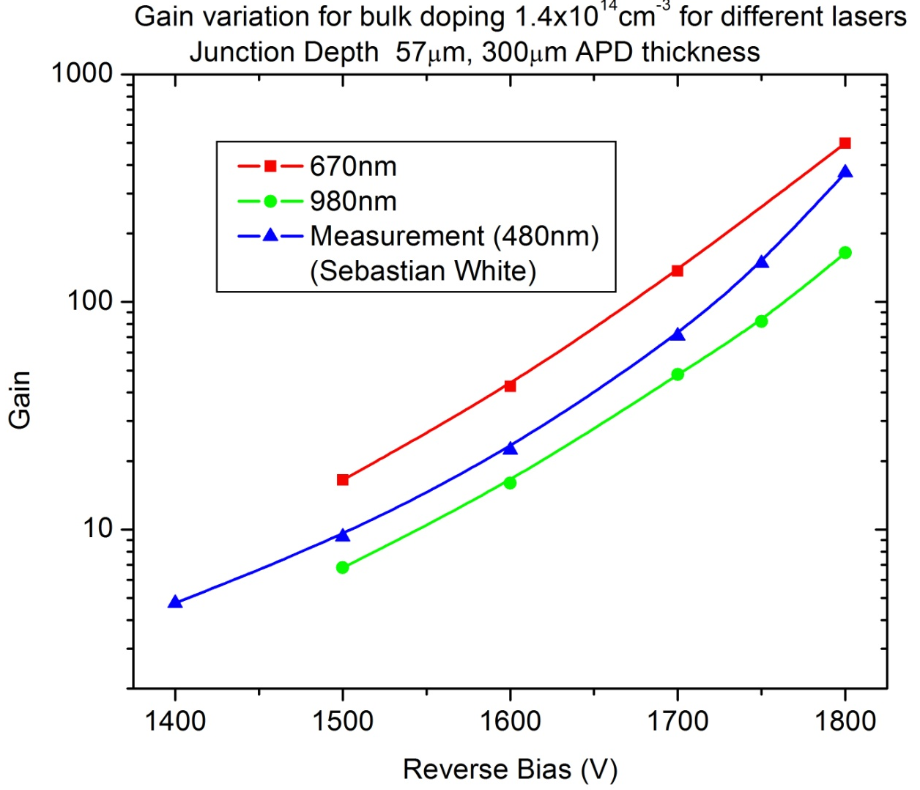
Gain vs bias (Simu. and measured result)
Simulation and measured values have similar trends and values
Remember, there can be slight variation in bulk doping (for different devices), different
way of calculating and measuring device gain and different baselines for gain calculating
(500V for measurement, signal without multiplication for simulation)

Slide 13
Summary
300 micron APD structure with 57micron junction depth is used to carry out simulations
Large and slow diffusion component for 670nm laser is observed
Very fast TCT signal (2-3ns) could be induced using infrared TCT (or charged particles)
Significant effect of bulk doping on APD gain is seen.
More coordinated simulations with CERN and Princeton will follow.
Suggestions … questions.

Slide 14
Doping Profile
0.004 | 9.10E+16
14.001 | 5.57E+16
25.898 | 3.68E+16
39.895 | 2.21E+16
54.943 | 1.23E+16
70.695 | 5.80E+15
86.444 | 3.12E+15
101.495 | 1.55E+15
111.643 | 1.08E+15
120.046 | 6.89E+14
128.097 | 4.72E+14
135.451 | 3.00E+14
141.061 | 1.70E+14
145.096 | 1.23E+14
151.238 | 4.53E+13
153.748 | 2.82E+13
155.465 | 1.57E+13
156.186 | 7.47E+12
156.857 | 2.84E+12
158.987 | 6.55E+12
Doping profile provided by Sebastian
  100 micron is assumed to be removed
  Junction at about 57 micron
It was wrong to assume APD thickness equal to
130 micron
Bulk doping may be slightly different from
measurements (measurement errors!)
For 57 micron junction depth
Initial bulk doping of 1.55e15 is used
For junction depth equal to 52 micron
- Initial bulk doping of 1.30e15 is used

