Slide 1
APD simulations using Silvaco
Ranjit Dalal
(Delhi Univ.)
30-3-2016 Meeting

Slide 2
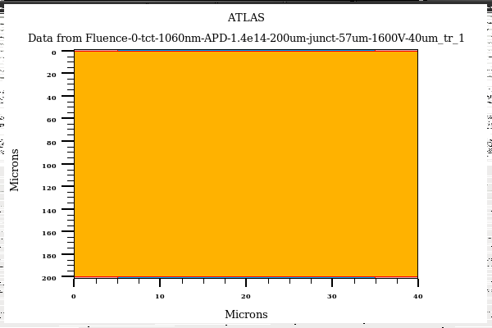
Edge-TCT for APD
APD Bulk = 1.4e14cm-3
Junction Depth = 57µm
Laser
1060nm
Laser Width = 1micron
Position = 10µm to 160µm
Bias = 1600V
Gain = Total collected charge (with multiplication on)/ Collected charge (without multiplication)

Slide 3
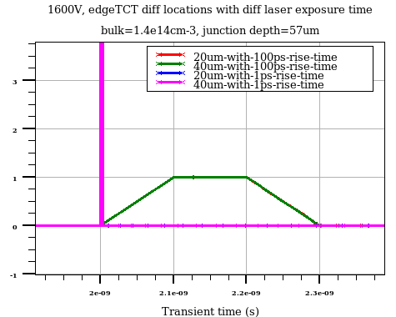
Laser rise time issue
Laser power density (w/cm2)
100 ps rise time (total 300ps) laser can contribute to the APD signal evolution
New simulations are with 1ps laser rise time (3 ps total)

Slide 4
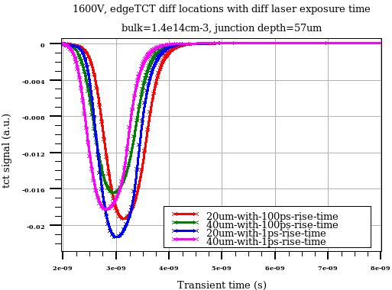
Laser rise time effect on signal evolution
Accumulated laser intensity are slightly different for these two cases
Gain curve remains unaffected by laser exposure time
Only 1 ps results are shown in next few slides

Slide 5
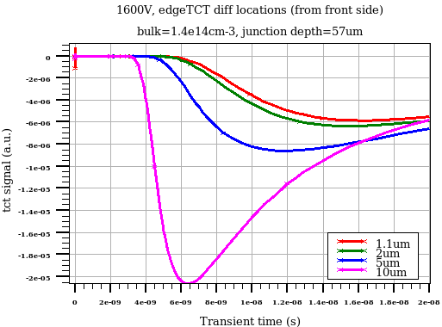
Signal evolution near front surface edgeTCT positions
Very slow diffusion component
Front side can be removed with impunity

Slide 6
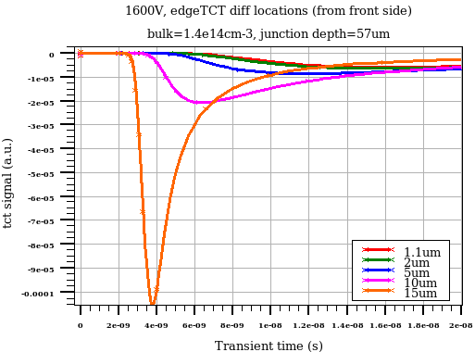
Signal evolution near front surface edgeTCT positions
Very slow diffusion component
Front side can be removed with impunity

Slide 7
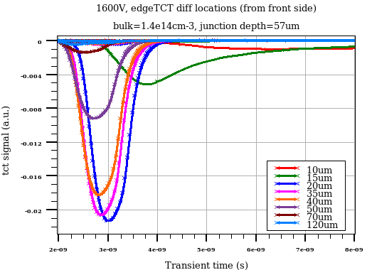
Signal evolution for different edgeTCT positions
Slow signal for 10-15µm location (diffusion component is significant)
Highest multiplication for 20-25µm laser position
Multiplication decreases for deeper locations
No multiplication after 90µm

Slide 8
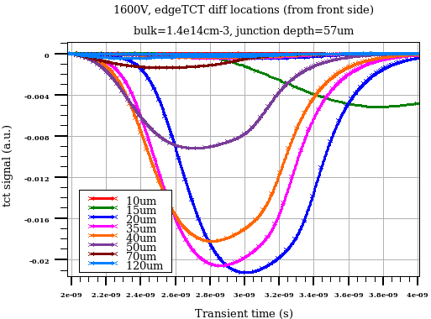
Signal evolution for different edgeTCT positions
2ns time window
electron/Hole drift components ?

Slide 9
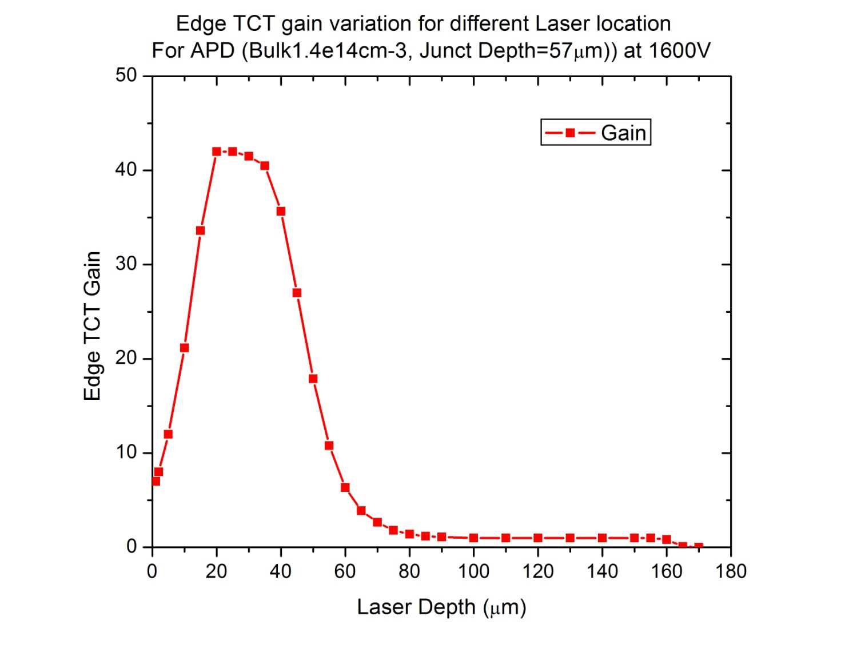
EdgeTCT gain for APD
Gain variation vs laser depth
eTCT profile for APD is very different from usual diodes
  Depend on drift and diffusion components
  Depends on multiplication

Slide 10
- Suggestions ?

Slide 11
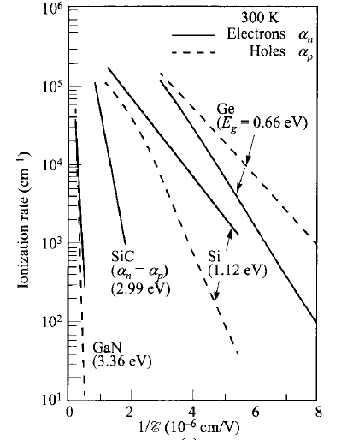
Ionization rate due to
e- are at least 20 times
More compared to holes
- Justify our approach
Ionization rate vs inverse of electric field at 300K
(S.M. Sze)

