Slide 1
Ranjeet Dalal
Delhi Uni.
30-1-2016 Meeting

Slide 2
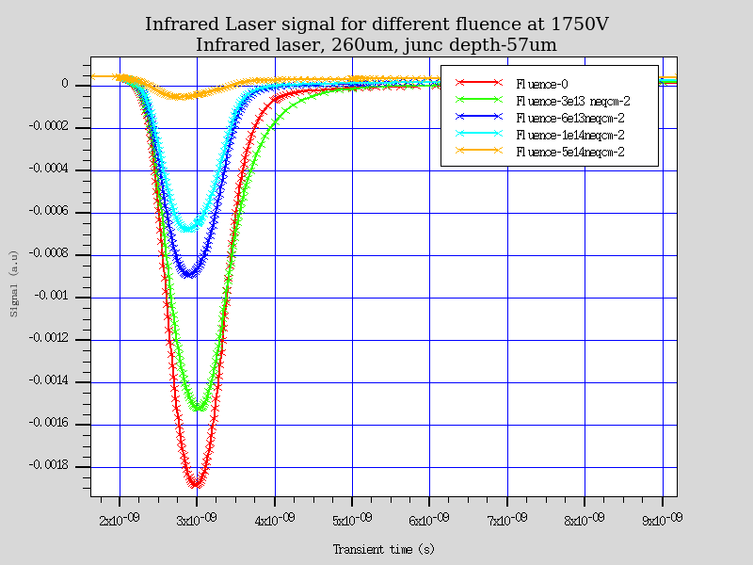
Infrared-Front TCT for 260 µm thick APD Junction 56.9 µm
- Strong radiation effect is anticipated for CCE

Slide 3
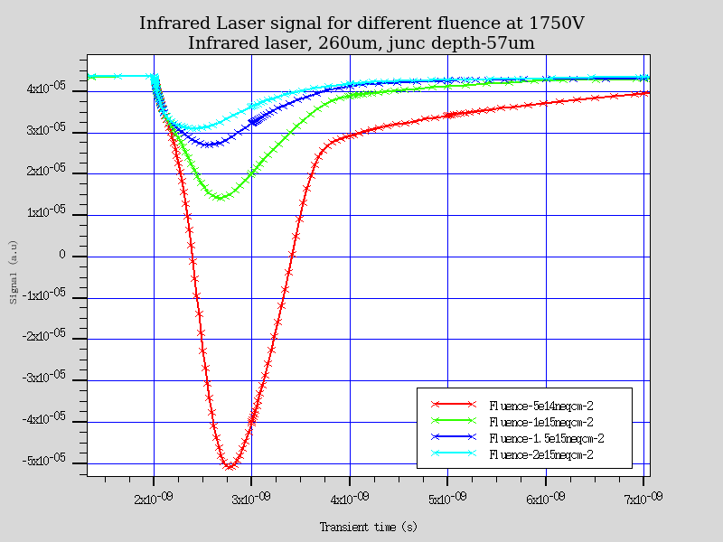
Infrared-Front TCT for 260 µm thick APD Junction 56.9 µm
- Strong radiation effect is anticipated for CCE

Slide 4
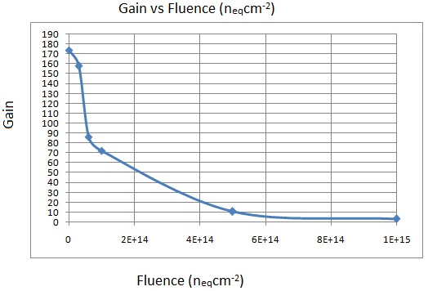
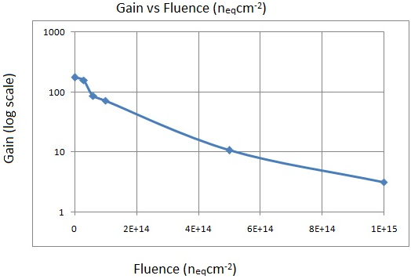
Gain vs Fluence (n_{eq}cm⁻²)
Gain at a given bias is defined with respected to the integrated signal of the same bias with no impact ionization.
Gain = Integrated charges with Impact Ionization/ Integrated Signal with no impact ionization

Slide 5
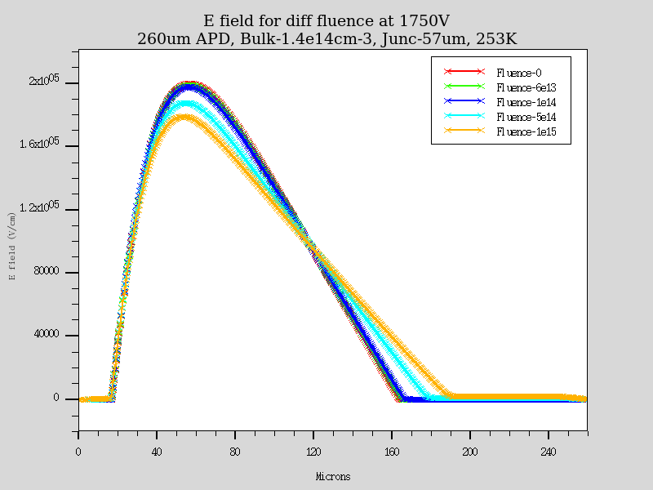
E field variation with fluence
Thinner APD (~150 micron thick) may be more radiation hard ???
There will be no space for backside extension for field after irradiation

Slide 6
Backup

Slide 7
Irradiation model
Radiation damage simulations are carried out using already published and tested two trap
model (R. Dalal et al., Vertex-2014 and LGAD paper, NIM 2016)
  It was developed during HPK campaign for proton irradiation
  It creates correct amount of leakage current, full depletion voltage (or CV), double peak
  electric field profile and CCE for fluence at least up to 2e15 n_{eq}cm⁻²
No acceptor removal term have been used in these simulations
Simulations are carried out at 253K
No. | Trap | Energy Level | g_{int} (cm⁻¹) | σ_{e} (cm⁻²) | σ_{h}(cm⁻²)
1. | Acceptor | E_{c}-0.51eV | 4 | 2x10⁻¹⁴ | 3.8x10⁻¹⁴
2. | Donor | E_{v}+0.48eV | 3 | 2x10⁻¹⁵ | 2x10⁻¹⁵
Parameter table for two trap model used in present simulations

Slide 8
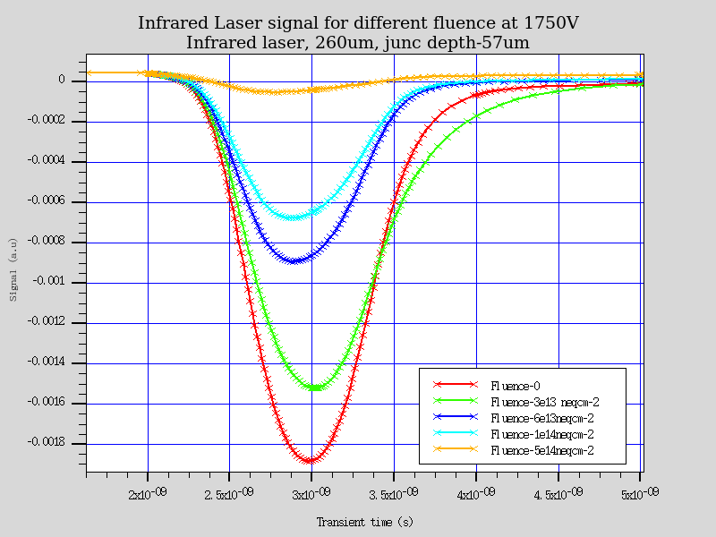
Infrared-Front TCT for 260 µm thick APD Junction 56.9 µm
- Strong radiation effect is anticipated for CCE

Slide 9
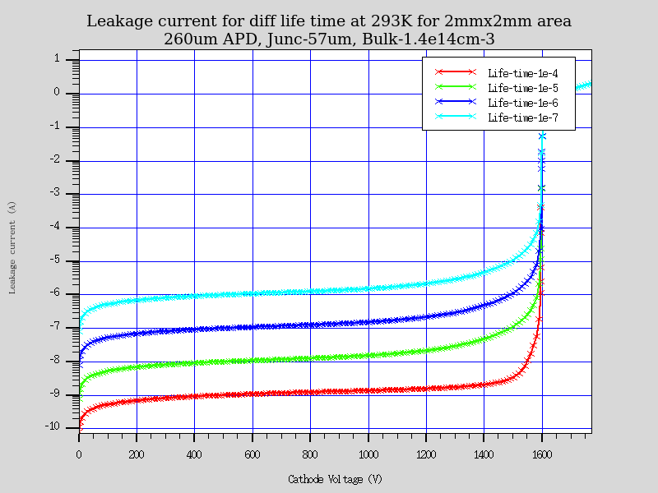
Leakage current for different carrier life time
293 K

Slide 10
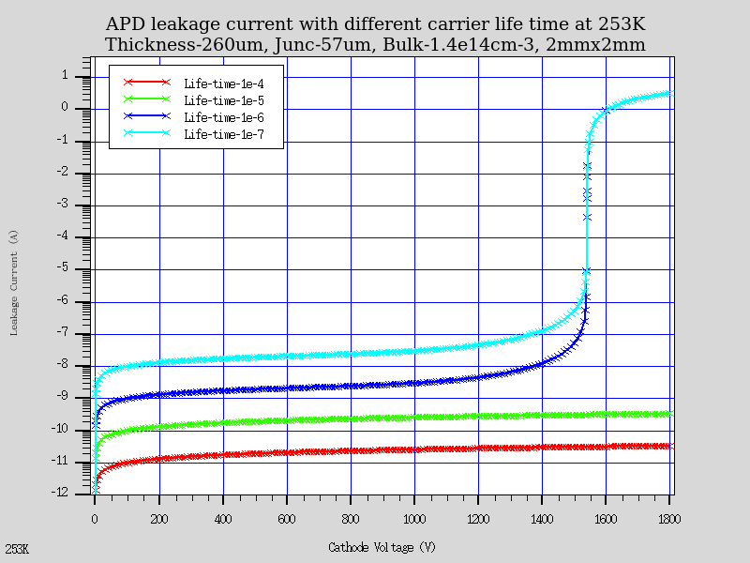
Leakage current for different carrier life time
253 K

Slide 11
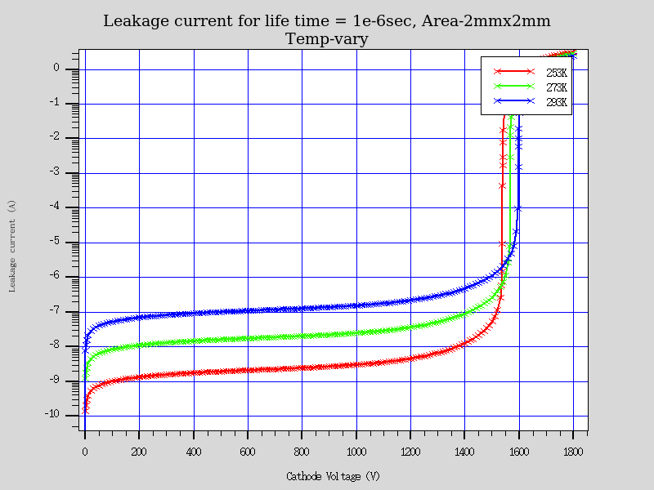
Leakage current for different carrier life time
253 K

