Slide 1
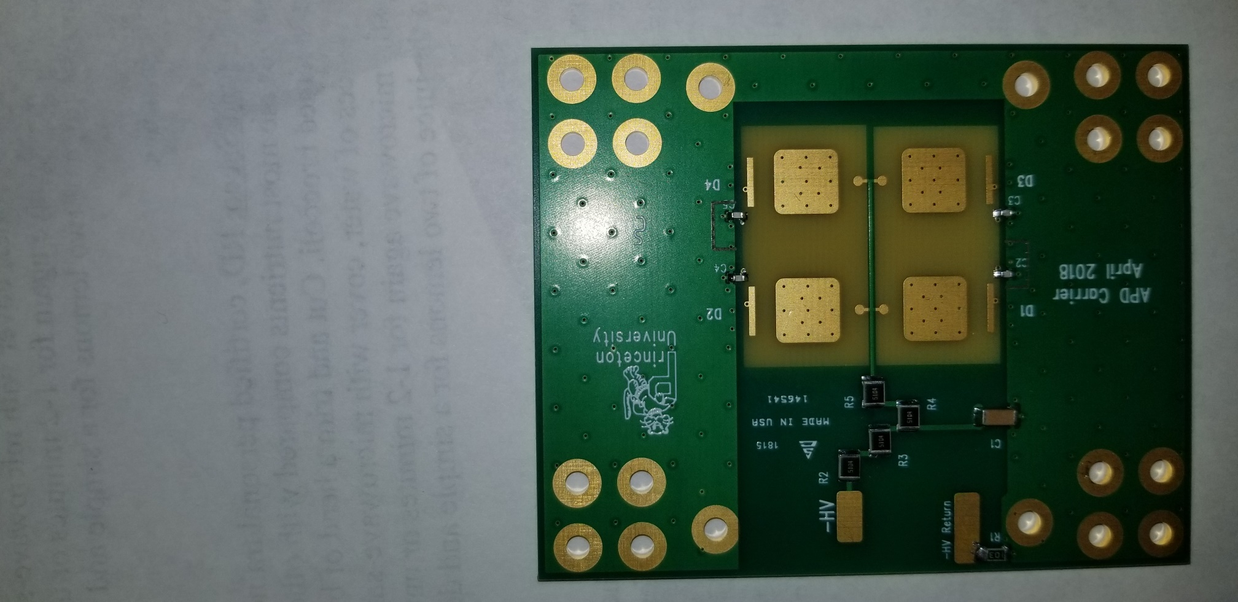
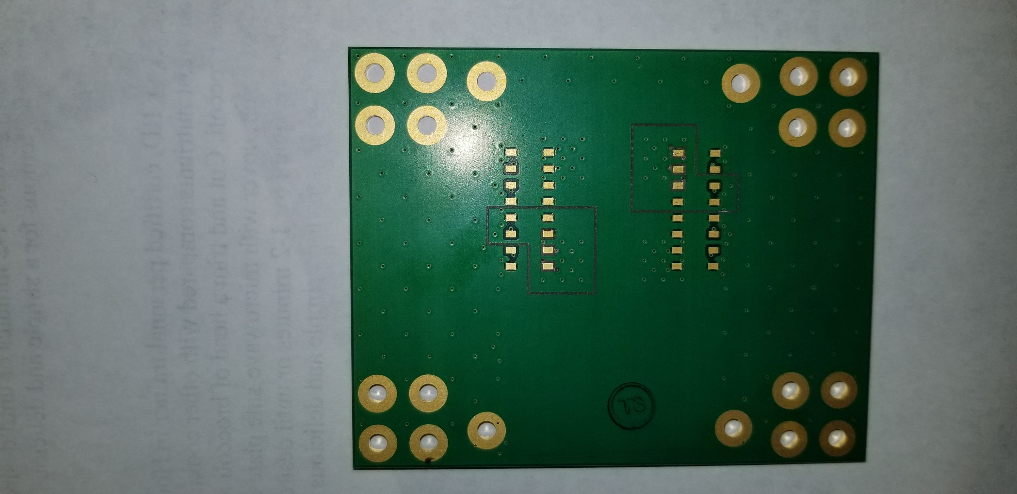
10/9/18 S. Chidzik, K. McDonald
As-built “trench” to isolate the ground pad of an APD, and connect it to the B pin via a cap, as per M. Newcomer.
Done to two APD pads on one carrier board. Only one of the “trenched par will have an APD initially.
These 2 pads will not be connected to the header
B pin
Cap from B pin to via
A pin
These 3 ground pads
are isolated

